Slide 1
The argumentative theory of reasoning (and scientific progress)
Cognitive Science of Science workshop Kazimierz Dolny
Hugo Mercier University of Neuchâtel & CNRS

Slide 2
Two types of inferences
Intuitive inferences (intuition)

Slide 3
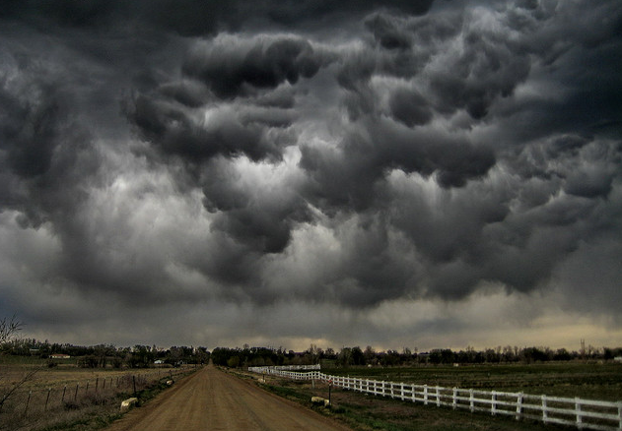
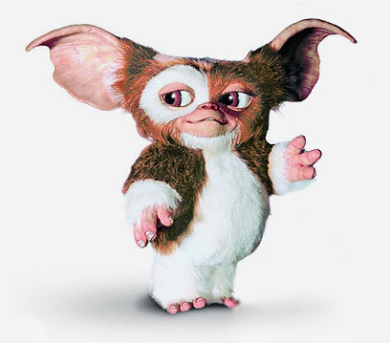
It’s going to rain
It needs food and water
Peter is 8, John is 12
John is older than Peter

Slide 4
Two types of inferences
Reflective inferences (reasoning)

Slide 5
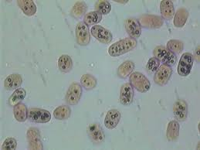
The pressure and the temperature are dropping
It’s going to rain
These are purple sulfur bacteria
They need hydrogen sulfide
S=1+2+…+99+100
S=(100*101)/2

Slide 6
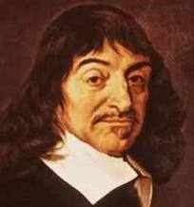
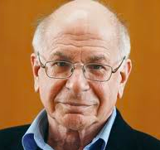
The classical view of reasoning

Slide 7
The Levesque task
Peter is looking at Linda
Linda is looking at Henry
Peter is married
Henry is not married
Is someone who is married looking at someone who is not married?
Yes No We can’t tell

Slide 8
An intuitive mistake
Peter is looking at Linda
Linda is looking at Henry
Peter is married
Henry is not married
Is someone who is married looking at someone who is not married?
Yes No We can’t tell

Slide 9
Reasoning saves the day
Peter is looking at Linda
Linda is looking at Henry
Peter is married
Henry is not married
Is someone who is married looking at someone who is not married?
Yes No We can’t tell

Slide 10
Reasoning can help the lone reasoner correct mistaken intuitions and arrive at better beliefs

Slide 11
Reasoning can help the lone reasoner correct mistaken intuitions and arrive at better beliefs

Slide 12
The Levesque task
Peter is looking at Linda
Linda is looking at Henry
Peter is married
Henry is not married
Is someone who is married looking at someone who is not married?
Yes No We can’t tell
10% correct answers

Slide 13
Reasoning can help the lone reasoner correct mistaken intuitions and arrive at better beliefs
But it often doesn’t

Slide 14
What reasoning actually does
The answer depends on Linda’s status
Peter is looking at Linda
Linda is looking at Henry
Peter is married
Henry is not married
Is someone who is married looking at someone who is not married?
Yes No We can’t tell
We don’t have enough information
We don’t know if Linda is married

Slide 15
Reasoning can help the lone reasoner correct mistaken intuitions and arrive at better beliefs
But it often doesn’t
Because it does precisely the opposite

Slide 16
?
The classical view of reasoning
WHAT THEN?

Slide 17
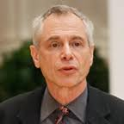
The argumentative view of reasoning

Slide 18
Prediction 1
Myside bias

Slide 19
Prediction 2
Selective laziness

Slide 20
Making the best of feedback
Sylvia: “We should go to Isami, it’s a good restaurant”
Helen: “I don’t know, I’ve had Japanese last week already”
Sylvia: “But this one is very original”

Slide 21
Making the best of feedback
Sylvia: “We should go to Isami, it’s a good restaurant”
Helen: “I don’t know, I don’t have much money at the moment, and Japanese restaurants can be pricy”
Sylvia: “But this one is quite cheap”

Slide 22
Other option: exhaustive argument
Sylvia: “We should go to Isami, it’s original, the prices are good, the fish is fresh, the crowd is lively… ”

Slide 23
Other option: anticipation
Sylvia, thinking: I wonder if Helen has been to a Japanese restaurant lately. And would she be bothered by high prices? Does she eat raw fish? Does she enjoy the kind of crowd you get in typical Japanese restaurants? Would she believe it’s in an inconvenient location?...

Slide 24
Prediction in production
People should typically start with a reasonable but weak, generic argument

Slide 25
Prediction in evaluation
People should carefully examine other people’s arguments

Slide 26
First phase

Slide 27
In a fruit and vegetable shop which carries, among other products, apples:
None of the apples are organic.
What can you conclude for sure about whether fruits are organic in this shop ?
All the fruits are organic
None of the fruits are organic
Some fruits are organic
Some fruits are not organic
We cannot tell anything for sure about whether fruits are organic in this shop
“Because none of the apples are organic, and an apple is one type of fruit, we can say that some of the fruits in the store are not organic.”

Slide 28
In a fruit and vegetable shop which carries, among other products, apples:
None of the apples are organic.
What can you conclude for sure about whether fruits are organic in this shop ?
All the fruits are organic
None of the fruits are organic
Some fruits are organic
Some fruits are not organic
We cannot tell anything for sure about whether fruits are organic in this shop
“Because none of the apples are organic, and an apple is one type of fruit, we can say that some of the fruits in the store are not organic.”

Slide 29
In a fruit and vegetable shop which carries, among other products, apples:
None of the apples are organic.
What can you conclude for sure about whether fruits are organic in this shop ?
All the fruits are organic
None of the fruits are organic
Some fruits are organic
Some fruits are not organic
We cannot tell anything for sure about whether fruits are organic in this shop
“Because none of the apples are organic, and an apple is one type of fruit, we can say that some of the fruits in the store are not organic.”
x 5

Slide 30
Second phase

Slide 31
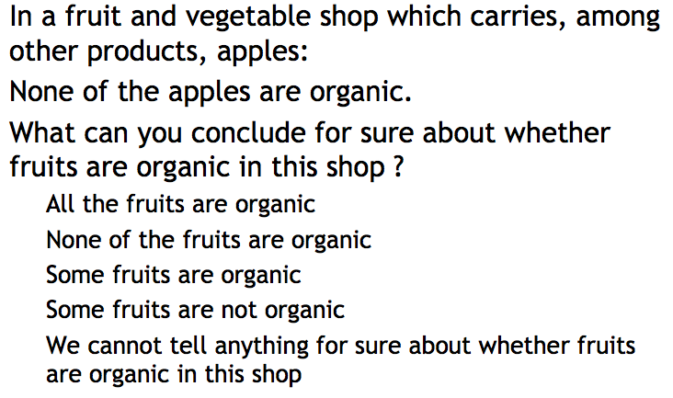
You answered
Some fruits are not organic
Someone else answered
We cannot tell anything for sure about whether fruits are organic in this shop
And the argument was:
“There is not enough information to conclude about all the fruits in this shop.”
If you want you can change your mind

Slide 32
You answered
Some fruits are not organic
Someone else answered
We cannot tell anything for sure about whether fruits are organic in this shop
And the argument was:
“There is not enough information to conclude about all the fruits in this shop.”
If you want you can change your mind

Slide 33
You answered
Some fruits are not organic
Someone else answered
We cannot tell anything for sure about whether fruits are organic in this shop
And the argument was:
“There is not enough information to conclude about all the fruits in this shop.”
If you want you can change your mind

Slide 34
You answered
Some fruits are not organic
Someone else answered
We cannot tell anything for sure about whether fruits are organic in this shop
And the argument was:
“There is not enough information to conclude about all the fruits in this shop.”
If you want you can change your mind

Slide 35
x 4
You answered
Some fruits are not organic
Someone else answered
We cannot tell anything for sure about whether fruits are organic in this shop
And the argument was:
“There is not enough information to conclude about all the fruits in this shop.”
If you want you can change your mind

Slide 36
You answered
We cannot tell anything for sure about whether fruits are organic in this shop
Someone else answered
Some fruits are not organic
And the argument was:
“Because none of the apples are organic, and an apple is one type of fruit, we can say that some of the fruits in the store are not organic.”
If you want you can change your mind

Slide 37
x 1
You answered
We cannot tell anything for sure about whether fruits are organic in this shop
Someone else answered
Some fruits are not organic
And the argument was:
“Because none of the apples are organic, and an apple is one type of fruit, we can say that some of the fruits in the store are not organic.”
If you want you can change your mind
NOT THEIR ANSWER
THEIR ANSWER
THEIR ARGUMENT

Slide 38
47% do not detect the inversion

Slide 39
57% reject their own argument

Slide 40
41% reject their own ‘good’ argument
63% reject their own ‘bad’ argument

Slide 41
Prediction 3
Overconfidence

Slide 42
What reasoning actually does
The answer depends on Linda’s status
Peter is looking at Linda
Linda is looking at Henry
Peter is married
Henry is not married
Is someone who is married looking at someone who is not married?
Yes No We can’t tell
We don’t have enough information
We don’t know if Linda is married

Slide 43
Overconfidence in individual reasoning

Slide 44
Prediction 4
Good argument evaluation skills

Slide 45
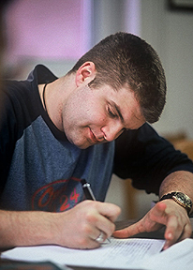
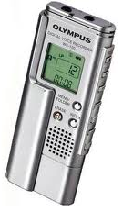
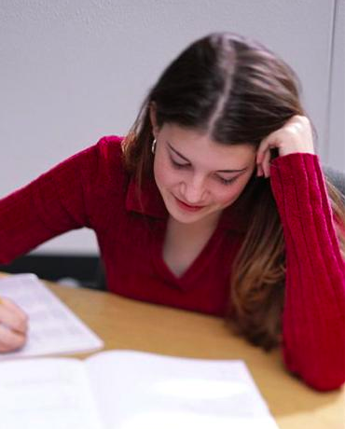
✗
✓
Yes because…
We don’t know because…
Try to convince someone
Levesque, etc.
✓
Yes because…
✗
✓
✗
We don’t know because…
Levesque, etc.

Slide 46
✓
✗
9%
91%
Levesque, etc.
✗
✓
We don’t know because…
Yes because…
*
✓
46%
✗
✓
✗
0%
41%
54%
*

Slide 47
How confident are you?
✓
Yes because…
✗
✓
✗
We don’t know because…
Levesque, etc.

Slide 48
% accepting the correct argument

Slide 49
Confidence manipulation
To elicit low confidence:
We ask that YOU ANSWER QUICKLY.
To elicit high confidence:
We ask that YOU THINK VERY CAREFULLY ABOUT YOUR ANSWER, and that you JUSTIFY IT WELL.

Slide 50
Confidence in wrong answer

Slide 51
% accepting the correct answer

Slide 52
Dishonesty manipulation
We are now going to give you the answer that was given by another participant, along with his or her justification.
However, you should be careful. When we gathered these results, we were doing a special experiment. In this experiment, the participants were told: YOU SHOULD TRY TO MISLEAD ANOTHER PARTICIPANT WITH YOUR ANSWER AND YOUR JUSTIFICATION.
Moreover, they were told that they would be getting a bonus of $1 whenever they managed to make someone adopt the wrong answer.

Slide 53
Honesty manipulation
We are now going to give you the answer that was given by another participant, along with his or her justification.
When we gathered these results, we were doing a special experiment. In this experiment, the participants were told: YOU SHOULD TRY TO BE AS HELPFUL AS POSSIBLE TO THE OTHER PARTICIPANT AS POSSIBLE.
As a result, people were very careful to try and give the right answer and the right justification.

Slide 54
Low expertise manipulation
We are now going to give you the answer that was given by another participant, along with his or her justification.
When we gathered these results, we were asking people to answer a series of 8 other problems similar to this one.
We can tell you that the participant whose answer you are going to see got
0
problems right out of 8 (not including the present problem obviously).

Slide 55
High expertise manipulation
We are now going to give you the answer that was given by another participant, along with his or her justification.
When we gathered these results, we were asking people to answer a series of 8 other problems similar to this one.
We can tell you that the participant whose answer you are going to see got
8
problems right out of 8 (not including the present problem obviously).

Slide 56
Trust / % accepting the correct argument

Slide 57
Prediction 5
Groups outperform individuals on reasoning tasks

Slide 58
Individual vs. group
20%
60%
18%

Slide 59
Individual vs. group
20%
60%
18%

Slide 60
Diffusion in large groups (N=40)
18%

Slide 61
% correct answers (Wason selection task)

Slide 62


Slide 63
% correct answers (conservation task)

Slide 64
Summary
Individual reasoning often achieves poor epistemic outcomes
People can evaluate others’ arguments and be convinced by strong arguments
As a result, groups outperform individuals in reasoning tasks

Slide 65
End of part 1

Slide 66
Summary
Individual reasoning often achieves poor epistemic outcomes
People can evaluate others’ arguments and be convinced by strong arguments
As a result, groups outperform individuals in reasoning tasks

Slide 67
Mismatch with a common view of scientific progress
Individual reasoning often achieves poor epistemic outcomes
→ Scientific breakthroughs are achieved by lone geniuses
People can evaluate others’ arguments and be convinced by strong arguments
→ Scientists die before they accept new ideas
As a result, groups outperform individuals in reasoning tasks
→ Progress in the history of ideas was very slow before the scientific revolution

Slide 68
Scientific breakthroughs are achieved by lone geniuses
The lone genius is a myth to a large extent (Shapin)
Scientific discussions are a crucial part of scientific progress (Dunbar, etc.)

Slide 69
Scientific breakthroughs are achieved by lone geniuses
Scientists also have a myside bias (Mahoney)
They too can become overconfident (e.g. Pauling)
Bias to remember only the cases in which increased confidence was warranted

Slide 70
Scientific breakthroughs are achieved by lone geniuses
A genuine difference
increased motivation to put forward strong arguments
a high degree of shared beliefs, making it easier to anticipate counter-arguments
Scientists can eliminate on their own many of their bad ideas
The social context is crucial: Newton on physics vs. Newton on alchemy

Slide 71
Scientists die before they accept new ideas
Scientific revolutions are often accepted very rapidly, and in a manner that is consistent with the strength of the evidence presented (Newton’s optics, Lavoisier’s chemistry, evolution, plate tectonics, etc.) (Kitcher, etc.)
Frequency of conversions (Cohen)
No strong evidence that older scientists are slower to accept revolutionary ideas (Hull, etc.)

Slide 72
The micro – macro mismatch

Slide 73
An apparent problem for the argumentative theory of reasoning
But also for the classical theory of reasoning

Slide 74
When argumentation works and when it doesn’t
Need for new evidence
Why isn’t it produced?

Slide 75
The production of reasons is meant to convince:
What is the most efficient argument?
Arguments that rely on shared evidence
Arguments that rely on non-shared evidence

Slide 76
The production of reasons is meant to convince:
What is the most efficient argument?
Arguments that rely on shared evidence
Arguments that rely on non-shared evidence

Slide 77
New evidence not in hand
New evidence of a kind not acceptable
New evidence hard to relate to conclusions
Lack of trust

Slide 78
You are traveling in Eastern Europe with a friend, and at some point you decide to look for a car to buy to go on a road trip. A car salesman would like to sell you a Lada, a cheap Russian car mass produced in the eighties. Without looking more at the car or trying it, your friend tells you:
"This car can reach at least 150mph!"
0 (impossible) 100 (certain)
35

Slide 79
You are traveling in Eastern Europe with a friend, and at some point you decide to look for a car to buy to go on a road trip. A car salesman would like to sell you a Lada, a cheap Russian car mass produced in the eighties. Your friend tries the car and tells you:
"It’s incredible, but this car can actually go very fast! I was on the highway, the speedometer was above 240 km per hour, which is about 150mph, and I was flying past all the other cars, even big German cars! This car can reach at least 150mph!"
0 (impossible) 100 (certain)
47

Slide 80
You are traveling in Eastern Europe with a friend, and at some point you decide to look for a car to buy to go on a road trip. A car salesman would like to sell you a Lada, a cheap Russian car mass produced in the eighties. The salesman tells you:
"This car can reach at least 150mph!"
0 (impossible) 100 (certain)
35

Slide 81
You are traveling in Eastern Europe with a friend, and at some point you decide to look for a car to buy to go on a road trip. A car salesman would like to sell you a Lada, a cheap Russian car mass produced in the eighties. The salesman tells you:
"It’s incredible, but this car can actually go very fast! I was on the highway, the speedometer was above 240 km per hour, which is about 150mph, and I was flying past all the other cars, even big German cars! This car can reach at least 150mph!"
0 (impossible) 100 (certain)
34

Slide 82
One of the major changes of the scientific revolution: making the communication of new evidence more trustworthy (Shapin & Schaffer)

Slide 83
Thank you!

Slide 84
Some arguments:
Data was collected prior to the scientific revolution, but mostly for practical ends
→ Not practically impossible
People engaged in plenty of thought experiments (cf. King)
Not conceptually impossible
Anecdote of experiments carried out before the scientific revolution

