Slide 1
Machines, Duels and a Beauty Contest Cognitive Synergy of Aristocrats and Craftsmen
Łukasz Afeltowicz
Radosław Sojak
Institute of Sociology
Nicolaus Copernicus University

Slide 2
Opening remarks
Ideas presented in the paper are under development.
This is mainly a sociological account of how science works, what are the actors and factors responsible for its success, what was its onset etc. We think, however, that our study has several implications for cognitive studies of science.
We assume that modern science as social institution was initiated only in XVII.

Slide 3
Outline of the paper
Case study: Robert Boyle’s experiments with the air pump and establishment of experimental community (based mainly on Steven Shapin’s book „A Social History of Truth”)
Francis Bacon and other thinkers designed modern science, but Robert Boyle was the man who actualy made it work
Galileo, Arab researchers, alchemists and others accepted and made extensive use of the experimental approach, but Boyle and representatives of experimental community made experimentation a scientific method-of-choice, which displaced abstract speculation
Analysis of alliance between aristocratic experimenters and craftsmen, who served them with their skills and ingenuity.

Slide 4
Initial situation
The experimental movement was a relatively small group of people and there were many alternative visions of how to do science (e.g. Thomas Hobbes).
Stakes were high, because it was a restoration period in England which followed the Wars of Three Kingdoms, and nobles were concerned with finding a way to stabilize political order; for both Hobbes and Boyle controversy over scientific method was strictly and directly a political issue:
Hobbes wanted the science to be an effective source of unanimity bringing peace to the Kingdom
Boyle saw scientific issues as a possible source of social disruption and believed that science should be something isolated from political problems

Slide 5
How, then, could Boyle’s vision of science prevail and flourish?
Modern, experimental science was founded on elements borrowed from existing and well established institutions and practices
Boyle used material resources and craftsmen's skills which gave him an edge over his adversaries in intellectual queries: the keystone element of the whole construction was machina Boyleana AKA the air pump

Slide 6
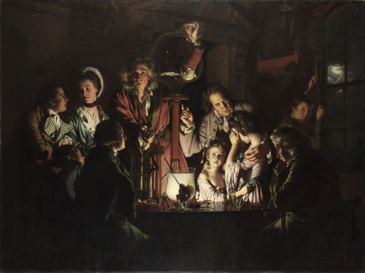
Did Boyle’s experiments with the air pump look like this?
An Experiment on a Bird in the Air Pump
by Joseph Wright of Derby (1768)

Slide 7
What seems to be historically accurate?
Reverential convention formerly reserved for scenes of religious significance: experiments were similar in their form to liturgy (not without reason Sunday was considered the proper day for experimentation)
Experiments were not organized in laboratories (or anything that looked like them), but in estates of nobles (houses of experiment).
And that’s it!

Slide 8
What doesn’t fit the picture?
Women and children were not allowed! Only gentlemen (men, representatives of higher social class) invited by the experimenter/the host witnessed the experiment.
Experiments were events which gathered relatively large audiences (dozens of gentlemen); they were also semi-public: Boyle contrasted his experiments with private practice of alchemists
Experimenter/the host was not operating the apparatus himself: his servants were „getting their hands dirty”. But he was commenting on the course of the experiment, explaining expected results, as well technical blunders.
The spatial organization of people and artifacts (proxemics) on the picture is totally awkward: gathered gentlemen watched experiments from the auditorium, the experimental device was located at the center, on a stage, initially hidden behind a curtain. This enabled vast control over the social interactions by the experimenter.
Boyle’s experiments were not didactic in their character: nobles gathered to settle the controversies (decide what is true, what counts as genuine research result), not to replicate old results (or at least they thought so).

Slide 9
Why is it so important that the scientific community consisted of gentlemen only?

Slide 10
Truthfulness of a gentleman and its relation to his wealth
In XVII century England gentlemen were considered cognitively and perceptually superior:
they had no patrons other then the King and were not forced to work; as economically independent they remained independent in their opinions and judgments;
their bodies and senses were not blunted by physical effort of any sort.

Slide 11
Truthfulness of a gentleman and its relation to his wealth
This way of perceiving gentleman and a gentleman’s word was a constant feature of juridical practice. That made gentlemen perfect witnesses not only in a courtroom, but also during experiments; testimony of multiple gentlemen witnessing the same experiment was deliberately used by Boyle in his strategy.

Slide 12
Science is fun!
In general, loafing was an obligation of every respectable gentleman.
One may say that a gentleman was defined by his pleasures.

Slide 13
Science is fun!
This attitude matched a newly designed scientific practice pretty well:
Experimental research and discussion of its results were designed as yet another sophisticated pleasures.
This was a gameplay in which aristocrats were able to engage each other in bloodless duels.
Rules of engagement and criteria of success were offered and the reward for victory was credit and recognition.
Rules and mechanics of this particular gameplay were designed and disseminated mainly by Henry Oldenburg, the first Secretary of the Royal Society.
This way of practicing science was in accordance with another simultaneous historical process – public and political opposition against dueling. The tradition of dueling was in retreat while scientific gameplay was becoming more and more popular.

Slide 14
Craftsmen: invisible actors of XVII century scientific revolution
Craftsmen were invisible in at least three ways:
They were anonymous authors of scientific instruments, often omitted in experimental protocols.
They were considered servants, and as such they were treated by gentlemen as nonexistent; as a result no one stated that effects demonstrated by the air pump were effects of deliberate machinations of craftsmen working behind the scene
For decades craftsmen remained invisible for historians, sociologists, and psychologists of science.

Slide 15
Craftsmen: invisible actors of XVII century scientific revolution
Craftsmen were not only operators of experimental devices, but also their actual designers and constructors; aristocrats were not getting their hands dirty because this was against their ethos and this was also rhetorically beneficial.
While aristocratic experimenters were responsible for ritual, craftsmen responsibility was to deliver reproducible, consistent results e.g. physical and chemical effects which could be demonstrated before gentle audience on cue

Slide 16
Robert Boyle (aristocrat, considered the author of experiments and the pump)
Invented the air pump
Assembled gentlemen to speak in the name of the Nature
Created semi-public space of science
Designed methodology and norms for scientific communication
Converted social capital into scientific authority
Robert Hooke
(craftsman, Boyle’s servant later recognized as a gentleman)
Designed the air pump
Prepared the stage and machinery for the show
Operated behind the scenes (in private) influencing the public
Constructed technical strategy for experiment replication
Converted scientific authority into (his own) social capital

Slide 17
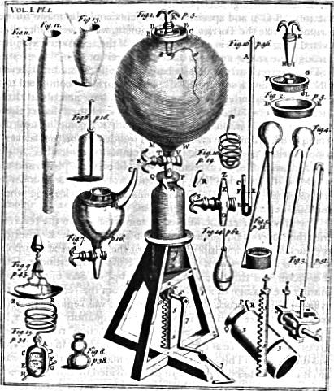
Craftsman was important because he delivered this:

Slide 18
What is so great about the air pump?
It made visible and „tangible” what was previously invisible and hard to grasp.
It functioned as an object of joint attention, facilitating coordination of judgments of different witnesses.
It was considered a medium through which Nature may manifest itself, independently of human will, biases, and beliefs.
It paved the way for development based on „genealogy of instruments” mechanism (e.g. telescopes, particle accelerators).
The air pump was an extremely expensive and complex device: it was very hard to replicate, so in order to discuss Boyle's experimental results (and interpretation of those results) one was obliged to go through the house of experiment and had to play by Boyle’s rules.
Air pump imposed on scientific community a sense that criteria of successes in scientific gameplay are objective and of external origin: the assumption that Nature settle the arguments.

Slide 19
Beauty contest problem
Fictional newspress contests proposed by John Meynard Keyness as an example of how markets work and how rational agents behave.
Task: choose the six prettiest faces from a hundred photographs
Criterion of success: those who picked the most popular faces win.

Slide 20
Most popular is not necessarily most beautiful
„It is not a case of choosing those [faces] that […] are really the prettiest, nor even those that average opinion genuinely thinks the prettiest. We have reached the third degree where we devote our intelligences to anticipating what average opinion expects the average opinion to be. And there are some, I believe, who practice the fourth, fifth and higher degrees.”
Keynes, General Theory of Employment Interest and Money, 1936

Slide 21
Guess the 2/3 of average: more explicit formulation of Keynes idea
Task: pick a number between 0 and 100
Criterion of sucess: the person(s) whose number is closest to 2/3 of the average of all numbers submitted wins.
How people bahave and how would ideal rational actors would behave.

Slide 22
Model:
Level 0 players: they pick randomly
Level 1 players: they assume that others are L0 and assume that the average is going to be 50, so they pick 33 (50 x 2/3 = 33,33).
Level 2 players: they assume that others are L1, so they pick 22 (50 x 2/3 x 2/3 = 22,22).
Level 3 players: they assume that others are L2 and picks 15 (50 x 2/3 x 2/3 x 2/3 = 14,81).
…
Nash equilibrium: rational actors assuming that others are also ideally rational would pick 0.

Slide 23
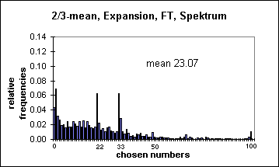
One, two, infinity: results of 3 newspaper experiments
(Bosch-Domènech et al. American Economic Review, Vol. 92, No. 5 2002)

Slide 24
Science as a beauty contest model:
Tasks: propose new concepts, theories, experiments etc. which have greatest probability of acceptance by others and are going to be exploited by others; external touchstone would be unavailable
Could recurrent gameplay result with an equilibrium-like state, conceptual stasis, or maybe we would stick with theories similar to four temperaments?

Slide 25
Touchstone
Thanks to Boyle’s strategy a general sense emerged that experimental devices work independently of our judgments, wishes etc. Each scientist desiring credit and recognition was left with only one option: instead of voting in a beauty contest he must choose „most beautiful faces” following his own judgment. In this way he’s freed from possibly endless iteration and guessing what others think and what they will do.

Slide 26
Boyle’s and Hooke’s heritage
The strategy used by Boyle worked perfectlly for others (e.g. Antoine Lavoisier and a second chemical revolution)
Elements of aristocratic ethos and the way craftsmen perceived their function and obligations can still be found in current science
Science is still fun and researchers are willing to pay for that.
Authority and collective judgment are still one of the most important features of scientific practice
But they are supressed by the role of external reality which is considered the factor settling the arguments: we usually forget that instruments, experimental devices and the results generated by them do not speak for themselves

Slide 27
Thank you for your attention!
Łukasz Afeltowicz
Radosław Sojak
Institute of Sociology
Nicolaus Copernicus University

