Slide 1
On Thagard’s Argument for the Approximate Truth of Deepened Scientific Theories
Witold M. Hensel
University of Bialystok
A Critical Examination of an Argument from Thagard, 2007, Coherence, truth, and the development of scientific knowledge, Philosophy of Science 74, 28-47.

Slide 2
THE PLAN
A little background
scientific realism
Putnam’s no-miracles argument
Laudan’s counterargument (pessimistic induction)
Thagard’s argument
mechanistic explanation
theory & approximate truth
the induction
Counterexample
Conceptual problems
Rival explanations?
Part explication, part critique
(sources of arbitrariness)

Slide 3
SCIENTIFIC REALISM
Metaphysical claim: The world is made up of objective things possessing objective properties, some of these things are unobservable.
Realism Constructivism
Semantical claim: Scientific theories are literal descriptions of the world. Their truth-value depends on how well they represent both the observable and the unobservable.
Realism Instrumentalism Dummett’s anti-realism
Epistemological claim: Some scientific theories are at least approximately true of the world.
Realism Skepticism

Slide 4
NO-MIRACLES ARGUMENTS FOR SCIENTIFIC REALISM
Putnam (1978): Realism as an empirical hypothesis.
The empirical success of some theories would be a miracle
if they were not at least approximately true.
Fact: Some theories are empirically successful.
Explanation 1: The theories are approximately true.
Theories that do not capture the causal structure of the world can’t be expected to regularly yield a wide range of true predictions; likewise, technology based on such theories cannot be expected to work.
Explanation 2: Scientists favor empirically successful theories.

Slide 5
LAUDAN’S PESSIMISTIC INDUCTION
Laudan (A Confutation of Convergent Realism, 1981) lists:
successful theories that don’t seem to be approximately true: early astronomy (crystalline spheres), humoralism, the effluvial theory of static electricity, catastrophist geology, the phlogiston theory, the caloric theory of heat, the vibratory theory of heat, vital force theories in physiology, optical and electromagnetic ether theories, the theory of circular inertia, theories of spontaneous generation.
- unsuccessful theories whose theoretical posits were approximately true (Greek atomism, Wegener’s theory in geology).
Though successful, our best theories may not be approximately true.
What’s the conceptual link between empirical success and approximate theoretical truth?

Slide 6
THAGARD’S CAUTIOUSLY OPTIMISTIC INDUCTION:
(COI) If theory T
maximizes explanatory coherence,
broadens its evidence base over time (i.e., explains new phenomena) &
is deepened, in the sense that its theoretical posits are explained in terms of underlying mechanisms,
then T will never be entirely rejected.
(COI) is supported by the historical record.
We can best account for (COI) by invoking the realist claim that
(RC) Deepened theories are approximately true
(the world is made up of layers of mechanisms).

Slide 7
MECHANISTIC EXPLANATION
Thagard 2007, p. 38: To explain a phenomenon is to describe a mechanism that produces it.
Constitutive Explanation
Same-Level Explanation
[Level 0]
[Level –1]
MDC 2000, p. 3: Mechanisms are entities and activities organized such that they are productive of regular changes ...

Slide 8
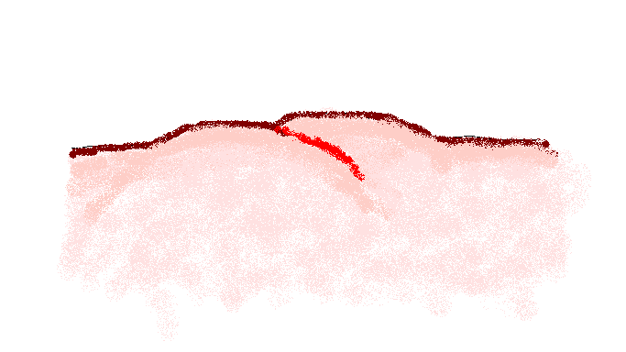
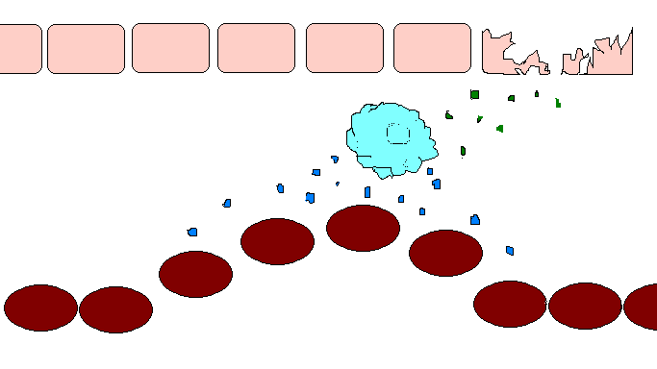
EXAMPLE: INFLAMMATORY RESPONSE
skin cell
mast cell
chemokines
histamine
endothelial cell
capillary

Slide 9
TO DEEPEN our explanation of the inflammatory response, we answer questions such as:
What’s the internal structure of a mast cell?
How exactly does a mast cell release histamine?
What’s the chemical composition of histamine?
How exactly does histamine cause vasodilation?
skin cell
mast cell
chemokines
histamine
endothelial cell

Slide 10
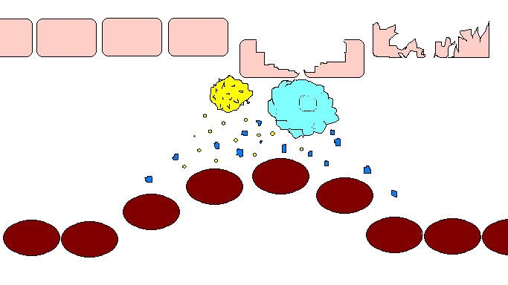
SOURCES OF ARBITRARINESS
Problems with mechanical explanations:
(a) blanket terms for entities and activities
(b) missing parameters (oversimplification)
(c) lack of confirmation
causes
histamine
release

Slide 11
THEORY & APPROXIMATE TRUTH
Thagard analyzes theories in terms of the mechanisms they posit.
I take a theory to be approximately true if it is partly true, that is, if most of its claims are nearly true in achieving quantitative closeness to accepted values. Assessment of approximate truth . . . needs to qualitatively consider the central mechanistic claims that the theory makes about parts, properties, relations, and resulting changes. (41)

Slide 12
THEORY & APPROXIMATE TRUTH
A theory is approximately true iff the mechanism it posits is sufficiently similar to the mechanism posited by a true theory.
Two problems:
An element of arbitrary decision (no similarity metric).
We tend evaluate obsolete theories on the assumption that our present theories are true rather than approximately true.
Thagard 2007: 41: [I]t is reasonable to maintain that Newtonian mechanics is approximately true in the sense that its major claims are quantitatively close to those supported by evidence and the theory that replaced it.
p. 34: Smolin (2001) suggests that problems in making quantum theory and relativity theory compatible with each other may lead to the replacement of both by a quantum theory of relativity.

Slide 13
THE INDUCTION
Universal generalization, falsified by one counterexample?
Statistical generalization, corrected by counterexamples?
Generalization about a mechanism?
Thagard 2007: 37: Actually, we do not need a universal generalization here: it would be enough if we could show from a survey of the history of science that broadened and deepened theories rarely turn out to be false.
Whewell’s consilience view was overoptimistic – counterexamples: Newton’s mechanics (?), wave theory of light (?), phlogiston chemistry.
Science as a mechanism for producing ever more accurate descriptions of the causal structure of the world.
But is it a Toyota or the human reproductive system?

Slide 14
FIRST PROBLEM: ARBITRARINESS
Given the number and nature of arbitrary decisions required to develop Thagard’s reasoning into a full-fledged argument, Thagard’s realist conclusion has not been justified.
Arbitrariness enters the picture due to problems with:
The notion of a deepened explanation (lack of criteria)
The notion of approximate truth (no similarity metric, no point of reference)
Evaluating the cautious induction (no useful description of science as a mechanism).
Next:
A counterexample to Thagard’s induction
The reason why Thagard’s induction may be false
If the induction were not false, how else could we account for it?

Slide 15
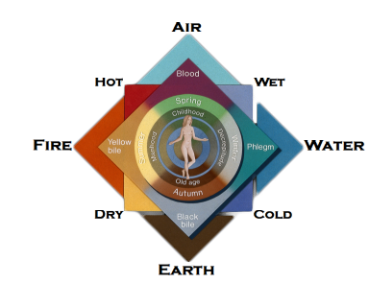
HUMORAL MEDICINE
ILLNESS RESULTS FROM HUMORAL IMBALANCE

Slide 16
WHY SHOUD DEEPENED EXPLANATIONS BE SPECIAL?
In everyday life, deepened explanations are often rejected. You would not adopt my hypothesis that dwarves steal certain foods even if I told you about their anatomy, physiology etc.
Consider same-level explanations. Does the unimpressive track record of strings of same-level explanations affect our confidence in the maxim that causes precede their effects?
Existing lower-level theories seldom determine the claims of upper-level theories (there are few complete micro-reductions). We should be able to find a multitude of counterexamples to Thagard’s induction.
A successful micro-reduction broadens the evidence base of the reduced theory and thereby increases its degree of confirmation.
Other things being equal, well-confirmed theories are harder to overthrow.

