Slide 1
A Process-Oriented Definition of Teamwork
Christopher P. Martin
Land Operations Division
Defence Science and Technology Organisation
Australian Department of Defence

Slide 2
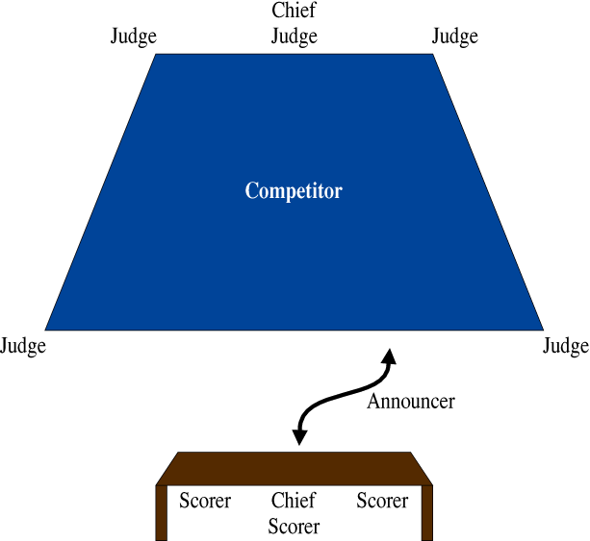
Teamwork at a karate competition
Notes:
This figure shows position and movement of participants in the scoring phase of a martial arts competition bout.
In some martial arts competitions, competitors are awarded numeric scores for performances. Calculating the scores is not an entirely straightforward process; most people require pencil and paper to work it out. After a given performance by a competitor, five judges (or seven judges, depending on the level of competition) each decide on a score. The highest and lowest scores are ignored, and the middle three (or five) scores are added together to give the final score. (Under some circumstances, the process can be further complicated by adding in the highest and lowest scores.) Each judge decides on a score independently without being privy to the thought processes or scoring of the other judges. When the competitor‘s performance is concluded, the judges have a few seconds to decide their scores. Then the chief judge blows a whistle and all the judges hold up their scores on placards to public view. An announcer calls out the scores. A few seconds later, the announcer is expected to call out the final score.
Experience has shown that the task of announcing the judges‘ scores while simultaneously calculating the final score in one‘s head is of sufficient cognitive complexity as to be difficult for a single person to perform consistently and quickly without errors. For this reason, positioned just off the competition floor behind the announcer and facing the chief judge is a table at which three people sit. These people are the scorers, and the task has thus been reorganised into integrated subtasks performed by announcer and scorer roles.
The announcer loudly calls the judges‘ scores in a specific order using a slow and measured cadence with accompanying gestures and adjustments to body orientation. From the scorers table, placards are often occluded, but the announcer can position himself or herself so as to ensure an unobstructed view of all the placards without further movement. Judges will often rotate their placards so that spectators can see the score, but because the scores are called in a specific order with gestures indicating the sequence, each judge can ensure that his or her placards are facing the announcer at the moment required to call.
Each scorer independently transcribes the scores as called and calculates a final score. The scorers then confer to check that they have all calculated the same final score. If there is disagreement, the scorers check each other‘s calculations. The purpose of checking is to find the error, not to entrench one's position of having the right answer. Scorers ask questions like, ”How did you get that?• or, ”Did I make a mistake?• While the scorers have been calculating and conferring, the announcer has stepped back to the table. The chief scorer shows and whispers the final score to the announcer who then steps forward and calls it out (loudly in a slow and measured cadence) to the chief judge (and everyone else listening) who then repeats it loudly enough for all the table officials to hear. All this time, the competitor has been standing in the middle of the competition floor.
We see teamwork in the interactions between the announcer, judges and scorers. In taking on the cognitive load of filtering the scores and performing the calculation, the scorers remove this burden from the announcer so that the announcer can concentrate exclusively on reading the placards and calling the scores accurately. And in calling the scores in a strict order using a slow and measured cadence, the announcer calls the scores in such a way as to make it easy for the scorers to transcribe them and compare their calculations. Here we see an example of a task that could be performed by a single person but, in order to ease performance demands and improve the detection and correction of error, has been reorganised into mutually supportive subtasks to be performed by multiple people. The key point is not that we have error mitigation or multiple subtasks per se, but that we have subtasks being performed in such a way as to establish conditions that are beneficial to the performance of other subtasks. That is to say, we have teamwork constituted in mutually beneficial subtasks and performance methods.
This point may be clarified by considering how a process may break down. If the announcer calls the scores too quietly or quickly, for example, the scorers will have difficulty transcribing them accurately and transcription errors will lead to calculation errors. Scorers may respond by trying to read the judges‘ placards for themselves, but this may require them to squirm in their chairs and will certainly add delays to the process. (And judges will not be thinking about holding their placards for the scorers to see.) On the other hand, scorers can make an announcer's job very stressful by neglecting to clearly indicate what the final score is or where it is written down. (Scorers‘ workpads typically become littered with score calculations over many bouts.)
The likelihood of transcription, filtering, calculation and identification errors increases with physical and cognitive workload, and the detection of error is made more difficult. The purpose of reorganising the process so as to involve several people was primarily to decrease errors and secondarily to increase speed. But if the people do not perform their roles in an appropriate manner˜that is, according to the principle of teamwork being constituted in mutually beneficial methods˜then the likelihood of errors will increase and speed may decrease. So ideally, by distributing the tasks of announcing and scoring, the load on any one person should be decreased to a more manageable level. However, through failing to consider the impact on teammates of aspects of his or her performance, an announcer can hinder the scorers and judges who in turn would consider the announcer to be a poor teammate.

Slide 3
Action Teams
  Surgical teams
  Emergency response teams
  Operate in situations of high tempo & uncertainty
  Maximise information gain & reduce uncertainty
  Partial plans & Contingency plans
  When it goes to custard…
    Re-plan on-the-fly!
Notes:
Action teams - Marks et al. (2002),
"The Impact of Cross-Training on Team Effectiveness."
Journal of Applied Psychology, 87(1), 3--13.
Perform in less familiar and more challenging environments
May be more temporary
Expertise, information and tasks are distributed
Members have specialized task-related skill sets
Members have honed teamwork abilities to coordinate their activities
Team performance and effectiveness depends on:
task contributions from each member
successful interaction among the team members
rapid, complex, and coordinated task behaviour
ability to dynamically adapt to the shifting demands of the situation
E.g. military operations, e.g. combined arms teams.
Suppose you were wanting to improve the effectiveness of such a team.
How would you make a start?
It might be useful to have a model of effective teamwork to use as a guide.
But there lies a problem…

Slide 4
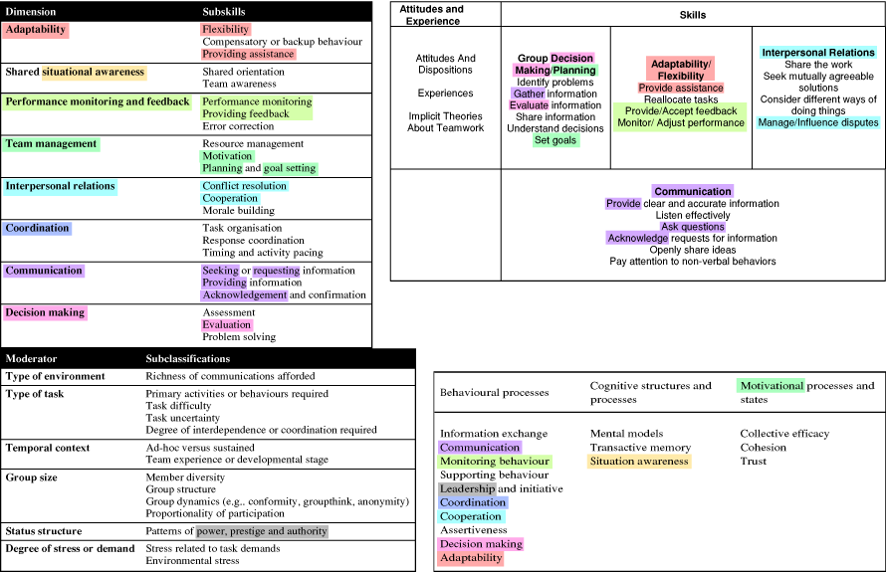
Frameworks… So many frameworks…
Baker et al. (2000–2007)
Driskell & Salas (2006)
Shanahan et al. (2007)
Notes:
Highlighting the problem of selecting a model for operational guidance:
Three frameworks sampled from the literature:
Driskell & Salas (2006), "Groupware, group dynamics, and team performance.“ In Creating High-Tech Teams: Practical Guidance on Work Performance and Technology, Washington: APA.
Baker et al. (2000–2007), “The Adult Literacy and Lifeskills (ALL) Survey.” URL <http://www.ets.org/Media/Tests/ETS_Literacy/ALLS_TEAMWORK.pdf>. Created 30 March, 2000. Last modified 03 July, 2007.
Shanahan et al. (2007), DSTO-RR-0328: “Measurement of the Behavioural, Cognitive, and Motivational Factors Underlying Team Performance.”
[Point out the highlighter marks showing how even common elements are re-positioned.]
[Point out the non-highlighted terms that could be unique to each framework.]
[Play animations to highlight the elements’ scattering among the frameworks…]
And here are the elements from the example of Marks’ model of mediating processes:
Mental models
Coordination
Backup
It is not clear that we are closer now to an operational model for improving teamwork.
There is a tension between trying to reduce the field to the “essential” elements of teamwork versus expanding the field to cater for vagaries in observed results in real-world contexts.
As already mentioned, these variables have complicated inter-relationships and their degrees of influence can be very context-dependent.
Still in search of an operational concept of teamwork.
From a practitioner’s point of view, how does one choose one framework over another?
And does it really matter…?

Slide 5
Operational difficulties with current theory
Correlations found between anticipation ratio and team awareness measures: Push/Pull > 1 → more anticipation → better team awareness and communications efficiency.
  (MacMillan et al. (2004), “Communication overhead: the hidden cost of team cognition.” In E. Salas & S. Fiore (Eds.), Team cognition: Understanding the factors that drive process and performance. Washington: APA.)
Question: What is a good anticipation ratio? Could there be a calculable ‘ideal’ or ‘optimal’ anticipation ratio for a characteristic scenario and activity phase?
Contrary to expectations, some observations to date even suggest an inverse correlation between anticipation ratio and mission success.
Suggestion: Using push/pull ratios to measure team awareness misses the point.
Notes:
<Perseus Link Team Comms Report280207.doc>
Example of an operational question to which theory responds inadequately or even misleadingly:
Wargames at DSTO have tried using “anticipation ratios” as a teamwork effectiveness metric and predictor of mission success.
Anticipation ratio: Push/pull > 1 → more anticipation → better team awareness and communications efficiency.
A ‘push/pull’ ratio higher than one suggests more anticipation, and by implication better team awareness and communications efficiency, than a ratio lower than one.
Encouraged by reported correlations found between anticipation ratio and team awareness measures.
MacMillan et al. (2004), “Communication overhead: the hidden cost of team cognition.” In E. Salas & S. Fiore (Eds.), Team cognition: Understanding the factors that drive process and performance. Washington: APA.
But a question arises, “What is a good anticipation ratio?”
Could there be a calculable ‘ideal’ or ‘optimal’ anticipation ratio for a characteristic scenario and activity phase?
Unfortunately…
Expected correlations between anticipation ratio and mission success have not been sustained. Some observations to date even suggest an inverse correlation between anticipation ratio and mission success.
Sample sizes to date are too small for statistical rigour and there are likely other, more significant, factors affecting mission success for strong correlations to be expected. (Overwhelming opposition, for example.)
I will return to this topic later, but for now I would like to leave it with a suggestion that using push/pull ratios to measure team awareness actually misses the point.
What that point is, I will come to shortly.

Slide 6
A different approach to teamwork study
  Explanatory frameworks based on general phases or categorisations.
  Explanations for team performance rest in terms of categorised teamwork factors.
Turn this on its head…
  Organisations of processes: (in detail) components; interactive characteristics; constraints.
  Delineation of the function and content of mental models, extended from the individual into the team domain, enabling and constraining functional team organisations.
  Teamwork emerges from the interaction of multilayered organisations of processes with mental models at the crux.

Slide 7
Defining task models
Miller and Parasuraman (2007)
“Designing for Flexible Interaction Between Humans and Automation: Delegation Interfaces for Supervisory Control.” Human Factors, 49(1), 57–75.
Task = an encapsulated set of behaviours that constitute a known method of accomplishing a domain goal.
  A task is functionally decomposed into inter-related subtasks
  A subtask associates a subgoal with one or more alternate methods of realisation.
  Methods are themselves subtasks
  A hierarchy descending through partial plans at higher levels to “primitive actions” (the lowest level of resolution required).
Notes:
Miller and Parasuraman (2007) define a task as “an encapsulated set of behaviours that constitute a known method of accomplishing a domain goal” (p. 66).
A complete task model is formed by functionally decomposing a task into related subtasks, each subtask associating a subgoal with one or more alternate methods of realisation.
These methods are themselves subtasks forming a hierarchy descending through partial plans at higher levels to “primitive actions” at the lowest level of resolution required for the purpose of the task model.

Slide 8
Task decomposition and alternative sets
Multiple methods
  There’s more than one way to do something
Subtle differences in:
  Requirements
  Timing
  Environmental effects
    Subtle differences in effect on one’s team-mates
(Brazier et al., 2000; Miller & Parasuraman, 2007; Seibt, 2009)
Notes:
The notion that a goal may have alternative methods of realisation is crucial to this discussion.
(See also
Brazier et al. (2000), “On the use of shared task models in knowledge acquisition, strategic user interaction and clarification agents.” International Journal of Human-Computer Studies, 52(1), 77–110.
Seibt (2009), “Forms of emergent interaction in General Process Theory.” Synthese 166(3), 479–512.
)

Slide 9
Graphic Notation
Action
Outcome
Notes:
‘Action’ could be any voluntary transfer or transformation of energy.
It may be transient, fleeting, with an outcome that is not a change of state in the actor.
An example of such is when one actor gestures to another. There is nothing that remains in the environment to signify that the gesture happened. (If a tree falls in a forest…)
(However, if it is useful for modeling purposes, we may chose to recognise that the actor performing the gesture does have a change of state which is the memory of performing the gesture.)
It may be extended in space and time.
It need not be atomic. (Though for ease of discussion, we will be dealing in actions that can be treated as atomic.)
It may involve an aggregate of actors. (Though for ease of discussion, we will be dealing in single-actor actions.)

Slide 10
Graphic Notation
Action
Outcome
Notes:
We can encapsulate an action with an outcome…

Slide 11
Graphic Notation
If that Action had that Outcome …
then this Action will have this Outcome.
Action
Outcome
Action
Outcome
Traditional | Situation Knowledge Web
If condition C holds, | If action X was performed Resulting in condition C holding,
Then perform action A. | Then perform action A Expecting condition Y to hold.
Notes:
And use it as a basis for selecting further actions and anticipating outcomes.
Those of you who are familiar with traditional rule-based reasoning systems should note that to encode a situation knowledge web would require more complex rule expressions than is traditional. The essential difference is illustrated in the following table. In the simplest case, a traditional condition-action rule will be bracketed by a preceding action and an expected post-action condition. Traditional rule-based systems perform actions conditional on immediate system states. But for rule-based systems to take full advantage of situation knowledge webs for reasoning, they must be able to relate actions-with-outcomes in hierarchical and temporal dimensions. Traditional expressions are still possible if it doesn’t matter what preceding action was performed nor what post-condition holds. But you get a lot more expressive power if you have access to and can use the agent’s interaction history for reasoning.
[Perhaps note in passing that this framework provides even the simplest of organisms with a basis for system-detectable error. The action-outcome pairing can be treated as a predicate: was the anticipated outcome realised, or not, when the action was performed? If the outcome is expressed entirely in terms of internal states, this gives a representation of truth value with no external referent required.]

Slide 12
Graphic Notation
Action
Outcome
Situation
Action
Outcome
Notes:
I will aggregate chains of relevant action-outcome events into “situation” placeholders.
We can read this as expressing an expectation that the current situation affords performing a particular action to achieve a particular outcome (or that the outcome will hold after the action is performed).
Classes of error
This could always turn out to be wrong:
The situation may have been misconstrued.
The action may not have been appropriate to the subtleties of the situation.
The action may in fact not be capable of achieving the outcome in any case.
The action was not in fact attempted.
The action was performed with inadequate skill.
The action appeared to be performed skilfully but was in fact intended to fail.
Altogether, we have a total six classes of error, subdivided into to two groups of three. One group pertains to matters of situation recognition. The other group pertains to issues of trust in teams.
Developed from Roda (2007), “Supporting attention with dynamic user models.” In proceedings of the Interactivist Summer Institute 2007, Paris, May 26-29.

Slide 13
Graphic Notation
Situation
Action
Outcome
Action
Notes:
There may of course be multiple ways of achieving the same outcome.

Slide 14
Graphic Notation
Outcome
Action
Situation
Outcome
Action
Outcome
Notes:
And of course different methods, while achieving the same nominal outcome, may have different “side effects”.
And those side effects may be important in creating the preconditions for further action.
If it fits a modelling purpose, actions can be parameterised.
What we might draw as two actions may in fact be two different parameterisations of the same action.
Or it could be two instances of the same parameterised action with different parameter values.
For example, the act of “reading out a numeric sequence” (like a grid reference, phone number or bank account) can be highly nuanced with sensitivity to rate and rhythm, to name just two possible variables.
Situation Knowledge Webs
I propose that task and team mental models are not composed fundamentally of task and team concepts (categories, things, nouns) with static or slow-to-change properties (numeric values, adjectives) linked by context-independent relations as seen in conventional ‘concept map’ diagrams.
Building task and team mental models is actually building a web of potential interactions; that is, outcome-action-outcome triads.
When functionally grounded in actions and outcomes-leading-to-further-actions (Bickhard, 2008) the mental models of two co-actors need not be structurally nor mechanistically alike in order to permit successful interaction (Smart, 2009).
Some actions performed in some contexts lead to beneficial outcomes for the actor; other actions, or the same actions in other contexts, lead to detrimental outcomes. For some actions, there may be multiple possible outcomes of which only some are beneficial. Whichever outcome is realised may depend upon factors in the current situation defined as the totality of state with respect to both actor and environment. For our discussion, it does not matter where the influencing factors lie, in the actor or the environment, or both: what matters is that a beneficial outcome will be realised in only some, not all, situations.
It should be noted that we are using ‘benefit’ in a sufficiently general sense so as to include the avoidance of some detrimental happening.
For brevity in the following discussion, unless otherwise specified, ‘outcome’ should be understood as ‘beneficial outcome.’
Smart et al. (2009), “Shared Understanding within Military Coalitions: A Definition and Review of Research Challenges.” In proceedings of Knowledge Systems for Coalition Operations, Southampton, 31st March–1st April.
Bickhard (2008), “Social Ontology as Convention.” Topoi., 27(1), 139–149.

Slide 15
What does it mean to “share” a mental model?
Similarity or Aggregation concepts:
  Knowledge & belief held in common by N >= 2 members
  Knowledge & belief held in common by all members
  Sum of that held by all members (regardless of commonality)
  Average of that held by all members
Higher-order concepts :
  Processes that let members use artifacts and other members as cognitive resources
  Multi-level organisation of processes that generate a virtual model which does not exist complete in any member but enables and constrains activity
    Each member has a ‘share’ of the larger process
    Cognition as high-order control (Wayne Christensen, in press)
Notes:
Need to make a leap to the consideration of mental models.
Still in search of an operational concept of teamwork, I’d like to focus now on Marks’ “shared mental model” input.
We can then return to the question, “What is teamwork?” armed with some ideas about those mental models on which teamwork operates…
Rouse & Morris (1986), “On looking into the black box: Prospects and limits in the search for mental models.”
Psychological Bulletin, 100(3), 349–363:
Mental models = mechanisms whereby humans are able to generate descriptions of system purpose and form, explanations of system functioning and observed system states, and predictions of future system states.
Putting aside the question of what an individual mental model might look like for a moment…
What does it mean to “share” a mental model?
[Review the list]
A key distinction between models in the second group is the degree of completeness of an individual’s model;
alternatively, their degree of dependence on an external system for successful (cognitive) operation.
Like some others, I subscribe to the last option.
I realise this is probably highly contentious.

Slide 16
Shared Extended Mind
In the literature, notions of representational content are usually restricted to internal mental states of one individual.
The notion of collective representational content extends this in two ways:
  for external, rather than internal, mental states;
  for groups of individuals rather than single individuals.
Bosse et al. (2006), “Collective representational content for shared extended mind.” Cognitive Systems Research, 7, pp. 151–174.

Slide 17
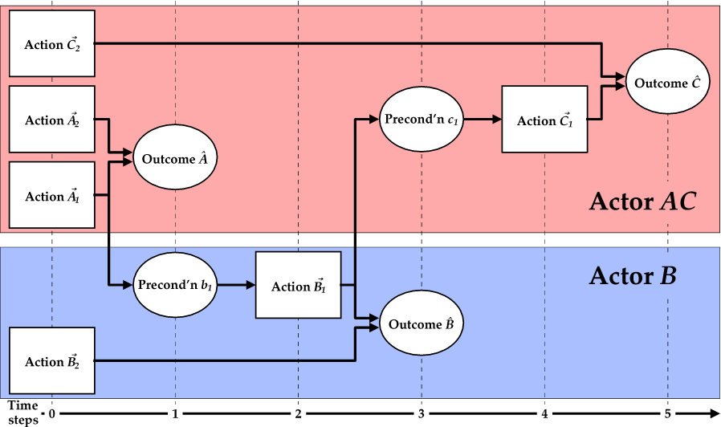
Extending mental models into teams
Notes:
This shows two actors performing three subtasks each having two alternate performance methods (actions).
Astute viewers will note that although the time stretches out to five steps, all three subtask outcomes could be realised simultaneously. If maximal speed of execution was the only performance criterion, this course of action would be appropriate. But let’s assume that other performance criteria must be accommodated. (Efficient resource use, ease of performance, safety of actors, etc.)
Outcome A can be realised by performing either action A1 or action A2, neither having any precondition for success.
Outcome B can be realised by performing either action B1 when precondition b1 is satisfied, or action B2 which has no precondition for success.
Outcome C can be realised by performing either action C1 when precondition c1 is satisfied, or action C2 which has no precondition for success.
Outcomes A, B and C are subtask goals.
(Associated performance indicators and higher-order goals are not essential to the argument and so are not depicted.)
Outcomes A and C are assigned to one team member Actor AC, and outcome B is assigned to another team member Actor B.
Now, suppose that the performance of action A1 also creates a situation that satisfies precondition b1; likewise B1 and c1. Then in choosing action A1 to realise outcome A, actor AC also makes it possible for actor B to choose action B1 to realise outcome B. And in choosing action B1 to realise outcome B, actor B also makes it possible for actor AC to choose action C1 to realise outcome C. And should this eventuate, we expect that actors AC and B will thereafter respond positively to the question, “Did you work as a team?” We propose that the essence of teamwork is constituted in this selection of mutually beneficial methods for task performance.
Key elements to supporting teamwork are the situational markers b1 and c1. Each relates two outcome-action-outcome triads and through them the two actors’ individual models. Element b1 is an outcome for actor AC and a precondition for actor B; likewise c1 but reversed. These two expressions taken together capture the beneficial relationship between the two actors’ subtasks. Element b1 provides actor AC with a rational basis for selection of action A1 over alternatives. Instances of such selections exemplify team orientation enabled by shared mental models and mutual trust.
This is a very simple example. But when several actors are involved, it may be that no two actors engage in activities that directly benefit each other but there is a complex transitive chain or web such that each actor benefits, or benefits from, some activity of some other actor.
In fact, we expect that an actor need only believe that another actor chooses to act in a way that benefits the former for that actor to experience being-in-a-team. The belief may not be true. The other actor may have perceived no choice in acting as they did. Or there may have been other methods, but none as personally appealing as the method chosen. Perhaps what matters is not that there were indeed better alternative methods, but that the receiver of the benefit believes that the other chose to act with the provision of that benefit in mind.

Slide 18
Bifurcation
Beneficial
Outcome
Situation
Action
Detrimental
Outcome
Notes:
Actions serve to classify situations as either affording, or not affording, expected outcomes.

Slide 19
Bifurcation
Beneficial
Outcome
Situation
Action
Action
Detrimental
Outcome
Notes:
Actions serve to classify situations as either affording, or not affording, expected outcomes.

Slide 20
Bifurcation
Beneficial
Outcome
Action
Situation
Situation
Detrimental
Outcome
Action
Notes:
Actions serve to classify situations as either affording, or not affording, expected outcomes.

Slide 21
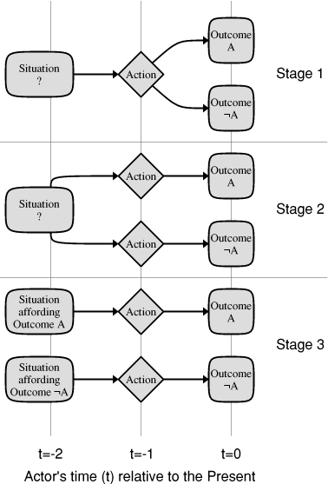
Bifurcation
Notes:
Bifurcation of the situation knowledge web is the outcome of a process by which an actor uses an action-outcome pair to differentiate a situational class. Bifurcations of the situation knowledge web are behind sentences that begin, “Had I known then what I know now…” Consider the simplest possible case as shown here. At time (t=-2) the actor projected the performance of a particular action at time (t=-1). Proceeding from that action were two parallel arcs to two mutually exclusive possible outcomes5 at time (t=0). But which outcome would be realised? The actor's situation at time (t=-2) was undifferentiated with respect to the two outcomes in that the actor could not predict which outcome would be realised at time (t=0). At time (t=-1) the actor performed the action. By time (t=0) there was no longer any question. One of the outcomes, either A or ¬A, was realised and the actor was able to bifurcate its situation knowledge web to determine which class of situation held at time (t=-2). That is, at time (t=0) the actor had the hindsight to know which situation it was in at time (t=-2): either a situation leading to particular outcome A, given a particular action; or a situation leading to some outcome other than A (i.e. ¬A) given that same action. This figure shows the stages of the bifurcation process from the outcome realisation back to the identification of the situational class that was.

Slide 22
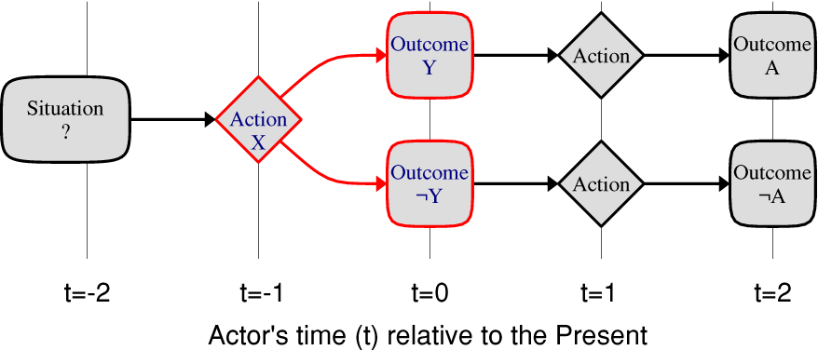
Bifurcation
Notes:
Think about crossing the street.
You want to get safely to the other side.
But there is the possibility that the situation does not afford safely crossing.
How to classify the situation before trying the action that could get you killed?
The actor in Figure 2 chose to perform Action X not because either Outcome Y or ¬Y is a beneficial end in itself but because of what the realised outcome indicates for further action-outcomes. This is different from either passively waiting for whatever sensory input arrives or applying some filter to all sensory input received. Rather, the actor engages in probing activity that is intended to elicit or invite a particular class of response from the environment whereby the absence of stimulation may be just as telling as its presence. In principle, bifurcation could be continued indefinitely (cognitive resources permitting) into the actor’s history of interactions; but in practice this does not happen. For the actor to predict the realisation of either Outcome A or ¬A, it is sufficient merely to stop bifurcation at Action X. Bifurcation is cognitively expensive and therefore the resolution of present and past situations is performed only as much as is necessary for the resolution of future interaction possibilities.

Slide 23
Anticipation ratios revisited
A key question:
  Did the receipt of a message make a difference to the recipient’s method selection?
  In other words…
  Did the message have apperceptive value?
Push/Pull anticipation ratios miss the effect of these pushed and pulled messages on the conduct of the mission.
What matters is not the number of messages pushed or pulled; what matters is the number of messages with apperceptive value.
Notes:
Communication brings us back to reconsider the utility of push/pull anticipation ratios.
The key question to be asked is, “Did the receipt of a message make a difference to the recipient’s method selection?” (With a nod to Gregory Bateson.)
In other words, did the message have apperceptive value?
(This “make a difference” includes cases in which a method selection is subsequently supported by communications received.
Such communications have apperceptive value in that they increase the commander’s confidence in the selected method being appropriate to the situation,
making it more likely that the commander will continue with that selection.)
So it is at least theoretically possible to discriminate messages with apperceptive value, on the basis of their effects on method selection, without needing access to the message content.
But this does require a different class of experimental design which strives to capture causality embedded in timing and sequence of events.
(Note that there is something of this in so-called push/pull anticipation ratios:
‘pulled’ information is classified as such because it is preceded by a ‘pushed’ request for information;
‘pushed’ information is that which is not preceded by a request.)
What matters is not the number of messages pushed or pulled; what matters is the number of messages with apperceptive value.
Without information about the effect of pushed and pulled messages on the conduct of the mission, push/pull ratios are a blunt instrument with low predictive or analytic value.

Slide 24
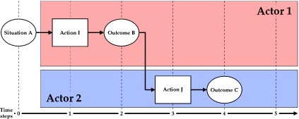
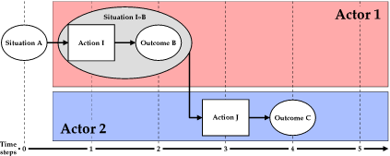
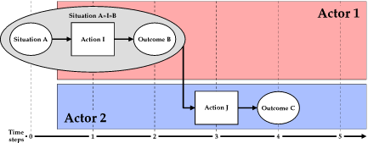
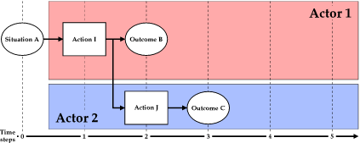
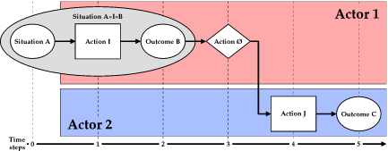
Fluent multi-actor coordination
Notes:
Now consider two actors coordinating the execution of their respective subtasks. We can distinguish several classes of coordination mechanism and, for each class, the prerequisite knowledge each actor requires of the other in relation to the task. For illustrative purposes, the scenario depicted in these figures is a very simple one involving the successful performance of just two actions in sequence. Each actor is capable of performing one of the required actions. Although simple, each case illustrates a distinct combination of coordination mechanism and prerequisite knowledge.
Each case includes a formal expression in Temporal Trace Logic. The ability to express teamwork relations in this way has great potential for experimentation. One can imagine populating a database of logged events, then formulating queries to detect examples of teamwork for analysis.
Tibor Bosse, Catholijn M. Jonker, Lourens van der Meij, Martijn C. Schut, Alexei Sharpanskykh, Jan Treur
<http://www.cs.vu.nl/~tbosse/papers/TTL.pdf>
<http://citeseerx.ist.psu.edu/viewdoc/download?doi=10.1.1.76.2889&rep=rep1&type=pdf>
<http://citeseerx.ist.psu.edu/viewdoc/download?doi=10.1.1.143.7436&rep=rep1&type=pdf>

Slide 25
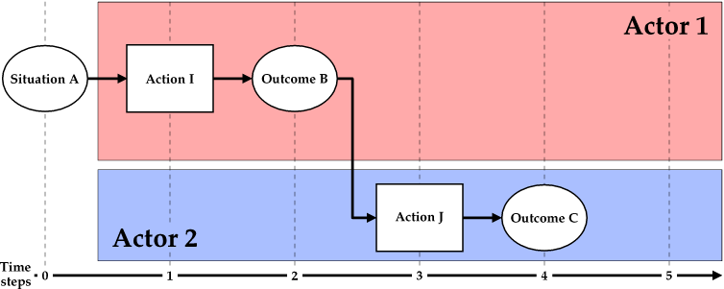
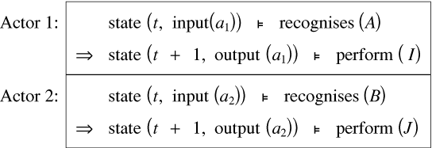
Situation / Action recognition (1)
Notes:
Figure 1: Action selection following decontextualised situation recognition.
This case shows the second actor performing action J after it recognises that outcome B has occurred.
(Recognition of an action or outcome necessarily presupposes the perception of same.)
For the second actor, so long as outcome B is recognisable and guarantees the successful transition to C through J, then no knowledge of the first actor’s role is required. Nor is any knowledge of any predecing situations required. Before perceiving B, all the second actor need know is that B will indicate that J should be performed to realise C.

Slide 26
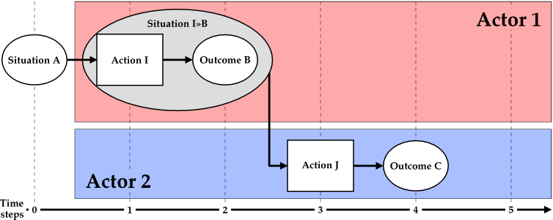
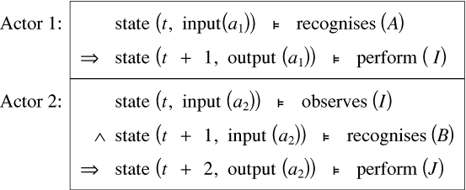
Situation / Action recognition (2)
Notes:
Figure 2: Action selection following contextualised situation recognition.
This case shows the second actor performing action J after it recognises that outcome B has occurred as a result of action I.
In other words, the actor knows that it is the performance of I realising B that indicates the possibility of performing J to realise C.
In this case, to make the decision to perform J, the second actor must be able to recognise not only outcome B but also the first actor performing action I.
So if the second actor cannot recognise the performance of I by another actor, then the ability to recognise B alone will not induce the actor to perform J.
Such contextualisation is demanding and offers no advantage in this simplistic task scenario, but would be essential in a more complicated task scenario in which B could also occur through other means in situations not related (or even counter) to achieving the goal via J.
As the need for such contextualisation increases, the cost to the second agent is a task knowledge web increasingly expanded and complicated with actions and outcomes that are not in that agent’s repertoire.
Note that actor 2’s formulae explicitly includes an observational reference to an action (I) in actor 1’s repertoire.
It is the cost of evaluating the observes predicate that establishes the crucial difference between this case and the simpler one.

Slide 27
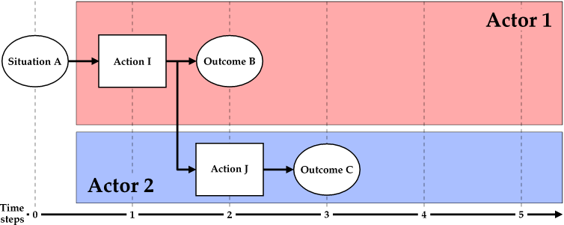
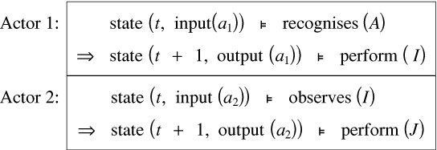
Situation / Action recognition (3)
Notes:
Figure 3: Action selection following decontextualised action recognition.
The preceding cases have required explicit situation recognition. However, there is another possibility: implicit situation recognition through action recognition.
This capability is key to improved fluency (Hoffman, 2008) of team performance.
As in the preceding case, it requires an actor to be capable of recognising (which presupposes perceiving) the performance of actions by other actors.
However, it does not necessarily require the ability to recognise the outcomes of those actions (or situations in general).
Recognising an action may be significantly less costly than recognising a situation and may also allow for decreased latency through anticipation of the outcome (Dousson 1993; Hoffman 2008; Knoblich2008).
In this case, the second actor will start to perform action J when it recognises that the first actor is performing I.
This presupposes that the first actor will perform action I only when it recognises a situation that will afford outcome B,
thereby realising B which in turn allows action J to realise outcome C.
The essential difference between these webs and those in case 1 may appear to be merely the substitution for actor 2 of recognises by observes.
However, remember that with this substitution comes an explicit reference to other actors’ behaviour.
Thus the decision to employ situation recognition or action recognition hinges on the cost difference between a socially-blind perception of the state of the environment versus a socially-aware perception of the behaviour of another actor.
(There is also the consideration due to reduced latency, although that is not clear in the TTL.)

Slide 28
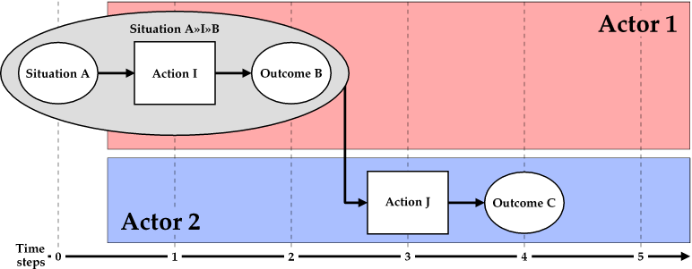
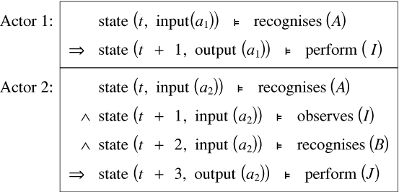
Situation / Action recognition (4)
Notes:
Figure 4: Action selection following contextualised action recognition.
As with the transition from the first to second cases, contextualisation is possible.
That is, task knowledge that was presupposed must be made explicit if the first actor may perform action I in other situations or with other possible outcomes.
This 4th figure depicts such a case.
In such cases, and in relation to the previous 3rd case, the ability to recognise situations will need to be reintroduced and latencies may increase again (when outcomes must be awaited).
The difference between this case and case 2 is subtle; it lies in whether the actor is attending preferentially to either other actors’ behavioural cues or situational cues.
The TTL for Figure 4 indicates that once actors need to represent extensive webs of other actors, there is no clear distinction between situation recognition and action recognition; both are needed.

Slide 29
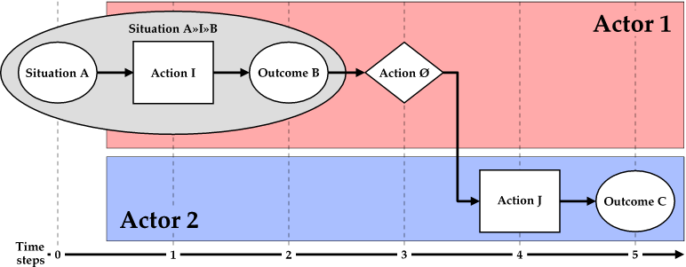
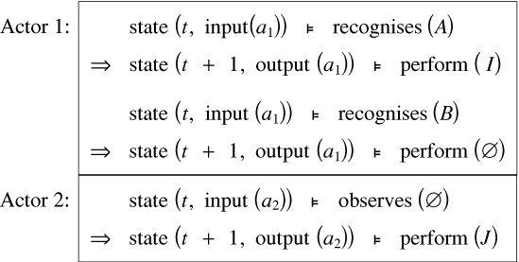
Situation / Action recognition (5)
Notes:
Figure 5: Using action recognition to minimise aggregate situation recognition costs.
Action recognition allows a special 5th case.
It allows the first actor to relieve the second actor of some of the recognition load and guesswork.
The first actor must already be capable of recognising a situation that affords performing action I to realise outcome B.
Should that situation arise and action I then be performed with outcome B realised, rather than leave it to the second actor to recognise this, the actors could establish a convention that the first actor will perform an action Ø as a signal to the second actor.
There need be no significant outcome of Ø.
The following criteria is required of Ø:
Its meaning in relation to the task is already agreed, or there is a process by which it can be agreed.
For the first actor, it is economical to perform.
For the second actor, it is more recognisable than the equivalent combination of A, I and B.
The TTL indicates the significant efficiencies possible at the team level with the introduction of conventions that can indicate and stand-in for extensive webs.
Receiving and computing the meaning of a brief, transient, fleeting communication—a signal—to indicate that a particular situation has arisen may be less costly than computing the same through situation recognition.
This is especially so for distributed teams denied opportunities to exploit action recognition.
Because situation knowledge must be continually updated, especially as plans go awry, efficient update mechanisms are highly desirable in rapidly changing complex environments.
Communication may therefore be highly functional as a stand-in for situation and action recognition.
In this sense, communication is less about information transfer and more about solving coordination problems and reducing cognitive load.
In asynchronous teams, coordination occurs in part through communications embodied in the production and exchange of artifacts (eg. letter drops, emails).
However, the potential for aggregate savings may come at some personal cost to actor 1 with additions to the action repertoire and knowledge web.
In particular, for the first time in the TTL expressions here, actor 1 must recognise outcome B, something which was previously only of concern to actor 2 (if at all).
Furthermore, the additional action Ø for actor 1 is unrelated to the task itself and only required for the sake of coordination with actor 2; that is, team-imposed communication overhead.

Slide 30
And back to where we started…
Comparison with classical “Team Orientation”:
  Alternative solutions are also an output, not just an input.
    To be considered for what they might offer as a means to set beneficial conditions for others to solve their problems.
  Information will be shared when it has (or is considered likely to have) apperceptive value.
    Information sharing will increase as a consequence of an increase in members’ ability to correctly estimate the apperceptive value of information.
    This shifts the focus away from communication bandwidth to the development of apperceptive capability across the team:
      “I see what you’re trying to do!”
Notes:
Conclude by coming full circle back to one of the “big five.”
Comparisons with classical frameworks
Some might say that my proposal is merely a re-statement of number five, “Team Orientation.”
Point out that (in part) my orientation is opposite and (I would argue) the focus is more balanced.
Alternative solutions are also an output, not just an input.
As a team member, I will also consider alternative solutions for what they might offer as a means to set beneficial conditions for others to solve their problems.
Information will be shared when it has (or is considered likely to have) apperceptive value.
Information sharing will increase as a consequence of an increase in members’ ability to correctly estimate the apperceptive value of information.
This shifts the focus away from communication bandwidth to the development of apperceptive capability across the team.

Slide 31
Conclusion
Based on a notion of the logical organisation and functioning of mental models, I offer a framework that could underpin the many components and coordinating mechanisms proposed for teamwork in the literature.
At core is a particular notion of the organisation and function of mental models, and a notion that teamwork is characterised by the selection of mutually beneficial methods.
Think of it as a lens through which we may re-examine team phenomena and re-assess how we might develop better teams.

