Slide 1
Musical Instrument Detection Zishuo Zhao, Haoyun Wang IIIS50, Tsinghua University June 17, 2017

Slide 2

“Everything that I see, I hear, I feel, As well as the scenery around, All begin to take on vivid colors.” ----Your Lies In April

Slide 3
Introduction
Features of music: Pitch (fundamental frequency) Timbre (patterns of spectrum)
Features of musical instruments:
Different pitches!
Timbre (patterns of spectrum)

Slide 4
Introduction
Highlight of our project:
Most handwork, least ML (only simple SVM for classification)
Combined utilization of simple tools
White-box model design by our observation
Good performance on compact model

Slide 5
Introduction
Material:
6 representative instruments
Piano, Guitar, Saxophone, Flute, Trumpet, Violin

Slide 6
Introduction
Tools:
Normalized LP Coefficient (14D)
Mel-Frequency Cepstrum Coefficient (12D)
Spectrum Outline & Cepstrum Peaks (our handwork, 6D)

Slide 7
Performance with partial features
Normalized LPC(14) | MFCC(12) | SO&CP(6) | Accuracy
+ |  |  | 67%
 | + |  | 85%
+ | + |  | 88%
 |  | + | 53%
+ | + | + | 91%
(not normalized) | + | + | 89%

Slide 8
Intuition
The same waveform (even when stretched) “should” have same timbre.
Like sin(x)+0.3sin(2x) and 2sin(2x)+0.6sin(4x).
In frequency domain, they have the same peak patterns.
Inversely…

Slide 9
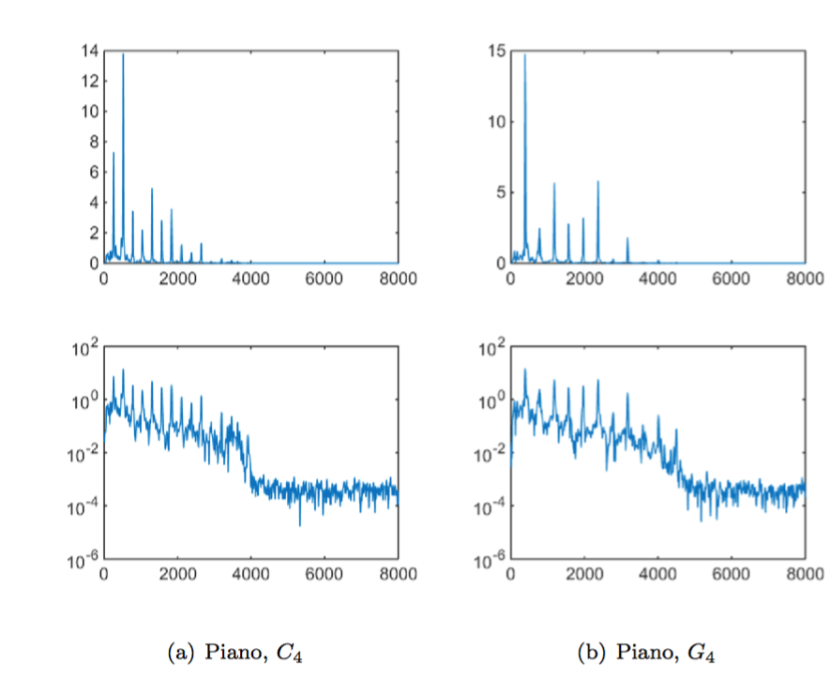
Intuition
However…
Their harmonic series do NOT look the same…

Slide 10
Intuition
But they seem to have similar outline…
Resonance at certain frequencies
“formant”
Working as a filter!

Slide 11
LP coefficients
To compute a filter to diminish the sound into white noise
Inverse: to make white noise resonate as the music!
Showing resonance features

Slide 12
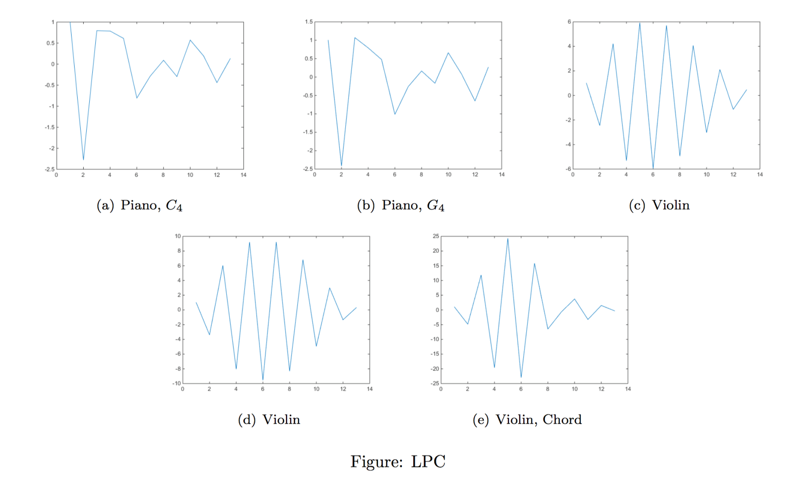
LP coefficients
It seems to work

Slide 13
Normalization trick
Magnitude may distinguish in a way
Normalize their STDEV to 1.
14 dimensions, 67% accuracy

