Slide 1
Musical Instrument Detection Zishuo Zhao, Haoyun Wang IIIS50, Tsinghua University June 17, 2017

Slide 2
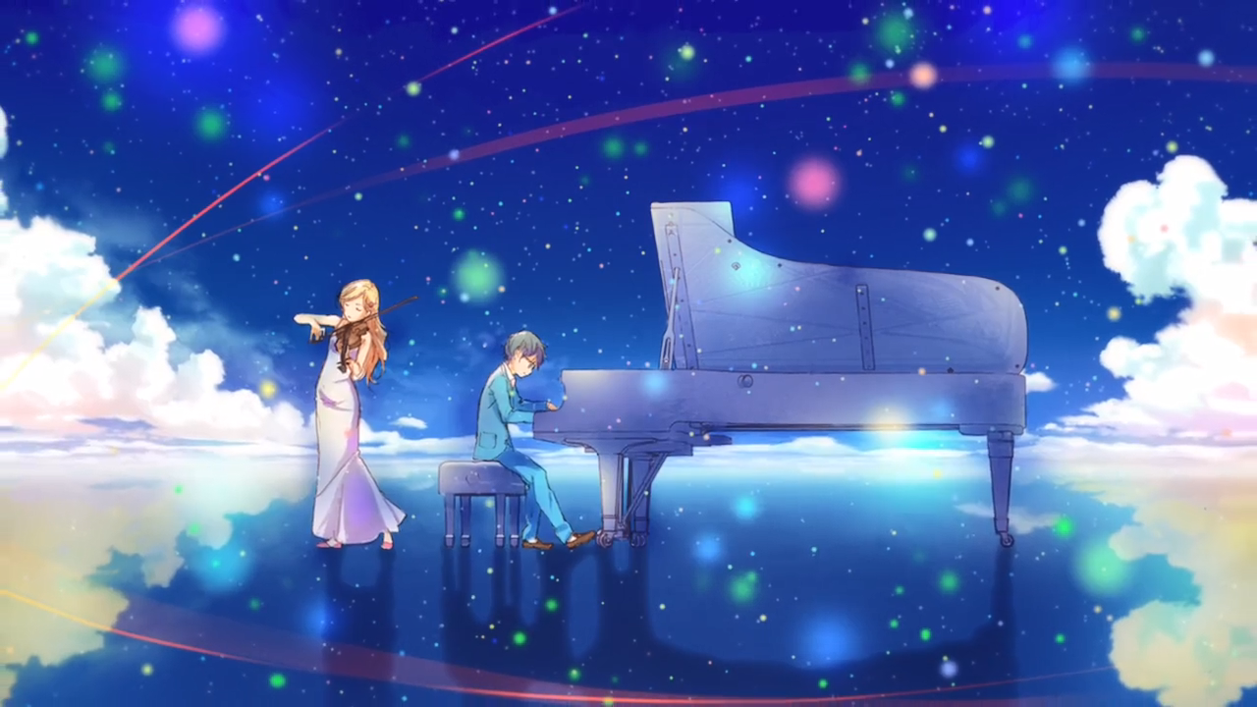
“Everything that I see, I hear, I feel, As well as the scenery around, All begin to take on vivid colors.” ----Your Lies In April

Slide 3
Introduction
Features of music: Pitch (fundamental frequency) Timbre (patterns of spectrum)
Features of musical instruments:
Different pitches!
Timbre (patterns of spectrum)

Slide 4
Introduction
Highlight of our project:
Most handwork, least ML (only simple SVM for classification)
Combined utilization of simple tools
White-box model design by our observation
Good performance on compact model

Slide 5
Introduction
Material:
6 representative instruments
Piano, Guitar, Saxophone, Flute, Trumpet, Violin
Basic dataset: conventional sounds of these instruments from RWC Music Database
Augmented dataset: special playing styles added
Mainly focused on basic dataset

Slide 6
Introduction
Tools:
Normalized LP Coefficient (14D)
Mel-Frequency Cepstrum Coefficient (12D)
Spectral Outline & Cepstrum Peaks (our handwork, 6D)

Slide 7
Performance with partial features
Normalized LPC(14) | MFCC(12) | SO&CP(6) | Accuracy
+ |  |  | 67%
 | + |  | 85%
+ | + |  | 88%
 |  | + | 53%
+ | + | + | 91%
(not normalized) | + | + | 89%

Slide 8
Intuition
The same waveform (even when stretched) “should” have same timbre.
Like sin(x)+0.3sin(2x) and 2sin(2x)+0.6sin(4x).
In frequency domain, they have the same peak patterns.
Inversely…

Slide 9
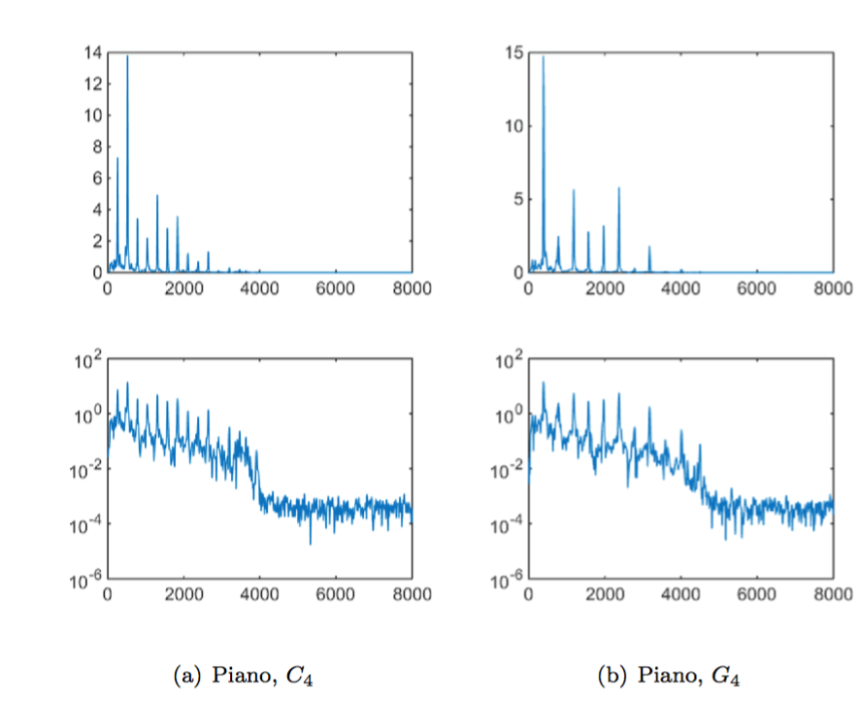
Intuition
However…
Their harmonic series do NOT look the same…

Slide 10
Intuition
But they seem to have similar outline…
Resonance at certain frequencies
“formant”
Working as a filter!

Slide 11
LP coefficients
To compute a filter to diminish the sound into white noise
Inverse: to make white noise resonate as the music!
Showing resonance features

Slide 12
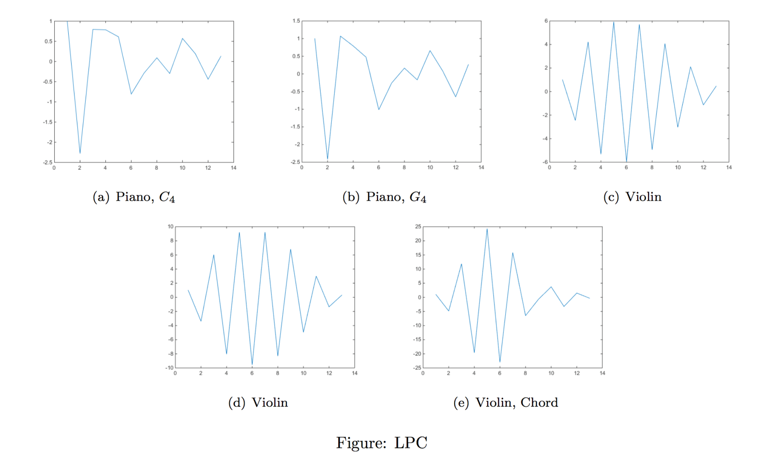
LP coefficients
It seems to work

Slide 13
Normalization trick
Magnitude may distinguish in a way
Normalize their STDEV to 1.
14 dimensions, 67% accuracy

Slide 14
MFCC
A traditional method for speech analysis
Designed for non-linear frequency response of human
Describes energy distribution to frequencies in human’s perspective
12-dim, 85% accuracy
Human ears are marvelous!

Slide 15
Spectral Outline
How to smoothen the log-spectrum?
Do FFT as if it is in time field, and pick low-freq components!
Then IFFT, as a low-pass filter.
cepstrum!

Slide 16
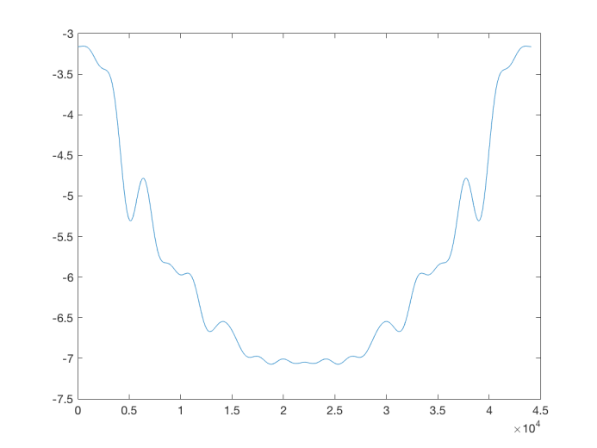
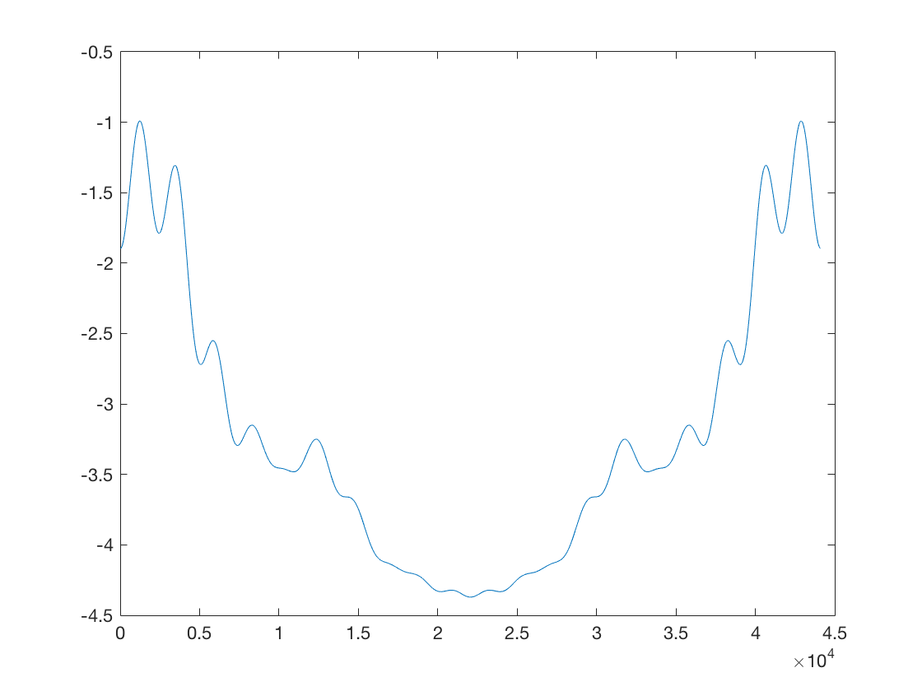
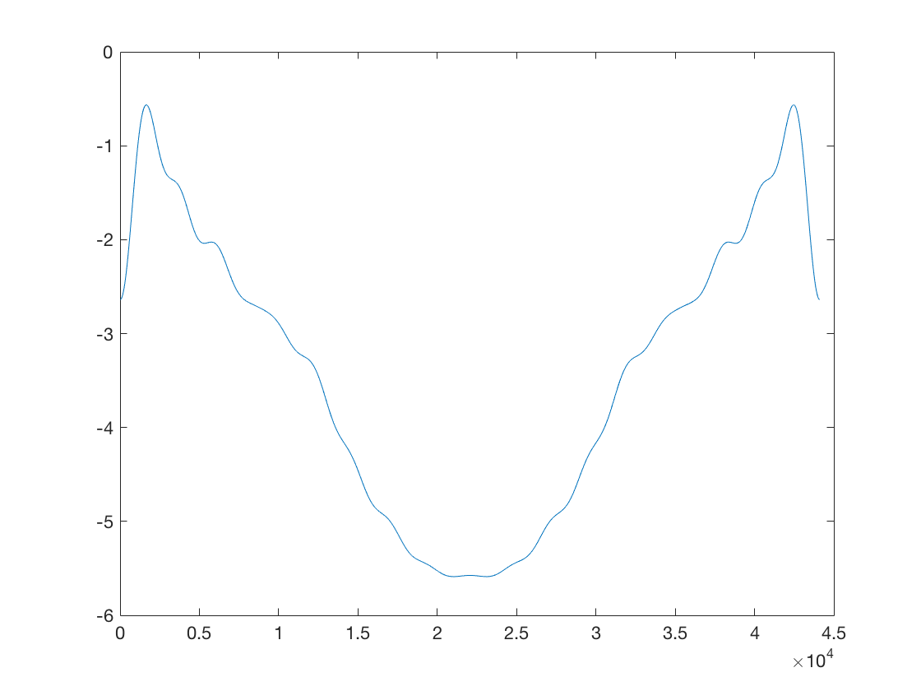
Spectral Outline
Peaks seem to represent instruments, BUT SVM needs fixed-dimensional vector.
Violin
Saxophone
Trumpet

Slide 17
Spectral Outline
A naive way: Linear Regression!
To project the resonance feature onto an 2D space.
Hope that it works.
37% accuracy, fairly better than random guess for 2-DIM!

Slide 18
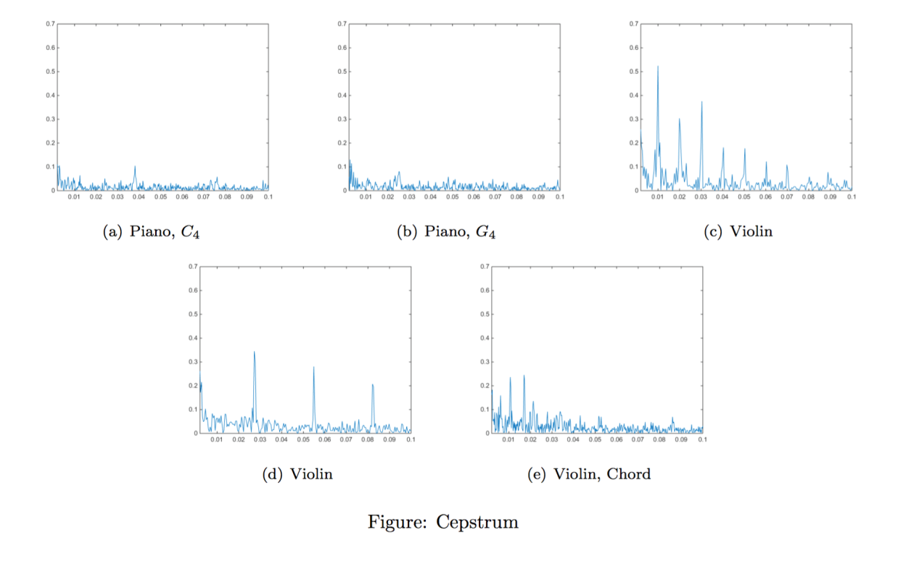
Cepstrum Peaks
How to measure the fluctuation of log-spectrum?
Peaks of its FFT (cepstrum).

Slide 19
Cepstrum Peaks
Does distinguish in a way.
Record heights of first 4 significant peaks
43% accuracy in 4-dim.

Slide 20
6-dim designed feature
53% accuracy in only 6-dim, for 6-classification.
Does decrease error by ¼ as auxiliary to LPC & MFCC.
By observation and attempt, enlighten our understanding of music.

Slide 21
Results
32-dim feature vector.
91% accuracy in 50/50 cross validation.
Generally less accurate in real music, due to noises, multiple instruments and different playing styles.
Better for piano, guitar and violin, moderate for flute, poor for trumpet and saxophone.
For those two, timbre is more variable with playing style, even pitch!

Slide 22
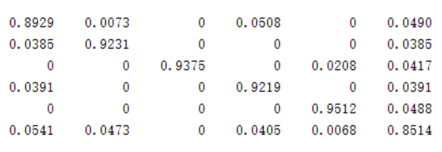
Results
Confusion matrix: (Guitar Saxophone Flute Piano Trumpet Violin)

Slide 23
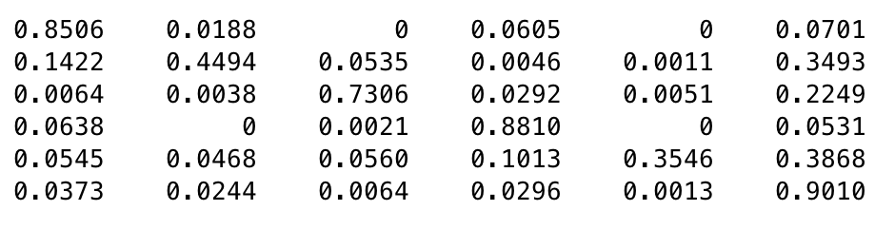
Results:
Confusion matrix when some “outlying” styles are add into dataset:

Slide 24
Future work
Robustness against noise to be improved.
Temporal analysis on notes to be adopted. (hopeful to increase accuracy in real-music)

Slide 25
Demo for real music

Slide 26
Music material in Demo:
Canon by Johann Pachelbel
Carrying you from Laputa: Castle in the Sky
《好想好想》 Violin Version
Mia & Seb’s Theme from La La Land
Edelweiss Saxophone Version
Sparkle from Your Name

Slide 27
Thanks!

