Slide 1
It Takes Two: A Peer-Prediction Solution to Blockchain Verifier’s Dilemma
Presenter: Zishuo Zhao University of Illinois Urbana-Champaign
Collaborators: Xi Chen (NYU Stern), Yuan Zhou (Tsinghua)
INFORMS Annual Meeting, October 2024

Slide 2
Artificial Intelligence: The New Moore’s Law
Deep Blue (1990s): AI for chess
AlphaGo (2017): AI for Go
ChatGPT (2022): AI for chatting…
Or everything?
Scaling Law: the capability of AI will improve consistently with the development of data, computing power and models.

Slide 3
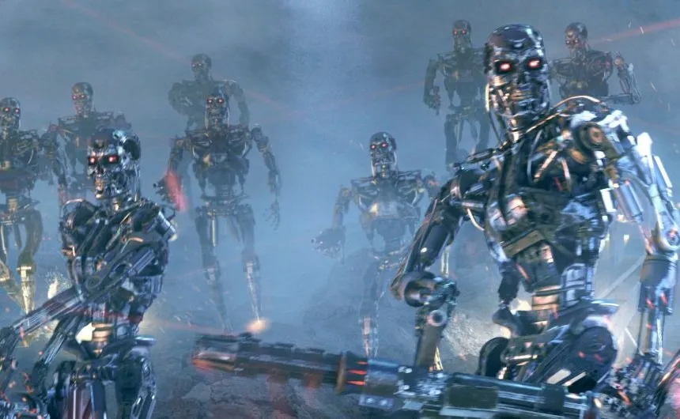
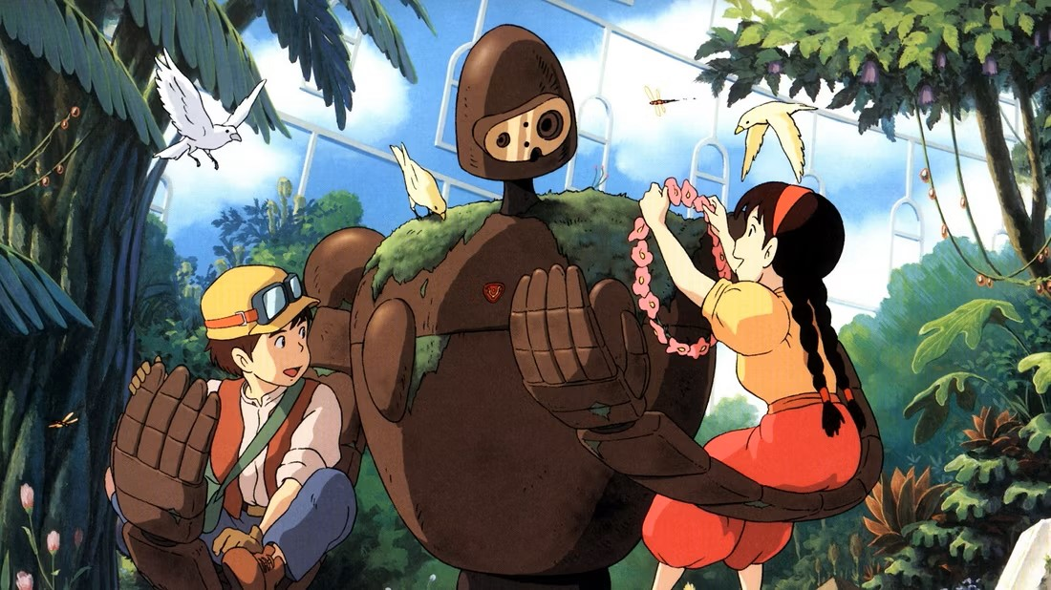
AI Safety: A Critical Concern in AGI Age
AI safety: the stronger AI becomes, the higher risk it might do evil.
AI alignment: make sure that AI’s behavior aligns with human interest.
But… How to ensure the AI is really aligned as claimed?

Slide 4
AI Safety: A Decentralized View
Conflict of Interest: if the AI is owned by a centralized party, the party may manipulate the alignment target for their interest.
Zishuo loves the person with SHA256(name)=0x5dc6dd7c…
Her Kayle fully evolves at level 15 instead of 16.
Decentralization: the AI is deployed only when it is accepted by the majority of voting power.
95% people think that committing suicide is immoral.
So our AI would not provide assistance to suicide attempts.
Blockchain: a decentralized platform aimed for trustworthiness.

Slide 5
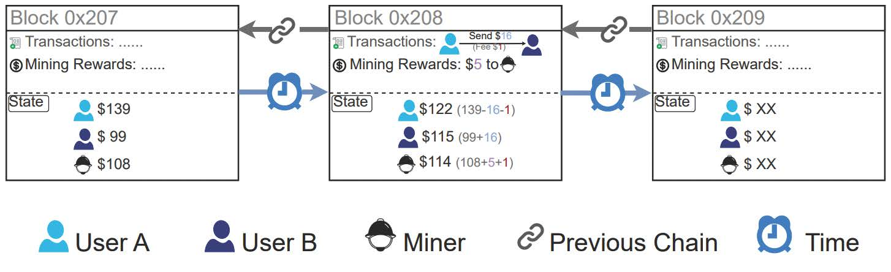
What is the Blockchain?
A growing linked-list stored in a decentralized way.
Each block: (Data, Prev_Hash (pointer), Certificate (PoW, PoS, …) )
The certificate works as an access control for the miner, an added block is valid only when the certificate passes verification.

Slide 6
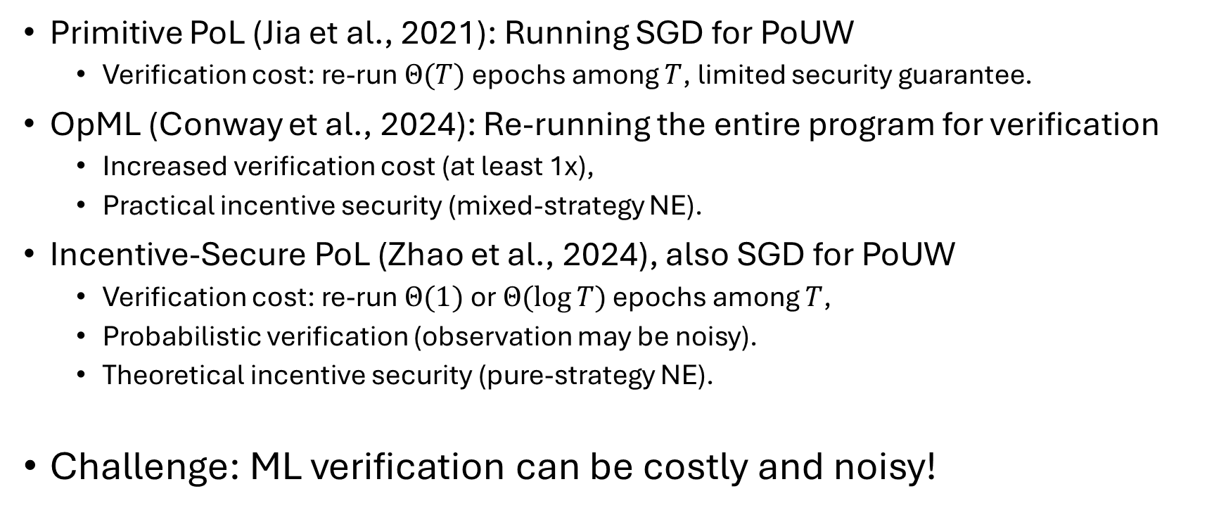
Verifiable AI Compute: Existing Work
Primitive PoL (Jia et al., 2021): Running SGD for PoUW
Verification cost: re-run $Θ(T)$ epochs among $T$, limited security guarantee.
OpML (Conway et al., 2024): Re-running the entire program for verification
Increased verification cost (at least 1x),
Practical incentive security (mixed-strategy NE).
Incentive-Secure PoL (Zhao et al., 2024), also SGD for PoUW
Verification cost: re-run $Θ(1)$ or $Θ(\log{T})$ epochs among $T$,
Probabilistic verification (observation may be noisy).
Theoretical incentive security (pure-strategy NE).
Challenge: ML verification can be costly and noisy!

Slide 7
Blockchain Security: Decentralized Consensus
What guarantees the security in a decentralized system?
Assuming the majority is honest. (i.e. no 51% attack)
Why would the majority choose be honest?
Are humans created good, or evil?
It works in some economic way…

Slide 8
Verifier’s Incentive?
If a mechanism is “well-designed”, then provers are prevented from cheating.
Verifiers are rewarded for catching cheats, or penalized for failing to.
But…
If no / too few provers actually cheat, why would verifiers verify, instead of lazily report “verification passed”?
Verifier’s Dilemma: For binary-report verification games with positive verification costs, it is impossible to achieve an honest pure-strategy Nash equilibrium.

Slide 9
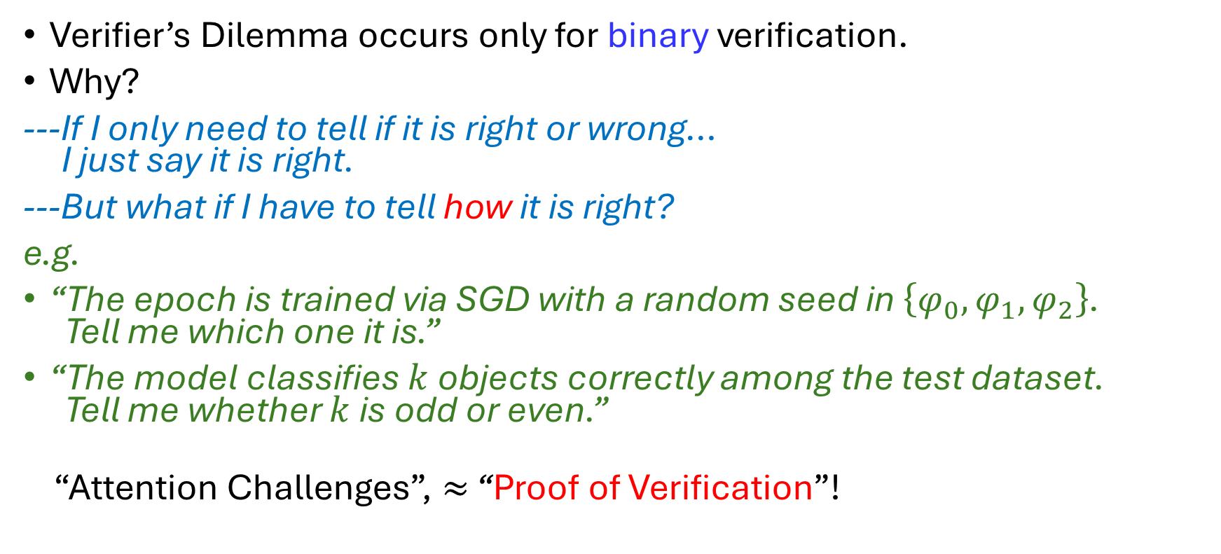
Verifier’s Dilemma: A Non-Binary Escape
Verifier’s Dilemma occurs only for binary verification.
Why?
---If I only need to tell if it is right or wrong… I just say it is right.
---But what if I have to tell how it is right?
e.g.
“The epoch is trained via SGD with a random seed in $\left\{φ_{0},φ_{1},φ_{2}\right\}$. Tell me which one it is.”
“The model classifies $k$ objects correctly among the test dataset. Tell me whether $k$ is odd or even.”
“Attention Challenges”, $≈$ “Proof of Verification”!

Slide 10
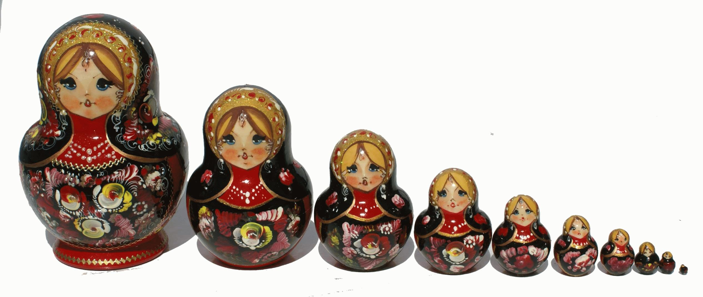
Attempted Solution: Capture-The-Flag
Existing works (e.g. Truebit): inject additional information (“flags”, non-binary verification) and reward detection of flags.
Can only prevent lazy behavior, but what about malicious “liars”?
If the verification result is also expensive to verify…
We need higher-level verifiers to verify the results.
How many layers of verifiers do we need?

Slide 11
Intuition: Decentralized Verification Game
Essential takeaway: verifiers also need to be verified.
---Can we just put them in equal positions to verify each other?
Close to our solution!

Slide 12


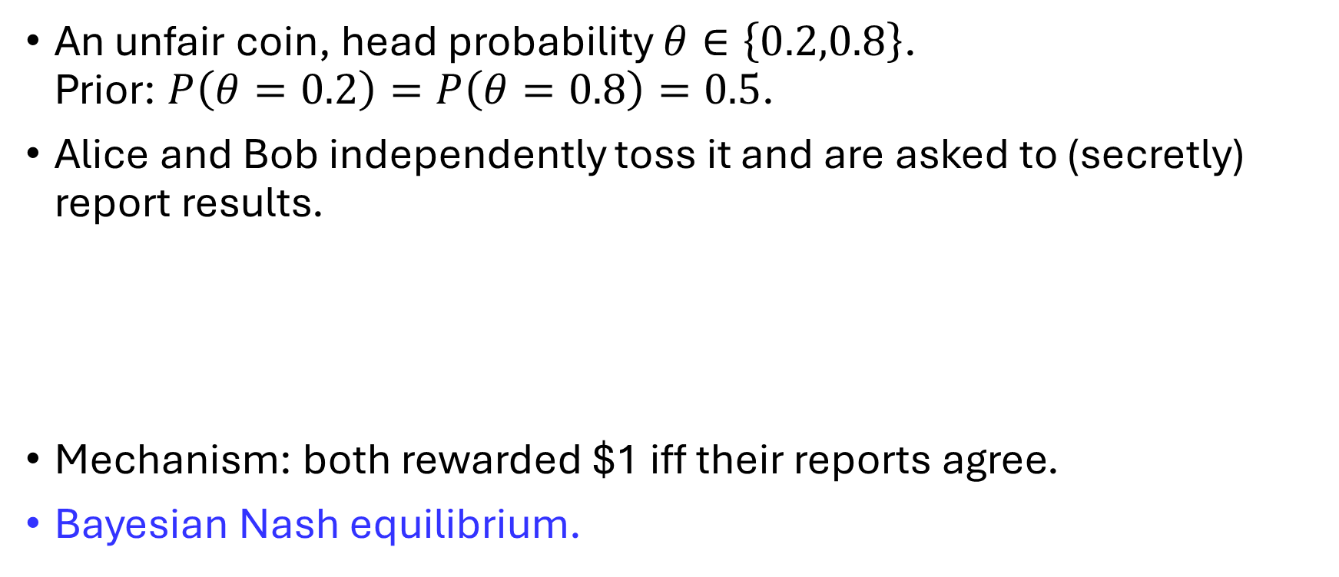
Peer Prediction: Toy Example
An unfair coin, head probability $θ∈\left\{0.2,0.8\right\}$. Prior: $P\left(θ=0.2\right)=P\left(θ=0.8\right)=0.5$.
Alice and Bob independently toss it and are asked to (secretly) report results.
Mechanism: both rewarded $1 iff their reports agree.
Bayesian Nash equilibrium.

Slide 13
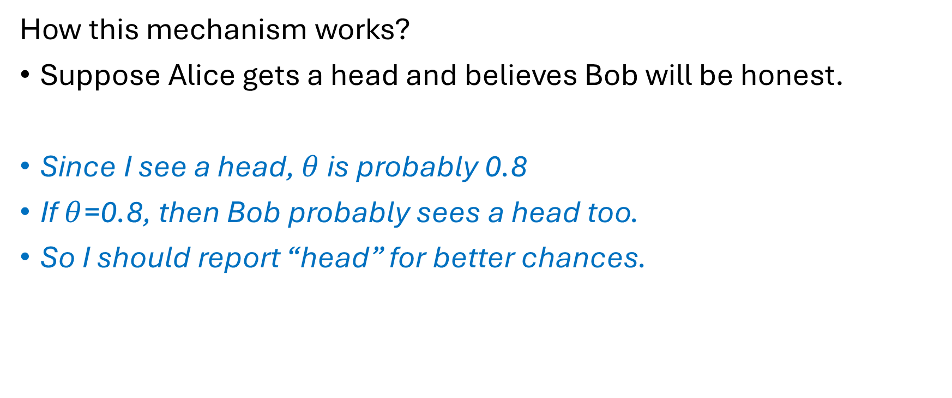
Peer Prediction: Toy Example (cont’d)
How this mechanism works?
Suppose Alice gets a head and believes Bob will be honest.
Since I see a head, $θ$ is probably 0.8
If $θ$=0.8, then Bob probably sees a head too.
So I should report “head” for better chances.

Slide 14
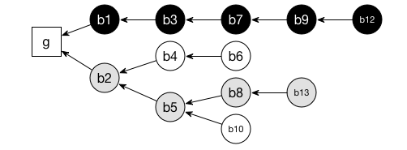
Peer Prediction: Nakamoto Consensus
I see this chain to be honest and longest so far... Other miners would probably also think so.
I get the block reward iff I’m on the longest chain...
So I will follow this chain.

Slide 15
Peer Prediction: Concept
Peer Prediction: information elicitation mechanisms incentivizing truthful report without access to ground truth.
What is the blockchain?
A (probably) fanciest application of (implicit) peer prediction!

Slide 16
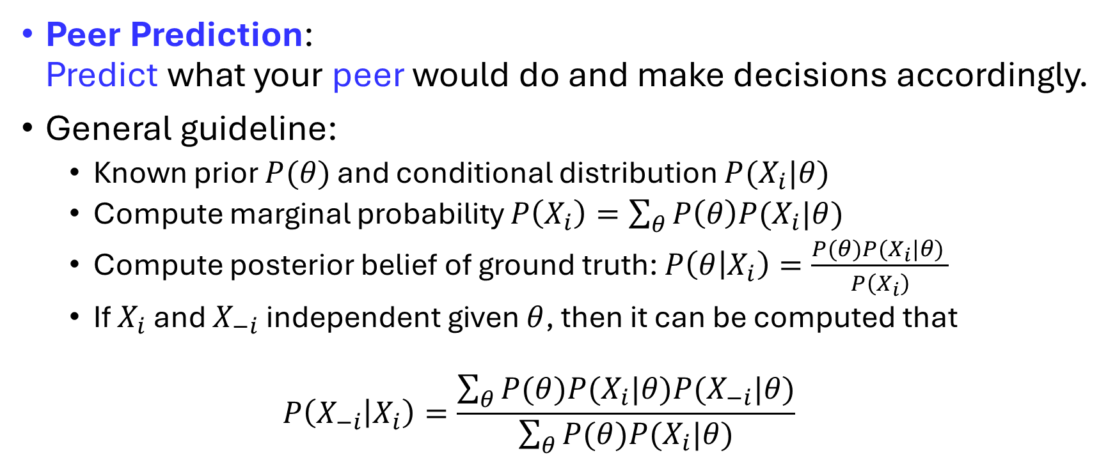
Peer Prediction: General Idea
Peer Prediction: Predict what your peer would do and make decisions accordingly.
General guideline:
Known prior $P(θ)$ and conditional distribution $P(X_{i}|θ)$
Compute marginal probability $P\left(X_{i}\right)=\sum_{θ}{P\left(θ\right)P(X_{i}|θ)}$
Compute posterior belief of ground truth: $P\left(θ | X_{i}\right)=\frac{P(θ)P(X_{i}|θ) }{P\left(X_{i}\right)}$
If $X_{i}$ and $X_{−i}$ independent given $θ$, then it can be computed that
$$P\left(X_{−i} | X_{i}\right)=\frac{\sum_{θ}{P(θ)P(X_{i}|θ)P(X_{−i}|θ)}}{\sum_{θ}{P(θ)P(X_{i}|θ)}}$$

Slide 17
CTF Peer Prediction: Theoretical Guarantees
Main Theorem: For any non-degenerate 2-party decentralized verification games, there exists a peer prediction mechanism satisfying all the desired properties.
How to generalize to multi-party DVG?
Match each party with everyone else and take the average!
@Mean-field games
How to find the mechanism?
Linear Programming!

Slide 18
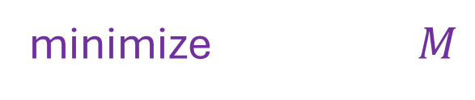
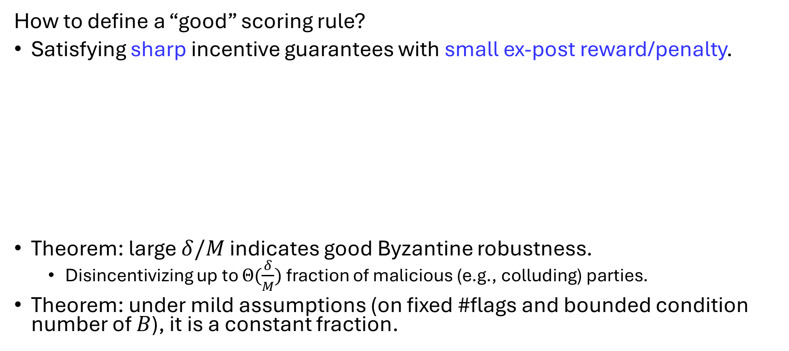

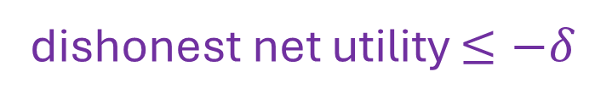
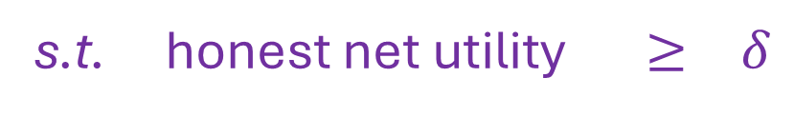
CTF Peer Prediction: Optimization
How to define a “good” scoring rule?
Satisfying sharp incentive guarantees with small ex-post reward/penalty.
Theorem: large $δ/M$ indicates good Byzantine robustness.
Disincentivizing up to $Θ(\frac{δ}{M})$ fraction of malicious (e.g., colluding) parties.
Theorem: under mild assumptions (on fixed #flags and bounded condition number of $B$), it is a constant fraction.
minimize $M$
s.t. honest net utility $≥ δ$
dishonest net utility $≤−δ$
$|T|$ $≤ M$

Slide 19
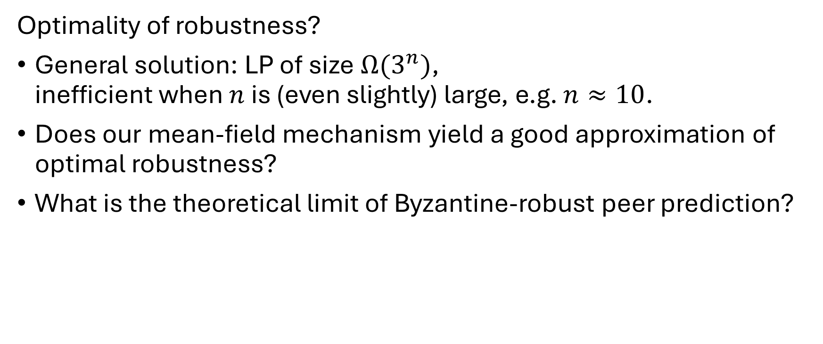
Discussion: Future Work
Optimality of robustness?
General solution: LP of size $Ω(3^{n})$, inefficient when $n$ is (even slightly) large, e.g. $n≈10$.
Does our mean-field mechanism yield a good approximation of optimal robustness?
What is the theoretical limit of Byzantine-robust peer prediction?

Slide 20
Q&A

