Slide 1

Bayesian Mechanism Design for Blockchain Transaction Fee Allocation
Xi Chen, David Simchi-Levi, Zishuo Zhao, Yuan Zhou
Operations Research (2025), https://arxiv.org/abs/2209.13099

Slide 2
Decentralized Platforms: Blockchain
Blockchain: distributed & growing database
Blocks contain transactions, states are implicit from history
State @ 0x207
Zishuo: 139
Xi: 99
Yuan: 108
State @ 0x208
Zishuo: 122 (139-16-1)
Xi: 115 (99+16)
Yuan: 114 (108+5+1)
Block 0x207
……
Block 0x208
Mined by: Yuan
Transactions:
Zishuo->Xi 16 (fee: 1)
Mining reward: 5
Block 0x209
……

Slide 3
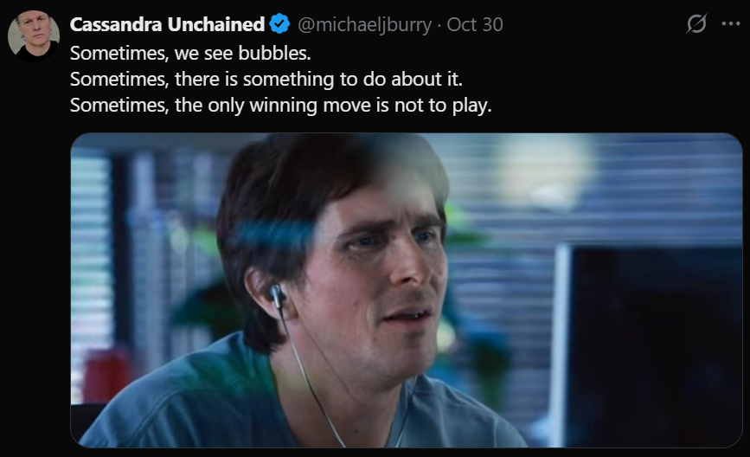



How (and why) does a blockchain work?
Every node stores a copy and maintains a consensus.
Why decentralized? Wasting space (and computation)?
Oct 20, 2025
Oct 29, 2025
Nov 17, 2025
Who, and when?

Slide 4
How does the consensus work?
Every node wants to get access to a block (and Bitcoins)!
Thanks for your interest in mining the block.
Unfortunately, due to large demands on the network and limited positions we can accommodate, we have to make difficult decisions to move forward with those candidates who…
have earned higher GPA? Or published more papers?
Proof-of-Work (PoW): you need to “do something” to win it!

Slide 5
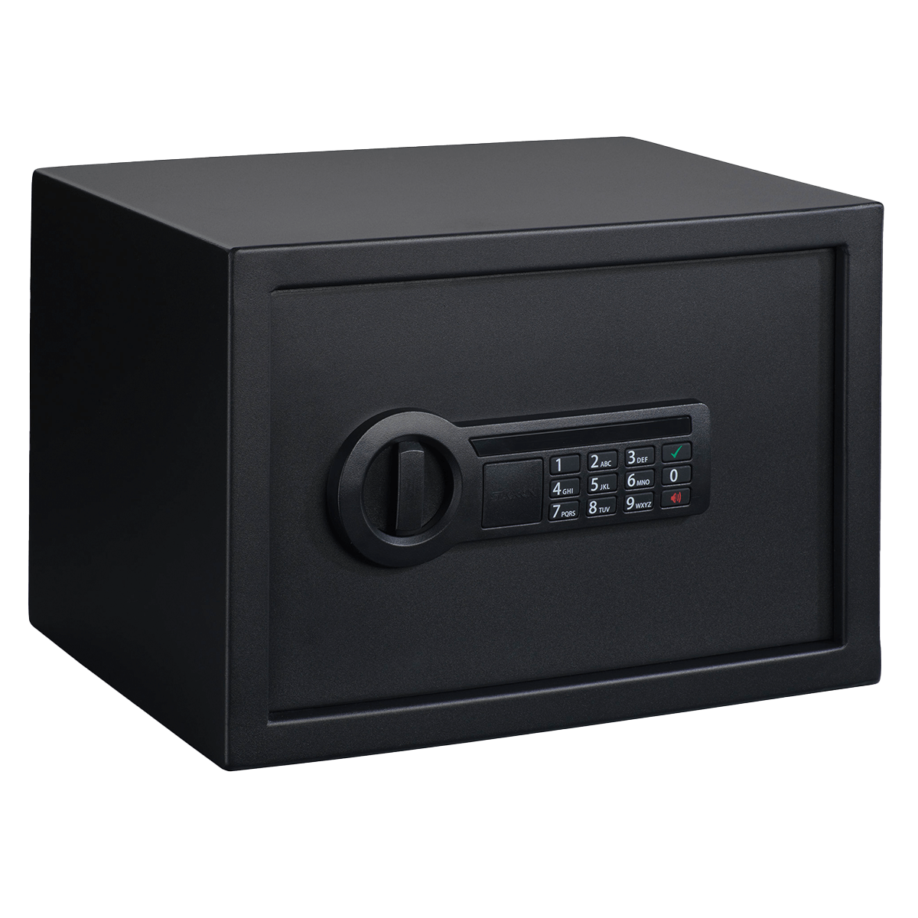
Consensus in Bitcoin: Proof-of-Work
Bitcoin PoW (“mining”):
“To access the block, find Nonce s.t.
Hash(Data, Prev_Hash, Nonce) < Thres
before other players!”
Whoever finds a correct password first,
gets the block and Bitcoins!
BITCOINS INSIDE
Hard to guess a password, but easy to verify it.
Everyone (honest) will agree on the winner.

Slide 6
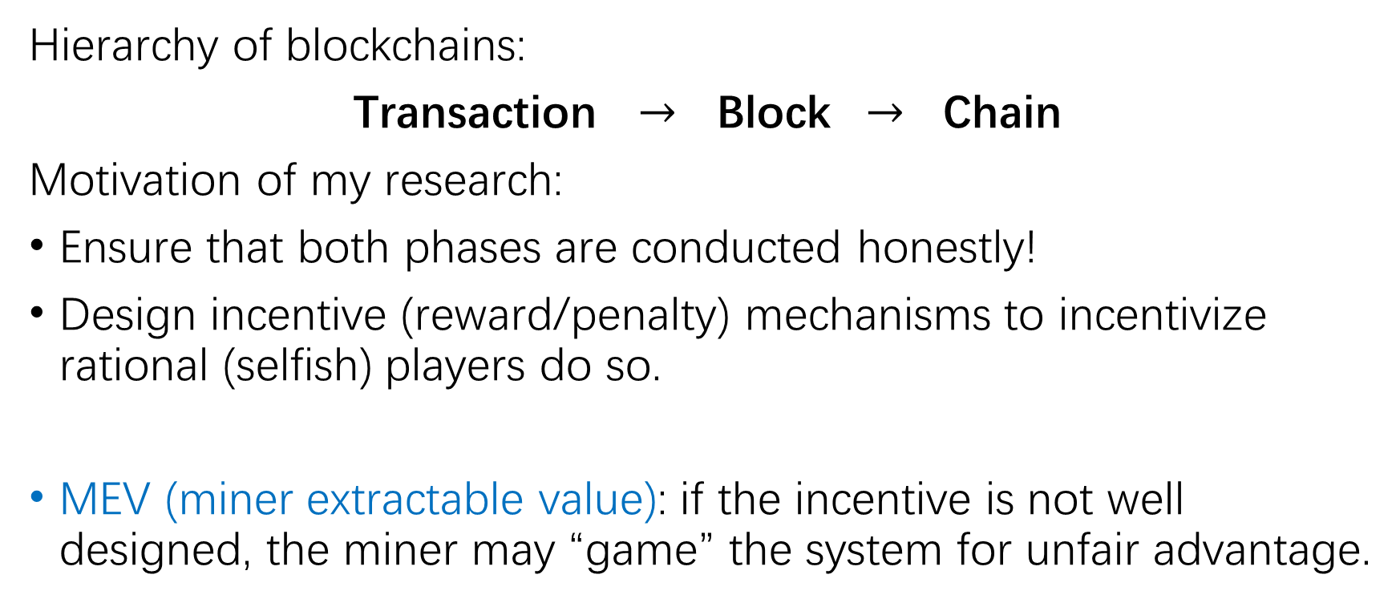
Incentive Design on Blockchain Systems
Hierarchy of blockchains:
Transaction $→$ Block $→$ Chain
Motivation of my research:
Ensure that both phases are conducted honestly!
Design incentive (reward/penalty) mechanisms to incentivize rational (selfish) players do so.
MEV (miner extractable value): if the incentive is not well designed, the miner may “game” the system for unfair advantage.

Slide 7
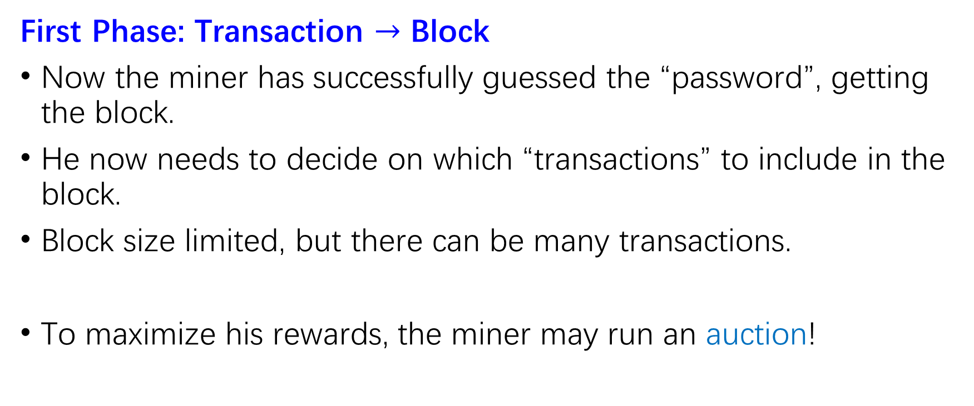
Transaction Fee Mechanism Design
First Phase: Transaction $→$ Block
Now the miner has successfully guessed the “password”, getting the block.
He now needs to decide on which “transactions” to include in the block.
Block size limited, but there can be many transactions.
To maximize his rewards, the miner may run an auction!

Slide 8
Transaction Fee Mechanism Design
Auction: users bid, mechanism decides
  -- who to confirm
  -- how much transaction fee (“gas fee”) to charge
  -- what fraction (or all) of fees are given to the miner
When “fraction”, some fees are “burnt” and removed from the system.
  Why we “burn” transaction fees? Let’s see!
Transaction Fee Mechanism (TFM) Design

Slide 9
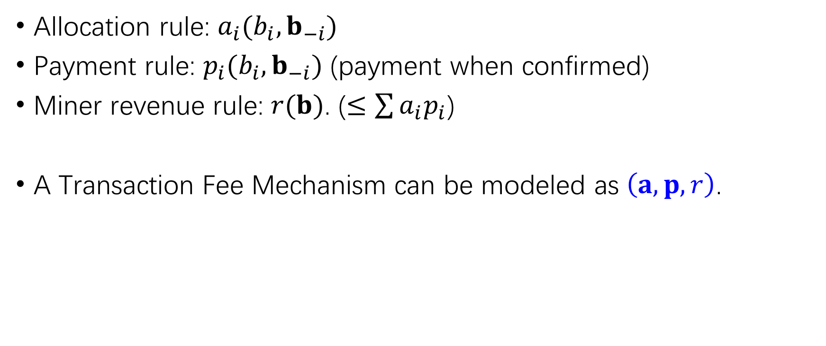
Modeling of Transaction Fee Mechanisms
Allocation rule: $a_{i}(b_{i},b_{−i})$
Payment rule: $p_{i}(b_{i},b_{−i})$ (payment when confirmed)
Miner revenue rule: $r(b)$. ($≤\sum{a_{i}p_{i}}$)
A Transaction Fee Mechanism can be modeled as $\left(a,p,r\right)$.

Slide 10
TFMs on Existing Blockchains
Bitcoin: Multi-slot first-price (pay-as-bid) auction
Highest bids included; user pay bids to miner.
Not truthful: users tend to bid lower than their valuation (willingness-to-pay).
Can we use second-price auction as it is truthful?
But it is subject to miner-user collusion…
10 9 8 7
10 9.99 8 7

Slide 11
TFM on Ethereum: EIP-1559
The system decides on a “base fee” (via congestion pricing) based on historical data.
Users may add a “tip” beside the base fee.
The base fee expects to prevent congestion and is burnt.
It incorporates “burning”: relaxing equality budget constraints to inequality, widening decision space.

Slide 12
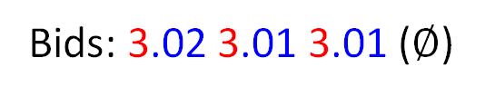
Example of EIP-1559
Block size 4, base fee 3
Can we possibly get more revenue to incentivize mining?
No Congestion:
Congestion:
Bids: 3.02 3.01 3.01 ($∅$)
Bids: 3.8 3.7 3.5 3.4 3.3
Total Burning: 9
Total Burning: 12
Miner Revenue: 0.04
Miner Revenue: 2.4
We want this!

Slide 13
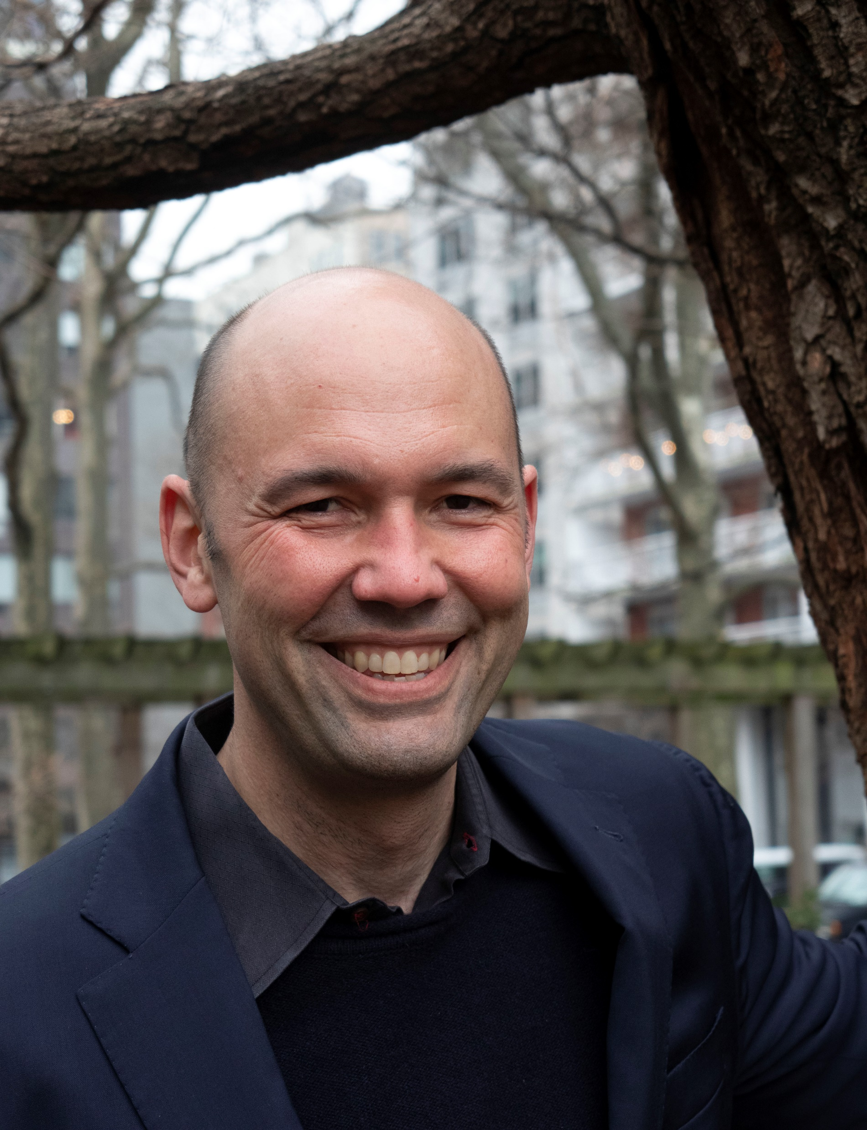

Transaction Fee Mechanism Design
How to design a transaction fee mechanism which satisfies incentive and collusion-proof guarantees?
Transaction Fee Mechanism Design, Tim Roughgarden
Can we possibly design a “dream” mechanism with these guarantees and also has good miner revenue?
Foundations of Transaction Fee Mechanism Design, H. Chung & E. Shi

Slide 14
Strategy Space of Players
 | Untruthful Bids (UB) | Fake Transactions (FT) | Transaction Deletion (TD)
Individual User (U) | U-UB | U-FT | ---
Individual Miner (M) | --- | M-FT | M-TD
Miner and c Users (MU^{c}) | MU^{c}-UB | MU^{c}-FT | MU^{c}-TD
c Users (U^{c}) | U^{c}-UB | U^{c}-FT | ---

Slide 15
Strategy Space of Players
We mainly consider:
Untruthful bidding: a user bids different from their valuation.
1-1 collusion: one user collude with the miner in untruthful bidding, to increase their total utility.
  The simplest form of MEV.
If we cannot prevent the simplest collusion, we cannot prevent more complicate collusion (and MEV) either.

Slide 16
Challenges of TFM Design
DSIC + Collusion-proof-> Zero Revenue (Chung & Shi, 2021)
Chung & Shi (2021): Relax the user utility in a multi-block setting for positive revenue
Motivation: find a reasonable (and mild) relaxation to break the zero-revenue barrier?

Slide 17

Challenges of TFM Design: Why?
First-order conditions:
DSIC: ${\left.\frac{∂}{∂b_{i}}u_{i}\right|}_{b_{i}=v_{i}}=0.$
1-SCP: ${\left.\frac{∂}{∂b_{i}}(u_{i}+u_{miner})\right|}_{b_{i}=v_{i}}=0.$
Hence, $\frac{∂}{∂b_{i}}u_{miner}=0.$
$⇒ u_{miner}≡0.$

Slide 18
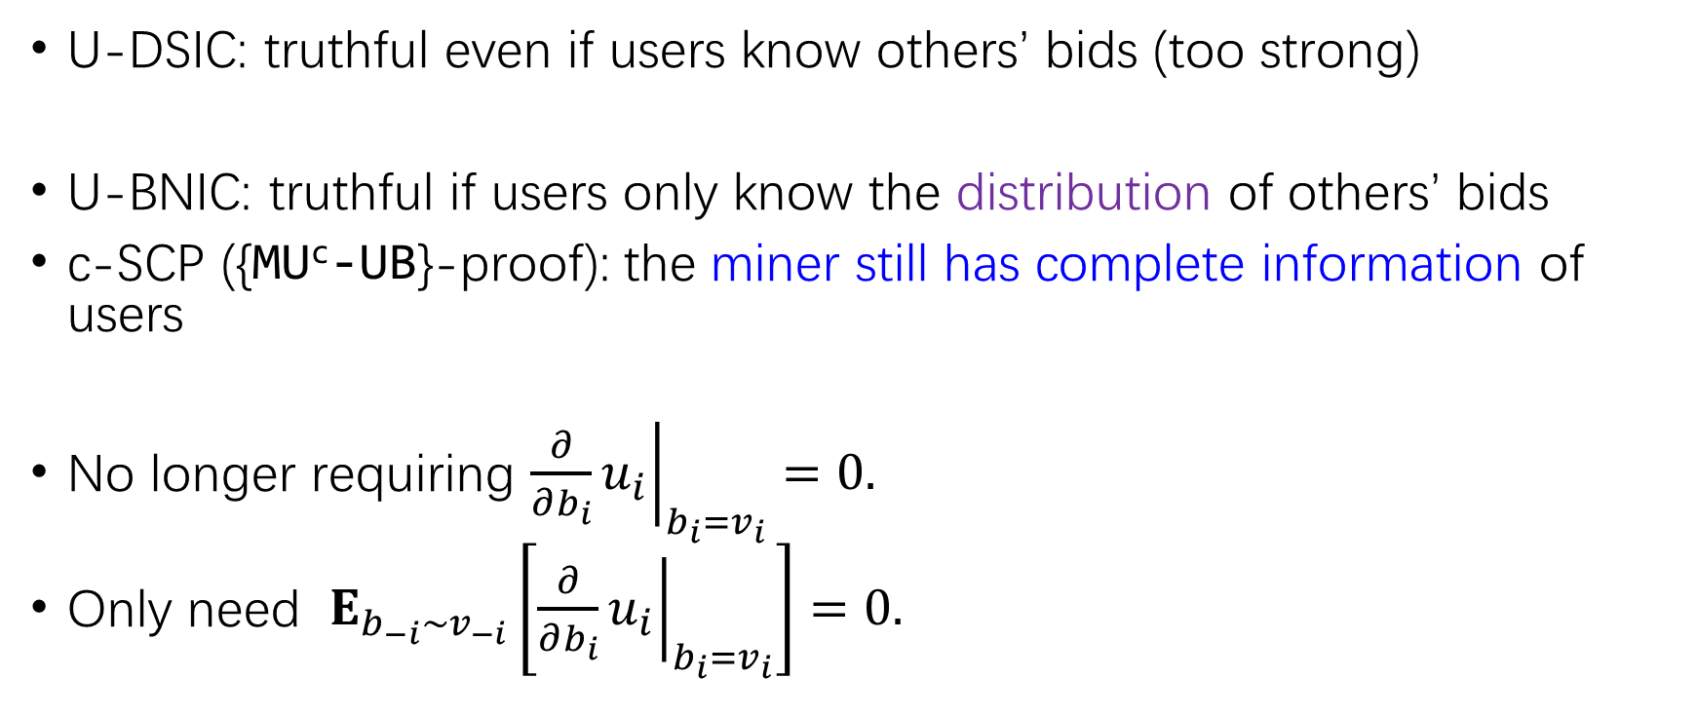
Bayesian-Game Relaxation
U-DSIC: truthful even if users know others’ bids (too strong)
U-BNIC: truthful if users only know the distribution of others’ bids
c-SCP ({MU^{c}-UB}-proof): the miner still has complete information of users
No longer requiring ${\left.\frac{∂}{∂b_{i}}u_{i}\right|}_{b_{i}=v_{i}}=0.$
Only need $E_{b_{−i}\sim v_{−i}}\left[{\left.\frac{∂}{∂b_{i}}u_{i}\right|}_{b_{i}=v_{i}}\right]=0.$

Slide 19
Information Sets?
BNIC mechanism needs users to NOT know others’ bids.
Naïve blockchain application: users can see bids before them, but not after.
MS reviewers: how can you implement sealed bids???
Cryptographic scheme: commitment
Simple explanation: propose encrypted bids first and reveal later.

Slide 20
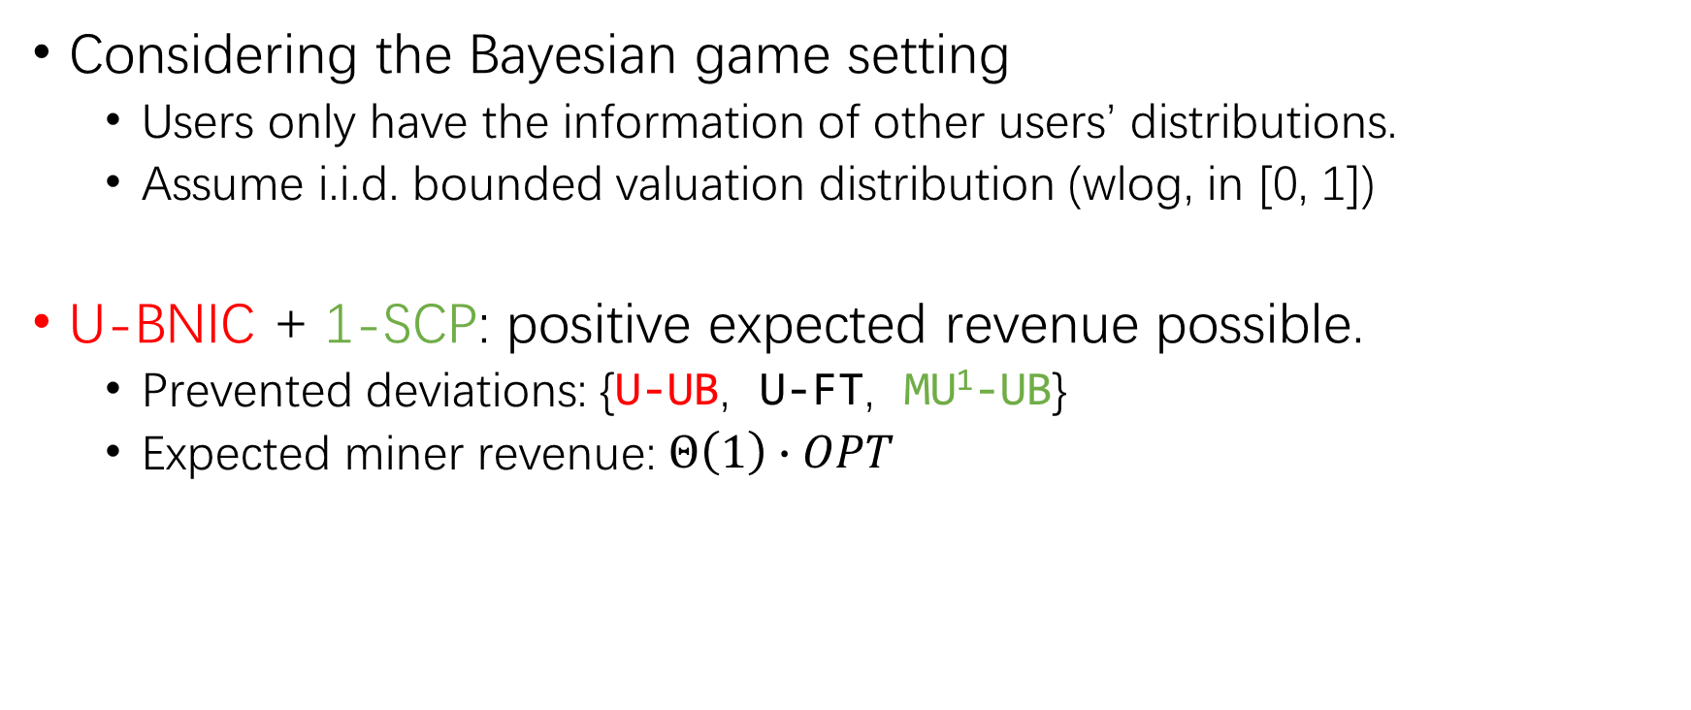
Our Work: Overview
Considering the Bayesian game setting
  Users only have the information of other users’ distributions.
  Assume i.i.d. bounded valuation distribution (wlog, in [0, 1])
U-BNIC + 1-SCP: positive expected revenue possible.
  Prevented deviations: {U-UB, U-FT, MU¹-UB}
  Expected miner revenue: $Θ\left(1\right)∙OPT$

Slide 21
A look into Bayesian mechanisms
First-price auctions are not truthful
  Bidders tend to bid lower than their valuation.
How much lower?
  It depends on settings.

Slide 22
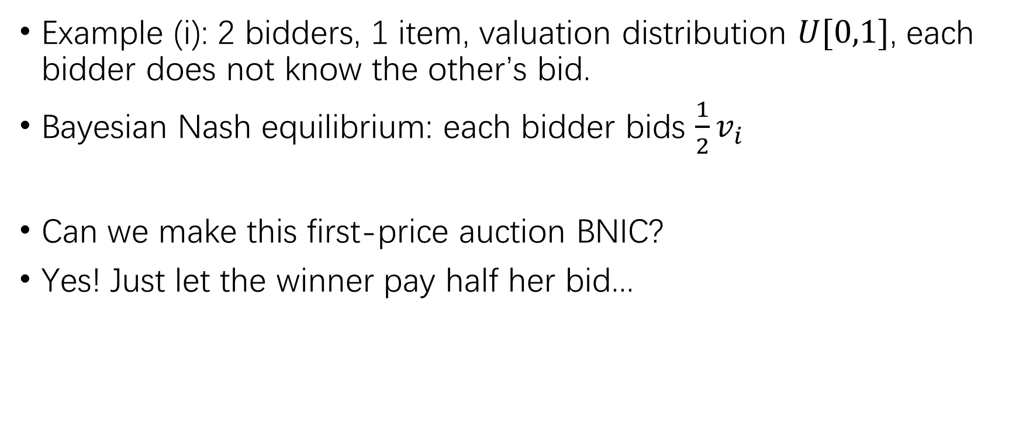
Variants of First-Price Auction (i)
Example (i): 2 bidders, 1 item, valuation distribution $U[0,1]$, each bidder does not know the other’s bid.
Bayesian Nash equilibrium: each bidder bids $\frac{1}{2}v_{i}$
Can we make this first-price auction BNIC?
Yes! Just let the winner pay half her bid...
Revelation Principle
(Informally) For any mechanism, we can construct an equivalent direct truthful mechanism by incorporating agents’ strategies into the mechanism itself.
“Tell me what you think, and I would lie for you.”

Slide 23
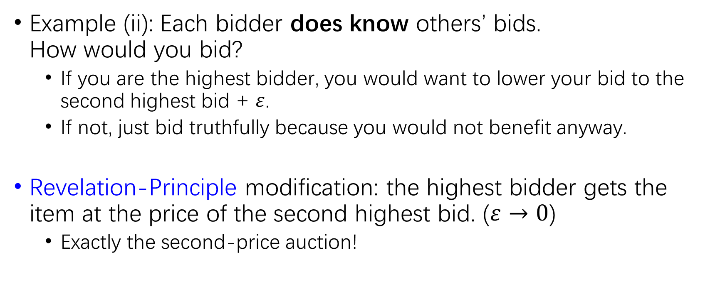
Variants of First-Price Auction (ii)
Example (ii): Each bidder does know others’ bids.
How would you bid?
  If you are the highest bidder, you would want to lower your bid to the second highest bid + $ε$.
  If not, just bid truthfully because you would not benefit anyway.
Revelation-Principle modification: the highest bidder gets the item at the price of the second highest bid. ($ε→0$)
  Exactly the second-price auction!

Slide 24
Comparison of Two Variants
Difference in allocation?
  No difference. The bidder with higher valuation gets the item.
Difference in payment?
  In (i), the winner pays half her valuation.
  In (ii), the winner pays the loser’s valuation.
  Observation: on expectation, the payment is also the same!
Intuition: the DSIC mechanism (ii) is “somehow equivalent” to the BNIC mechanism (i). (Revenue Equivalence Theorem)

Slide 25
“Revenue” Equivalence (or not)?
For traditional auctions,
The same allocation + i.i.d. distribution -> the same revenue.
For blockchain Transaction Fee Mechanism,
Not all “revenue” awarded to miner, some (all, if U-DSIC + 1-SCP) burnt!
Possible to increase miner revenue while decreasing burning.

Slide 26
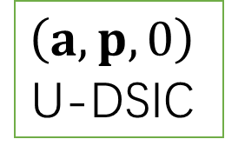
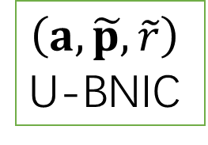
Auxiliary Mechanism Method
Our main technique: Auxiliary Mechanism Method
From a U-BNIC mechanism, we can construct an “auxiliary” U-DSIC mechanism with the same allocation rule and look into the difference between them.
From a U-DSIC mechanism, we can in turn “perturbate” its payment rule to construct a U-BNIC mechanism, in hope that it has better properties in miner revenues (more generally, scopes other than truthfulness).
Auxiliary
$$\left(a, p,0\right)$$
U-DSIC
$$\left(a, \tilde{p}, \tilde{r}\right)$$
U-BNIC
Perturbation

Slide 27
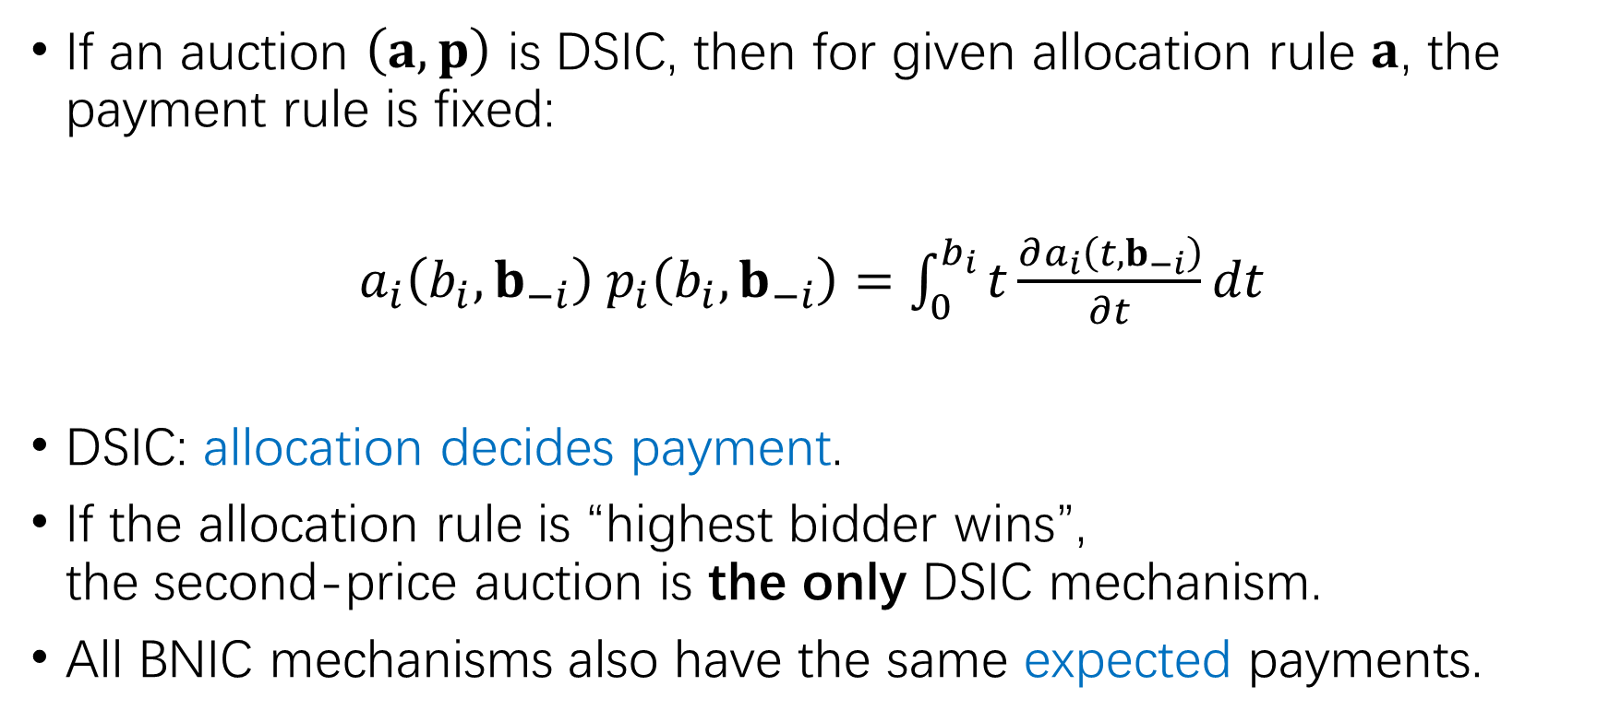
Basis: Myerson’s Lemma
If an auction $\left(a, p\right)$ is DSIC, then for given allocation rule $a$, the payment rule is fixed:
$a_{i}\left(b_{i},b_{−i}\right) p_{i}\left(b_{i},b_{−i}\right)=$ $\int_{0}^{b_{i}}{t\frac{∂a_{i}\left(t,b_{−i}\right)}{∂t}dt}$
DSIC: allocation decides payment.
If the allocation rule is “highest bidder wins”,
the second-price auction is the only DSIC mechanism.
All BNIC mechanisms also have the same expected payments.

Slide 28
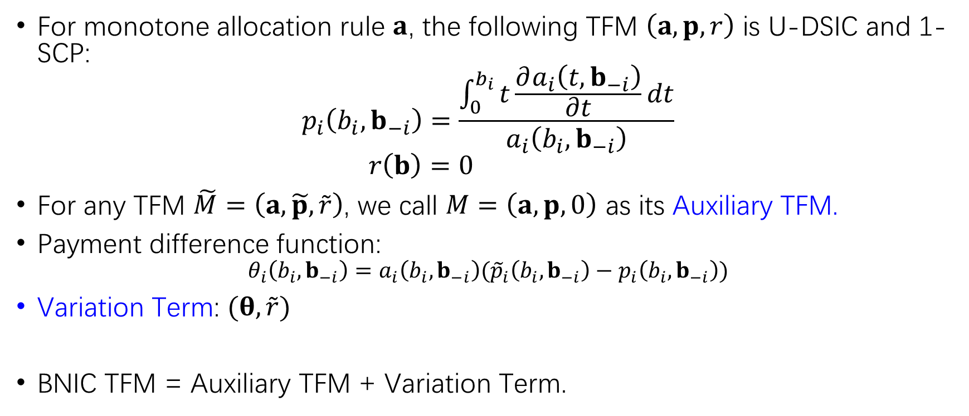
Construction of Auxiliary Mechanism
For monotone allocation rule $a$, the following TFM $\left(a,p,r\right)$ is U-DSIC and 1-SCP:
$$p_{i}\left(b_{i},b_{−i}\right)=\frac{\int_{0}^{b_{i}}{t\frac{∂a_{i}\left(t,b_{−i}\right)}{∂t}dt}}{a_{i}\left(b_{i},b_{−i}\right)}$$
$$r\left(b\right)=0$$
For any TFM $\tilde{M}=\left(a, \tilde{p}, \tilde{r}\right)$, we call $M=\left(a,p,0\right)$ as its Auxiliary TFM.
Payment difference function:
$$θ_{i}\left(b_{i},b_{−i}\right)=a_{i}\left(b_{i},b_{−i}\right)({\tilde{p}}_{i}\left(b_{i},b_{−i}\right)−p_{i}\left(b_{i},b_{−i}\right))$$
Variation Term: $(θ,\tilde{r})$
BNIC TFM = Auxiliary TFM + Variation Term.

Slide 29
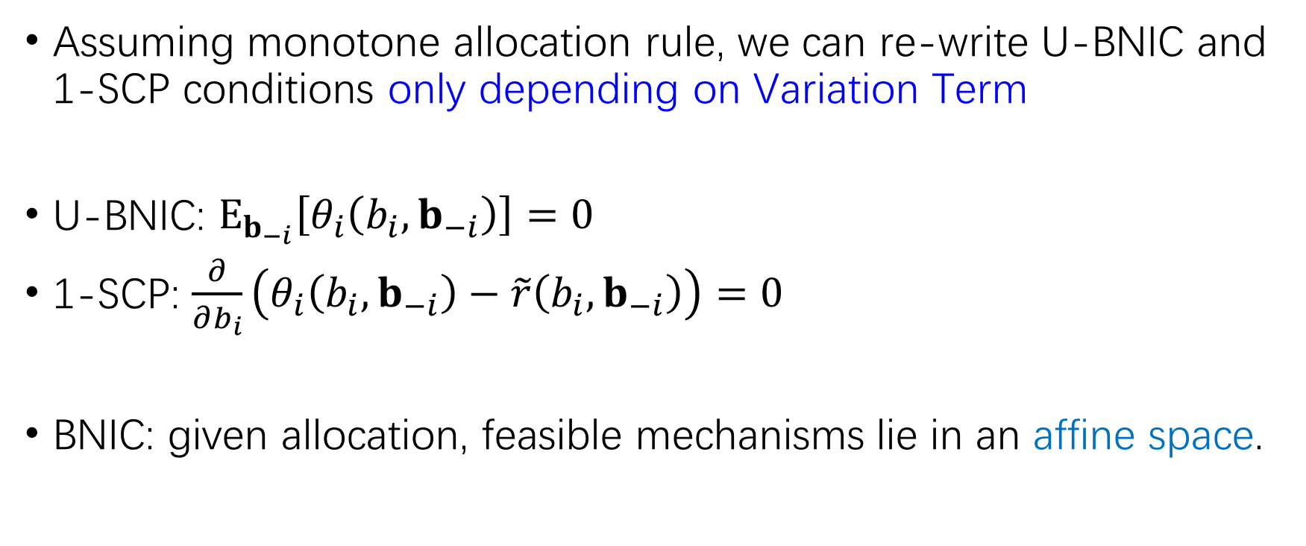
Conditions of U-BNIC and 1-SCP
Assuming monotone allocation rule, we can re-write U-BNIC and 1-SCP conditions only depending on Variation Term
U-BNIC: $E_{b_{−i}}\left[θ_{i}\left(b_{i},b_{−i}\right)\right]=0$
1-SCP: $\frac{∂}{∂b_{i}}\left(θ_{i}\left(b_{i},b_{−i}\right)−\tilde{r}\left(b_{i},b_{−i}\right)\right)=0$
BNIC: given allocation, feasible mechanisms lie in an affine space.
We can construct AM and VT separately!

Slide 30

Construction of Main Mechanism
Construction for Block Size 1
Extension for Block Size $k$ (Overview)

Slide 31
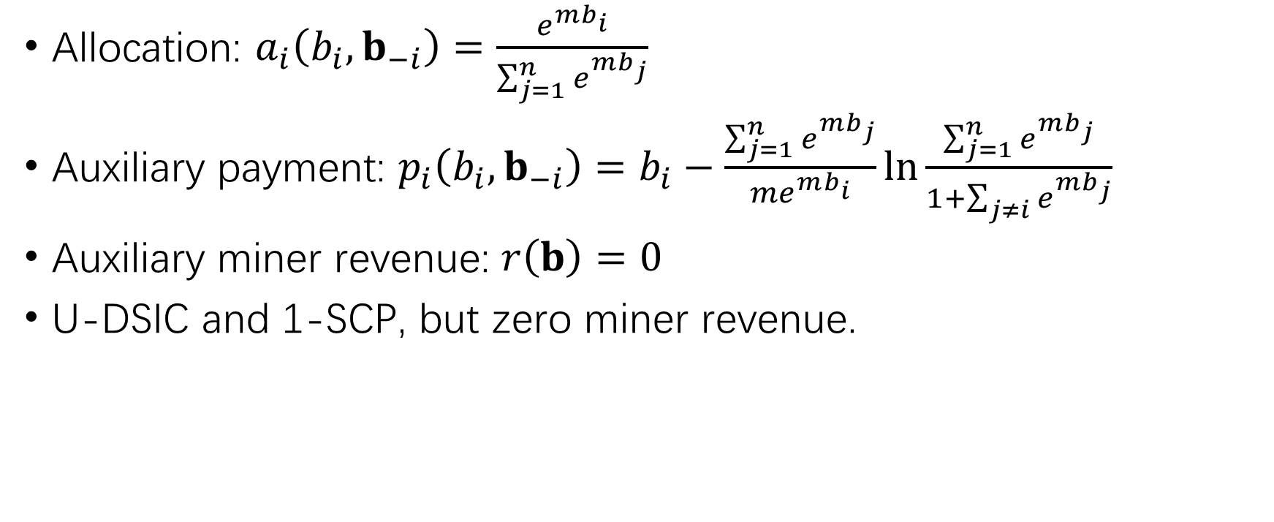
Construction for Block Size 1: Auxiliary
Allocation: $a_{i}\left(b_{i},b_{−i}\right)=\frac{e^{mb_{i}}}{\sum_{j=1}^{n}{e^{mb_{j}}}}$
Auxiliary payment: $p_{i}\left(b_{i},b_{−i}\right)=b_{i}−\frac{\sum_{j=1}^{n}{e^{mb_{j}}}}{{me}^{mb_{i}}}ln\frac{\sum_{j=1}^{n}{e^{mb_{j}}}}{1+\sum_{j≠i}{e^{mb_{j}}}}$
Auxiliary miner revenue: $r\left(b\right)=0$
U-DSIC and 1-SCP, but zero miner revenue.

Slide 32
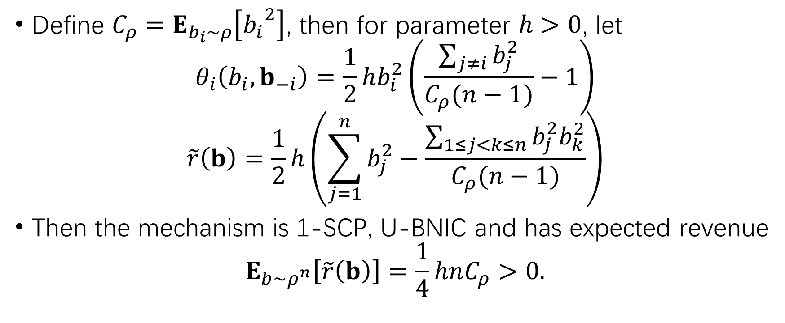
Construction for Block Size 1: Variation Term
Define $C_{ρ}=E_{b_{i}\sim ρ}\left[{b_{i}}^{2}\right]$, then for parameter $h>0$, let
$$θ_{i}\left(b_{i},b_{−i}\right)=\frac{1}{2}hb_{i}^{2}\left(\frac{\sum_{j≠i}{b_{j}^{2}}}{C_{ρ}(n−1)}−1\right)$$
$$\tilde{r}\left(b\right)=\frac{1}{2}h\left(\sum_{j=1}^{n}{b_{j}^{2}}−\frac{\sum_{1≤j<k≤n}{b_{j}^{2}b_{k}^{2}}}{C_{ρ}(n−1)}\right)$$
Then the mechanism is 1-SCP, U-BNIC and has expected revenue
$$E_{b\sim ρ^{n}}\left[\tilde{r}\left(b\right)\right]=\frac{1}{4}hnC_{ρ}>0.$$

Slide 33
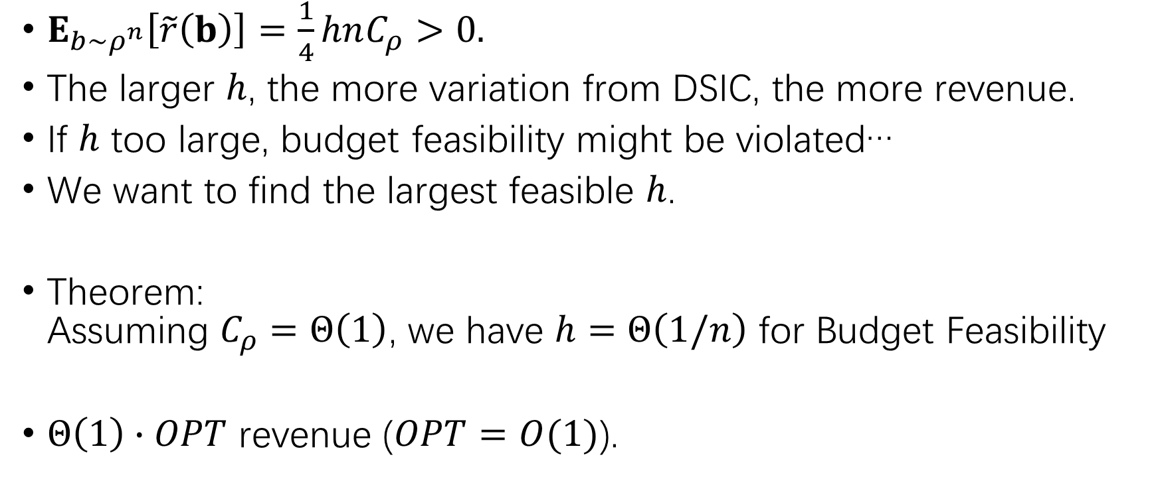
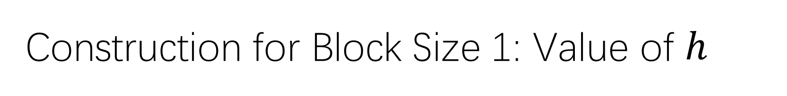
Construction for Block Size 1: Value of $h$
$E_{b\sim ρ^{n}}\left[\tilde{r}\left(b\right)\right]=\frac{1}{4}hnC_{ρ}>0.$
The larger $h$, the more variation from DSIC, the more revenue.
If $h$ too large, budget feasibility might be violated…
We want to find the largest feasible $h$.
Theorem:
Assuming $C_{ρ}=Θ\left(1\right)$, we have $h=Θ\left(1/n\right)$ for Budget Feasibility
$Θ\left(1\right)∙OPT$ revenue ($OPT=O(1)$).

Slide 34
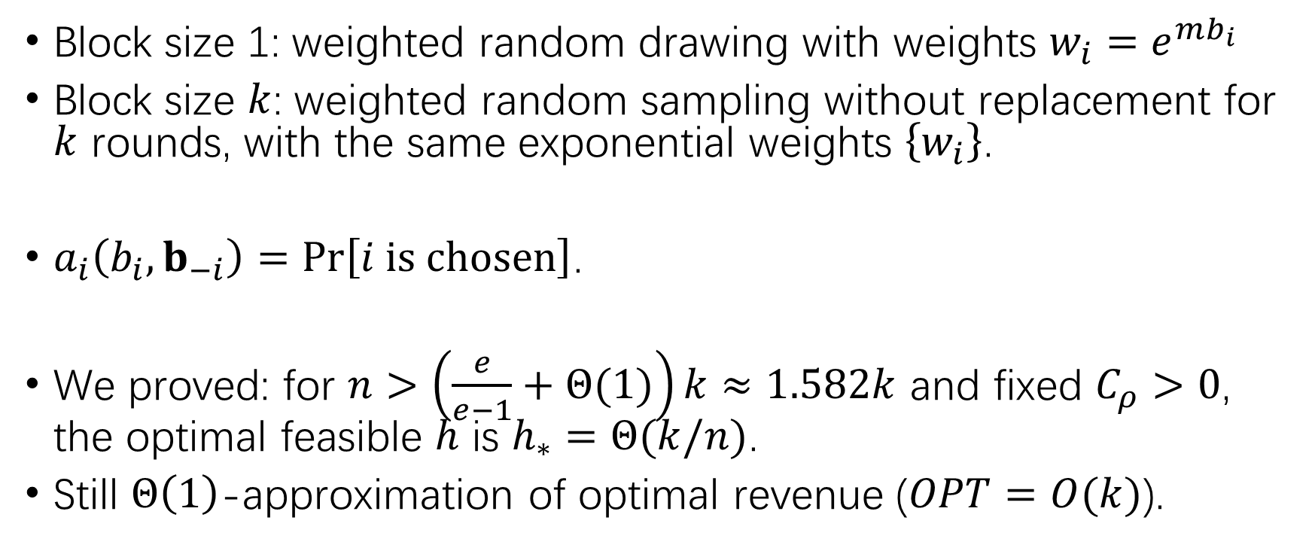

Extension for Block Size $k$: Overview
Block size 1: weighted random drawing with weights $w_{i}=e^{mb_{i}}$
Block size $k$: weighted random sampling without replacement for $k$ rounds, with the same exponential weights $\left\{w_{i}\right\}$.
$a_{i}\left(b_{i},b_{−i}\right)=Pr\left[i is chosen\right]$.
We proved: for $n>\left(\frac{e}{e−1}+Θ(1)\right)k≈1.582k$ and fixed $C_{ρ}>0$, the optimal feasible $h$ is $h_{∗}=Θ(k/n)$.
Still $Θ\left(1\right)$-approximation of optimal revenue ($OPT=O(k)$).

Slide 35
Methodology: Parametric Mechanism Optimization
It may be tricky to optimize mechanisms in a function space.
But if we can find a parametric subspace of feasible mechanisms…
We can do optimization in the parametric subspace!
But we “lose” some domain of decision variables.
We still need a “good” subspace for better approximation to optimality.

Slide 36
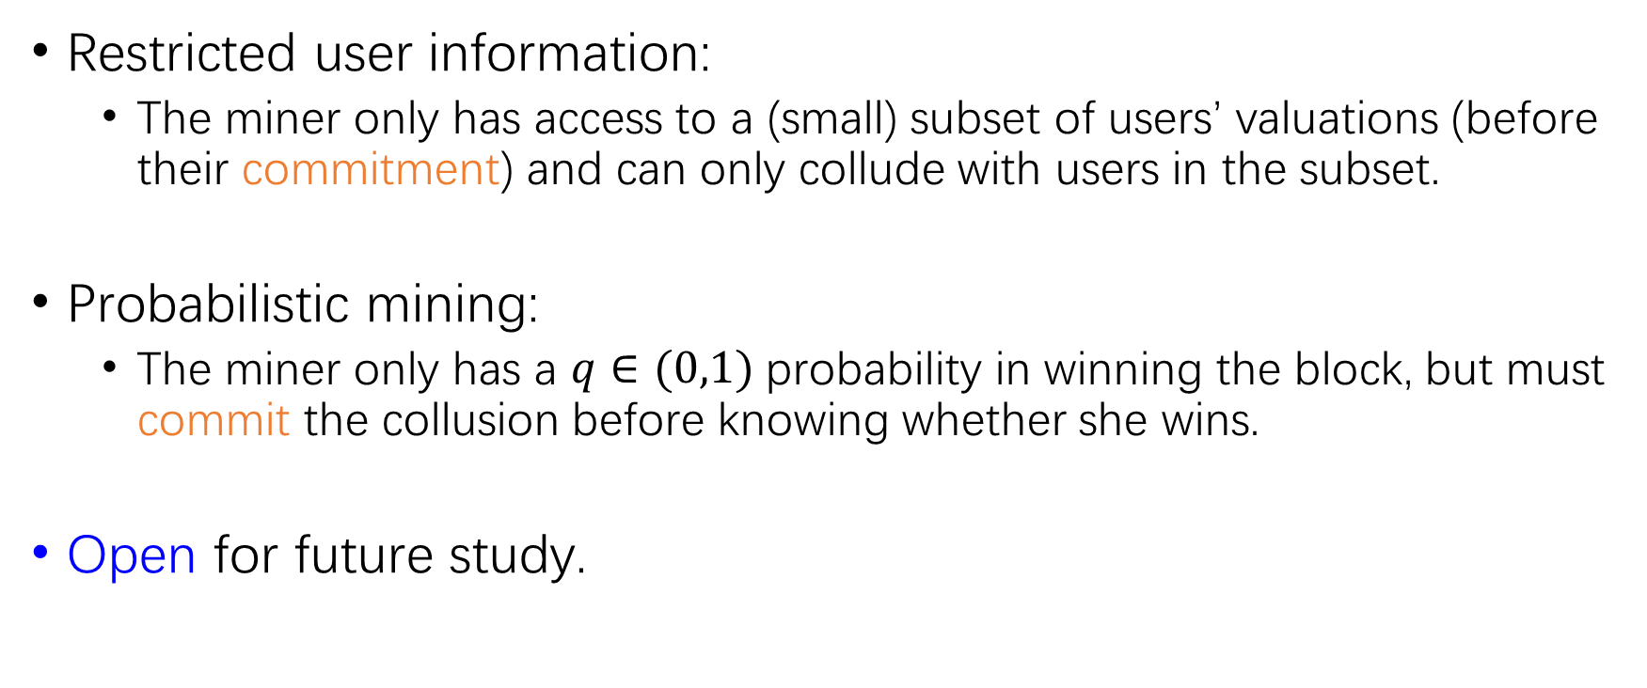
Open: Possible Relaxations of Collusion-Proofness
Restricted user information:
  The miner only has access to a (small) subset of users’ valuations (before their commitment) and can only collude with users in the subset.
Probabilistic mining:
  The miner only has a $q∈(0,1)$ probability in winning the block, but must commit the collusion before knowing whether she wins.
Open for future study.

Slide 37
Conclusion
We make an organized and more refined analysis on the strategy space of blockchain transaction fee market.
We propose the versatile Auxiliary Mechanism method as a framework for Bayesian design on transaction fee mechanisms and possibly other relevant scopes.
We utilize the Auxiliary Mechanism method to design a transaction fee mechanism that addresses all critical strategy-proof issues while yielding a constant-fractional approximation of optimal revenue in a (basic) Bayesian game setting.

Slide 38
My Current Interest:
Mechanism Design for Decentralized AI
Proof of Work (PoW):
Fundamental for blockchain systems, but wasting (a lot of) energy
Proof of Useful Work (PoUW):
Modifying the PoW to do useful computation!
Proof of Learning (PoL):
ML training for PoW, securing AI models w/ blockchain in turn.
Recent research: how to design incentive-compatible protocols for decentralized AI training/inference and verification?

Slide 39
Incentive Challenge in Decentralized AI
Verification of AI models is more difficult (and costly) than PoW hash puzzles.
Verifier’s Dilemma: when verification is costly and most “proofs” are honest, verifiers may be incentivized to be lazy.
My recent research topic (2023-now)!

Slide 40
Q&A

