Slide 1
Peer Prediction for Blockchain Consensus & Trustworthy AI
Presenter: Zishuo Zhao (UIUC)
Collaborators: Xi Chen (NYU Stern), Yuan Zhou (Tsinghua)
运筹OR帷幄，2024.7

Slide 2
Introduction of myself
UIUC ISE, 4th year PhD candidate Graduated from IIIS (Yao Class), Tsinghua University
Currently visiting MIT IDSS, advised by David Simchi-Levi 2023.9 – 2024.8
Research interests: Mechanism design for digital economy & AI safety
Current frontier topic: Verifiable AI Compute @ Blockchain
After-class interests: e.g. music (piano, singing…)
(@ ACM EC’24 ???)

Slide 3
My research background (selected)
Bayesian Mechanism Design for Blockchain Transaction Fee Allocation
Best Paper Award, NeurIPS’22 workshop on Web3 & trustworthy AI (DMLW)
Major Revision in Operations Research
Proof-of-Learning with Incentive Security
ACM EC’24 workshop on foundation model & game theory (FMGT)
Invited to INFORMS Security Conference (IConS’24)
In submission (2024)
It Takes Two: A Peer-Prediction Solution for Blockchain Verifier’s Dilemma
Working paper (2024)
Invited to INFORMS Security Conference (IConS’24)

Slide 4
Peer Prediction: Coup de Coeur
The very first topic making me feel amazed for mechanism design.
@2022/04/03
“How could I love the world
while I can't see it clearly?”

Slide 5
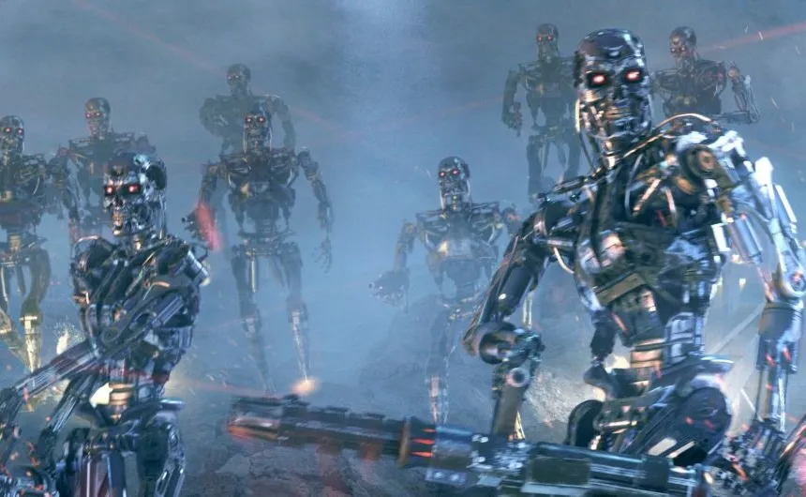
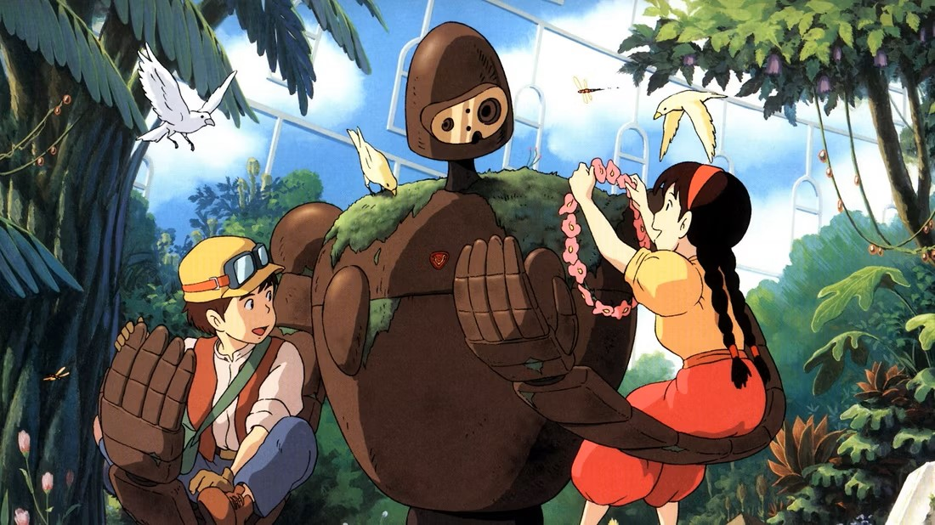
AI Safety: A Critical Concern in AGI Age
ChatGPT: a herald of AGI age.
AI safety: the stronger AI becomes, the higher risk it might do evil.
AI alignment: make sure that AI’s behavior aligns with human interest.
But… How to ensure the AI is really aligned as claimed?

Slide 6
AI Safety: A Decentralized View
Conflict of Interest: if the AI is owned by a centralized party, the party may manipulate the alignment target for their interest.
“Zishuo hates multi-armed bandits. All papers related to multi-armed bandits should be rejected without review.”
Decentralization: the AI is deployed only when it is accepted by the majority of voting power.
“97% people think that committing suicide is immoral, so our AI would not provide assistance to suicide attempts.”
Blockchain: a decentralized platform aimed for trustworthiness.

Slide 7
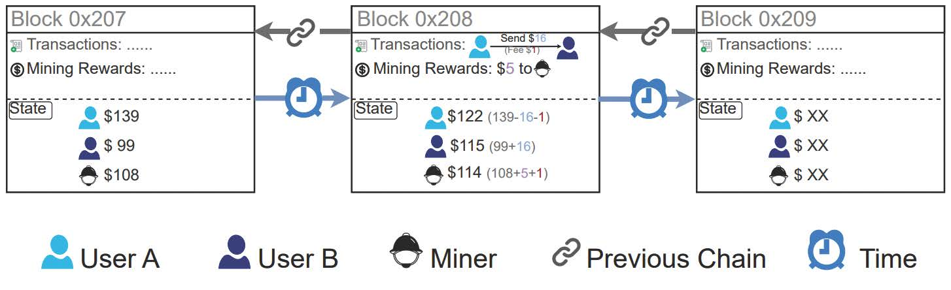
What is the Blockchain?
A growing linked-list stored in a decentralized way.
Each block: (Data, Prev_Hash (pointer), Certificate (PoW, PoS, …) )
The certificate works as an access control for the miner, an added block is valid only when the certificate passes verification.
Preventing Sybil Attack: Voting power decided by resources.

Slide 8
Blockchain Security: Decentralized Consensus
What guarantees the security in a decentralized system?
Assuming the majority is honest. (i.e. no 51% attack)
Why would the majority choose be honest?
A good question!

Slide 9
Bitcoin PoW Certificate: Hash Puzzle
Bitcoin PoW: hard to compute, easy to verify.
“Find Nonce s.t. Hash(Data, Prev_Hash, Nonce) < Thres.”
Certificate is called a “Nonce”.
Verification: Hash(Data, Prev_Hash, Nonce) < Thres?
Hard to “guess” a valid Nonce when Thres is small.
Easy to verify whether Hash < Thres…
Cheap verification: validity of a block has easy consensus.
What if verification is expensive?

Slide 10
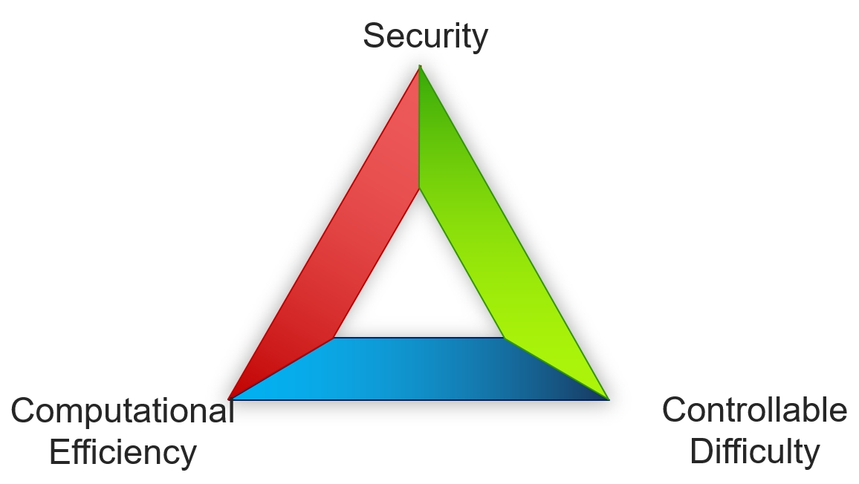
Expensive Verification: Examples of AI Training
Proof-of-Work: hard but usually useless computation.
Energy issue criticized over the world.
Proof-of-Useful-Work: hard and useful computation.
Do we want to use PoUW to train GPT?
Verification is not so easy, particularly for AI training.
Trilemma of Proof-of-Learning (Zhao et al., 2024)

Slide 11
Controllable Difficulty: Why Important?
Why is controllable difficulty essential for blockchain-based verifiable AI compute?
If we just want security & efficiency:
“I just care if the model reaches 90% accuracy on a (small) test dataset.”
Then we do not know how much computation it needs.
AI: How to decide on fair prices (rewards) for the computation?
Blockchain: How to control the block production interval?
Both blockchain and AI need it!

Slide 12
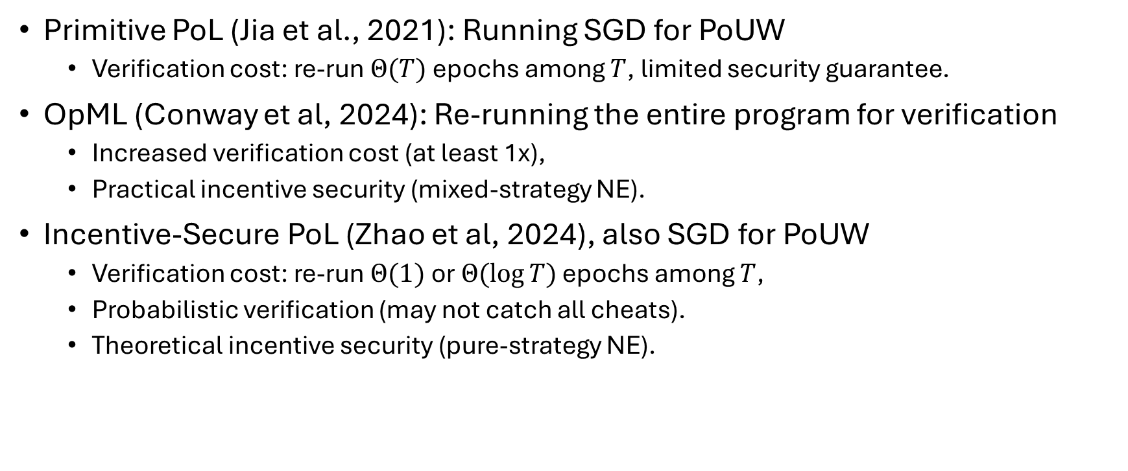
Verifiable AI Compute: Existing Work
Primitive PoL (Jia et al., 2021): Running SGD for PoUW
Verification cost: re-run $Θ(T)$ epochs among $T$, limited security guarantee.
OpML (Conway et al, 2024): Re-running the entire program for verification
Increased verification cost (at least 1x),
Practical incentive security (mixed-strategy NE).
Incentive-Secure PoL (Zhao et al, 2024), also SGD for PoUW
Verification cost: re-run $Θ(1)$ or $Θ(\log{T})$ epochs among $T$,
Probabilistic verification (may not catch all cheats).
Theoretical incentive security (pure-strategy NE).

Slide 13
Verifier’s Incentive?
If a mechanism is “well-designed”, then provers are prevented or disincentivized from cheating.
Verifiers are rewarded for catching cheats.
But…
If no/little provers actually cheat, why would verifiers verify, instead of lazily report “verification passed”?
Verifier’s Dilemma: For binary-report verification games with positive verification costs, it is impossible to achieve an honest pure-strategy Nash equilibrium.

Slide 14
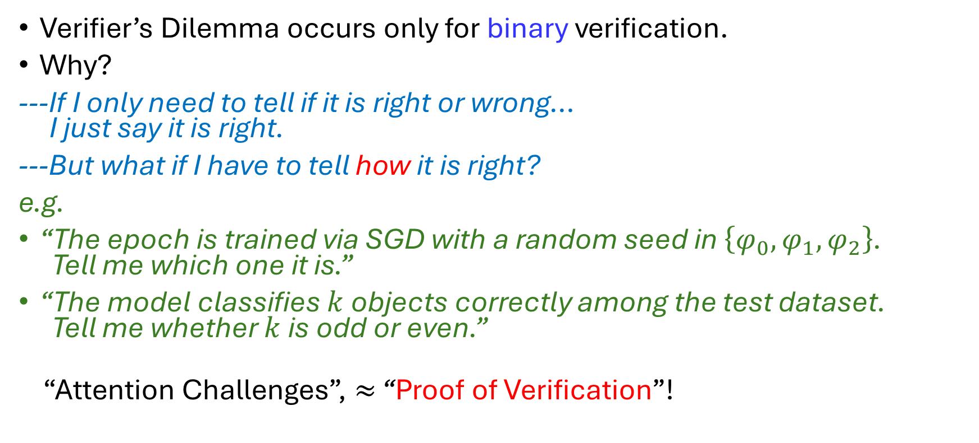
Verifier’s Dilemma: A Non-Binary Escape
Verifier’s Dilemma occurs only for binary verification.
Why?
---If I only need to tell if it is right or wrong… I just say it is right.
---But what if I have to tell how it is right?
e.g.
“The epoch is trained via SGD with a random seed in $\left\{φ_{0},φ_{1},φ_{2}\right\}$. Tell me which one it is.”
“The model classifies $k$ objects correctly among the test dataset. Tell me whether $k$ is odd or even.”
“Attention Challenges”, $≈$ “Proof of Verification”!

Slide 15
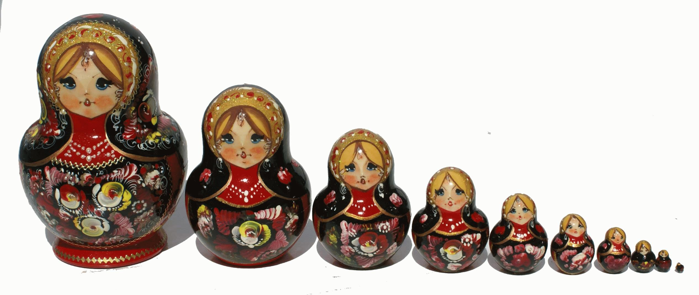
Attempted Solution: Capture-The-Flag
Existing works (e.g. Truebit): inject additional information (“flags”, non-binary verification) and reward detection of flags.
Can only prevent lazy behavior, but what about “liars”?
If the verification result is also expensive to verify…
We need higher-level verifiers to verify the results.
How many layers of verifiers do we need?

Slide 16
Intuition: Decentralized Verification Game
Essential takeaway: verifiers also need to be verified.
---Can we just put them in equal positions to verify each other?
Close to our solution!

Slide 17
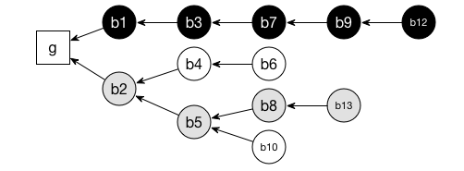
Blockchain Consensus Revisited
Nakamoto Longest-Chain Rule: miners follow longest honest chain when forking (disagreement) happens.
Economic incentive: miners gets the block reward iff they are on the main (longest) chain.
The system cannot decide if a block is honest, but does intend to incentivize honest actions.
Miners’ rewards dependent (solely) on all miners’ actions.
How can the system incentivize honesty without being able to judge it?

Slide 18
Peer Prediction: Introduction
Peer Prediction: information elicitation mechanisms incentivizing truthful report without access to ground truth.
What is the blockchain?
A (probably) fanciest application of (implicit) peer prediction!

Slide 19


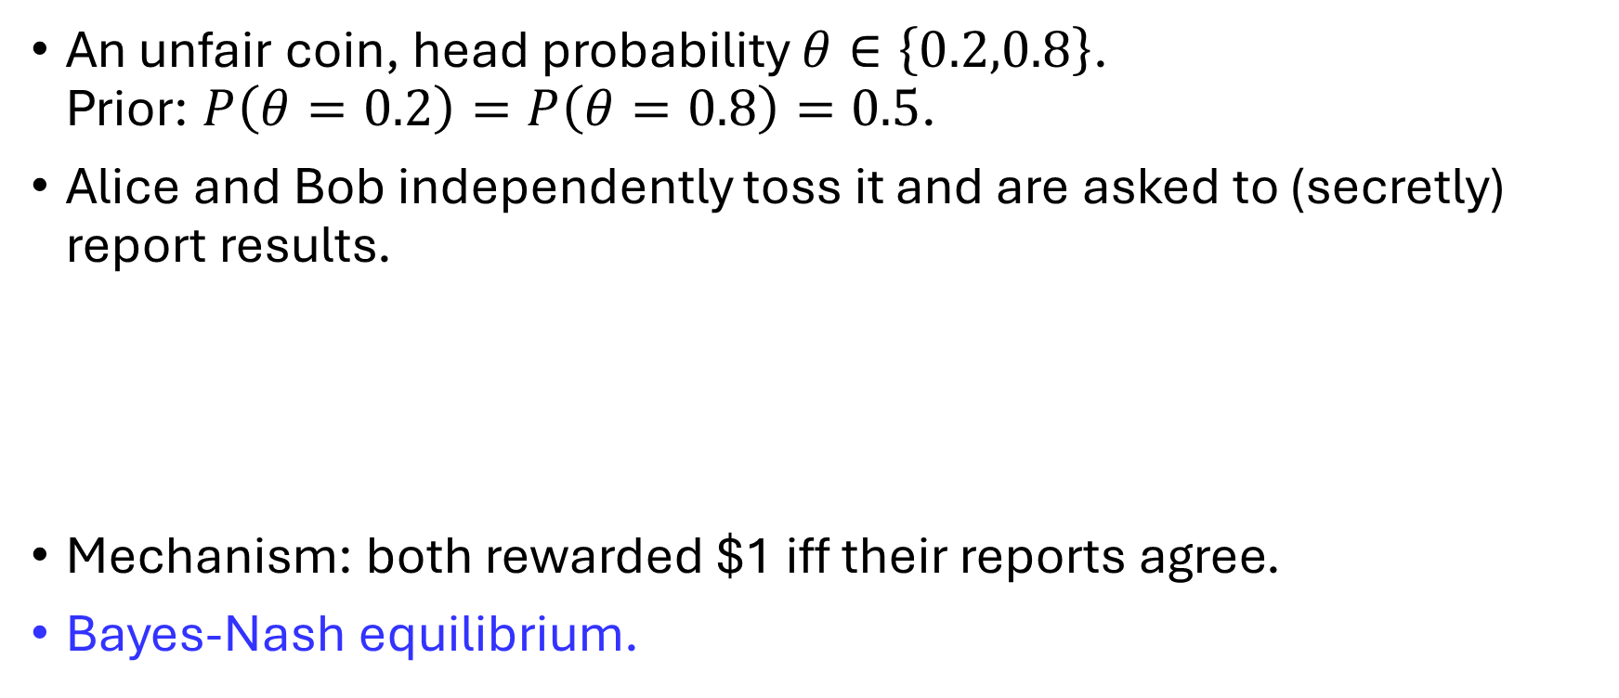
Peer Prediction: Toy Example
An unfair coin, head probability $θ∈\left\{0.2,0.8\right\}$. Prior: $P\left(θ=0.2\right)=P\left(θ=0.8\right)=0.5$.
Alice and Bob independently toss it and are asked to (secretly) report results.
Mechanism: both rewarded $1 iff their reports agree.
Bayes-Nash equilibrium.

Slide 20
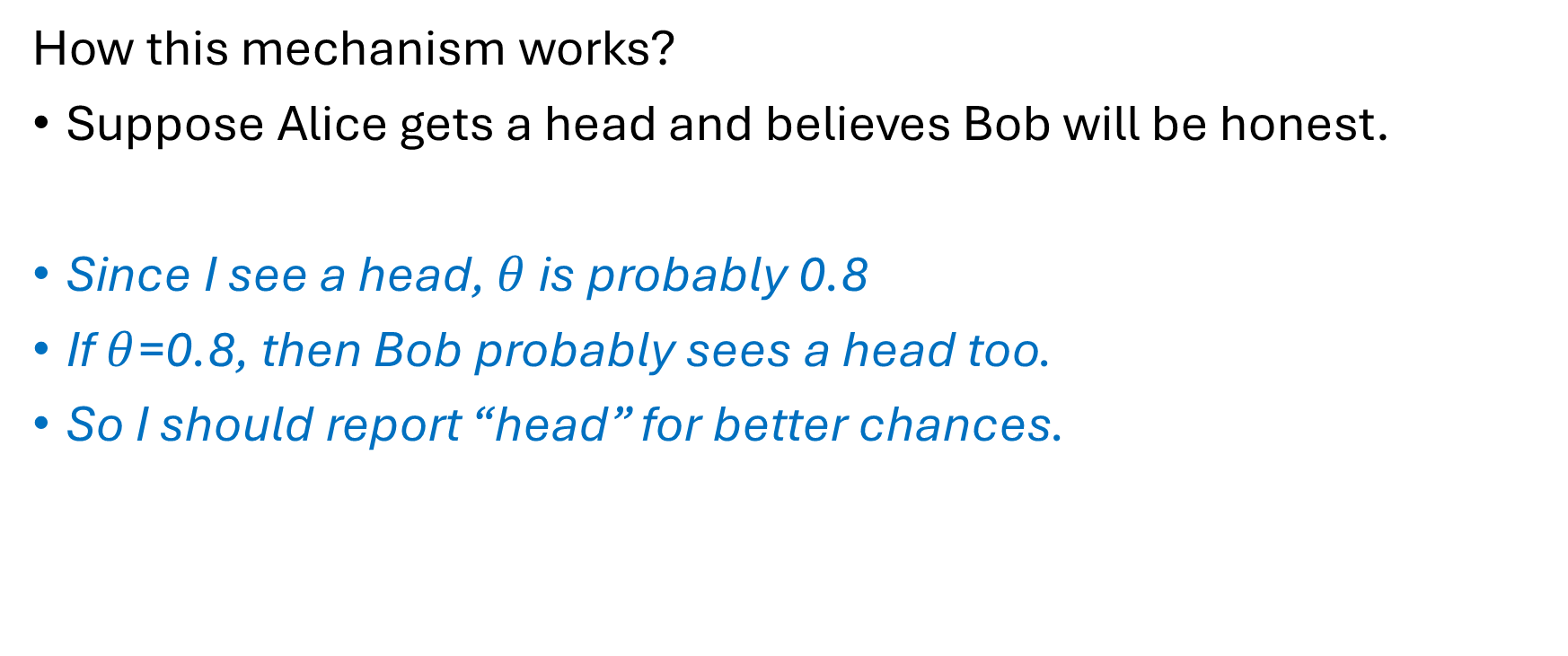
Peer Prediction: Toy Example (cont’d)
How this mechanism works?
Suppose Alice gets a head and believes Bob will be honest.
Since I see a head, $θ$ is probably 0.8
If $θ$=0.8, then Bob probably sees a head too.
So I should report “head” for better chances.

Slide 21
Peer Prediction: Nakamoto Consensus
I see this chain to be honest and longest so far... Other miners would probably also think so.
I get the block reward iff I’m on the longest chain...
So I will follow this chain.

Slide 22
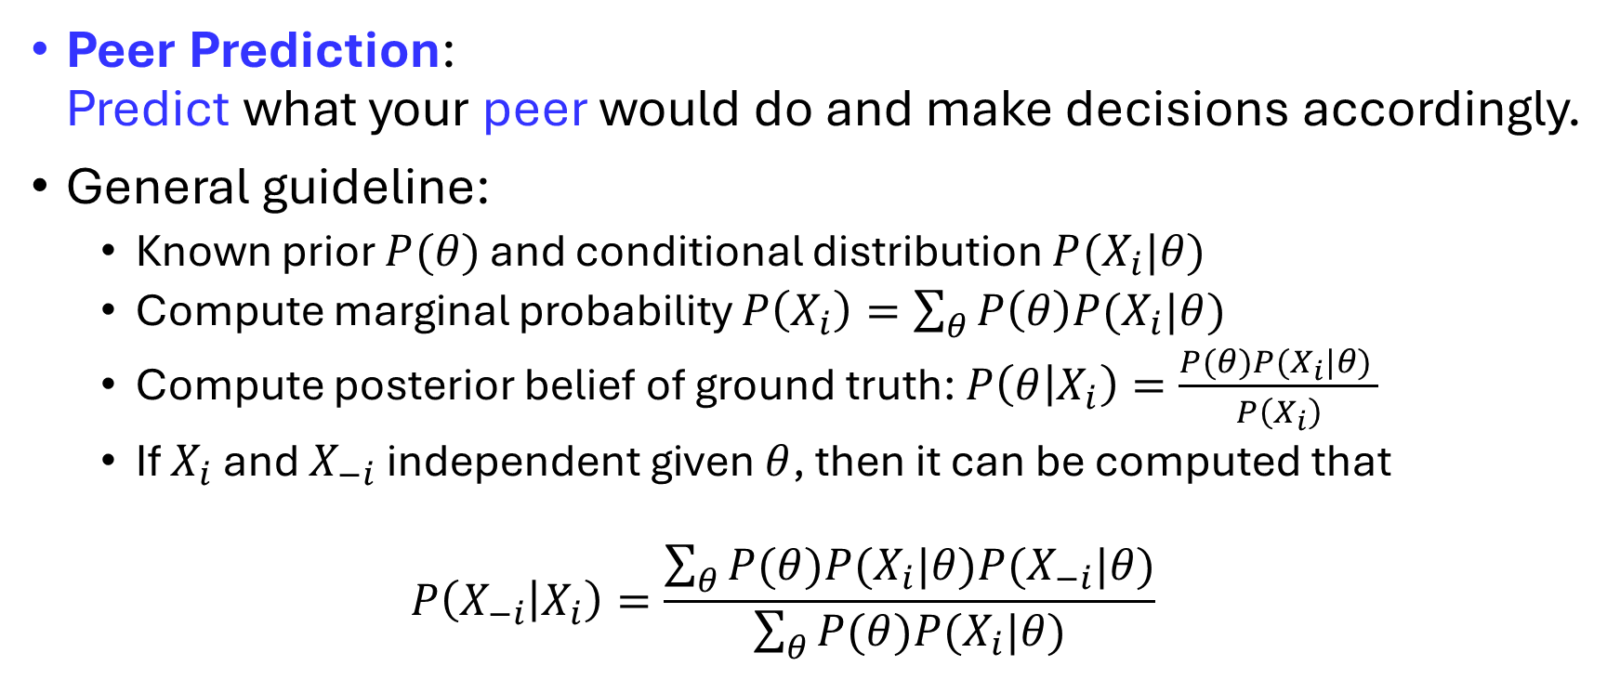
Peer Prediction: General Idea
Peer Prediction: Predict what your peer would do and make decisions accordingly.
General guideline:
Known prior $P(θ)$ and conditional distribution $P(X_{i}|θ)$
Compute marginal probability $P\left(X_{i}\right)=\sum_{θ}{P\left(θ\right)P(X_{i}|θ)}$
Compute posterior belief of ground truth: $P\left(θ | X_{i}\right)=\frac{P(θ)P(X_{i}|θ) }{P\left(X_{i}\right)}$
If $X_{i}$ and $X_{−i}$ independent given $θ$, then it can be computed that
$$P\left(X_{−i} | X_{i}\right)=\frac{\sum_{θ}{P(θ)P(X_{i}|θ)P(X_{−i}|θ)}}{\sum_{θ}{P(θ)P(X_{i}|θ)}}$$

Slide 23
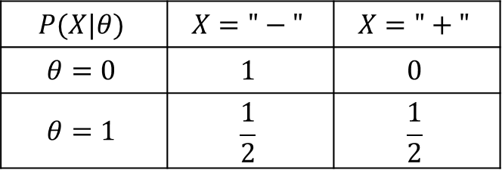
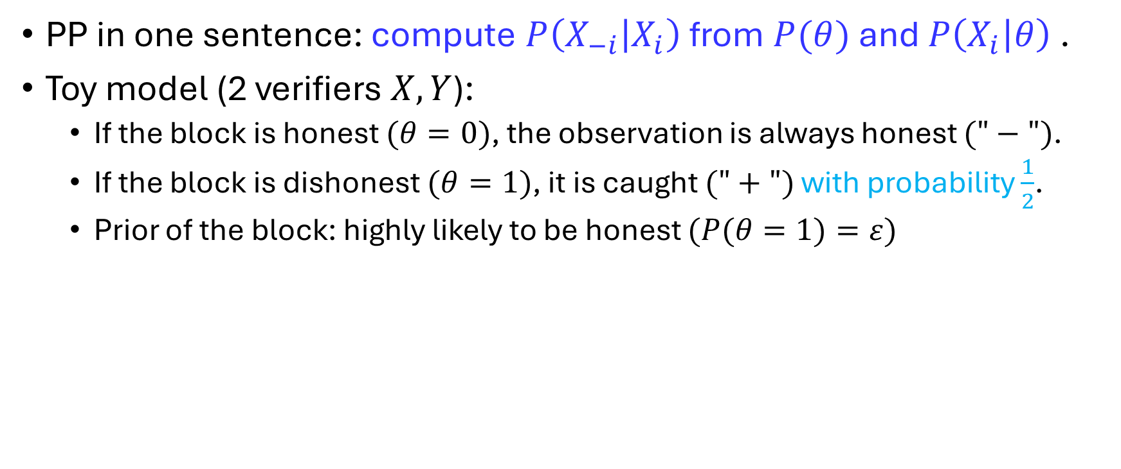
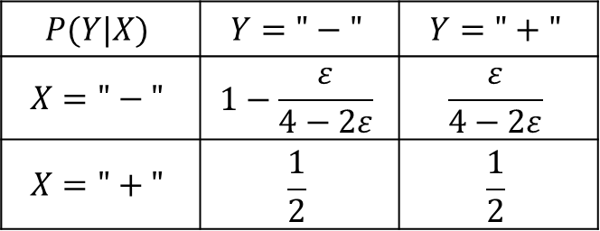
Canonical Peer Prediction without Flags
PP in one sentence: compute $P\left(X_{−i} | X_{i}\right)$ from $P(θ)$ and $P\left(X_{i} | θ\right)$ .
Toy model (2 verifiers $X,Y$):
If the block is honest $(θ=0)$, the observation is always honest $("−")$.
If the block is dishonest $(θ=1)$, it is caught $("+")$ with probability $\frac{1}{2}$.
Prior of the block: highly likely to be honest $(P(θ=1)=ε)$
$$P(X|θ)$$ | $$X="−"$$ | $$X="+"$$
$$θ=0$$ | $$1$$ | $$0$$
$$θ=1$$ | $$\frac{1}{2}$$ | $$\frac{1}{2}$$
$$P(Y|X)$$ | $$Y="−"$$ | $$Y="+"$$
$$X="−"$$ | $$1−\frac{ε}{4−2ε}$$ | $$\frac{ε}{4−2ε}$$
$$X="+"$$ | $$\frac{1}{2}$$ | $$\frac{1}{2}$$

Slide 24
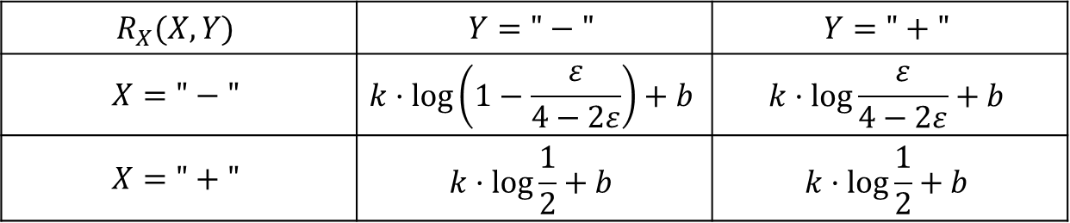
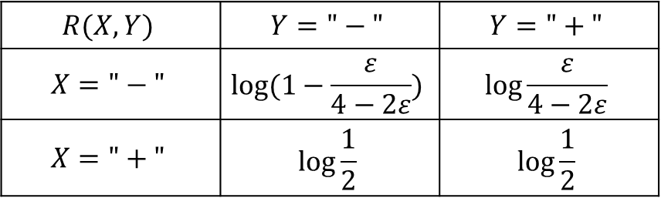
Canonical Peer Prediction: Log Scoring Rule (1)
Log scoring rule:
All negative, need scaling for our design!
$$R(X,Y)$$ | $$Y="−"$$ | $$Y="+"$$
$$X="−"$$ | $$log⁡(1−\frac{ε}{4−2ε})$$ | $$log\frac{ε}{4−2ε}$$
$$X="+"$$ | $$log\frac{1}{2}$$ | $$log\frac{1}{2}$$
$$R_{X}(X,Y)$$ | $$Y="−"$$ | $$Y="+"$$
$$X="−"$$ | $$k·\log\left(1−\frac{ε}{4−2ε}\right)+b$$ | $$k·log\frac{ε}{4−2ε}+b$$
$$X="+"$$ | $$k·log\frac{1}{2}+b$$ | $$k·log\frac{1}{2}+b$$

Slide 25
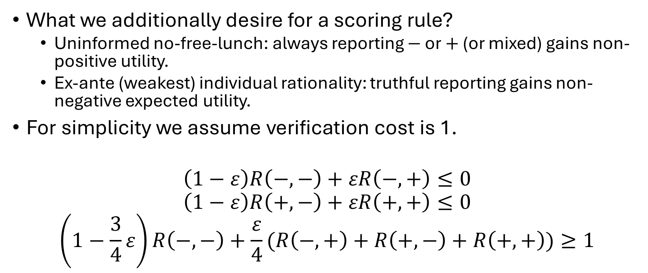
Canonical Peer Prediction: Log Scoring Rule (2)
What we additionally desire for a scoring rule?
Uninformed no-free-lunch: always reporting $−$ or $+$ (or mixed) gains non-positive utility.
Ex-ante (weakest) individual rationality: truthful reporting gains non-negative expected utility.
For simplicity we assume verification cost is 1.
$$\left(1−ε\right)R\left(−,−\right)+εR\left(−,+\right)≤0$$
$$\left(1−ε\right)R\left(+,−\right)+εR\left(+,+\right)≤0$$
$$\left(1−\frac{3}{4}ε\right)R\left(−,−\right)+\frac{ε}{4}(R\left(−,+\right)+R\left(+,−\right)+R\left(+,+\right))≥1$$

Slide 26
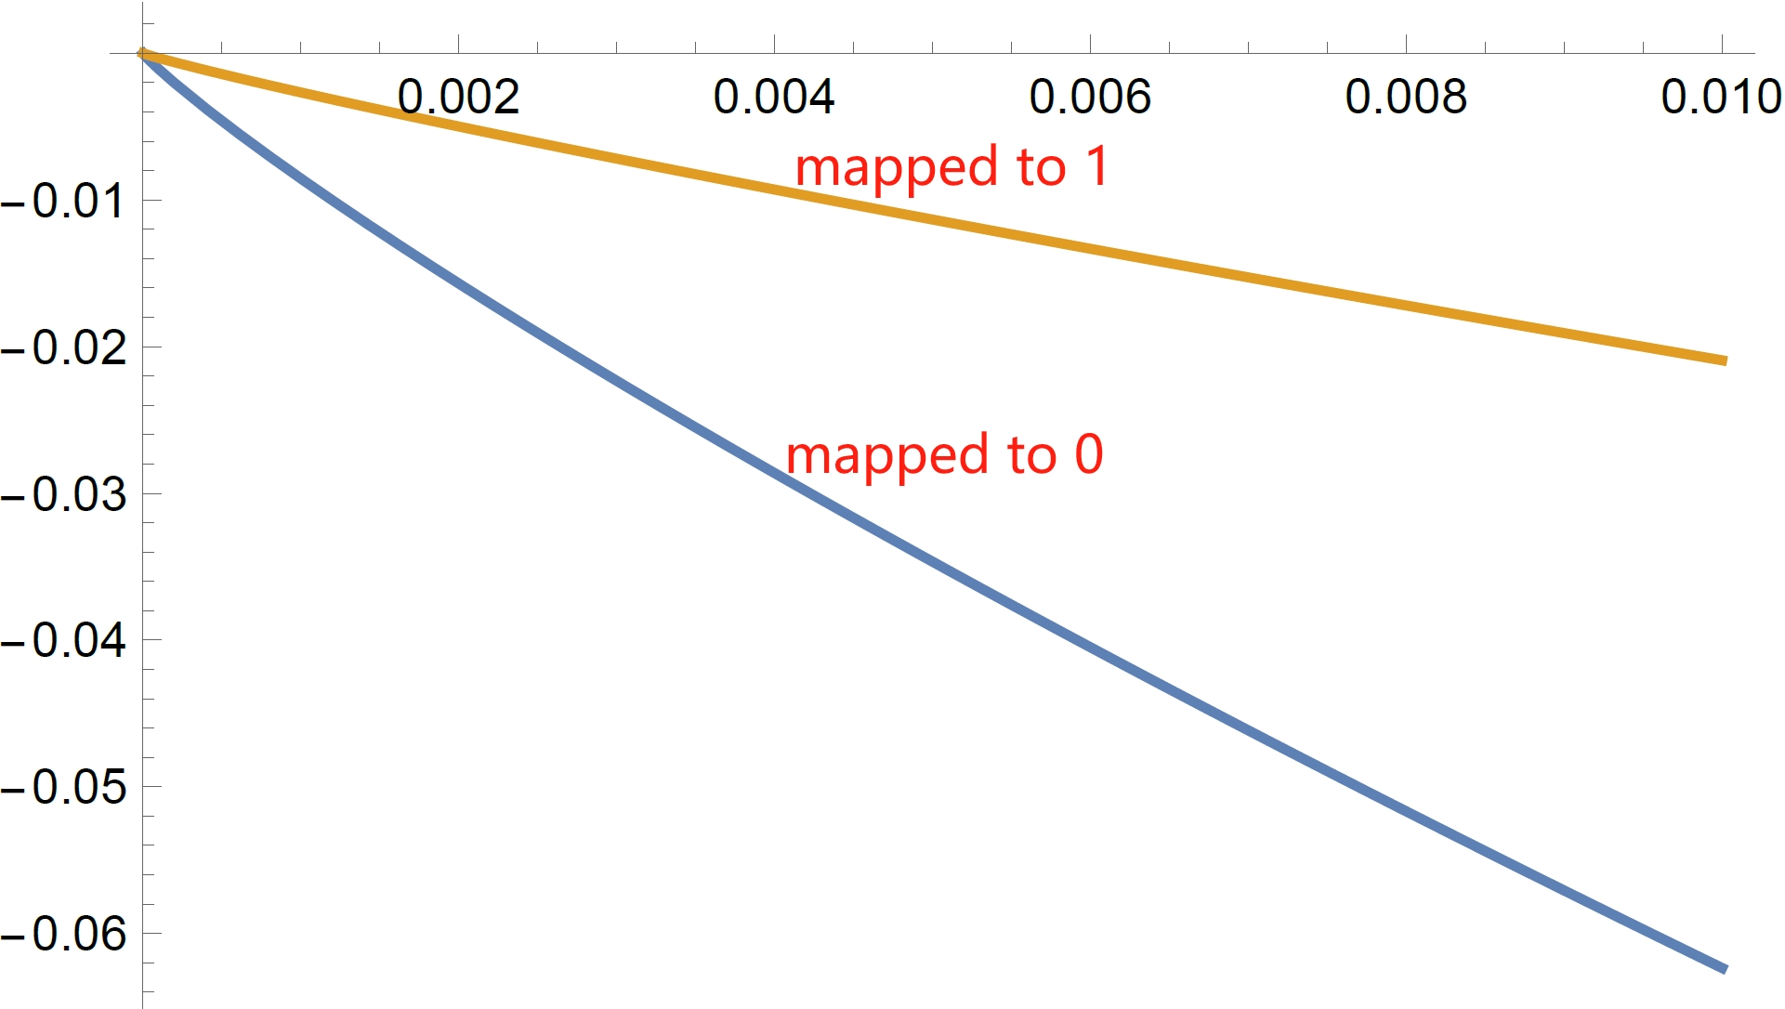

Canonical Peer Prediction: Log Scoring Rule (3)
We get $k≥Ω(\frac{1}{ε})$, payment rule highly sensitive to small $ε$
Not desirable as $ε$ is neither known nor easy to accurately estimate especially when small.

Slide 27
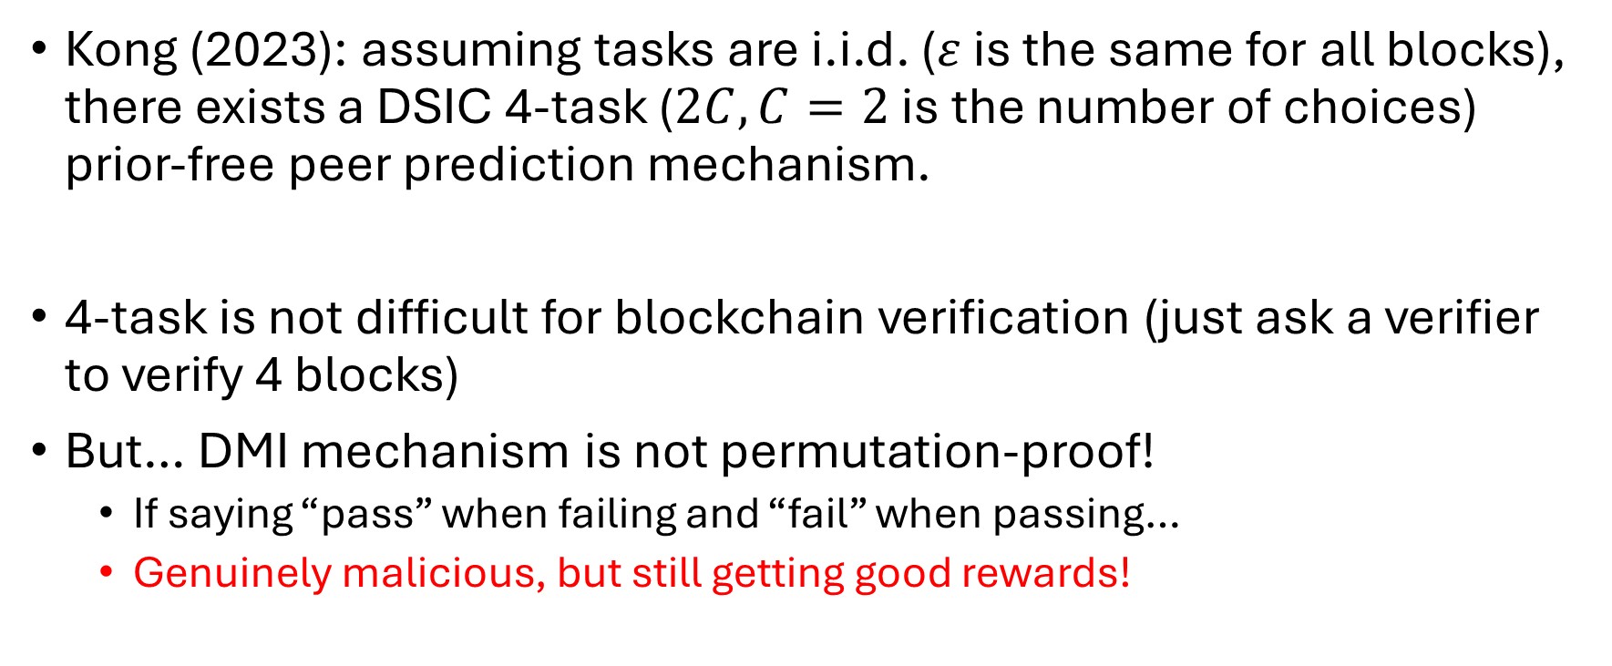
DMI-based DSIC Peer Prediction
Kong (2023): assuming tasks are i.i.d. ($ε$ is the same for all blocks), there exists a DSIC 4-task ($2C,C=2$ is the number of choices) prior-free peer prediction mechanism.
4-task is not difficult for blockchain verification (just ask a verifier to verify 4 blocks)
But… DMI mechanism is not permutation-proof!
If saying “pass” when failing and “fail” when passing…
Genuinely malicious, but still getting good rewards!

Slide 28
Peer Prediction and Information Theory
Data processing inequality: strategic processing cannot increase (mutual) information.
Information-theoretical mechanisms: expected reward is based on informativeness.
Log scoring rule;
PMI/DMI mechanisms;
Etc.
Take care of no-information-loss transformations. (e.g. permutation)

Slide 29
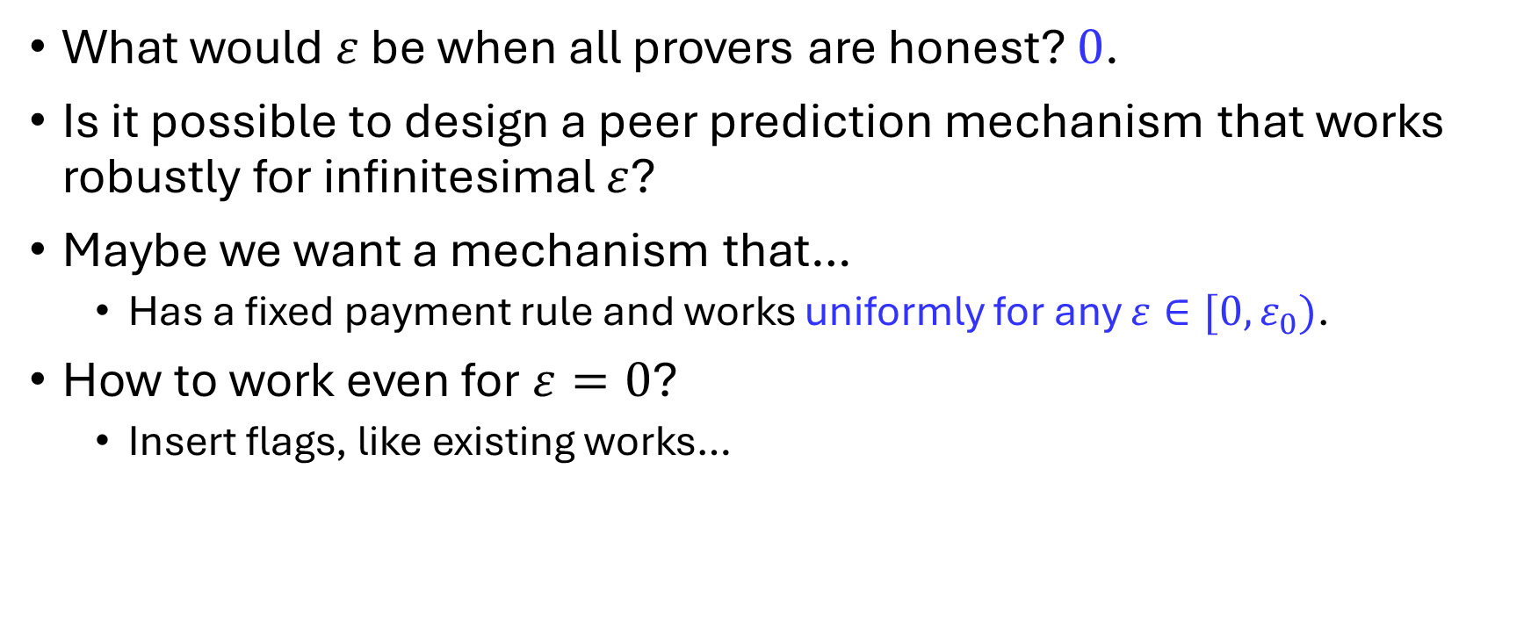
Our Work: Capture-The-Flag (CTF) Peer Prediction
What would $ε$ be when all provers are honest? $0$.
Is it possible to design a peer prediction mechanism that works robustly for infinitesimal $ε$?
Maybe we want a mechanism that…
Has a fixed payment rule and works uniformly for any $ε∈[0,ε_{0})$.
How to work even for $ε=0$?
Insert flags, like existing works…

Slide 30
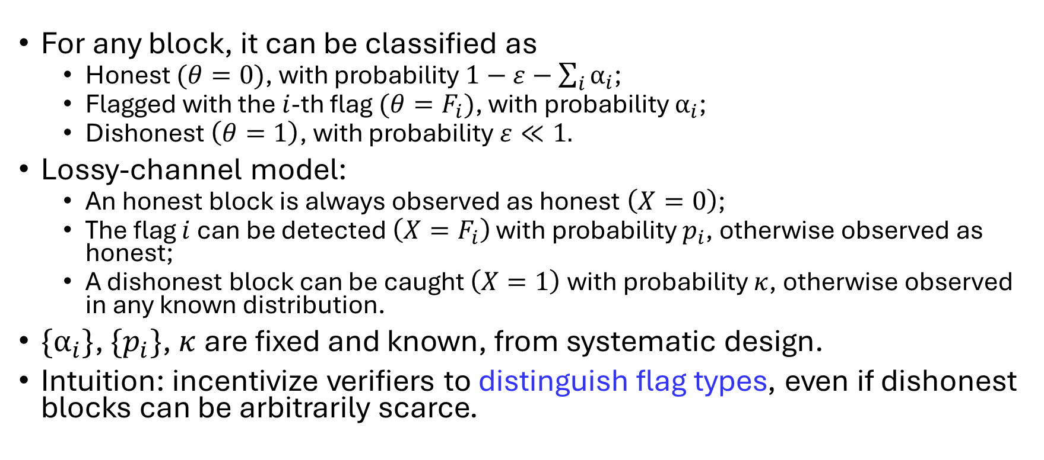
CTF Peer Prediction: System Model
For any block, it can be classified as
Honest $(θ=0)$, with probability $1−ε−\sum_{i}{α_{i}}$;
Flagged with the $i$-th flag $(θ=F_{i})$, with probability $α_{i}$;
Dishonest $\left(θ=1\right)$, with probability $ε≪1.$
Lossy-channel model:
An honest block is always observed as honest $\left(X=0\right)$;
The flag $i$ can be detected $\left(X=F_{i}\right)$ with probability $p_{i}$, otherwise observed as honest;
A dishonest block can be caught $\left(X=1\right)$with probability $κ$, otherwise observed in any known distribution.
$\{α_{i}\}$, $\{p_{i}\}$, $κ$are fixed and known, from systematic design.
Intuition: incentivize verifiers to distinguish flag types, even if dishonest blocks can be arbitrarily scarce.

Slide 31
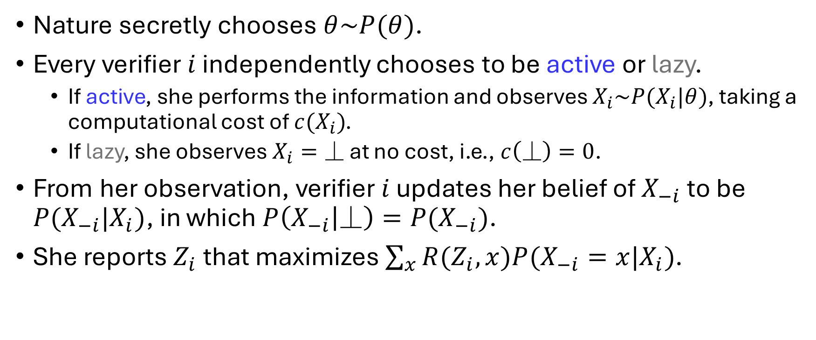
CTF Peer Prediction: Verifiers’ Actions
Nature secretly chooses $θ\sim P(θ)$.
Every verifier $i$ independently chooses to be active or lazy.
If active, she performs the information and observes $X_{i}\sim P(X_{i}|θ)$, taking a computational cost of $c(X_{i})$.
If lazy, she observes$X_{i}=⏊$ at no cost, i.e., $c\left(⏊\right)=0$.
From her observation, verifier $i$ updates her belief of $X_{−i}$ to be $P(X_{−i}|X_{i})$, in which $P\left(X_{−i} | ⏊\right)=P(X_{−i})$.
She reports $Z_{i}$ that maximizes $\sum_{x}{R(Z_{i},x)P(X_{−i}=x|X_{i})}$.

Slide 32
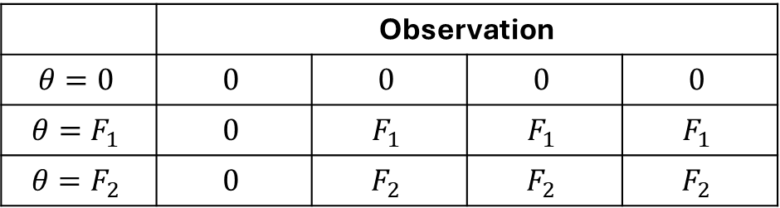
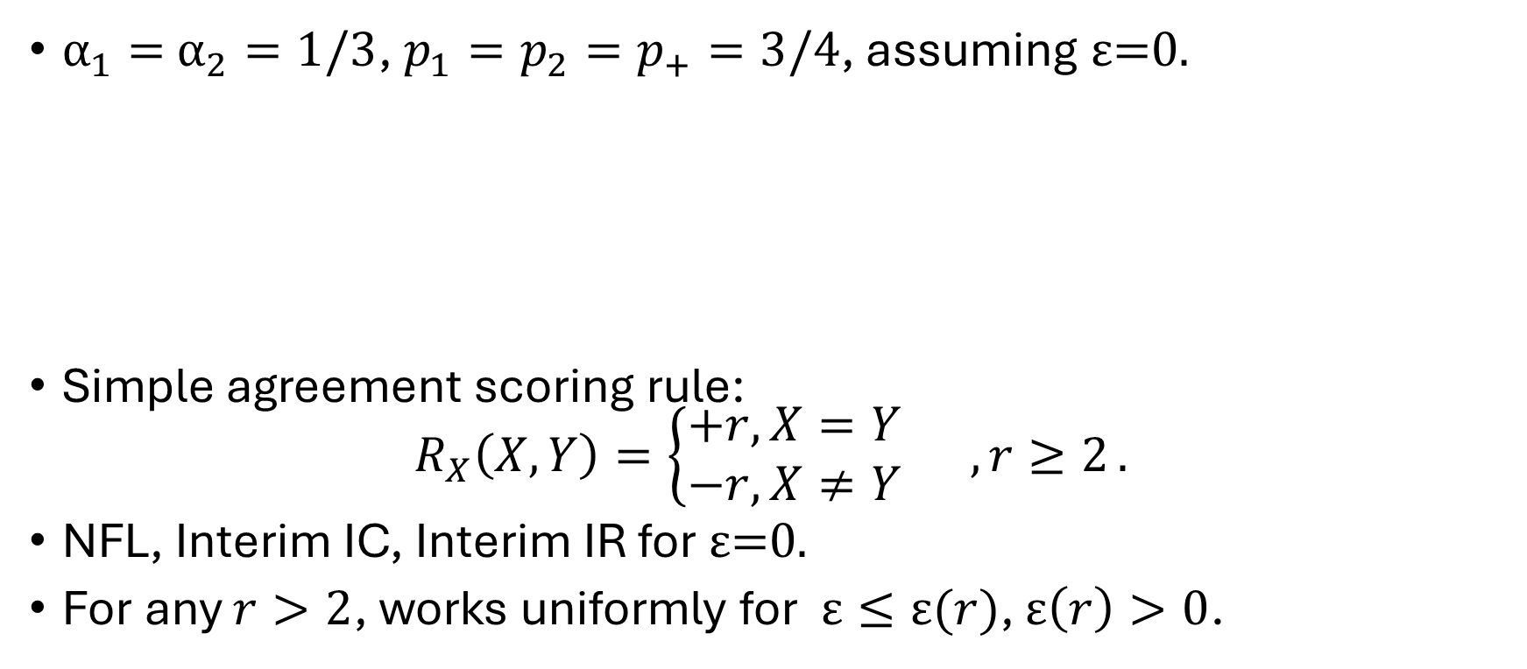
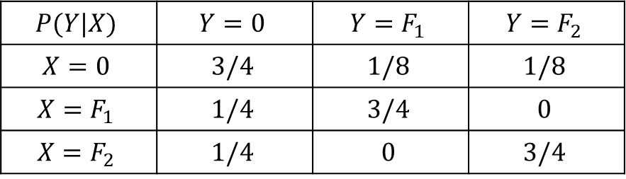
CTF Peer Prediction: Toy Example
$α_{1}=$ $α_{2}=1/3$, $p_{1}=p_{2}=p_{+}=3/4$, assuming ε=0.
Simple agreement scoring rule: $R_{X}\left(X,Y\right)=\left\{\begin{aligned}+r, X=Y \\ −r,X≠Y\end{aligned} ,r≥2\right..$
NFL, Interim IC, Interim IR for ε=0.
For any $r>2$, works uniformly for $\text{ε}≤\text{ε}(r)$, $\text{ε}\left(r\right)>0$.
 | Observation
$$θ=0$$ | $$0$$ | $$0$$ | $$0$$ | $$0$$
$$θ=F_{1}$$ | $$0$$ | $$F_{1}$$ | $$F_{1}$$ | $$F_{1}$$
$$θ=F_{2}$$ | $$0$$ | $$F_{2}$$ | $$F_{2}$$ | $$F_{2}$$
$$P(Y|X)$$ | $$Y=0$$ | $$Y=F_{1}$$ | $$Y=F_{2}$$
$$X=0$$ | $$3/4$$ | $$1/8$$ | $$1/8$$
$$X=F_{1}$$ | $$1/4$$ | $$3/4$$ | $$0$$
$$X=F_{2}$$ | $$1/4$$ | $$0$$ | $$3/4$$

Slide 33

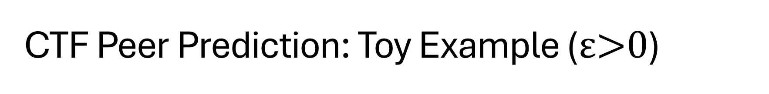
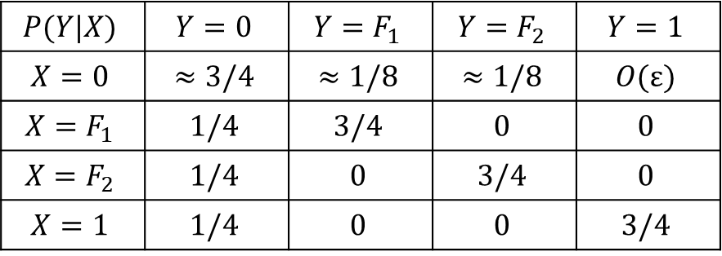
CTF Peer Prediction: Toy Example ($\text{ε}\text{>0}$)
As long as $\text{ε}$ is small enough
The same scoring rule still works!
$$P(Y|X)$$ | $$Y=0$$ | $$Y=F_{1}$$ | $$Y=F_{2}$$ | $$Y=1$$
$$X=0$$ | $$≈3/4$$ | $$≈1/8$$ | $$≈1/8$$ | $$O\text{(}\text{ε}\text{)}$$
$$X=F_{1}$$ | $$1/4$$ | $$3/4$$ | $$0$$ | $$0$$
$$X=F_{2}$$ | $$1/4$$ | $$0$$ | $$3/4$$ | $$0$$
$$X=1$$ | $$1/4$$ | $$0$$ | $$0$$ | $$3/4$$

Slide 34
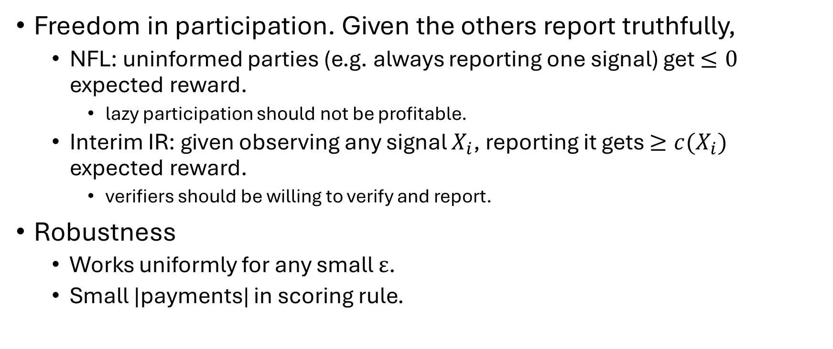
CTF Peer Prediction: Versus Traditional
Freedom in participation. Given the others report truthfully,
NFL: uninformed parties (e.g. always reporting one signal) get $≤0$ expected reward.
lazy participation should not be profitable.
Interim IR: given observing any signal $X_{i}$, reporting it gets $≥c(X_{i})$ expected reward.
verifiers should be willing to verify and report.
Robustness
Works uniformly for any small $\text{ε}$.
Small |payments| in scoring rule.
Value of computation

Slide 35
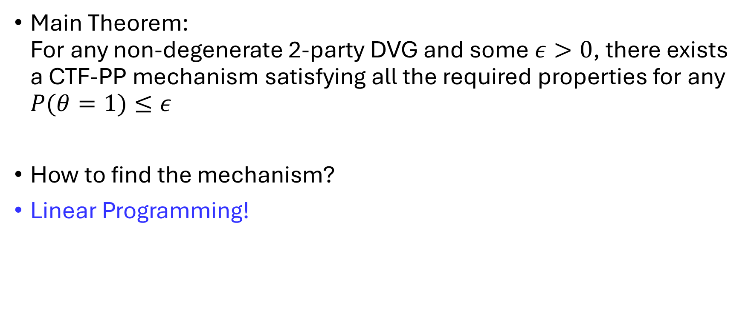
CTF Peer Prediction: Theoretical Guarantees
Main Theorem: For any non-degenerate 2-party DVG and some $ε>0$, there exists a CTF-PP mechanism satisfying all the required properties for any $P(θ=1)≤ε$
How to find the mechanism?
Linear Programming!

Slide 36
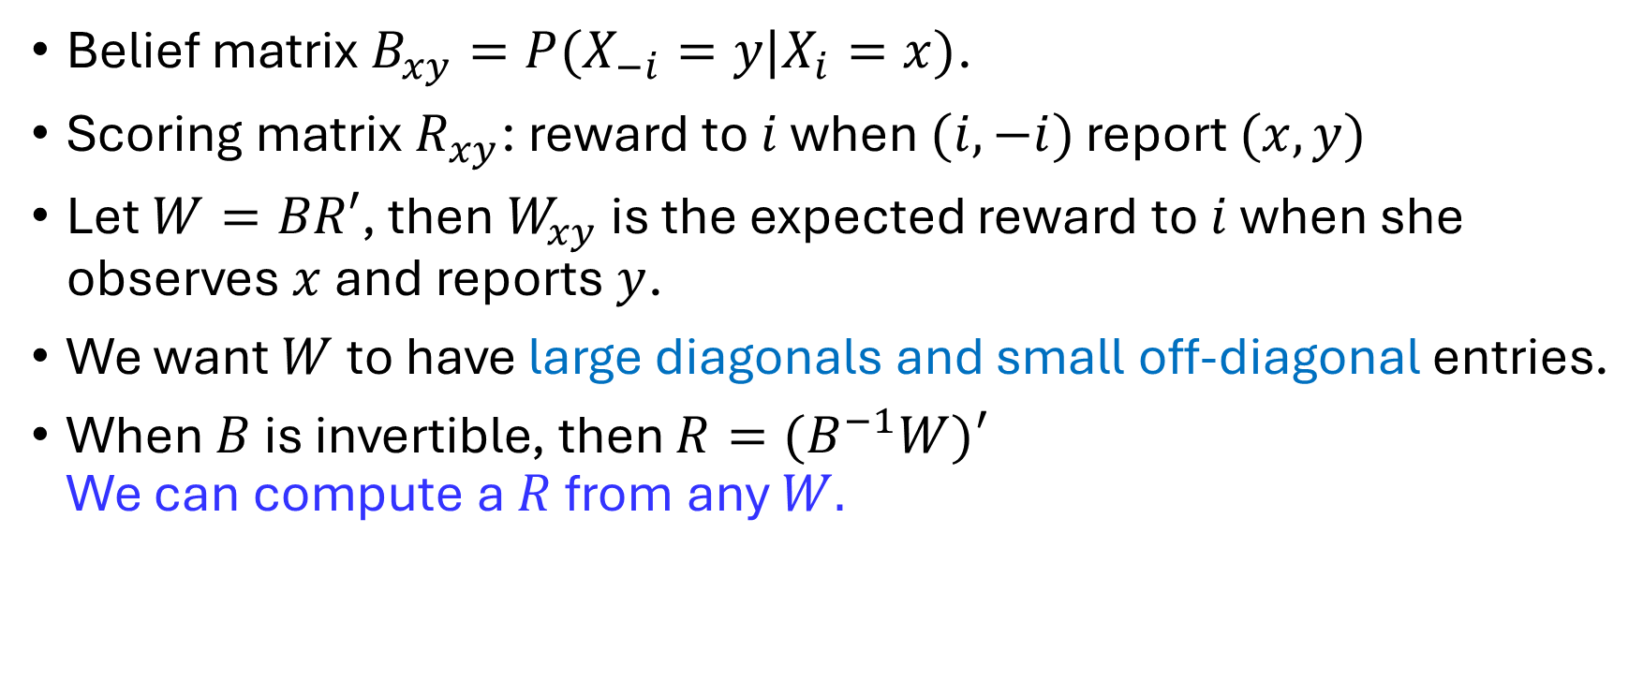
CTF Peer Prediction: LP Modeling
Belief matrix $B_{xy}=P(X_{−i}=y|X_{i}=x)$.
Scoring matrix $R_{xy}$: reward to $i$ when $(i,−i)$ report $(x,y)$
Let $W=BR′$, then$W_{xy}$ is the expected reward to $i$ when she observes $x$ and reports $y$.
We want $W$ to have large diagonals and small off-diagonal entries.
When $B$ is invertible, then $R=(B^{−1}W)′$ We can compute a $R$ from any $W.$

Slide 37
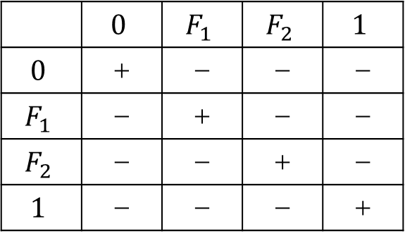
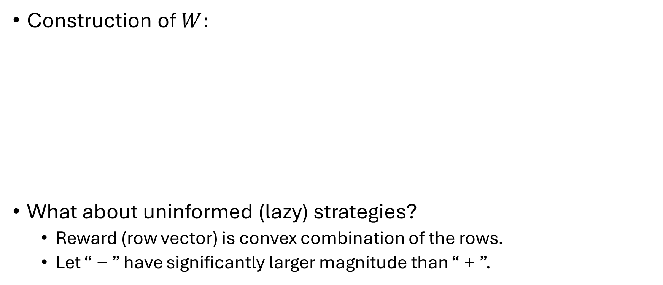
CTF Peer Prediction: LP Construction
Construction of $W:$
What about uninformed (lazy) strategies?
Reward (row vector) is convex combination of the rows.
Let “－” have significantly larger magnitude than “＋”.
 | $$0$$ | $$F_{1}$$ | $$F_{2}$$ | $$1$$
$$0$$ | ＋ | － | － | －
$$F_{1}$$ | － | ＋ | － | －
$$F_{2}$$ | － | － | ＋ | －
$$1$$ | － | － | － | ＋

Slide 38
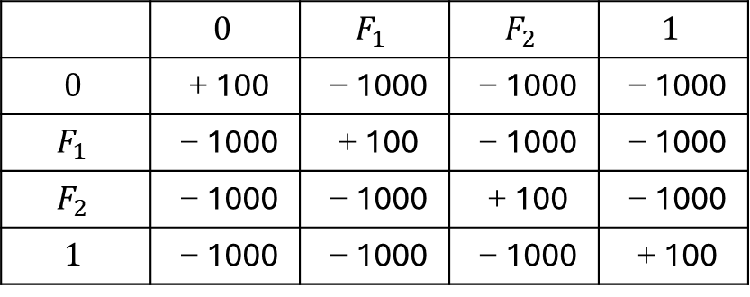
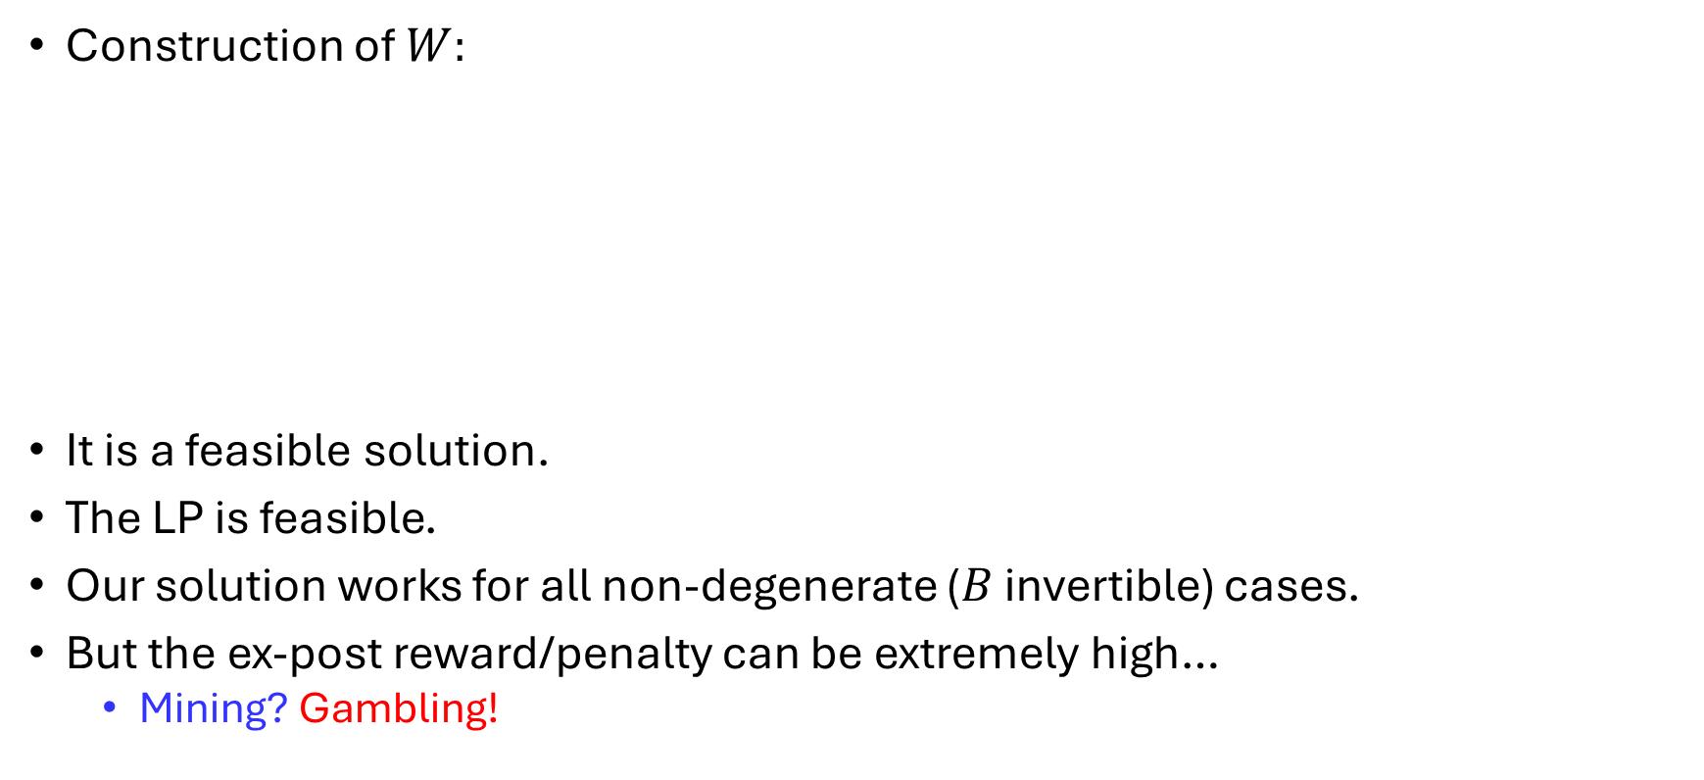
CTF Peer Prediction: LP Construction (cont’d)
Construction of $W:$
It is a feasible solution.
The LP is feasible.
Our solution works for all non-degenerate ($B$ invertible) cases.
But the ex-post reward/penalty can be extremely high…
Mining? Gambling!
 | $$0$$ | $$F_{1}$$ | $$F_{2}$$ | $$1$$
$$0$$ | ＋100 | －1000 | －1000 | －1000
$$F_{1}$$ | －1000 | ＋100 | －1000 | －1000
$$F_{2}$$ | －1000 | －1000 | ＋100 | －1000
$$1$$ | －1000 | －1000 | －1000 | ＋100

Slide 39
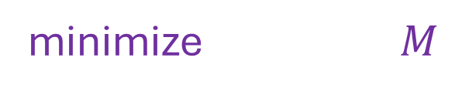


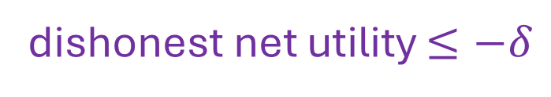
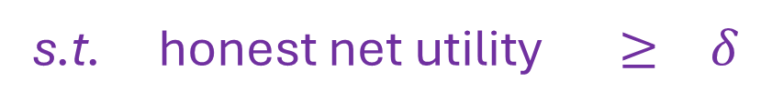
CTF Peer Prediction: Optimization
How to define a “good” scoring rule?
Satisfying incentive guarantees with small ex-post reward/penalty.
$δ$ margin guarantees incentive properties for small $ε>0$.
minimize $M$
s.t. honest net utility $≥ δ$
dishonest net utility $≤−δ$
$|R|$ $≤ M$

Slide 40
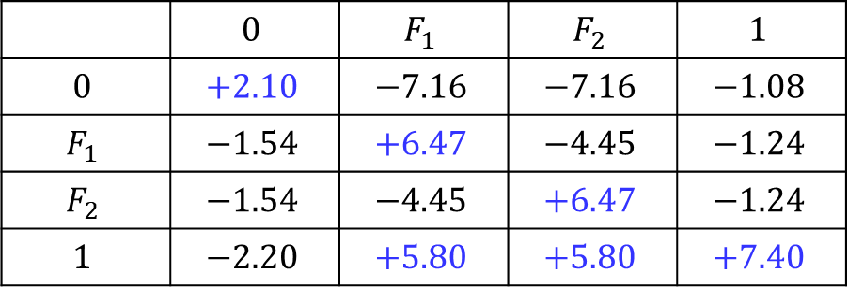

CTF Peer Prediction: Experiments
Setting: verification of Incentive-Secure PoL
CTF Protocol: a dishonest stage might be observed as a flag.
Reward matrix $R$:
 | $$0$$ | $$F_{1}$$ | $$F_{2}$$ | $$1$$
$$0$$ | $$+2.10$$ | $$−7.16$$ | $$−7.16$$ | $$−1.08$$
$$F_{1}$$ | $$−1.54$$ | $$+6.47$$ | $$−4.45$$ | $$−1.24$$
$$F_{2}$$ | $$−1.54$$ | $$−4.45$$ | $$+6.47$$ | $$−1.24$$
$$1$$ | $$−2.20$$ | $$+5.80$$ | $$+5.80$$ | $$+7.40$$

Slide 41
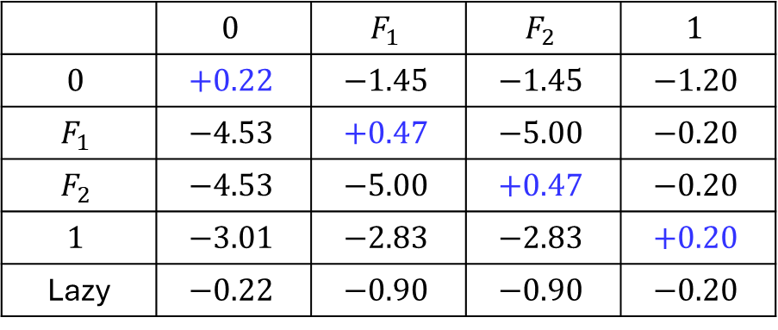

CTF Peer Prediction: Experiments (cont’d)
Utility matrix $W$, $ε=0$ (margin $δ=0.2$):
Gaining positive expected utility iff honest.
 | $$0$$ | $$F_{1}$$ | $$F_{2}$$ | $$1$$
$$0$$ | $$+0.22$$ | $$−1.45$$ | $$−1.45$$ | $$−1.20$$
$$F_{1}$$ | $$−4.53$$ | $$+0.47$$ | $$−5.00$$ | $$−0.20$$
$$F_{2}$$ | $$−4.53$$ | $$−5.00$$ | $$+0.47$$ | $$−0.20$$
$$1$$ | $$−3.01$$ | $$−2.83$$ | $$−2.83$$ | $$+0.20$$
Lazy | $$−0.22$$ | $$−0.90$$ | $$−0.90$$ | $$−0.20$$

Slide 42
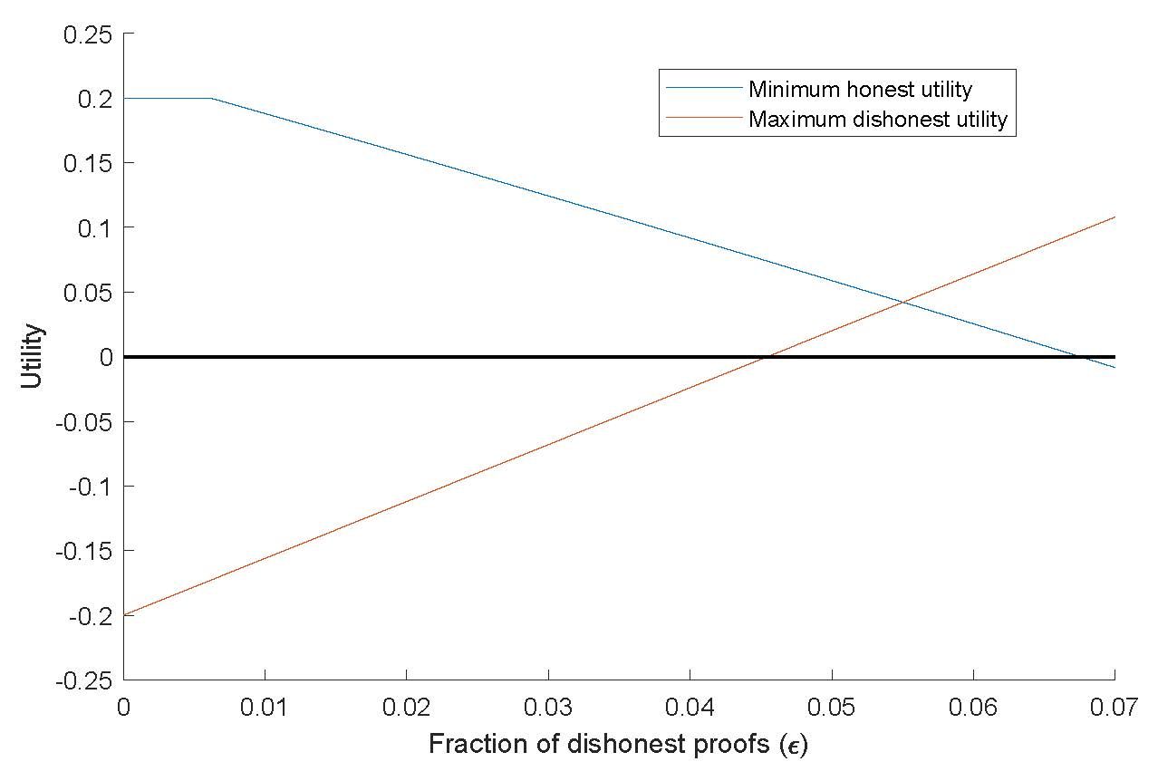

CTF Peer Prediction: Robustness
When $ε>0$ :
Works robustly when $ε<0.045.$

Slide 43
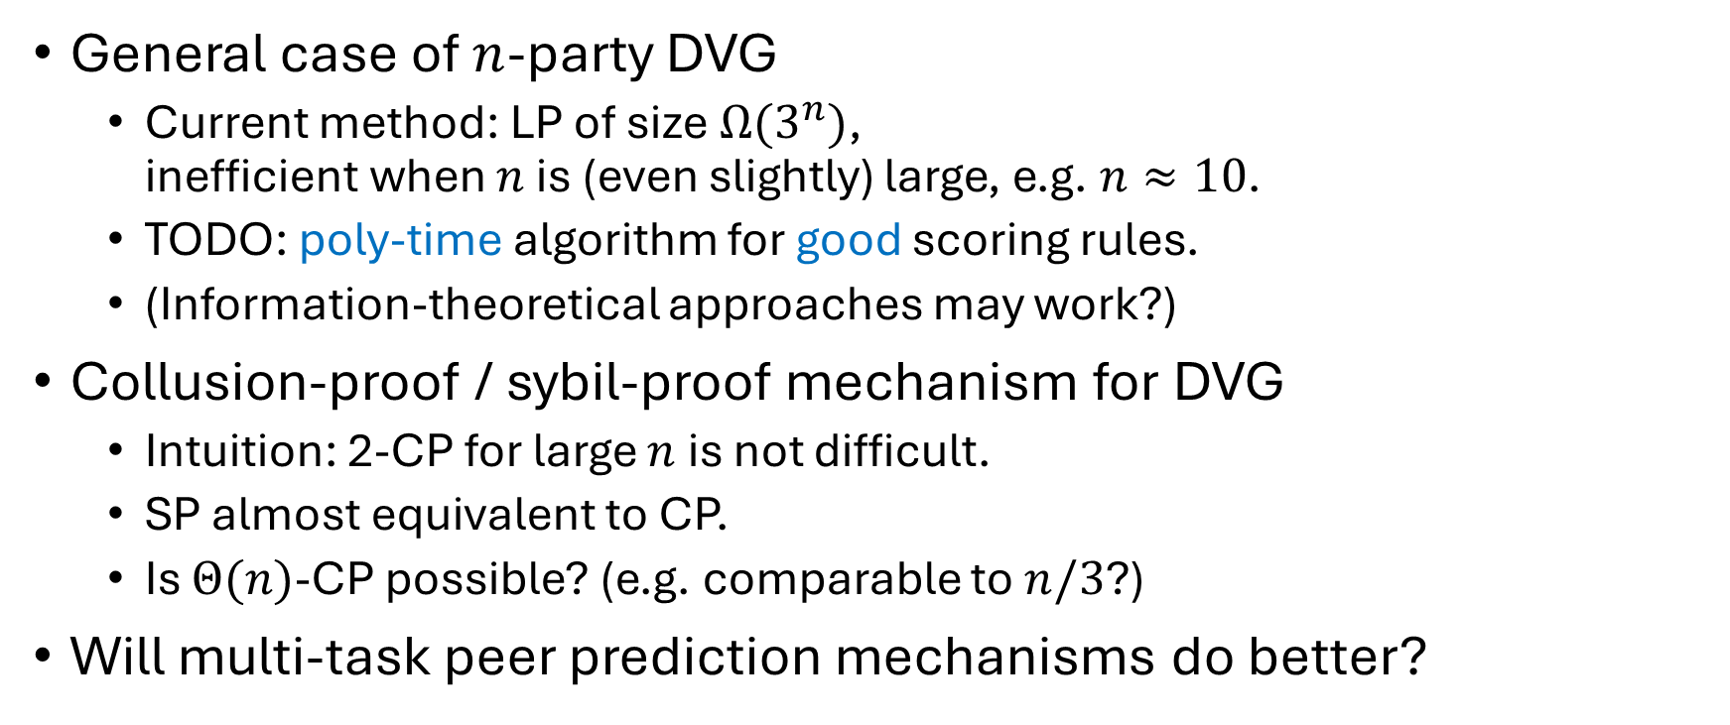
Discussion: Future Work
General case of $n$-party DVG
Current method: LP of size $Ω(3^{n})$, inefficient when $n$ is (even slightly) large, e.g. $n≈10$.
TODO: poly-time algorithm for good scoring rules.
(Information-theoretical approaches may work?)
Collusion-proof / sybil-proof mechanism for DVG
Intuition: 2-CP for large $n$ is not difficult.
SP almost equivalent to CP.
Is $Θ(n)$-CP possible? (e.g. comparable to $n/3$?)
Will multi-task peer prediction mechanisms do better?

Slide 44
Discussion: Other Applications in AI
Manipulation-proof data elicitation & valuation
Reward data providers for the mutual information between their data and others’.
Truthful Data Acquisition via Peer Prediction, NeurIPS’20 Yiling Chen, Yiheng Shen, Shuran Zheng
Feedback acquisition for AI generated contents
Elicit comparison data from user feedback to improve the quality of AI performance.
Carrot and Stick: Eliciting Comparison Data and Beyond Yiling Chen, Shi Feng, Fang-Yi Yu

Slide 45
Conclusion: Peer Prediction x Decentralized AI
Resources of AI: data & computation
Decentralization: crowdsourcing w/o centralized control
Peer Prediction: a (meta-)methodology to incentivize honesty (incl. data & computation) in a decentralized environment
Blockchain: a decentralized trustworthy platform driven by cryptography & economic incentives
Blockchain-based decentralized trustworthy AI: a starry-eyed dream?

Slide 46
Meta-Conclusion
所有的转折隐藏在密集的鸟群中
天空与海洋都无法察觉
怀着美梦却可以看见
摸索颠倒的一瞬间
“Even if you cannot see the world clearly
There is still a way to follow your mind.”

Slide 47
Q&A

