Slide 1
It Takes Two: A Peer-Prediction Solution for Blockchain Verifier’s Dilemma
Zishuo Zhao (UIUC), Xi Chen (NYU), Yuan Zhou (Tsinghua)
INFORMS Annual Meeting, October 2024

Slide 2
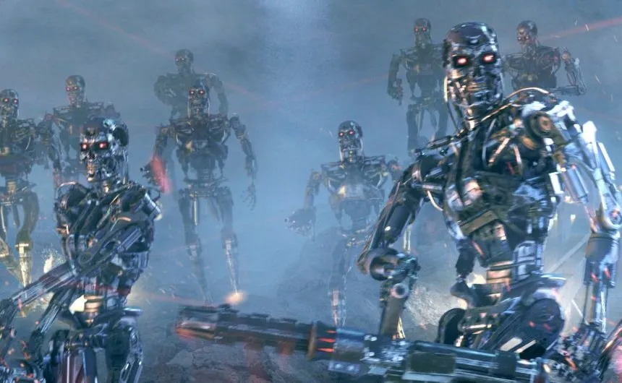
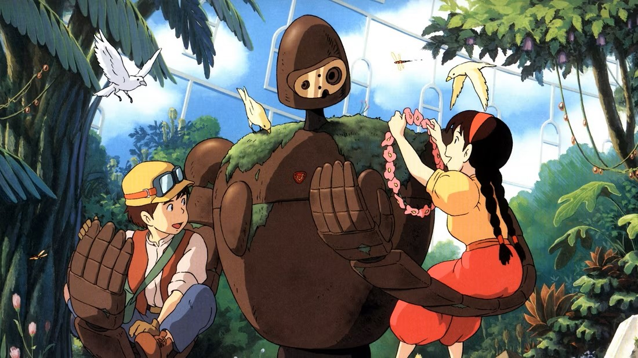
AI Safety: A Critical Concern in AGI Age
ChatGPT: herald of AGI age.
AI safety: the stronger AI becomes, the higher risk it might do evil.
AI alignment: make sure that AI’s behavior aligns with human interest.
Terminator (1984)
But… How to ensure the AI model is really aligned as claimed?
Laputa: Castle in the Sky (1986)

Slide 3
AI Safety: Threat of Untrusted Training
Malicious attacks: Bytedance (TikTok) LLM training was recently attacked by a malicious intern.
8000 H100’s were hacked for a month, >$10M loss.
Conflict of interest: If the AI is owned by a centralized party, the party may manipulate the alignment target for their interest.
Suppose that Zishuo hates multi-armed bandits.
ZishuoGPT: All papers related to multi-armed bandits should be rejected without review!
Blockchain: a decentralized platform aimed for trustworthiness.

Slide 4
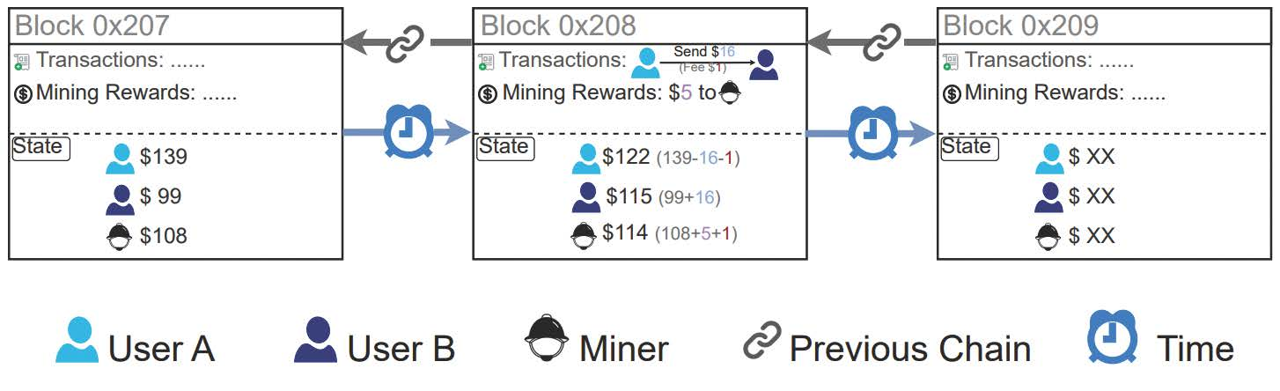
What is the Blockchain?
A growing linked-list stored in a decentralized way.
Each block: (Data, Prev_Hash (pointer), Certificate (PoW, PoS, …) )
The certificate works as an access control for the miner, an added block is valid only when the certificate passes verification.
Roles of players: provers & verifiers.

Slide 5
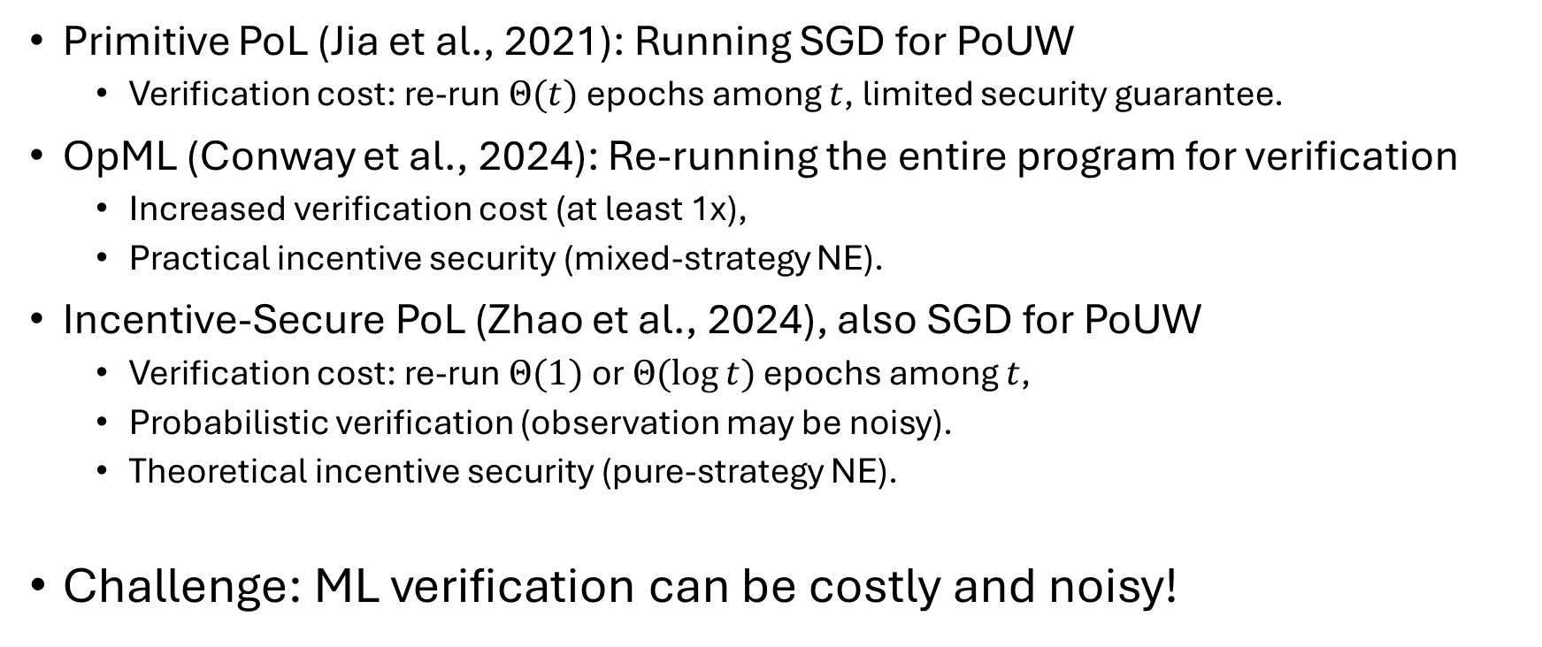
Verifiable AI Compute: Existing Work
Primitive PoL (Jia et al., 2021): Running SGD for PoUW
Verification cost: re-run $Θ(t)$ epochs among $t$, limited security guarantee.
OpML (Conway et al., 2024): Re-running the entire program for verification
Increased verification cost (at least 1x),
Practical incentive security (mixed-strategy NE).
Incentive-Secure PoL (Zhao et al., 2024), also SGD for PoUW
Verification cost: re-run $Θ(1)$ or $Θ(\log{t})$ epochs among $t$,
Probabilistic verification (observation may be noisy).
Theoretical incentive security (pure-strategy NE).
Challenge: ML verification can be costly and noisy!

Slide 6
Blockchain Security: Decentralized Consensus
What guarantees the security in a decentralized system?
Basic assumption of blockchain: the majority is honest. (i.e. no 51% attack)
Why would the majority choose be honest?
Are humans created good, or evil?
Economic assumption: humans are created rational (selfish)!

Slide 7
Verifier’s Incentive and Dilemma
Verifiers are rewarded for catching cheats, or penalized for failing to.
If a mechanism is “well-designed”, then provers are prevented or disincentivized from cheating.
But…
If no / too few provers actually cheat, why would verifiers verify, instead of lazily report “verification passed”?
Verifier’s Dilemma: For binary-report verification games with positive verification costs, it is impossible to achieve an honest pure-strategy Nash equilibrium.

Slide 8
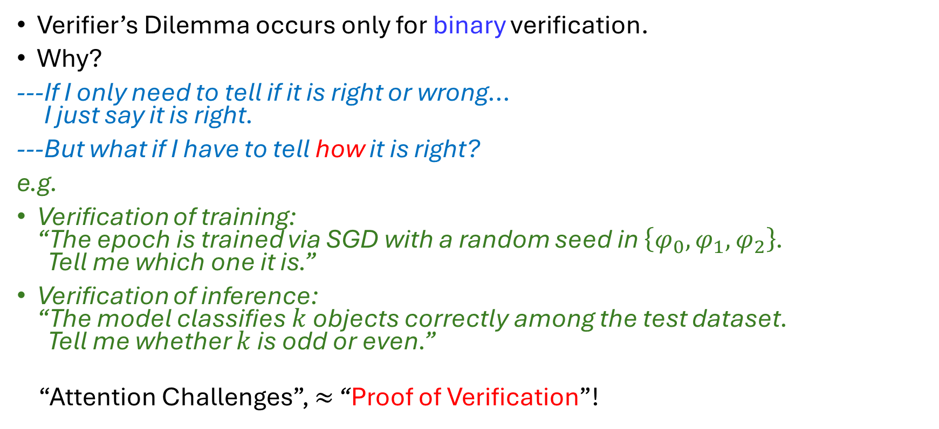
Verifier’s Dilemma: A Non-Binary Escape
Verifier’s Dilemma occurs only for binary verification.
Why?
---If I only need to tell if it is right or wrong… I just say it is right.
---But what if I have to tell how it is right?
e.g.
Verification of training: “The epoch is trained via SGD with a random seed in $\left\{φ_{0},φ_{1},φ_{2}\right\}$. Tell me which one it is.”
Verification of inference: “The model classifies $k$ objects correctly among the test dataset. Tell me whether $k$ is odd or even.”
“Attention Challenges”, $≈$ “Proof of Verification”!

Slide 9
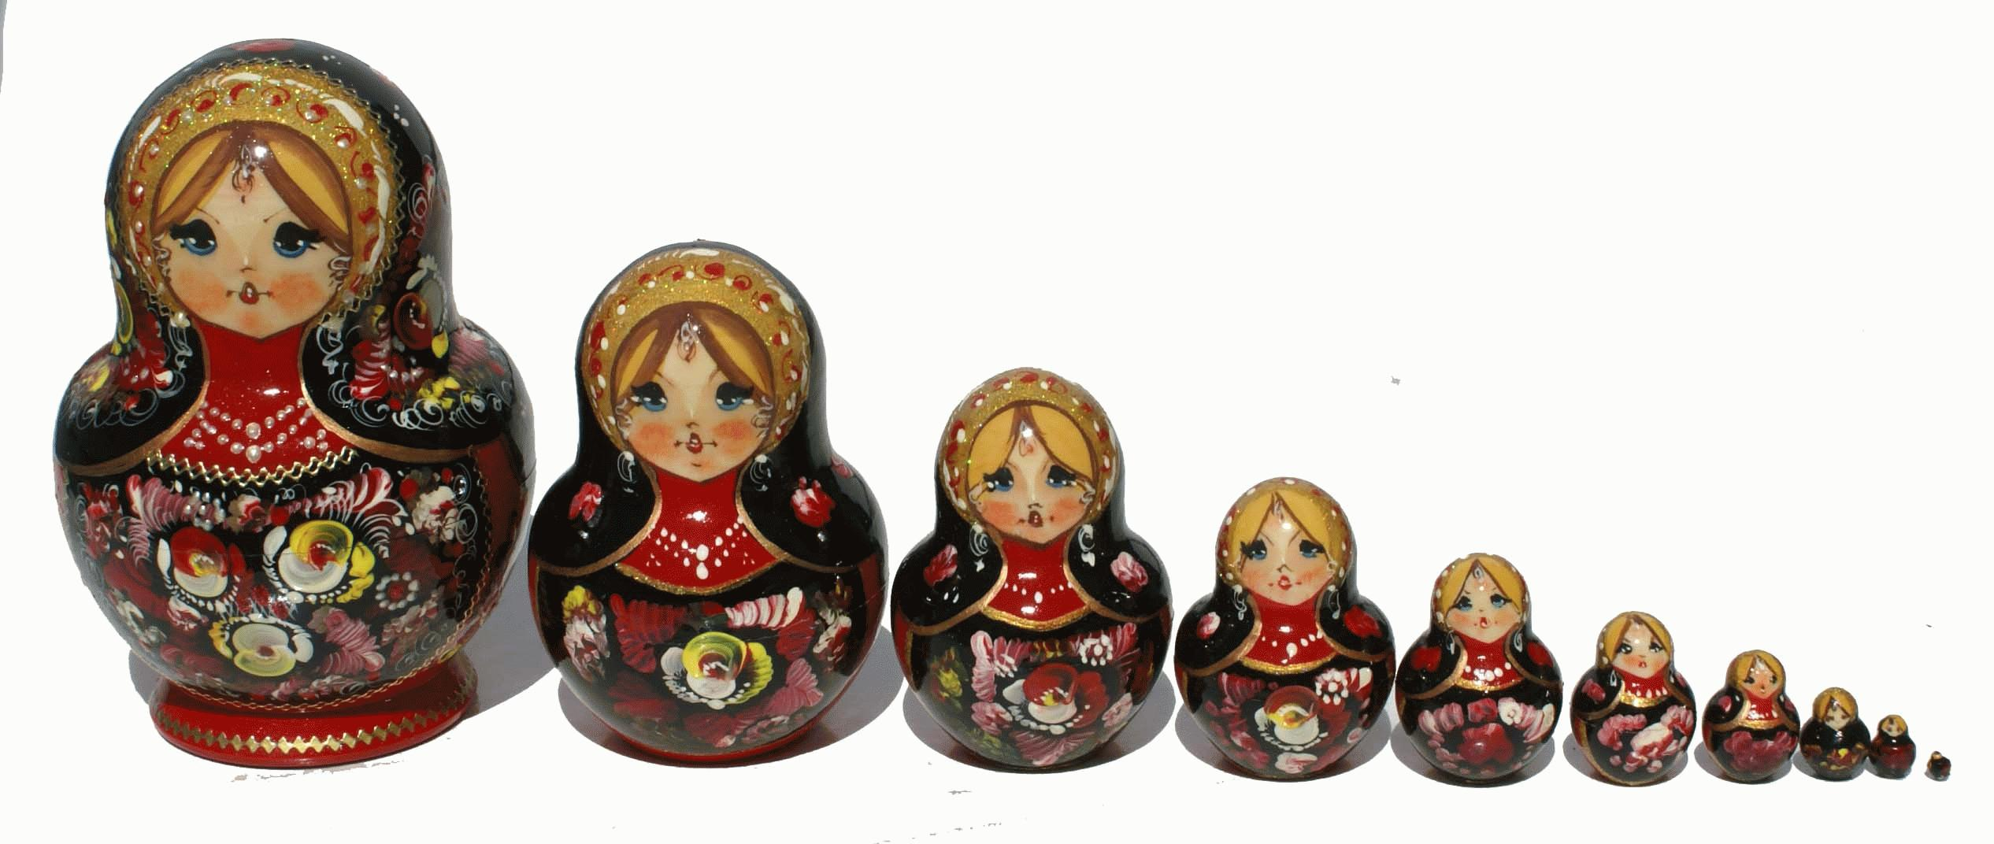
Attempted Solution: Capture-The-Flag
Existing works (e.g. Truebit): inject additional information (“flags”, non-binary verification) and reward detection of flags.
Can prevent lazy behavior, but what about malicious verifiers?
If the verification result is also expensive to verify…
We need higher-level verifiers to verify the results.
How many layers of verifiers do we need?

Slide 10
Intuition: Decentralized Verification Game
Essential takeaway: verifiers also need to be verified.
---Can we just put them in equal positions to verify each other?
Close to our solution!

Slide 11


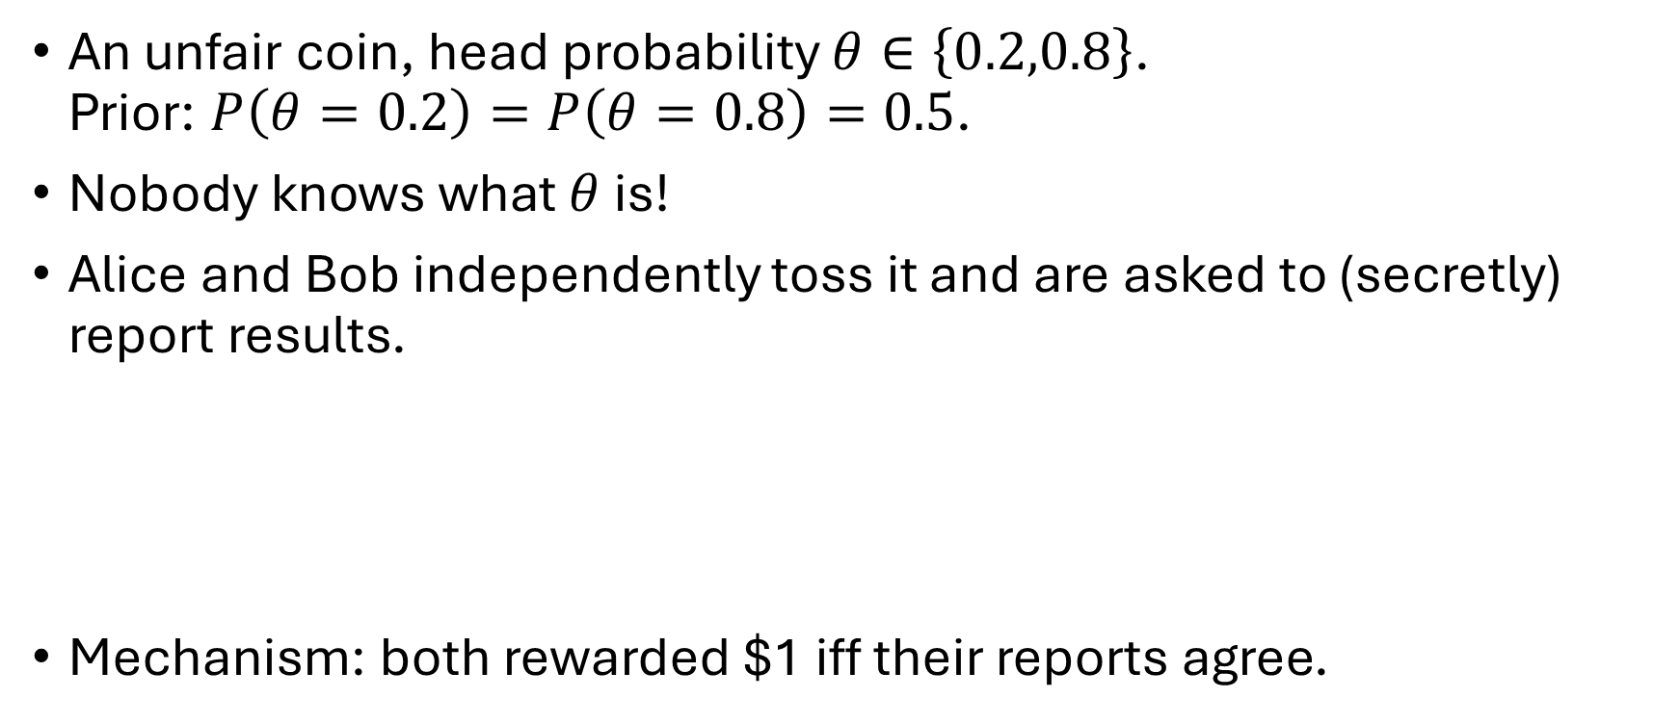
Peer Prediction: Toy Example
An unfair coin, head probability $θ∈\left\{0.2,0.8\right\}$. Prior: $P\left(θ=0.2\right)=P\left(θ=0.8\right)=0.5$.
Nobody knows what $θ$ is!
Alice and Bob independently toss it and are asked to (secretly) report results.
Mechanism: both rewarded $1 iff their reports agree.

Slide 12
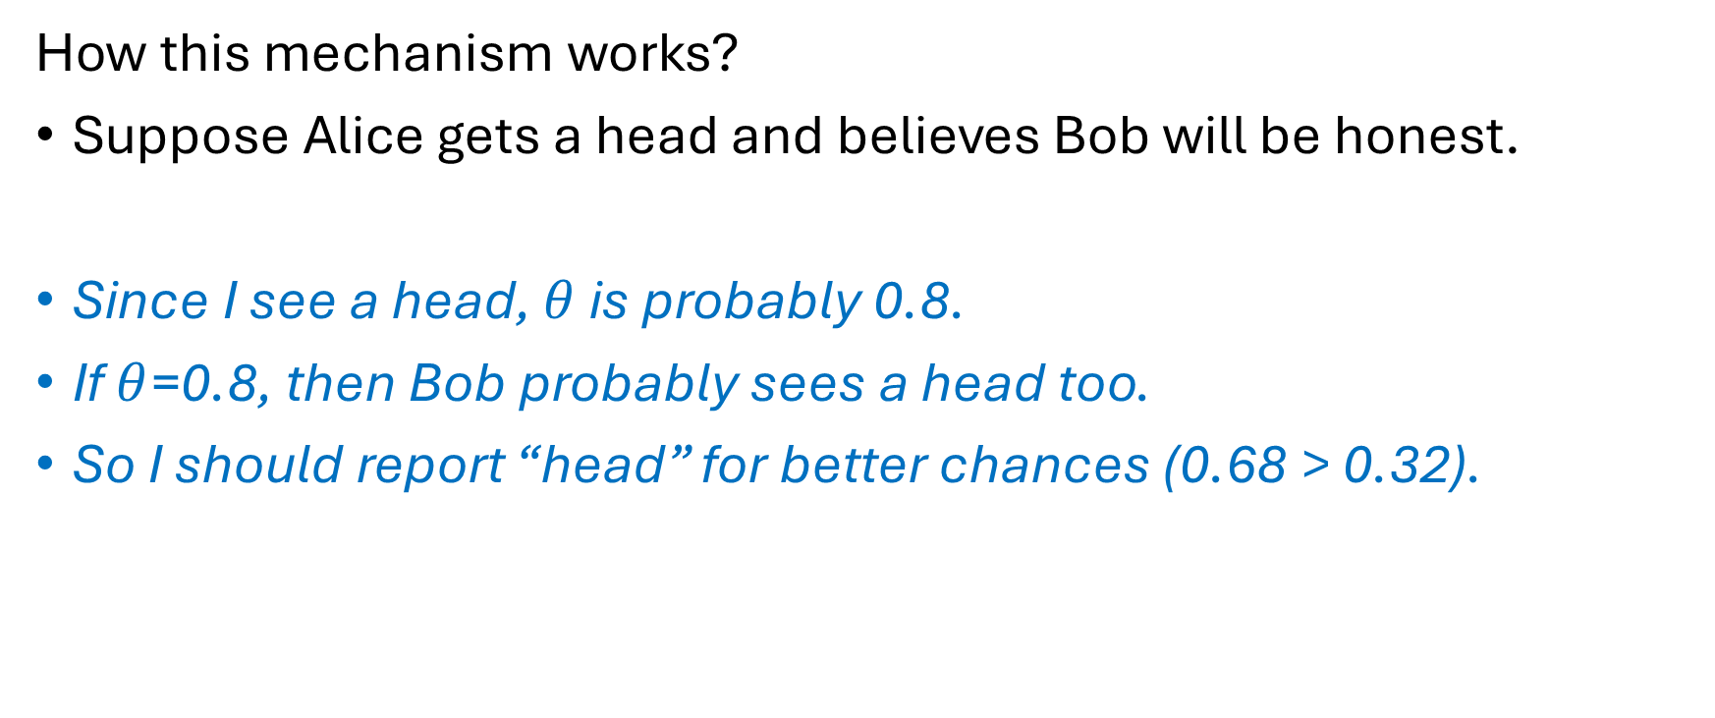
Peer Prediction: Toy Example (cont’d)
How this mechanism works?
Suppose Alice gets a head and believes Bob will be honest.
Since I see a head, $θ$ is probably 0.8.
If $θ$=0.8, then Bob probably sees a head too.
So I should report “head” for better chances (0.68 > 0.32).

Slide 13
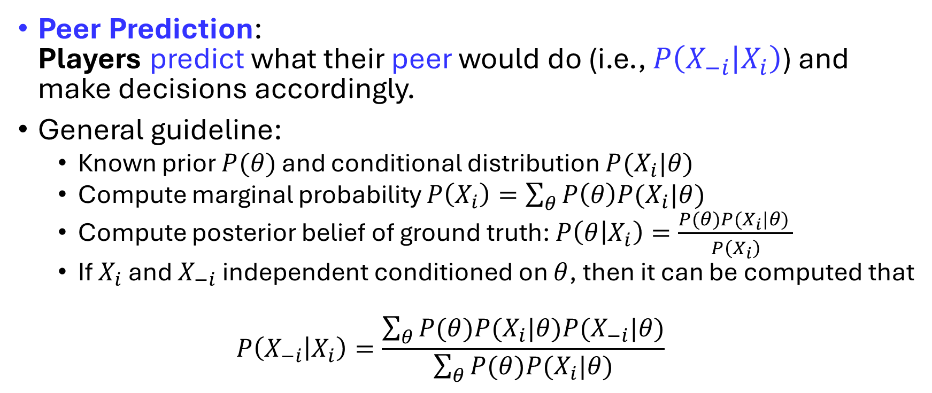
Peer Prediction: General Idea
Peer Prediction: Players predict what their peer would do (i.e., $P\left(X_{−i} | X_{i}\right)$) and make decisions accordingly.
General guideline:
Known prior $P(θ)$ and conditional distribution $P(X_{i}|θ)$
Compute marginal probability $P\left(X_{i}\right)=\sum_{θ}{P\left(θ\right)P(X_{i}|θ)}$
Compute posterior belief of ground truth: $P\left(θ | X_{i}\right)=\frac{P(θ)P(X_{i}|θ) }{P\left(X_{i}\right)}$
If $X_{i}$ and $X_{−i}$ independent conditioned on $θ$, then it can be computed that
$$P\left(X_{−i} | X_{i}\right)=\frac{\sum_{θ}{P(θ)P(X_{i}|θ)P(X_{−i}|θ)}}{\sum_{θ}{P(θ)P(X_{i}|θ)}}$$

Slide 14
Peer Prediction: A Confusing Name?
The name might be confusing as it describes what players do.
What does the mechanism do?
Incentivizing truthful report (action) without access to ground truth.
Valuable for (fully) decentralized environments!
Quite under-explored in studies of blockchain & decentralized consensus mechanism design.

Slide 15
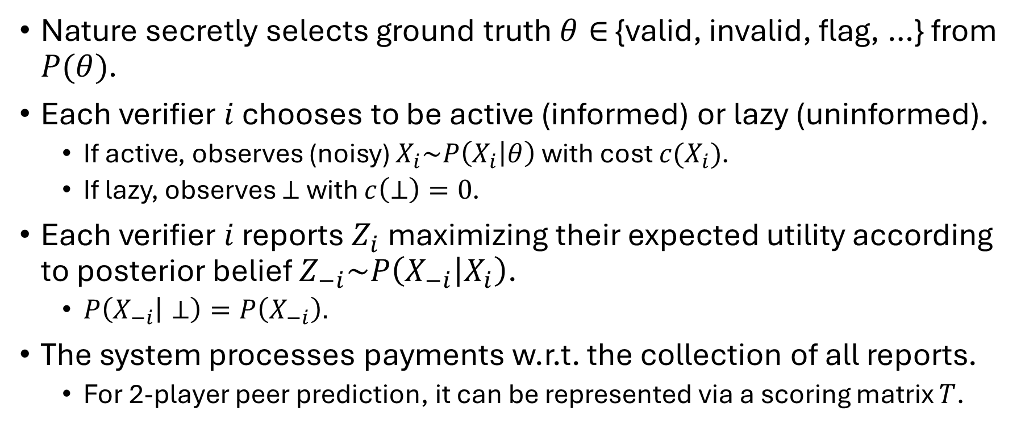
CTF Peer Prediction: The Pipeline
Nature secretly selects ground truth $θ∈$ {valid, invalid, flag, …} from $P(θ)$.
Each verifier $i$ chooses to be active (informed) or lazy (uninformed).
If active, observes (noisy) $X_{i}\sim P\left(X_{i} | θ\right)$ with cost $c(X_{i})$.
If lazy, observes $⊥$ with $c\left(⊥\right)=0$.
Each verifier $i$ reports $Z_{i}$ maximizing their expected utility according to posterior belief $Z_{−i}\sim P\left(X_{−i} | X_{i}\right)$.
$P\left(X_{−i} | ⊥\right)=P\left(X_{−i}\right).$
The system processes payments w.r.t. the collection of all reports.
For 2-player peer prediction, it can be represented via a scoring matrix $T$.

Slide 16
CTF Peer Prediction: Theoretical Guarantees
Main Theorem: For any non-degenerate 2-party decentralized verification games, there exists a peer prediction mechanism satisfying desired incentive properties.
How to generalize to multi-party DVG?
Match each party with everyone else and take the average!
@Mean-field games
How to find the mechanism?
Linear Programming!

Slide 17
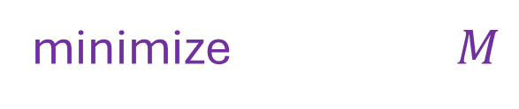
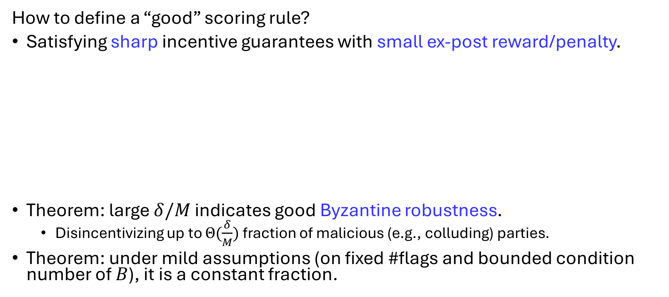

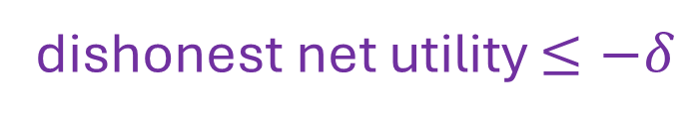
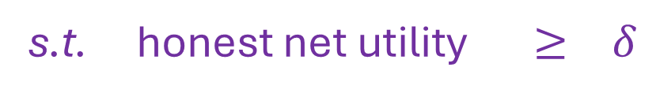
CTF Peer Prediction: Optimization
How to define a “good” scoring rule?
Satisfying sharp incentive guarantees with small ex-post reward/penalty.
Theorem: large $δ/M$ indicates good Byzantine robustness.
Disincentivizing up to $Θ(\frac{δ}{M})$ fraction of malicious (e.g., colluding) parties.
Theorem: under mild assumptions (on fixed #flags and bounded condition number of $B$), it is a constant fraction.
minimize $M$
s.t. honest net utility $≥ δ$
dishonest net utility $≤−δ$
$|T|$ $≤ M$

Slide 18
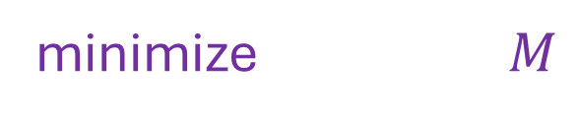
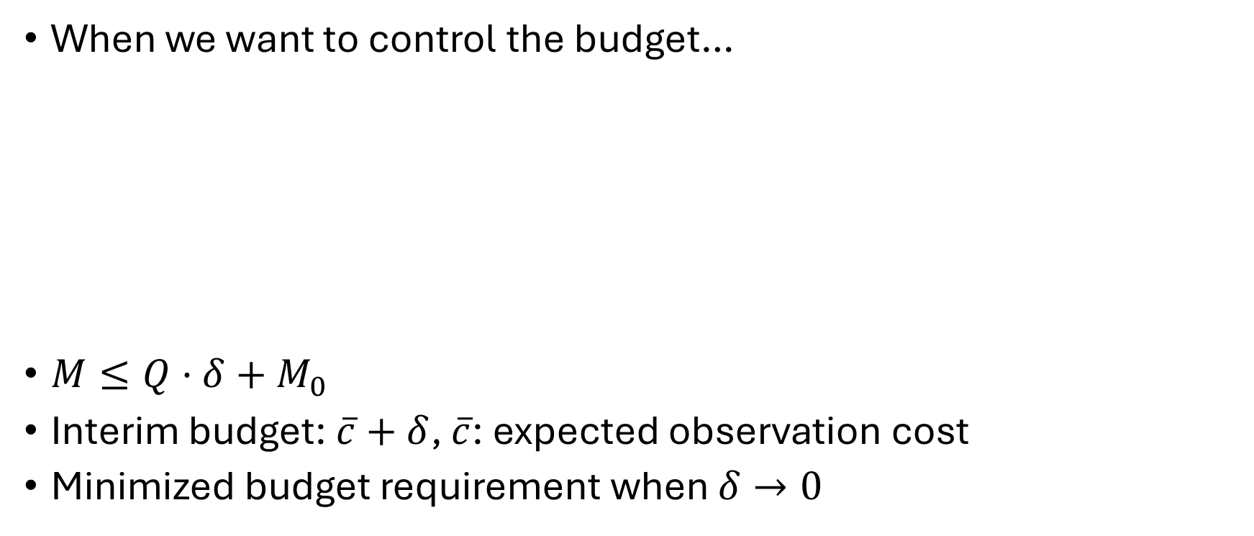

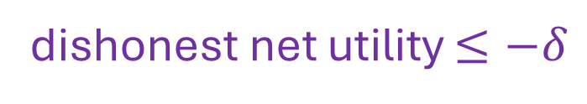
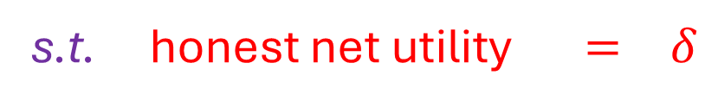
CTF Peer Prediction: Budget vs. Robustness
When we want to control the budget…
$M≤Q·δ+M_{0}$
Interim budget: $\overline{c}+δ$, $\overline{c}$: expected observation cost
Minimized budget requirement when $δ→0$
minimize $M$
s.t. honest net utility $= δ$
dishonest net utility $≤−δ$
$|T|$ $≤ M$

Slide 19
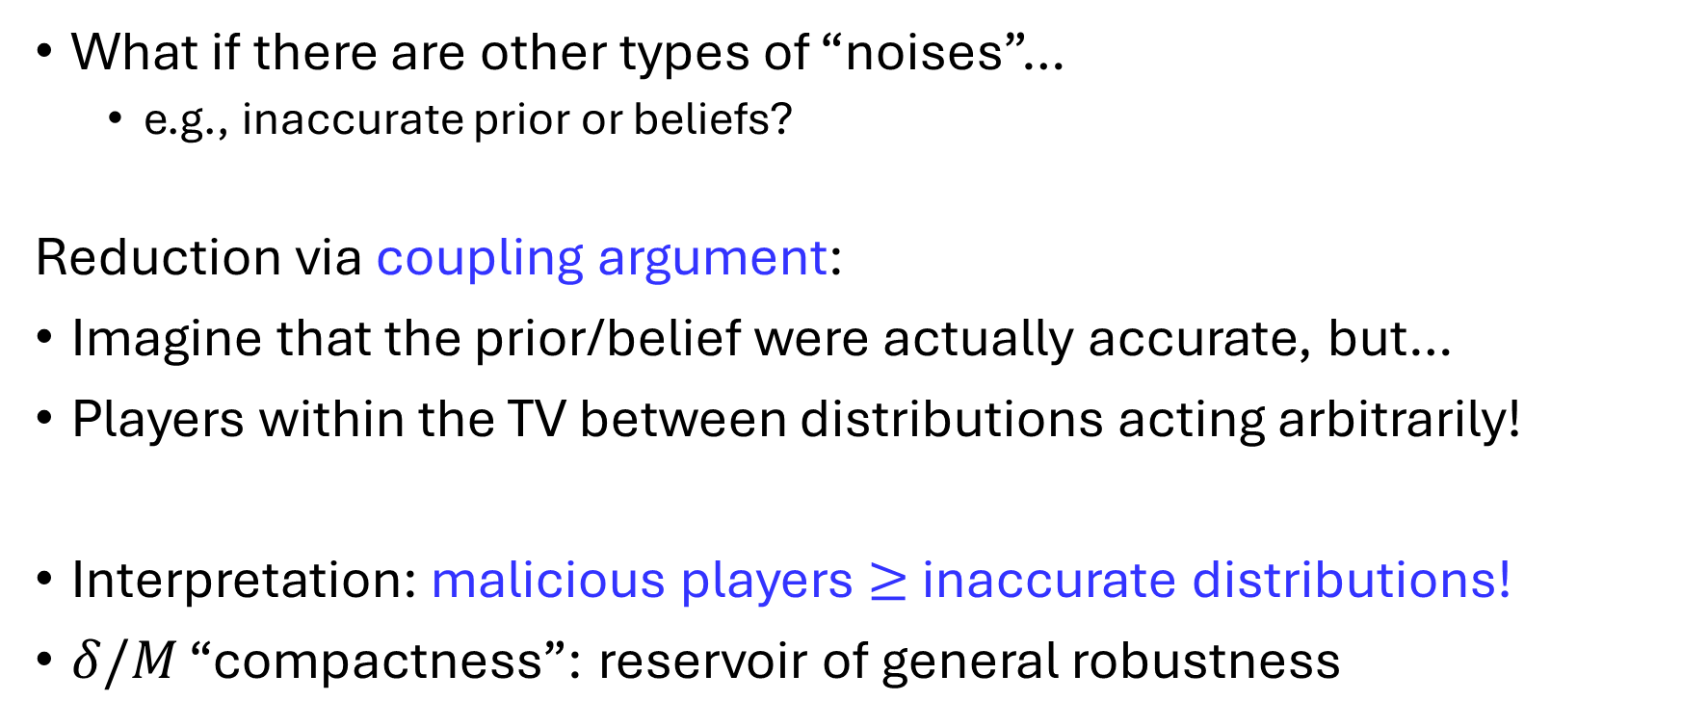
Byzantine-Robust PP: Universal Robustness?
What if there are other types of “noises”…
e.g., inaccurate prior or beliefs?
Reduction via coupling argument:
Imagine that the prior/belief were actually accurate, but…
Players within the TV between distributions acting arbitrarily!
Interpretation: malicious players $≥$ inaccurate distributions!
$δ/M$ “compactness”: reservoir of general robustness

Slide 20
Conclusion: Our Contribution
Theoretical formulation of decentralized verification games (DVG).
Proposal of peer prediction for DVG.
Replacing simple majority vote with theoretical incentive guarantees.
Robust peer prediction resilient to malicious (Byzantine) players w/ budget control.

Slide 21
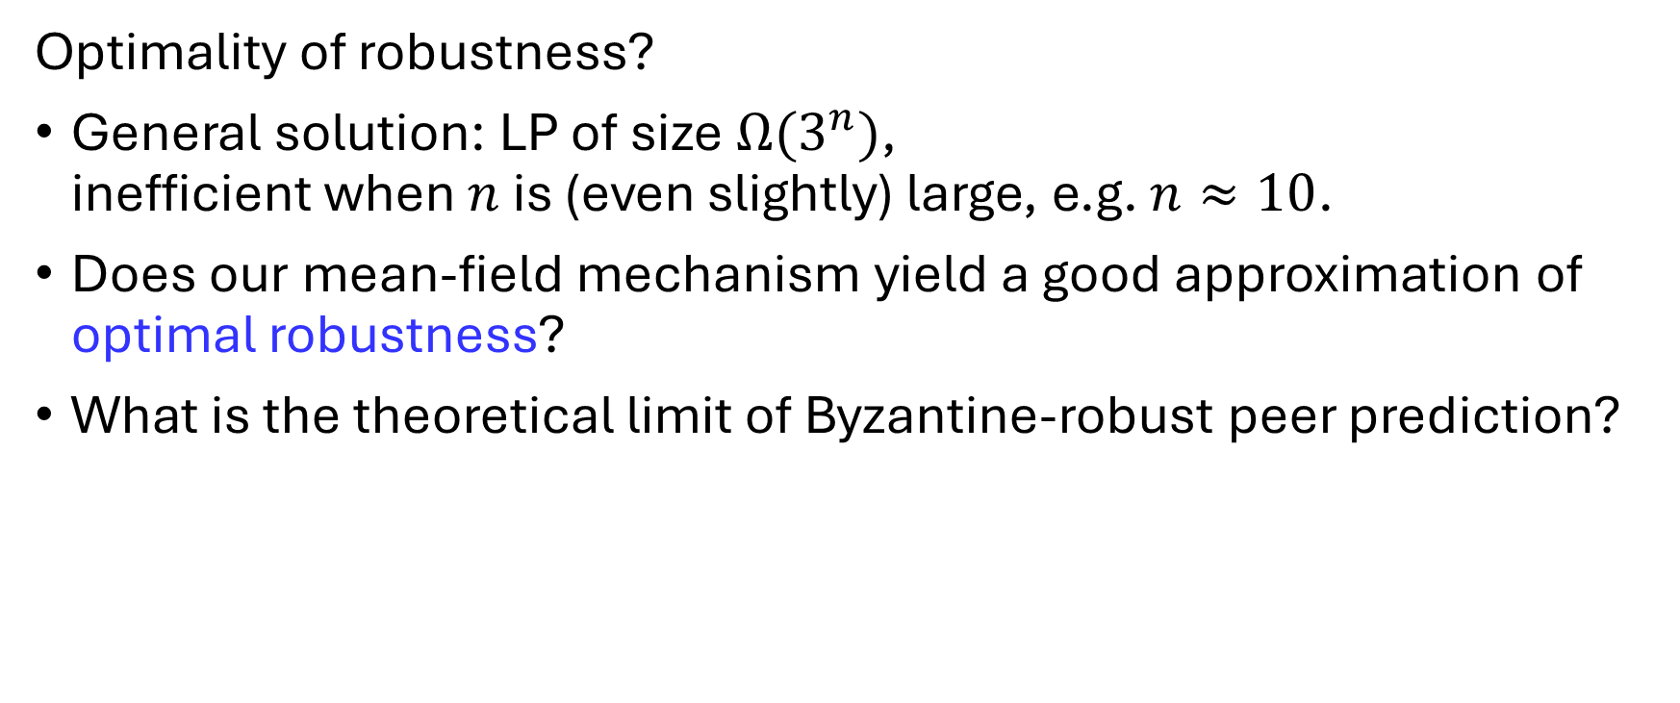
Discussion: Future Work
Optimality of robustness?
General solution: LP of size $Ω(3^{n})$, inefficient when $n$ is (even slightly) large, e.g. $n≈10$.
Does our mean-field mechanism yield a good approximation of optimal robustness?
What is the theoretical limit of Byzantine-robust peer prediction?

Slide 22
Q&A

