Slide 1



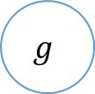







$$1$$
$$b$$
$$x1$$
$$ω1$$
$$x2$$
$$ω2$$
∑
$$g$$
y
$$ω3$$
$$x3$$
激活函数
输出
$$ωn$$
…
$$xn$$
权重
输入

Slide 2
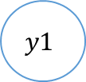



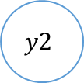


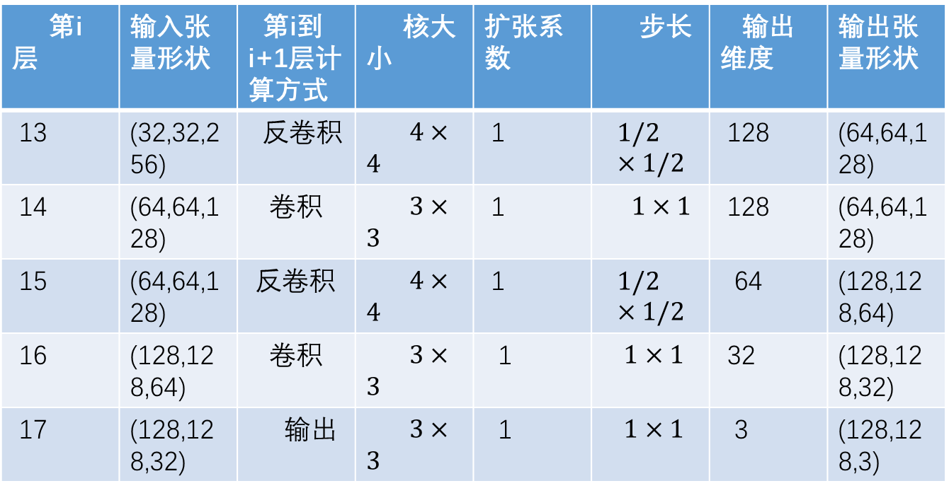
$$b1$$
$$b2$$
$$y1$$
h1
$$x1$$
h2
$$y2$$
$$x2$$
$$x3$$
h3
第i层 | 输入张量形状 | 第i到i+1层计算方式 | 核大小 | 扩张系数 | 步长 | 输出维度 | 输出张量形状
13 | (32,32,256) | 反卷积 | $4×4$ | 1 | $$1/2×1/2$$ | 128 | (64,64,128)
14 | (64,64,128) | 卷积 | $3×3$ | 1 | $1×1$ | 128 | (64,64,128)
15 | (64,64,128) | 反卷积 | $4×4$ | 1 | $$1/2×1/2$$ | 64 | (128,128,64)
16 | (128,128,64) | 卷积 | $3×3$ | 1 | $1×1$ | 32 | (128,128,32)
17 | (128,128,32) | 输出 | $3×3$ | 1 | $1×1$ | 3 | (128,128,3)

Slide 3


真实数据x
$$x$$
判别器D
判别结果
生成样本$G(z)$
随机噪声z
生成器G

Slide 4
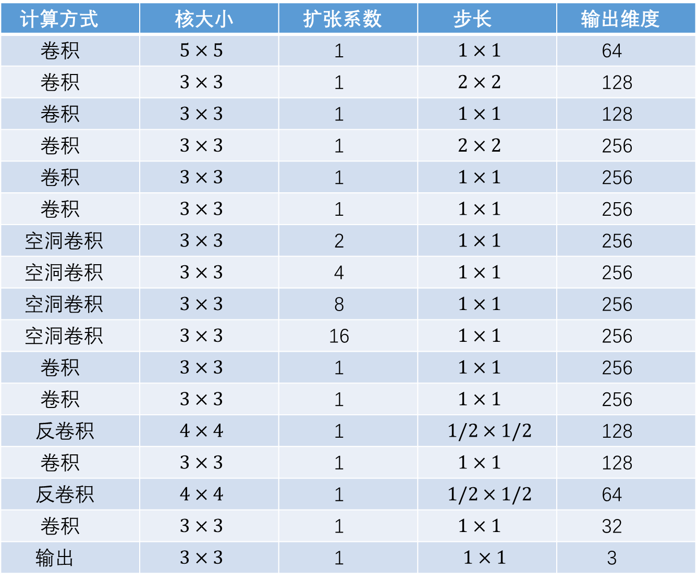
计算方式 | 核大小 | 扩张系数 | 步长 | 输出维度
卷积 | $5×5$ | 1 | $1×1$ | 64
卷积 | $3×3$ | 1 | $2×2$ | 128
卷积 | $3×3$ | 1 | $1×1$ | 128
卷积 | $3×3$ | 1 | $2×2$ | 256
卷积 | $3×3$ | 1 | $1×1$ | 256
卷积 | $3×3$ | 1 | $1×1$ | 256
空洞卷积 | $3×3$ | 2 | $1×1$ | 256
空洞卷积 | $3×3$ | 4 | $1×1$ | 256
空洞卷积 | $3×3$ | 8 | $1×1$ | 256
空洞卷积 | $3×3$ | 16 | $1×1$ | 256
卷积 | $3×3$ | 1 | $1×1$ | 256
卷积 | $3×3$ | 1 | $1×1$ | 256
反卷积 | $4×4$ | 1 | $1/2×1/2$ | 128
卷积 | $3×3$ | 1 | $1×1$ | 128
反卷积 | $4×4$ | 1 | $1/2×1/2$ | 64
卷积 | $3×3$ | 1 | $1×1$ | 32
输出 | $3×3$ | 1 | $1×1$ | 3

Slide 5
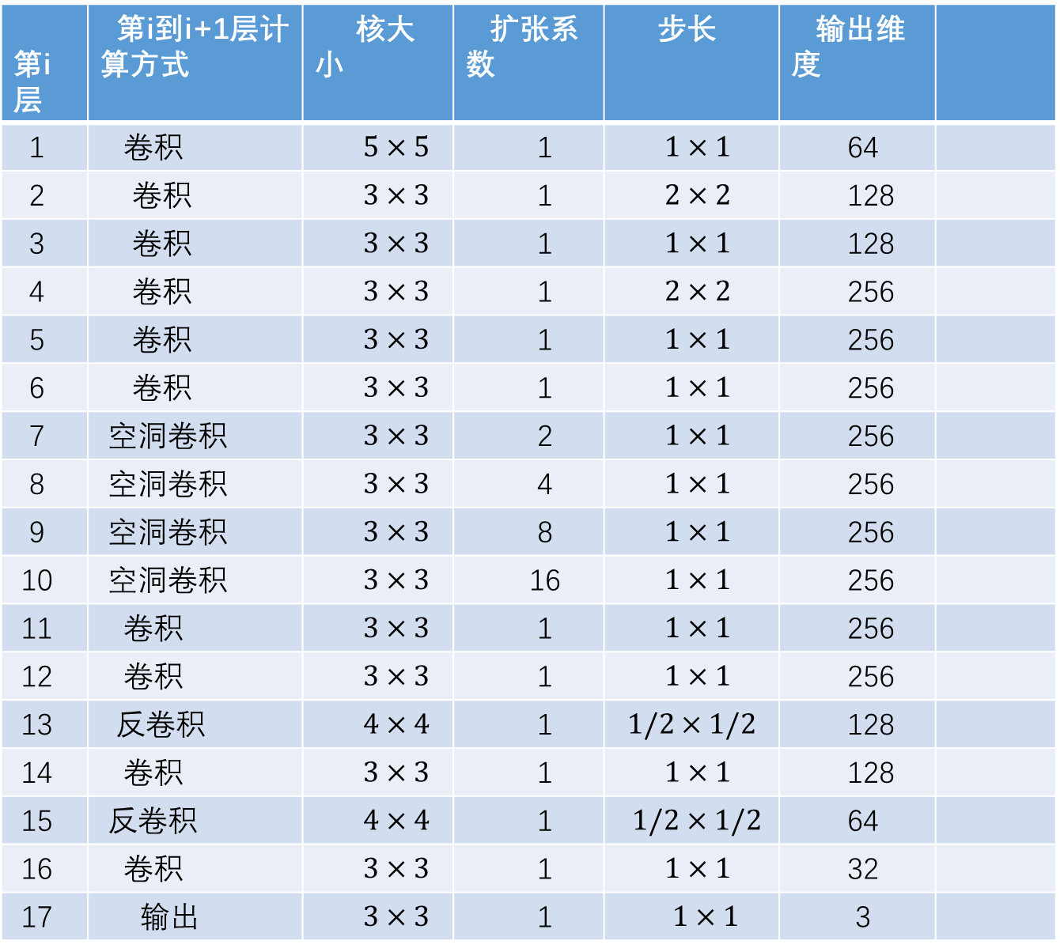
第i层 | 第i到i+1层计算方式 | 核大小 | 扩张系数 | 步长 | 输出维度
1 | 卷积 | $5×5$ | 1 | $1×1$ | 64
2 | 卷积 | $3×3$ | 1 | $2×2$ | 128
3 | 卷积 | $3×3$ | 1 | $1×1$ | 128
4 | 卷积 | $3×3$ | 1 | $2×2$ | 256
5 | 卷积 | $3×3$ | 1 | $1×1$ | 256
6 | 卷积 | $3×3$ | 1 | $1×1$ | 256
7 | 空洞卷积 | $3×3$ | 2 | $1×1$ | 256
8 | 空洞卷积 | $3×3$ | 4 | $1×1$ | 256
9 | 空洞卷积 | $3×3$ | 8 | $1×1$ | 256
10 | 空洞卷积 | $3×3$ | 16 | $1×1$ | 256
11 | 卷积 | $3×3$ | 1 | $1×1$ | 256
12 | 卷积 | $3×3$ | 1 | $1×1$ | 256
13 | 反卷积 | $4×4$ | 1 | $$1/2×1/2$$ | 128
14 | 卷积 | $3×3$ | 1 | $1×1$ | 128
15 | 反卷积 | $4×4$ | 1 | $1/2×1/2$ | 64
16 | 卷积 | $3×3$ | 1 | $1×1$ | 32
17 | 输出 | $3×3$ | 1 | $1×1$ | 3

Slide 6
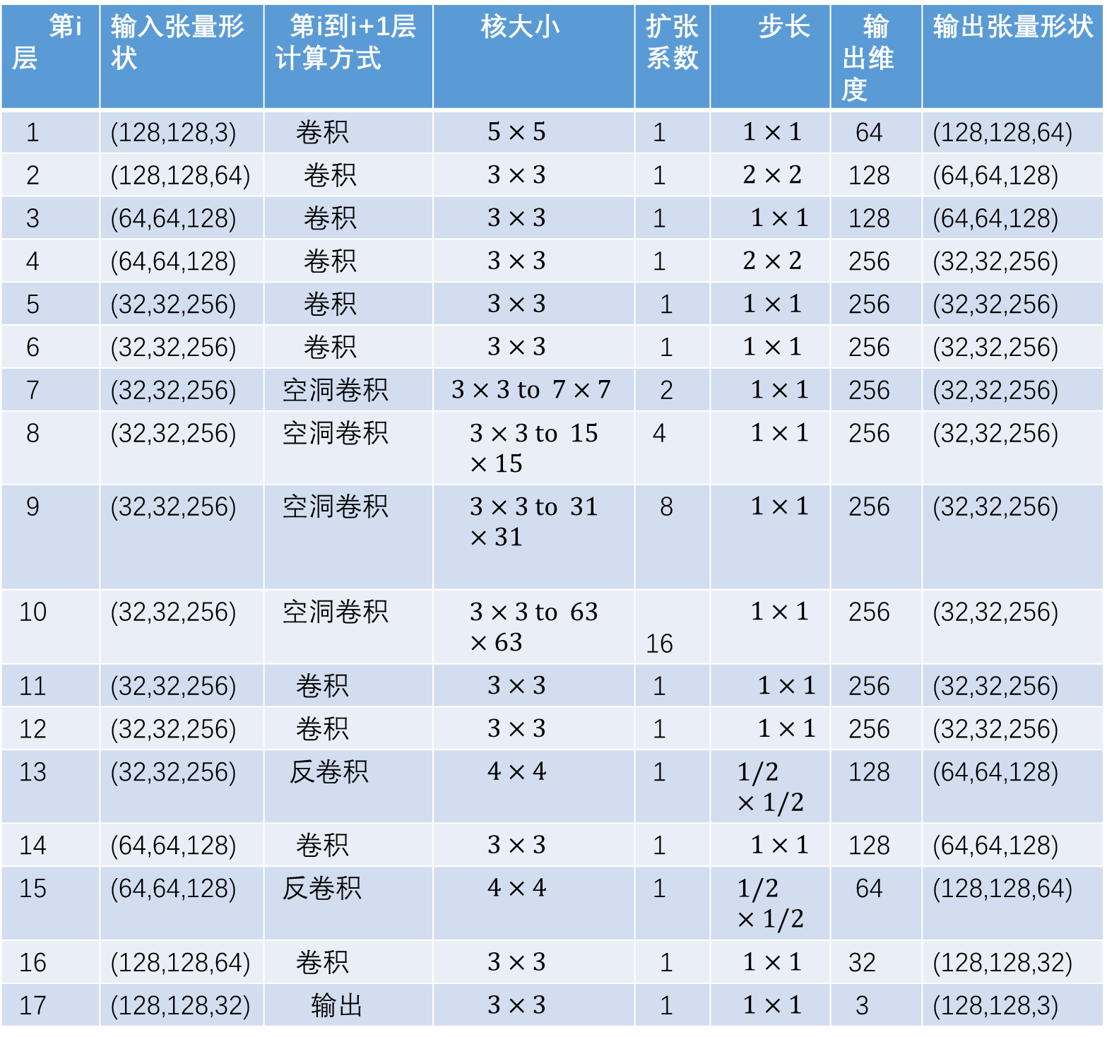
第i层 | 输入张量形状 | 第i到i+1层计算方式 | 核大小 | 扩张系数 | 步长 | 输出维度 | 输出张量形状
1 | (128,128,3) | 卷积 | $5×5$ | 1 | $1×1$ | 64 | (128,128,64)
2 | (128,128,64) | 卷积 | $3×3$ | 1 | $2×2$ | 128 | (64,64,128)
3 | (64,64,128) | 卷积 | $3×3$ | 1 | $1×1$ | 128 | (64,64,128)
4 | (64,64,128) | 卷积 | $3×3$ | 1 | $2×2$ | 256 | (32,32,256)
5 | (32,32,256) | 卷积 | $3×3$ | 1 | $1×1$ | 256 | (32,32,256)
6 | (32,32,256) | 卷积 | $3×3$ | 1 | $1×1$ | 256 | (32,32,256)
7 | (32,32,256) | 空洞卷积 | $3×3 to 7×7$ | 2 | $1×1$ | 256 | (32,32,256)
8 | (32,32,256) | 空洞卷积 | $$3×3 to 15×15$$ | 4 | $1×1$ | 256 | (32,32,256)
9 | (32,32,256) | 空洞卷积 | $$3×3 to 31×31$$ | 8 | $1×1$ | 256 | (32,32,256)
10 | (32,32,256) | 空洞卷积 | $$3×3 to 63×63$$ | 16 | $1×1$ | 256 | (32,32,256)
11 | (32,32,256) | 卷积 | $3×3$ | 1 | $1×1$ | 256 | (32,32,256)
12 | (32,32,256) | 卷积 | $3×3$ | 1 | $1×1$ | 256 | (32,32,256)
13 | (32,32,256) | 反卷积 | $4×4$ | 1 | $$1/2×1/2$$ | 128 | (64,64,128)
14 | (64,64,128) | 卷积 | $3×3$ | 1 | $1×1$ | 128 | (64,64,128)
15 | (64,64,128) | 反卷积 | $4×4$ | 1 | $$1/2×1/2$$ | 64 | (128,128,64)
16 | (128,128,64) | 卷积 | $3×3$ | 1 | $1×1$ | 32 | (128,128,32)
17 | (128,128,32) | 输出 | $3×3$ | 1 | $1×1$ | 3 | (128,128,3)

Slide 7
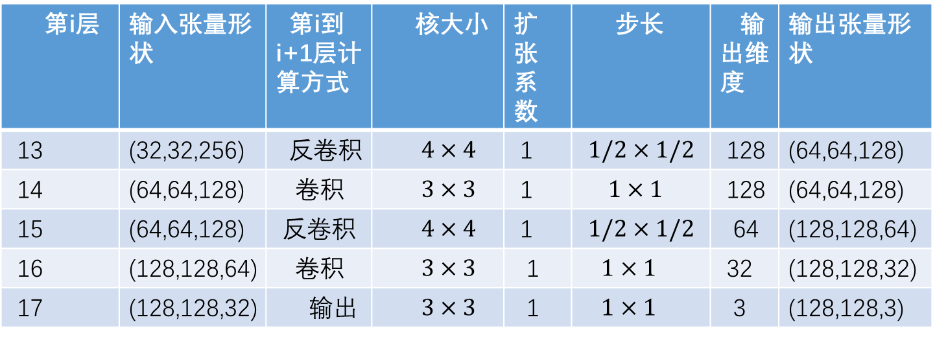
第i层 | 输入张量形状 | 第i到i+1层计算方式 | 核大小 | 扩张系数 | 步长 | 输出维度 | 输出张量形状
13 | (32,32,256) | 反卷积 | $4×4$ | 1 | $$1/2×1/2$$ | 128 | (64,64,128)
14 | (64,64,128) | 卷积 | $3×3$ | 1 | $1×1$ | 128 | (64,64,128)
15 | (64,64,128) | 反卷积 | $4×4$ | 1 | $$1/2×1/2$$ | 64 | (128,128,64)
16 | (128,128,64) | 卷积 | $3×3$ | 1 | $1×1$ | 32 | (128,128,32)
17 | (128,128,32) | 输出 | $3×3$ | 1 | $1×1$ | 3 | (128,128,3)

Slide 8
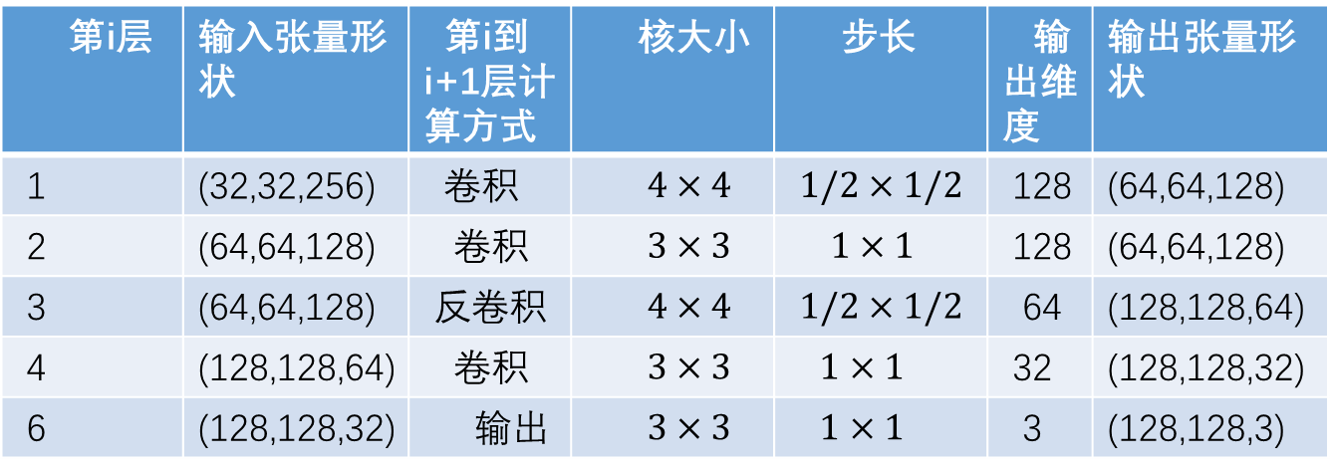
第i层 | 输入张量形状 | 第i到i+1层计算方式 | 核大小 | 步长 | 输出维度 | 输出张量形状
1 | (32,32,256) | 卷积 | $4×4$ | $$1/2×1/2$$ | 128 | (64,64,128)
2 | (64,64,128) | 卷积 | $3×3$ | $1×1$ | 128 | (64,64,128)
3 | (64,64,128) | 反卷积 | $4×4$ | $$1/2×1/2$$ | 64 | (128,128,64)
4 | (128,128,64) | 卷积 | $3×3$ | $1×1$ | 32 | (128,128,32)
6 | (128,128,32) | 输出 | $3×3$ | $1×1$ | 3 | (128,128,3)

Slide 9
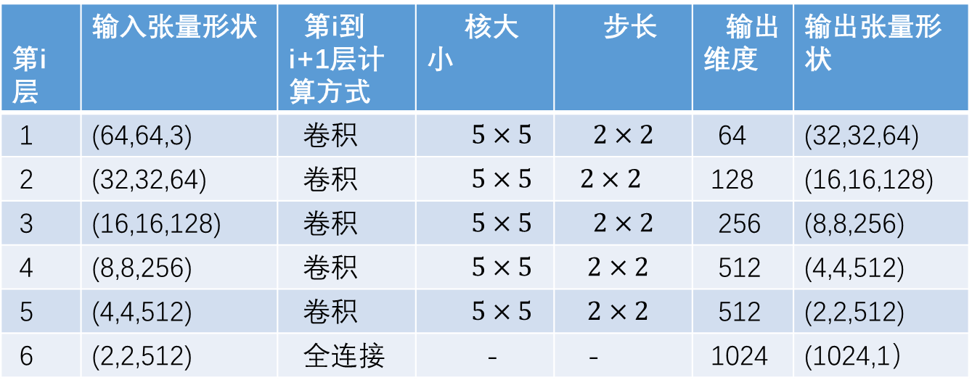
第i层 | 输入张量形状 | 第i到i+1层计算方式 | 核大小 | 步长 | 输出维度 | 输出张量形状
1 | (64,64,3) | 卷积 | $5×5$ | $$2×2$$ | 64 | (32,32,64)
2 | (32,32,64) | 卷积 | $5×5$ | $2×2$ | 128 | (16,16,128)
3 | (16,16,128) | 卷积 | $5×5$ | $$2×2$$ | 256 | (8,8,256)
4 | (8,8,256) | 卷积 | $5×5$ | $2×2$ | 512 | (4,4,512)
5 | (4,4,512) | 卷积 | $5×5$ | $2×2$ | 512 | (2,2,512)
6 | (2,2,512) | 全连接 | - | - | 1024 | (1024,1）

Slide 10
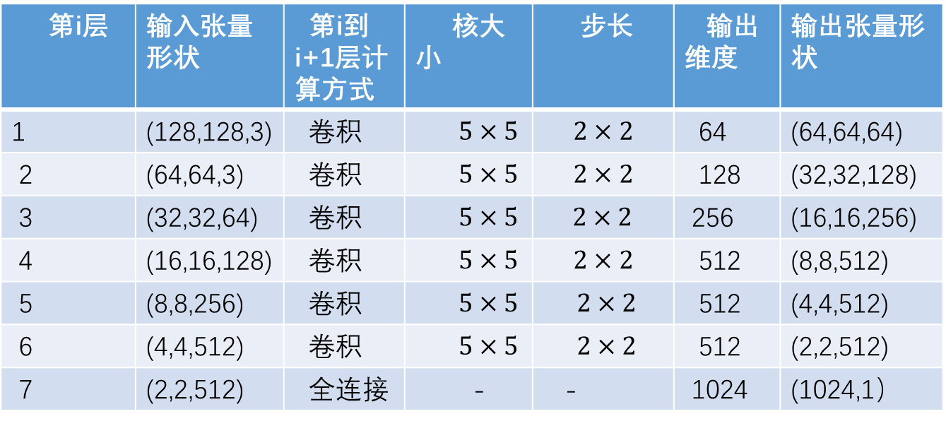
第i层 | 输入张量形状 | 第i到i+1层计算方式 | 核大小 | 步长 | 输出维度 | 输出张量形状
1 | (128,128,3) | 卷积 | $5×5$ | $$2×2$$ | 64 | (64,64,64)
2 | (64,64,3) | 卷积 | $5×5$ | $$2×2$$ | 128 | (32,32,128)
3 | (32,32,64) | 卷积 | $5×5$ | $2×2$ | 256 | (16,16,256)
4 | (16,16,128) | 卷积 | $5×5$ | $$2×2$$ | 512 | (8,8,512)
5 | (8,8,256) | 卷积 | $5×5$ | $2×2$ | 512 | (4,4,512)
6 | (4,4,512) | 卷积 | $5×5$ | $2×2$ | 512 | (2,2,512)
7 | (2,2,512) | 全连接 | - | - | 1024 | (1024,1）

Slide 11
真实数据x
$$x$$
判别器D
判别结果
生成样本$G(z)$
生成器G

