Slide 1
YT Trending Est App
Isha Baxi Data Science 220
Zachary Vrabel Prof. Lee
Jaehoon Ha
Zhejing Shi
Sophie Massolas
Wilfred Fontanez

Slide 2
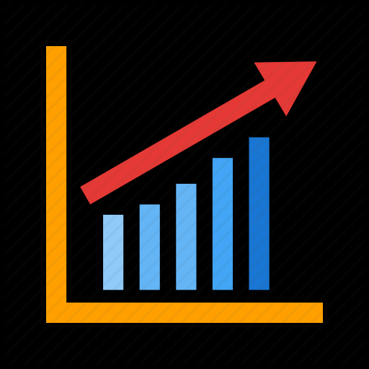
Youtube will soon become the main format used for entertainment in the US replacing standard cable televisions
Wilfred

Slide 3

With more and more content creators joining youtube The need for an application that allows people to estimate there chance at success is essential to help them create better content
Wilfred

Slide 4
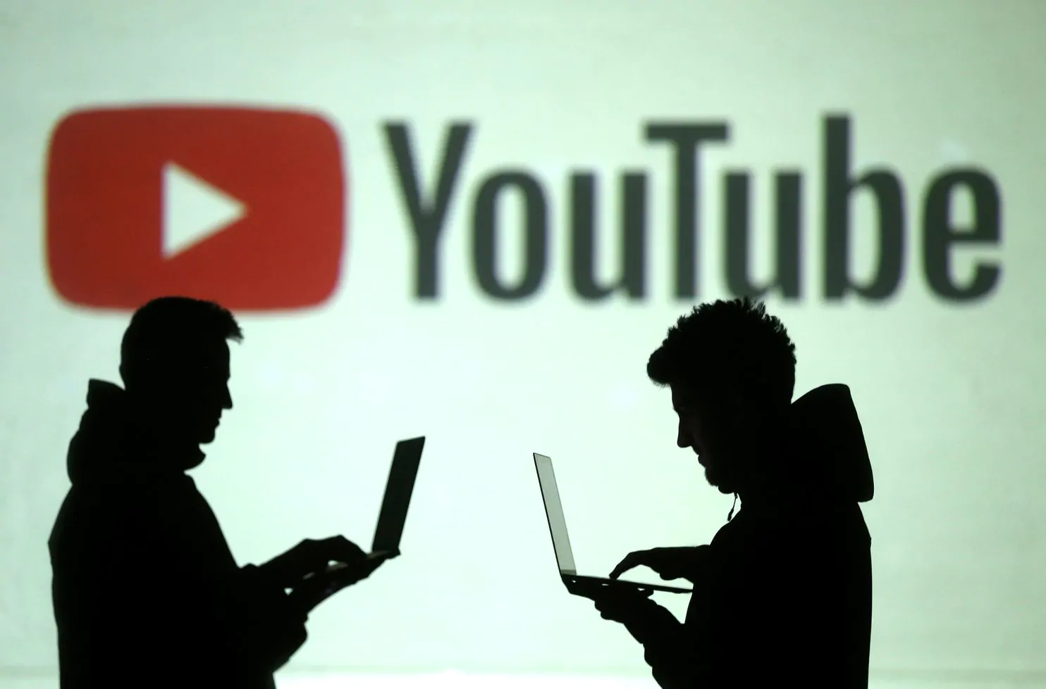
Motivation/Justification
Youtube is becoming a widely used platform for streaming videos
Many youtubers have started to make careers out of posting videos.
Need a certain number of views to become profitable
Youtubers need something to help them understand and keep up with trending videos and what their audience wants to see.
Isha Baxi

Slide 5

Dataset used and why
Kaggle
One of the most popular websites that contains datasets.
Easily accessible and free for usage.
Easy download of millions of datasets
Contains image datasets, CSVs, movie reviews, financial time-series, etc.
Of course about Youtube!
Jaehoon Ha

Slide 6

Dataset used and why
Why Kaggle?
Searched datasets about Youtube
(Datausa, Amazon datasets, Springboards, and Kaggle)
Found Interesting datasets about Youtube trends
Datasets contain Youtube’s trend for many countries
Used CSV files to make our website!
Jaehoon Ha , Zhejing Shi

Slide 7
noSQL database used and why
Redis: Key-value database
Dataset comprised of thousands of videos with multiple attributes
Video ID, Trending Date, Title, Channel Category, Publish Date, Tags, Views, Likes, Dislikes, Comments, etc.
Hash data structure
Maps values to attributes for a given object; perfect for this dataset
Object: Video- each video has unique ID in the dataset
Attributes: Title:(video title), likes:(number of likes), comments:(number of comments)...
Zach Vrabel

Slide 8
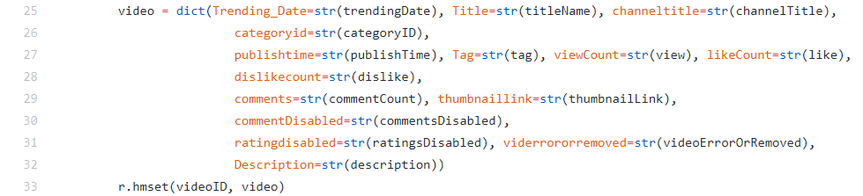
How database was populated Zach Vrabel
Python program reads a csv file row by row, inserting each attribute into a dictionary
A redis hash is created with the videoID as the key and the dictionary as attributes.

Slide 9
Design of the App
The app uses shiny as a base
Shiny is a package in R that allows the user to build a web app from R
The app takes the linear regression equations that describe each country and creates a plot that will show you how many views you are likely to get based on your likes, dislikes, comment count, and category id
GitHub: https://github.com/wil-fontanez/Proj2-DS220.git
App: https://sophiemassolas.shinyapps.io/Finalfinalfinal/

