Slide 1
AI FInance Project
Google I/O 2023 Central FL

Slide 2
Agenda
Intro
Goal
Tech/tools used
Demo?
TBC

Slide 3
INTRO
Wilber Hernandez
LinkedIn: https://www.linkedin.com/in/wilberhdez26/
Hobbies:
reading tech books
sci-fi movies/books
practice salsa
travel by going to conferences

Slide 4

Goal
As a financial planner/investor, I'd like to assess,
how location (geography/geospatial info) affects financial decision-making
What’s the dream?
What’s the value of a security?
Stocks
Bond
Are there connections between security performance and local economic behavior?
Let’s say we’re talking about Microsoft stock,
Where is Microsoft stock most popular?
Where does the data come from?
Inspired by game stop story
Gaming Wall Street (hbo max original series)
The Lesson Of GameStop: Investing Is Not A Game – Forbes Advisor

Slide 5
TECH/TOOLS USED
NLP
Natural Language Processing
About using computers to analyze/process human natural language
NLTK
Libraries used for NLP
VADER sentiment
Valence Aware Dictionary and sEntiment Reasoner
Determines polarity or sentiment to classify words in three different categories: Negative, Neutral, and Positive
A “gold standard” tool,
The VADER lexicon is an empirically validated by multiple independent human judges, VADER incorporates a "gold-standard" sentiment lexicon that is especially attuned to microblog-like contexts.

Slide 6
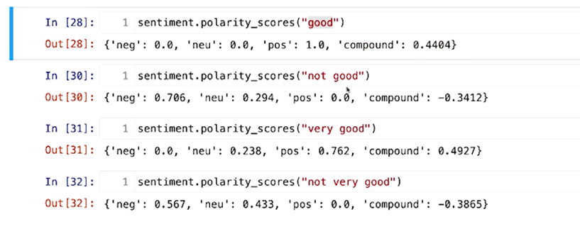
How does that look like?
Sentiment polarity score:

Slide 7
(more) TECH/TOOLS USED
NewsAPI
Free-tier: only the last 30 days of data
Access to news articles various online news/periodicals sites
Yahoo Finance API
get stock/ticker prices
Tableau Public
TBC - work to be done

Slide 8
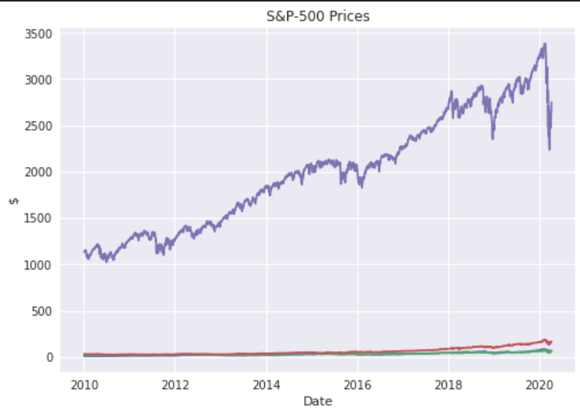
DEMO?
TBC

