Slide 1
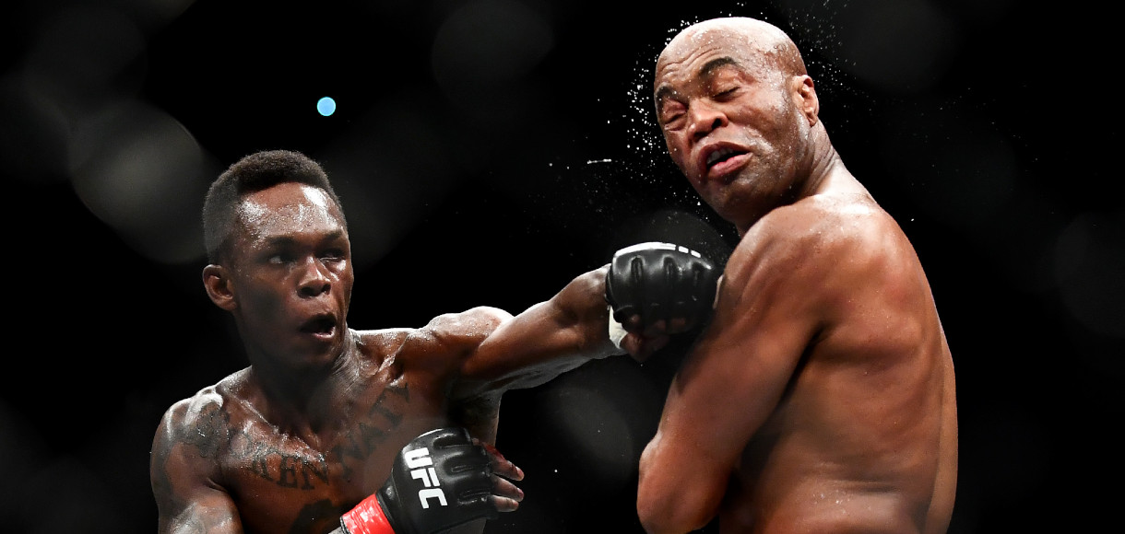
Predicting ufc fighter winner

Slide 2
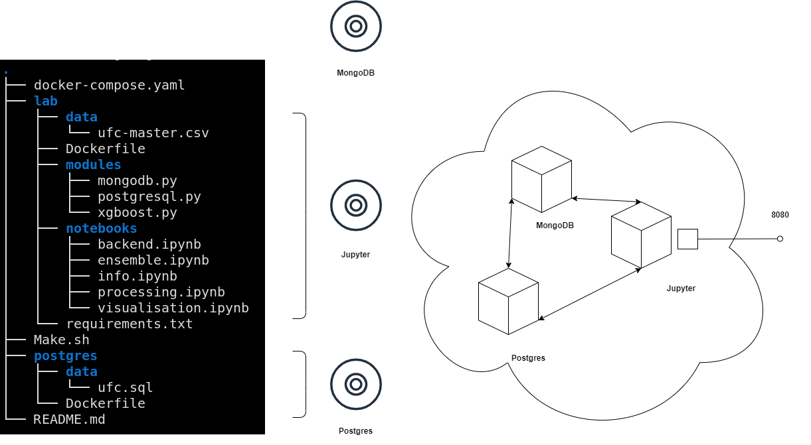
ARQUITECTURE

Slide 3
Why?
emulates the acquisition and saving of data with real data store tools
allows you to work in a modular way
you do not depend on the saturation of google servers
the result can be easily distributed

Slide 4
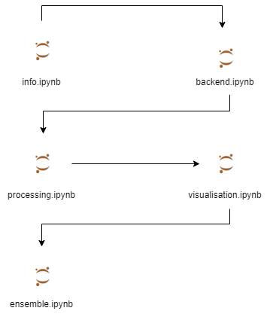
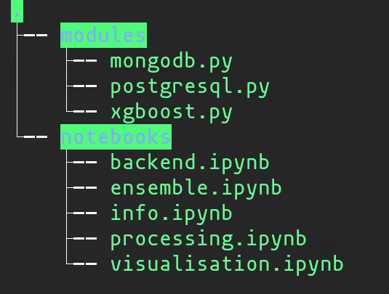

Workflow

Slide 5
AND THE DATA?

Slide 6
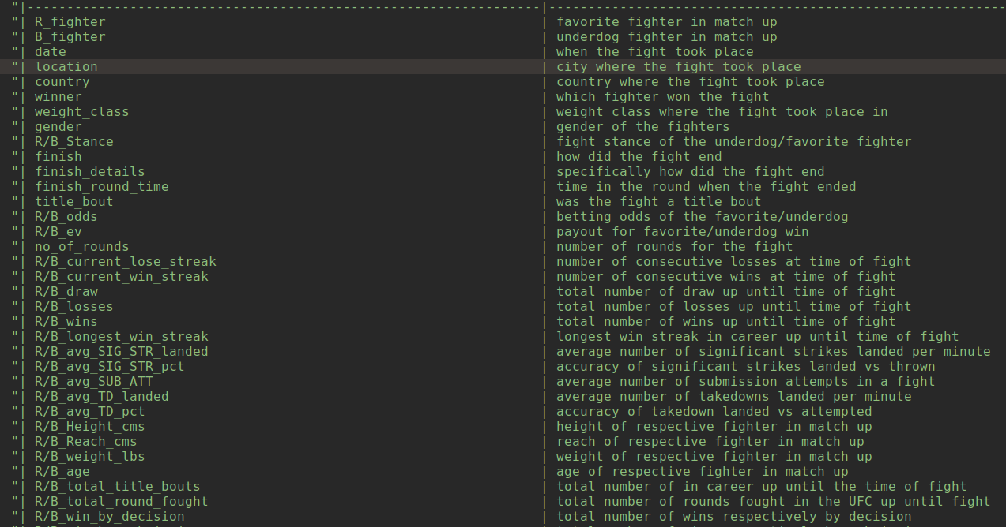

Slide 7
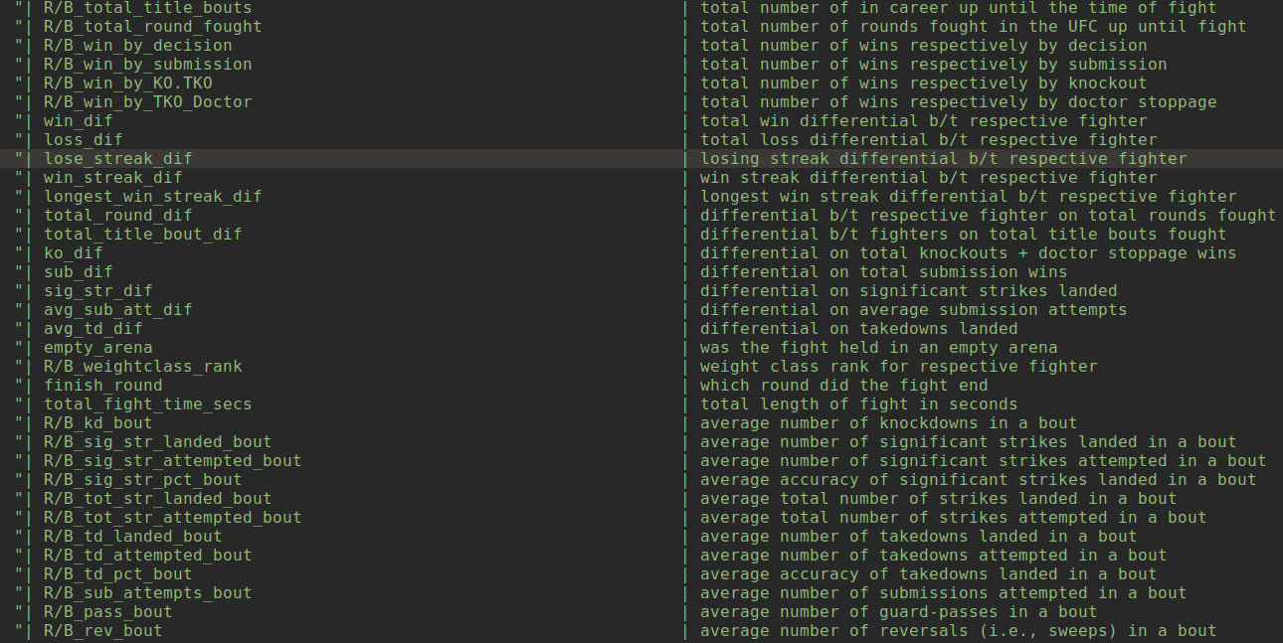

Slide 8
About the data
ultimate UFC Dataset - Kaggle
numeric, boolean, strings
non-temporary data, temporary data
statistics, latest results, knowledge we shouldn’t know
missing values

Slide 9
visualization

Slide 10
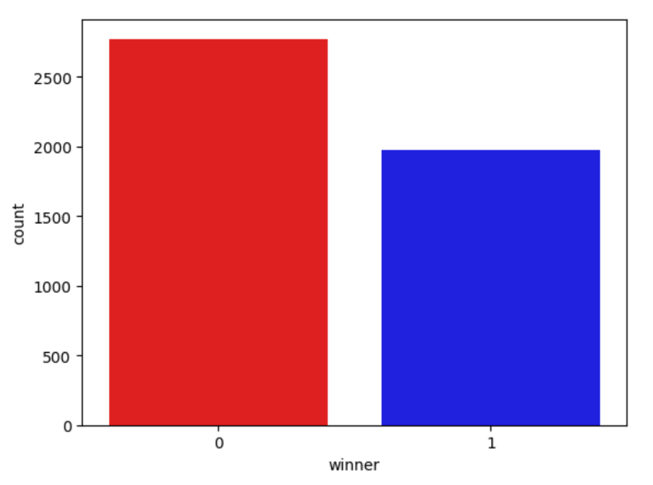
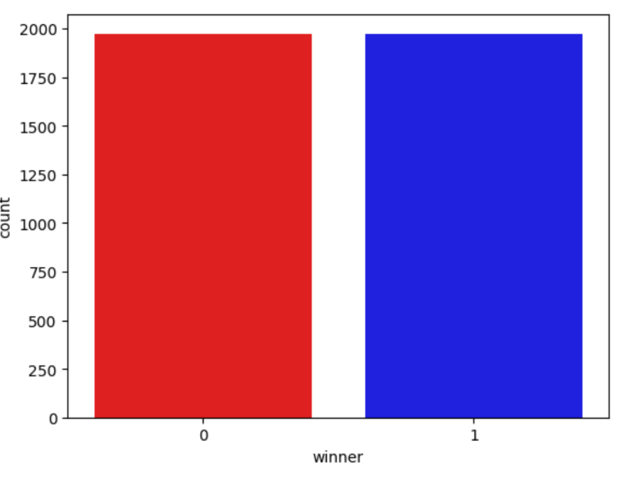
The winner

Slide 11
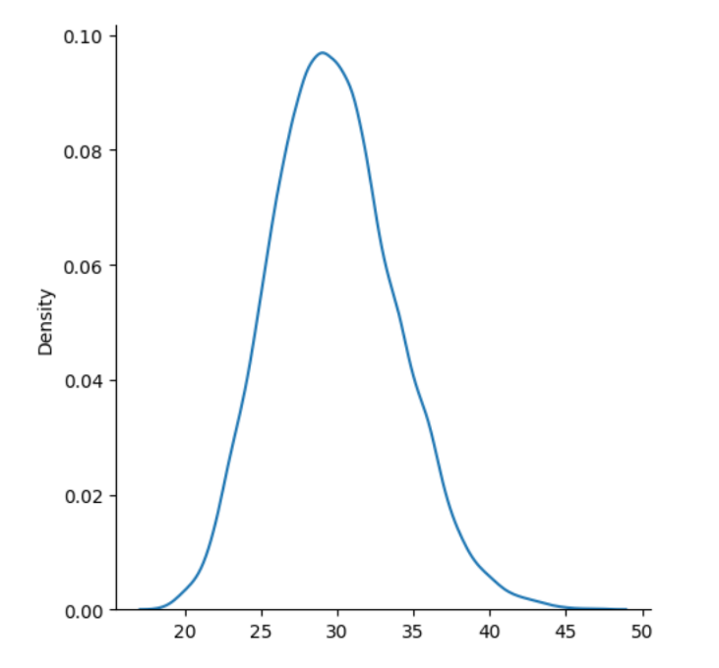
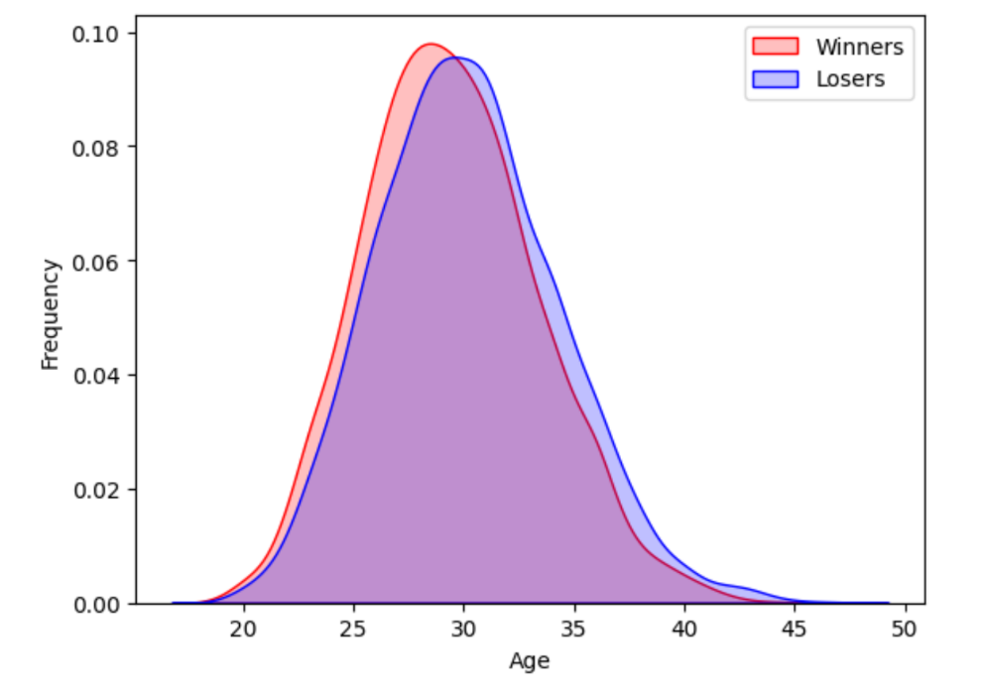
Age distribution

Slide 12
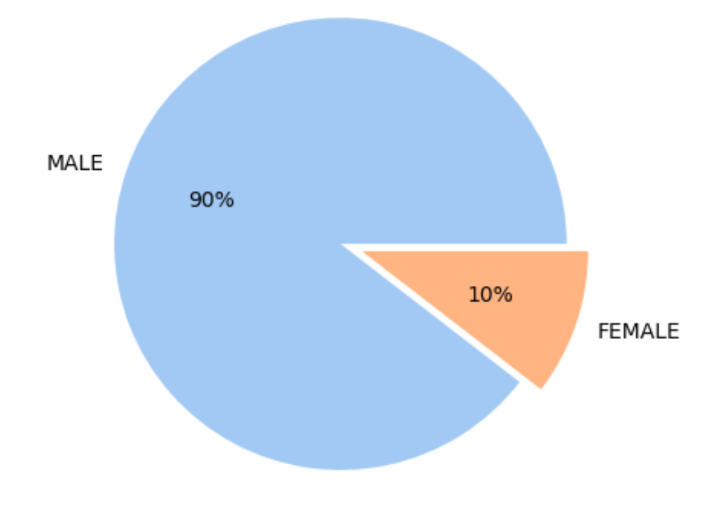
Gender distribution

Slide 13
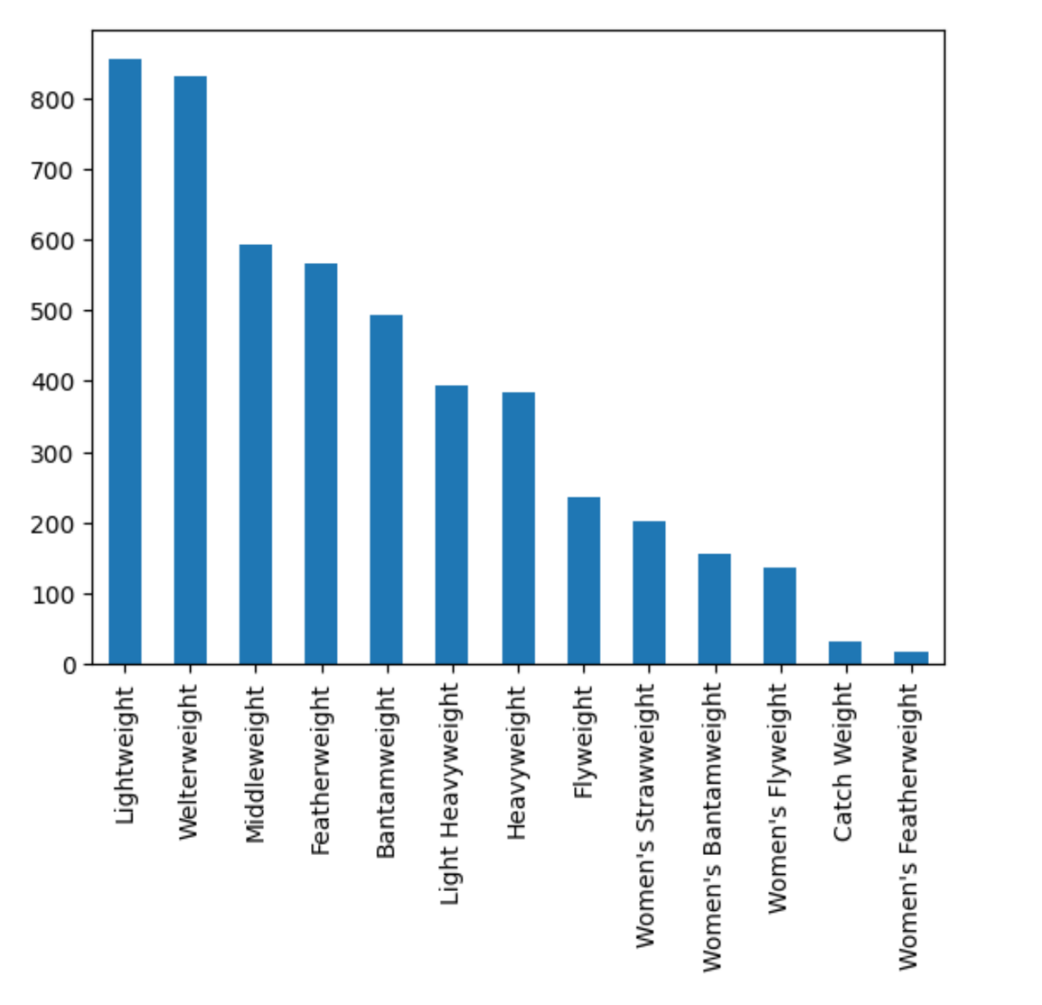
Weight classes

Slide 14
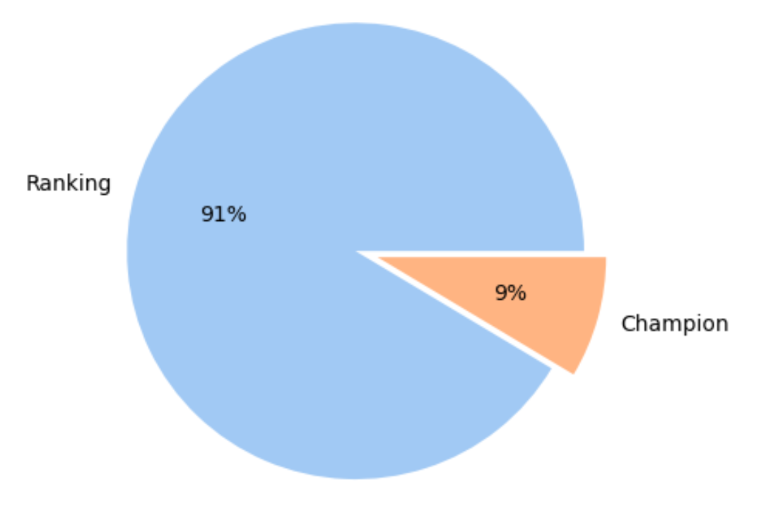
Fight type

Slide 15
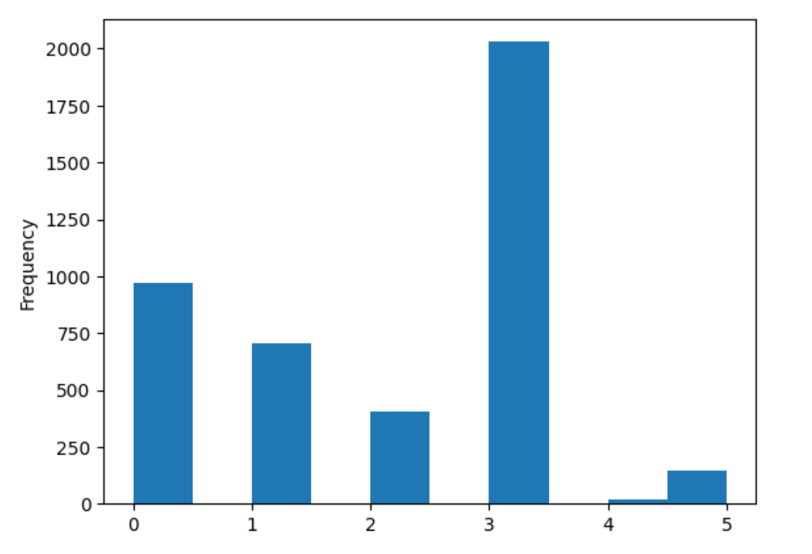
Fight duration

Slide 16
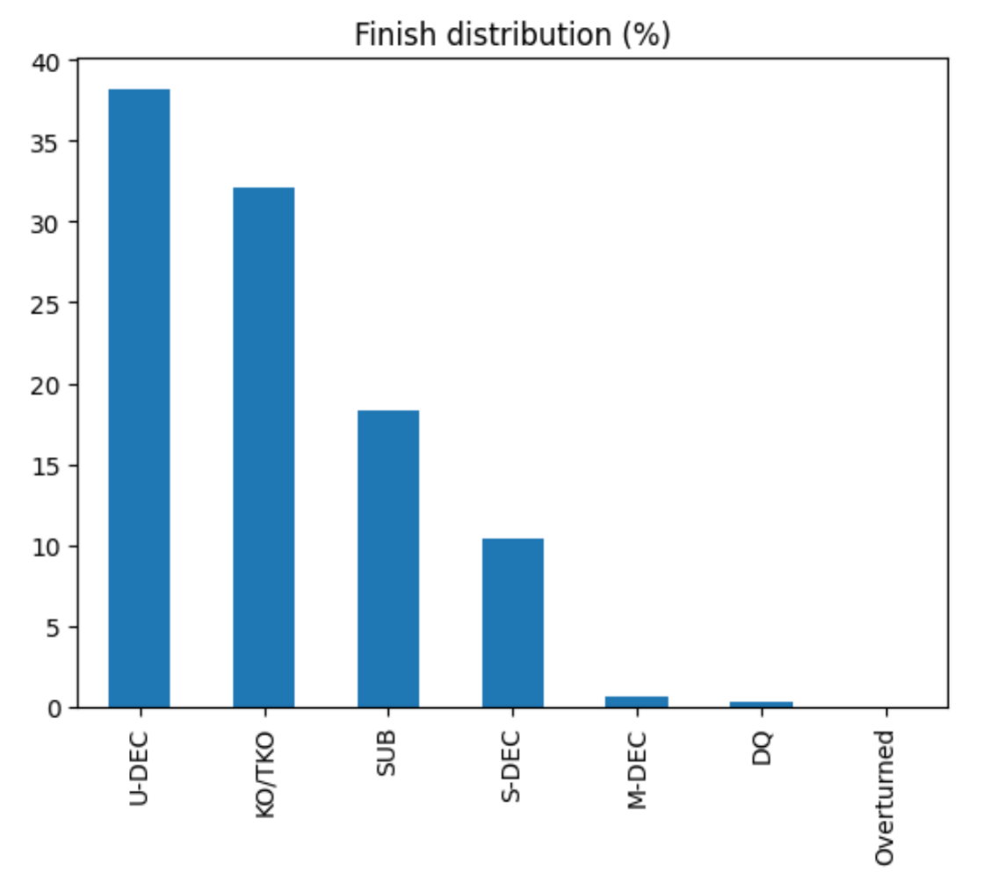
Finish type

Slide 17
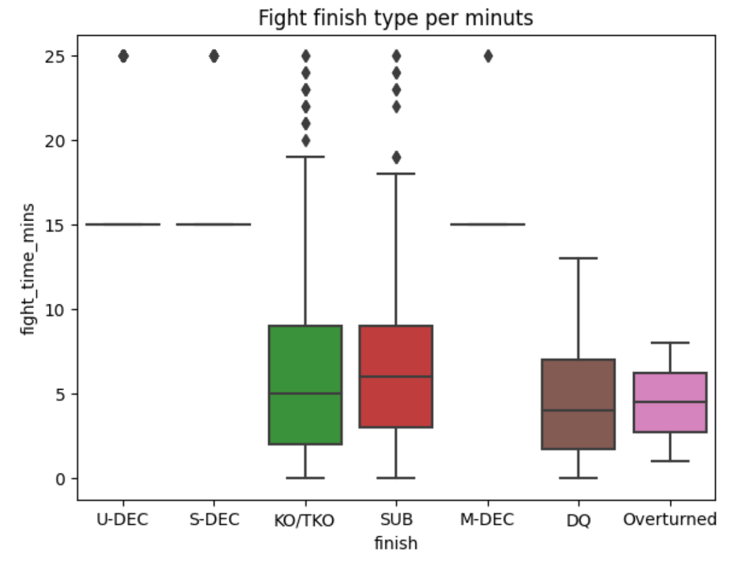
Finish type PER TIME

Slide 18
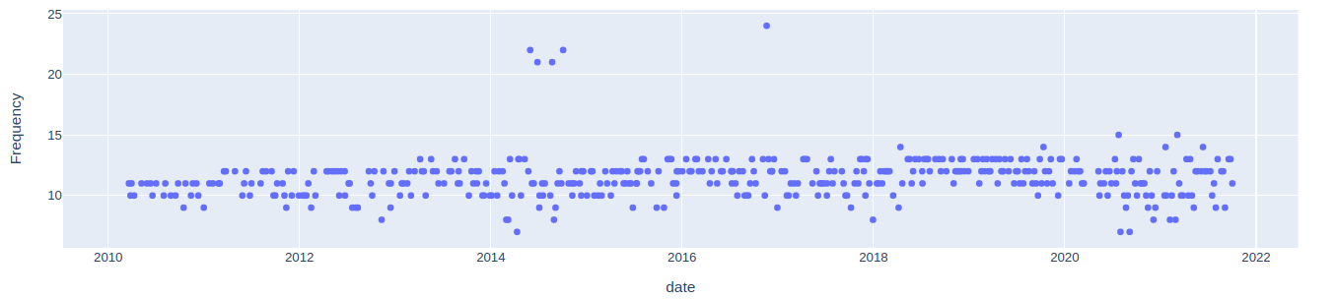
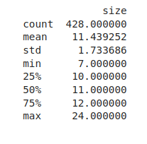
Fight frequency per months

Slide 19
Which columns were dropped?

Slide 20
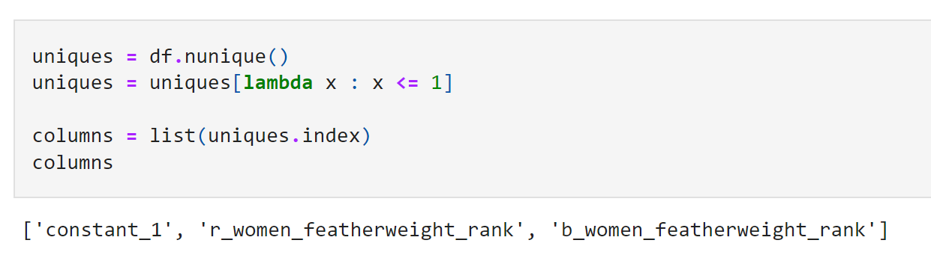
Constant columns

Slide 21
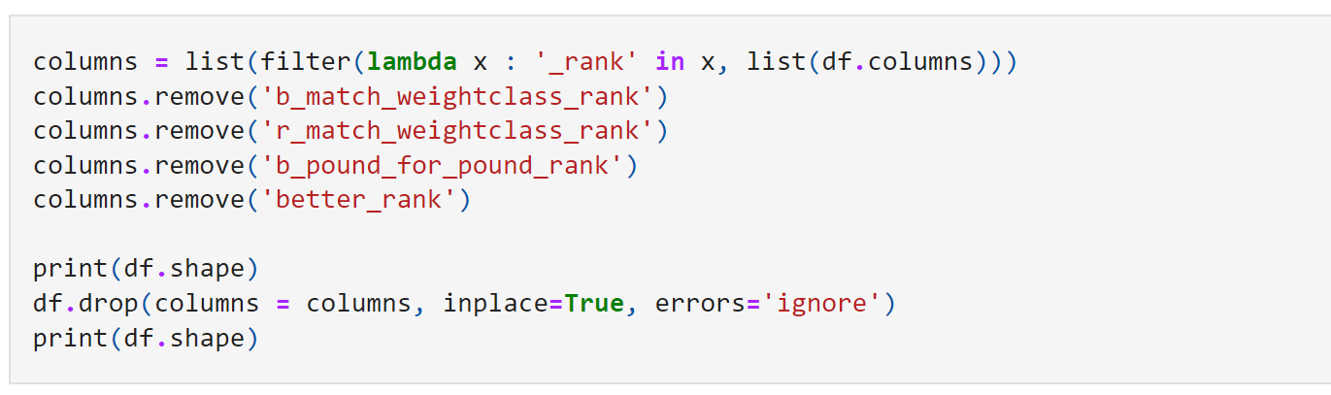
columns represented by other columns

Slide 22
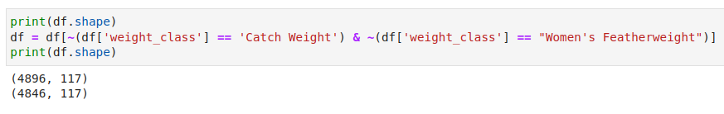
Underrepresented data

Slide 23
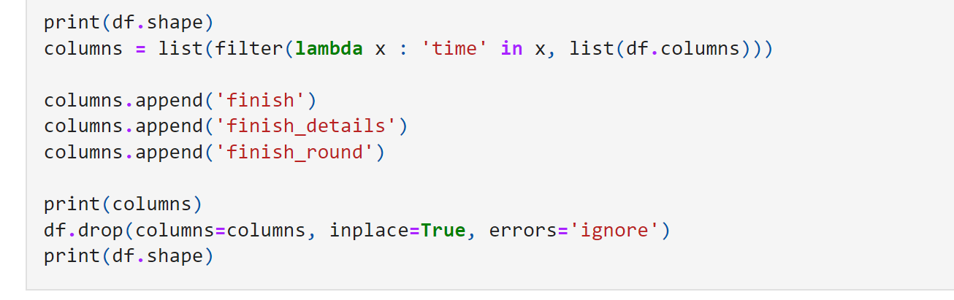
Data that can only be known after the fight

Slide 24
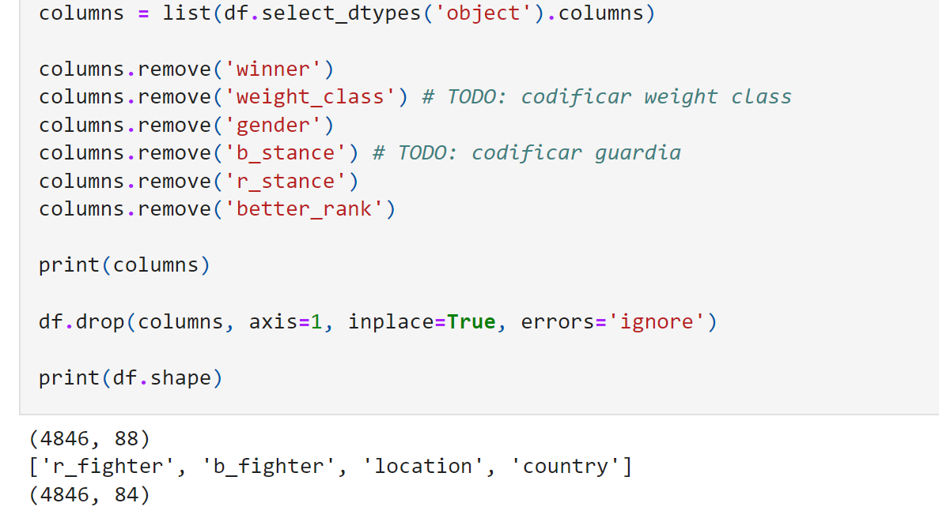
Hard-to-code categorical data

Slide 25
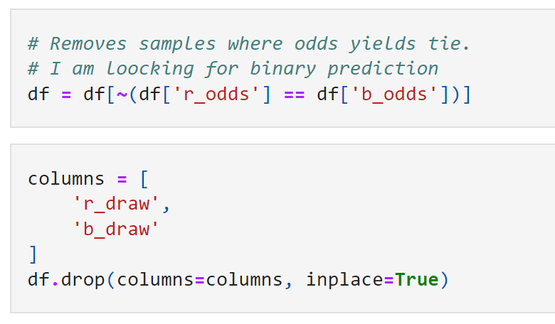
Draw data

Slide 26
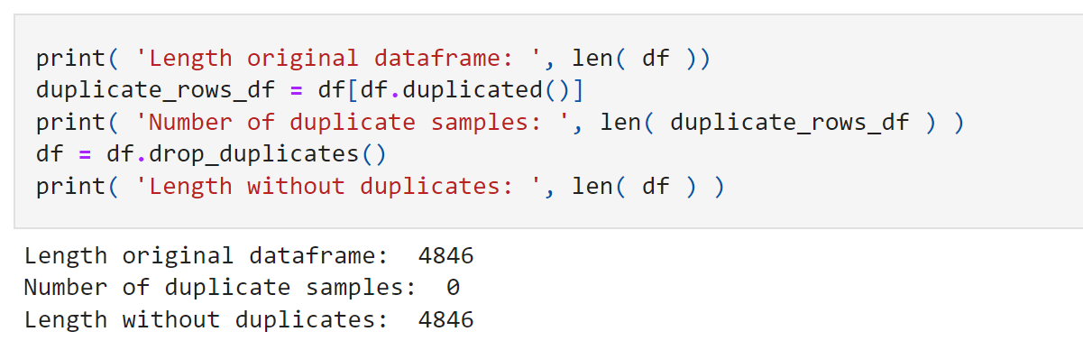
Duplicate features

Slide 27
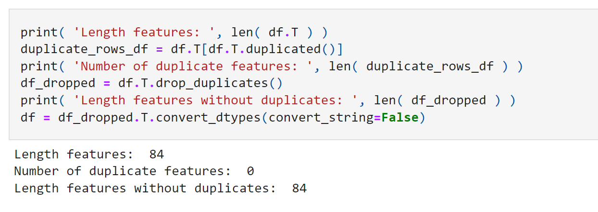
Duplicate samples

Slide 28
transformations

Slide 29
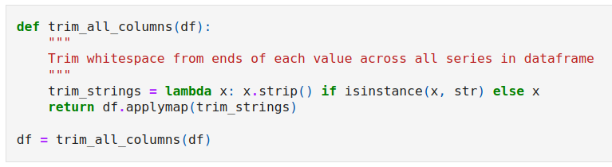
Trim columns

Slide 30
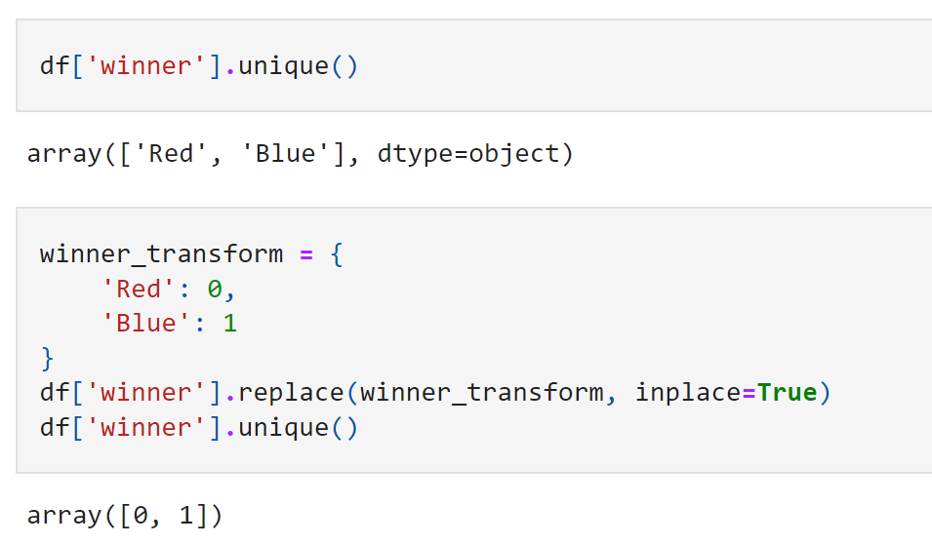
winner

Slide 31
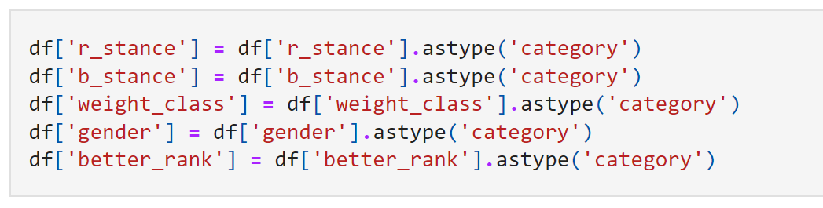
Strings to categories

Slide 32
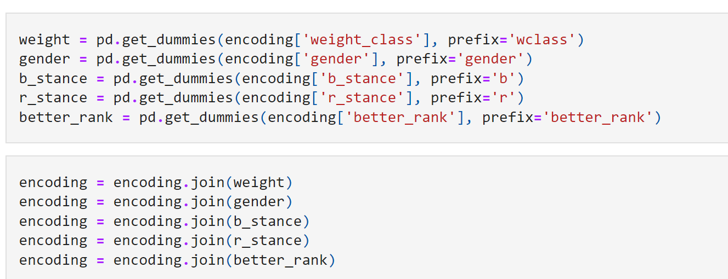
Categories to dummies

Slide 33
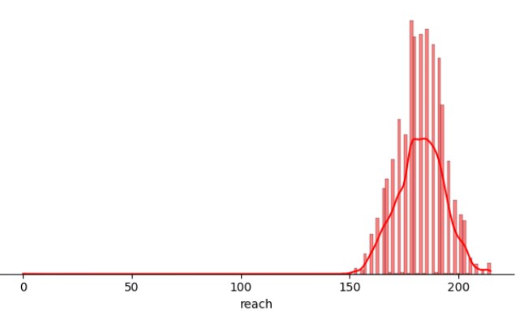
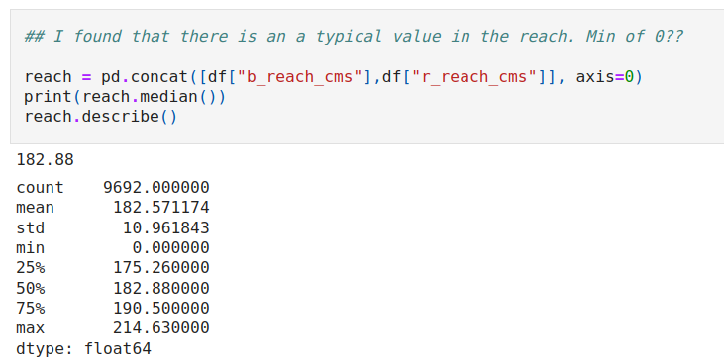
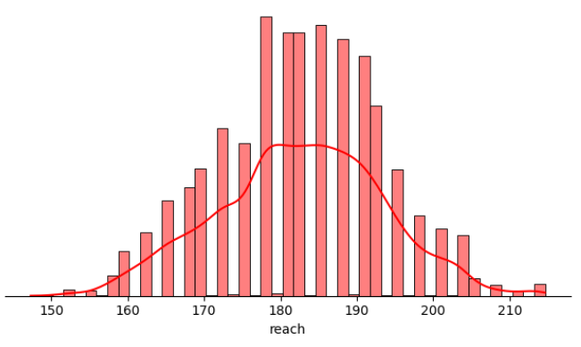
outliers

Slide 34
Feature engineering

Slide 35
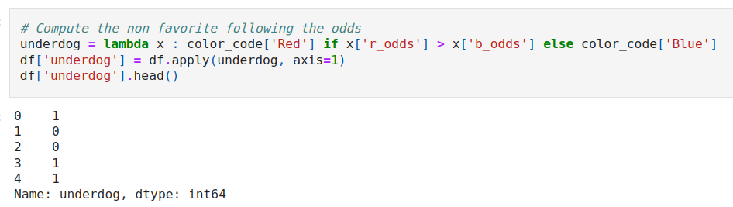
The underdog

Slide 36
results

Slide 37
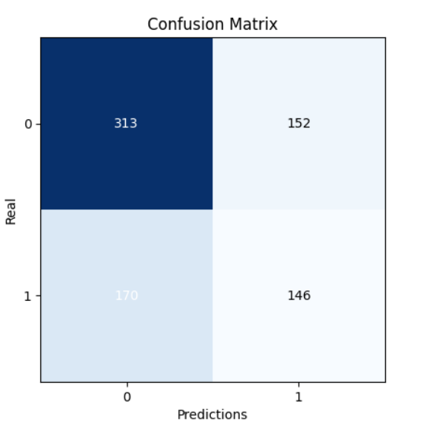
Biased distribution

Slide 38
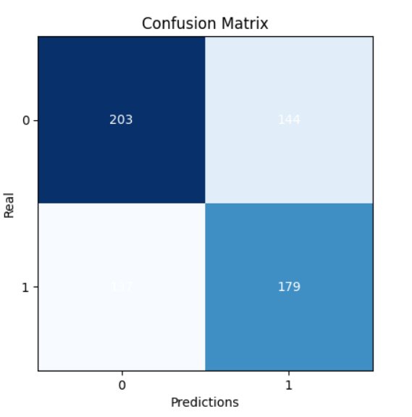
Non-biased distribution

Slide 39
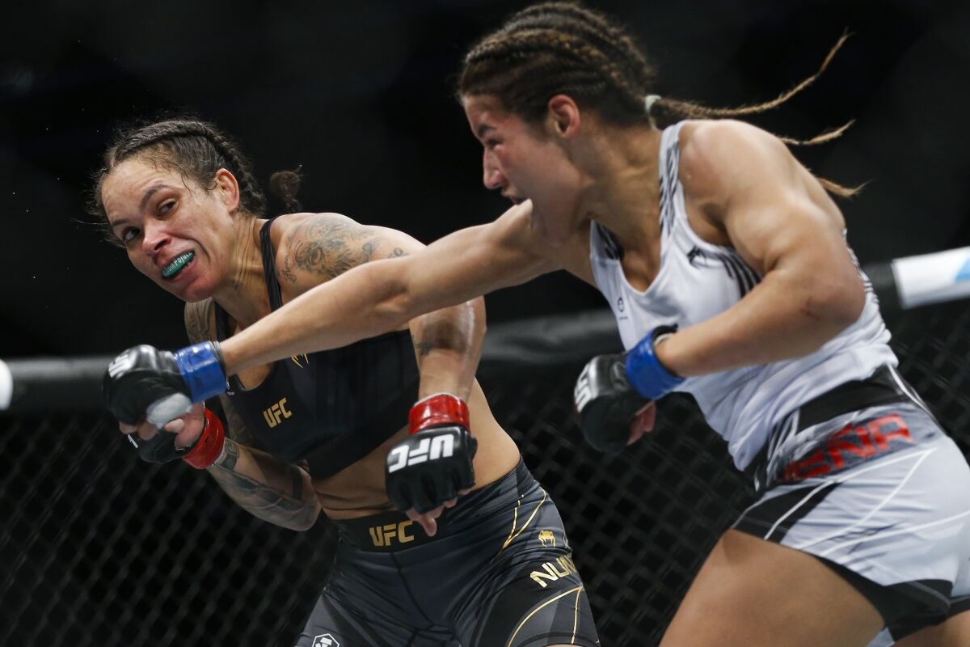
The end

