Slide 1
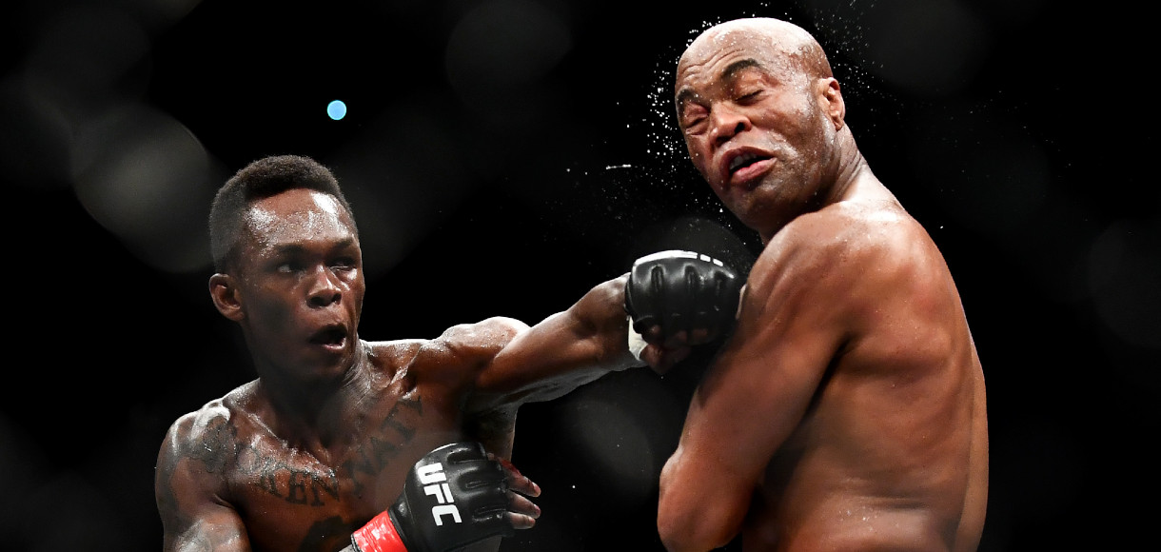
Predicting ufc fighter winner

Slide 2
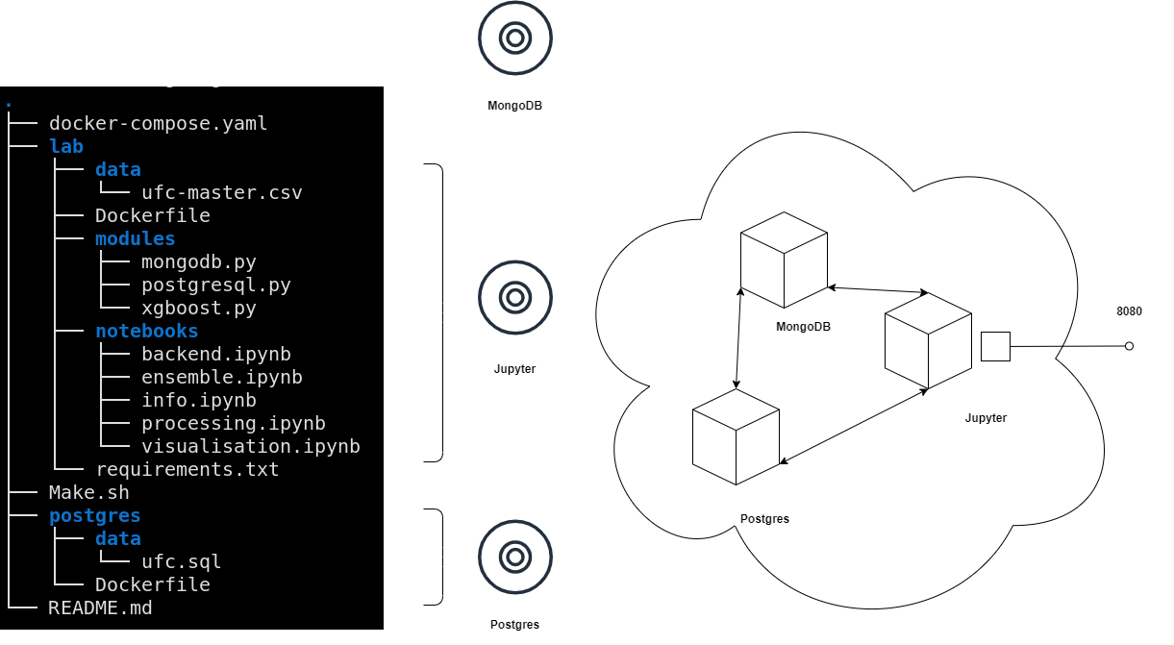
ARQUITECTURE

Slide 3
Why?
emulates the acquisition and saving of data with real data store tools
allows you to work in a modular way
you do not depend on the saturation of google servers
the result can be easily distributed

Slide 4
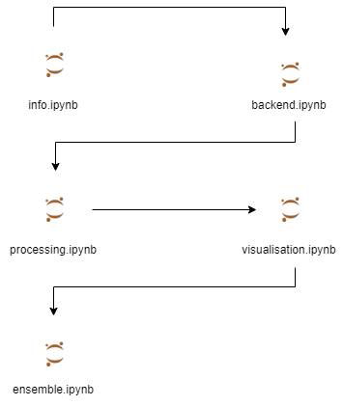
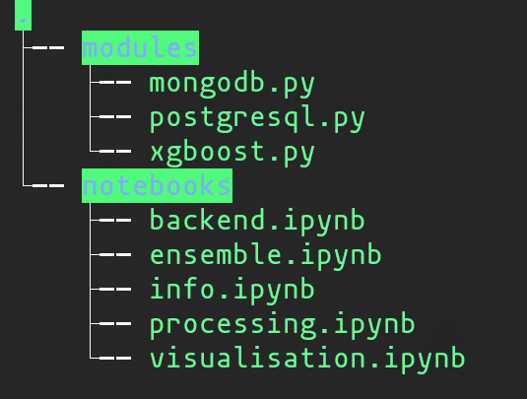

Workflow

Slide 5
AND THE DATA?

Slide 6
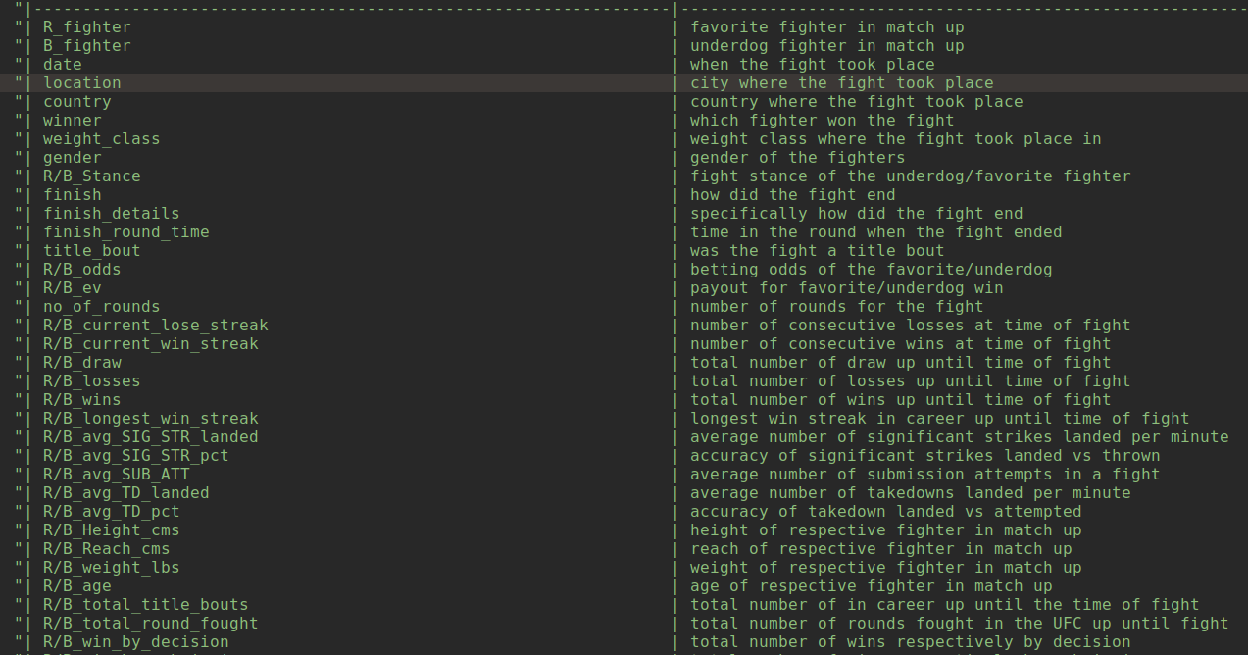

Slide 7
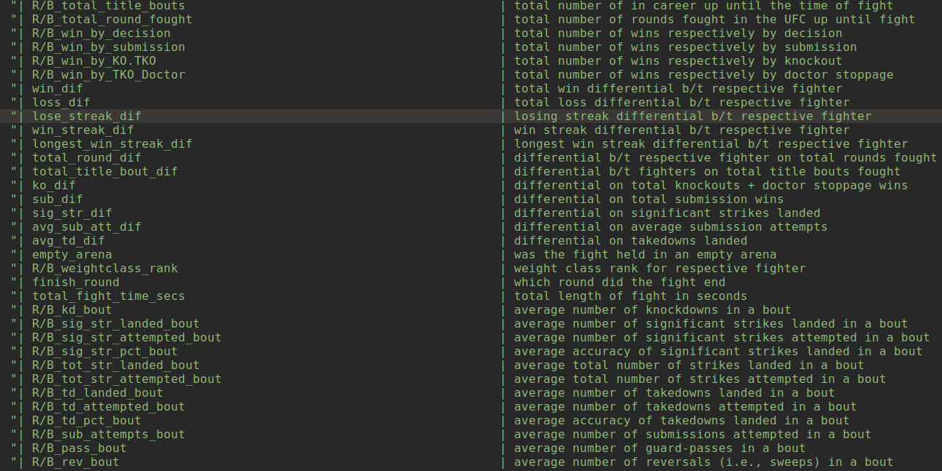

Slide 8
type of data
numeric, boolean, strings
non-temporary data, temporary data
statistics, latest results, knowledge we shouldn’t know
missing values

