Slide 1
Growing a Proof Assistant
William J. Bowman
Northeastern University
https://github.com/wilbowma/cur
Notes:
Let me ask you a question.

Slide 2
What is a proof assistant?
Something that assists
with proofs
Notes:
Well I would hazard to define it as…
I don’t think I’m breaking new ground here.
And working with that definition, I would suppose that.

Slide 3
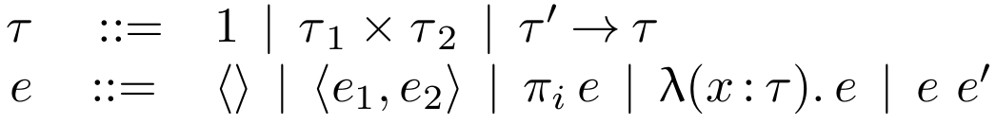

A proof assistant would...
Notes:
Therefore a proof assistant ought to help me take this formal, but handwritten, system.

Slide 4
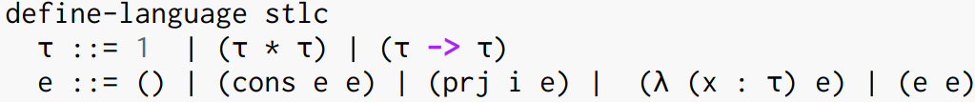
Support standard notation
Notes:
And turn it into machine checked code.
Using standard, familiar, notation.

Slide 5
Allow user-defined notation
Notes:
Allowing the kind of convenient extension I write on paper.

Slide 6

Communicate formal ideas
Notes:
Communicate my formal ideas, but provide extra assurance that they’re right.

Slide 7
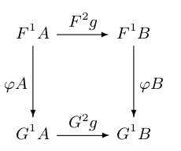
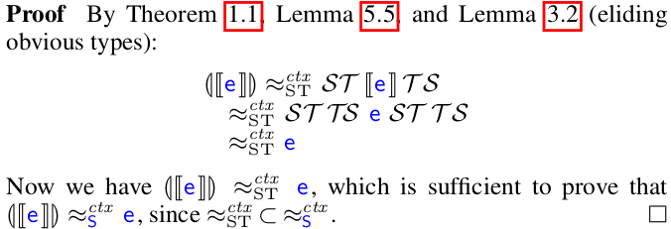
Assist with proofs
Notes:
And, above all, assist with proofs.
Of which there are many and varied.

Slide 8

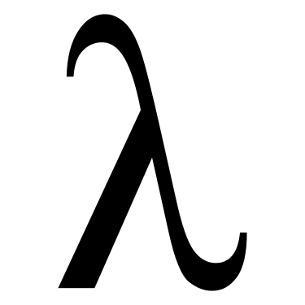
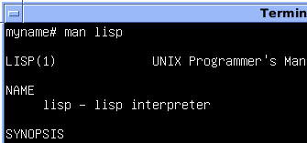
A proof assistant needs
“I need a language that can grow”
A trusted core language for encoding proofs
Convenient, sophisticated, user-define notation.
We need to take a lesson from the Lisp community.
Proof assistants need language extension.
Notes:
A proof assistant needs …
I wonder. Has anyone ever worked on a language click
With a small core click
And support for letting users extend the language in a safe, but fairly arbitrary way.
Click click click

Slide 9
The Design

Slide 10
Pick an object language
Isabelle | HOL
Agda, Idris | TT
Coq | CIC
Notes:
Here’s how we’ll design such a proof assistant.
First, pick an object language. This is the language in which proofs are encoded.
E.g. isabelle uses higher-order logic; Coq uses CIC.
Agda and Idris use variants on Martin-Lof type-theory.

Slide 11
Pick a meta language
Isabelle | Isar*, ML*
Agda | N/A
Idris | Idris*?
Coq | Ltac*, Ocaml
* Limited forms of meta-programming
Notes:
Next, we pick a meta language. This meta-language will have the ability to manipulate and generate code in the object language.
For example, Coq can use Ltac for limited meta-programming.
Idris has elaborator reflection in Idris, although I haven’t fully internalized its limitations
Agda doesn’t have a good analog here.
Isabelle has limited forms of pre/postprocessing in ML, and the Isar tactic language.
Notably, Coq’s Ocaml plugins are the only ones that allow near arbitrarily complex extensions (as far as I know).

Slide 12
Make meta-programming powerful
Isabelle | Isar*, ML*
Agda | N/A
Idris | Idris*?
Coq | Ltac*, Ocaml
Notes:
Meta programs should have a lot of power.
To support the sophisticated notation we use on paper, we need to allow users to define new syntax, redefine old syntax, run meta-language computation during compile time, before type checking, during type checking, after type checking, reflectively and call the object language type checker and evaluator.
To support awesome new features, users need to be able to redefine what modules are, what application means, extend the reader or parser.

Slide 13
Make meta-programming trivial
Isabelle | Isar*, ML*
Agda | N/A
Idris | Idris*?
Coq | Ltac*, Ocaml
Notes:
And finally, writing extensions needs to be easy. Easy enough to tip the cost/benefit analysis and get people to stop writing paper proofs.
I should be able to write a new extension, know it will compose with other extensions, not require a whole new toolchain to do so.
Users should be able to use new extensions as easily as importing a library.

Slide 14
Cur
Notes:
So I’ve hypothesized that this is how we should design a proof assistant; let’s that hypothesis.
I’ve built a prototype proof assistant called “Cur”. Let’s take a look.

Slide 15
The Design
Pick an object language
Pick a meta-language
Make meta-programming powerful
Make meta-programming trivial
TT
Notes:
I pick TT with inductive types as my object language, because it’s small and easy to implement, and relatively powerful.

Slide 16
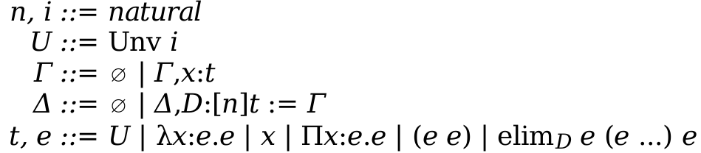
TT: Syntax
Notes:
Here’s the syntax of the core language.
We have an infinite hierarchy of cumulative universes, and impredicativity in universe 0.
We can declare inductive types D of type t with n parameters with constructors Gamma.
We have dependent functions
and folds over inductive types.
No general recursive functions and termination checker

Slide 17





TT: Typing (excerpts)
Notes:
I’ll show you a few typing rules just to get your mind in the right mode, but the type system is a very standard dependent type system.
Each universe is in the next higher universe.
Function types can refer to their variables.
The type of application can refer to the argument
We have subtyping, which can refer to the internal beta equivalence, and allows universe cumulativity.

Slide 18
The Design
Pick an object language
Pick a meta-language
Make meta-programming powerful
Make meta-programming trivial
TT
Racket
Notes:
Next we pick a meta-language. We pick Racket as the meta-language, because they’ve got powerful language extension features we can reuse.

Slide 19
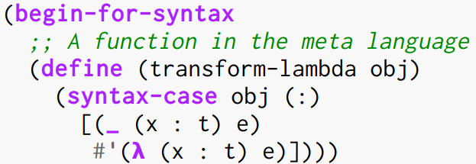
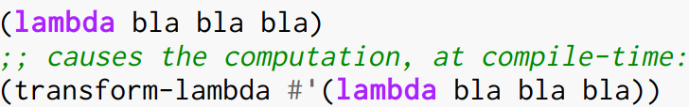
Meta-programming with Racket
All meta-programs have two parts:
Notes:
For the purposes of this talk, all meta-programs have two parts to them.
1) function definition in the meta language on object programs.
#’ is short-hand for “this code represents object language code”.
2) syntactic hook in the object language. This hook adds the ascii word “lambda” as a syntactic form in the object language, whose interpretation is defined by the meta-language function “transform-lambda”.
Now, the word lambda causes transform-lambda to be called at compile-time to produce some code. It receives the object code that existed before as an argument. In this example, since this object code does not match the pattern expect by transform-lambda, the result is a syntax error.

Slide 20
The Design
Pick an object language
Pick a meta-language
Make meta-programming powerful
Make meta-programming trivial
TT
Racket
…
…
Notes:
So we have the two ingredients to our proof assistant.
Now I just need to demonstrate that these two simple ideas, compile-time computation triggered by hooks into the object language, make it easy to write powerful extensions.

Slide 21
Some extensions
Notes:
Let’s see some extensions. These are all user-level extensions; they live in library that any user could have written, without modifying the core implementation, and without leaving the normal Cur toolchain.

Slide 22
Pattern Matcher

Slide 23
Tactic Language (ntac)

Slide 24
PL Meta-theory Library (olly)

Slide 25
Take Away
Stuff and things

