Slide 1
CMPE-255 Term Project:
CLUSTERING INDIVIDUAL HOUSEHOLD ELECTRIC POWER CONSUMPTION AND FUTURE CONSUMPTION REGRESSION ANALYSIS.
David Montes, Aaron Choi, Wil Carrasco

Slide 2
Introduction
Clustering Individual Household Electric Power Consumption
Motivation
Power usage/utilization is a metric every household generates
Can patterns exist in time lapsed measurands?
Can that data be used to predict high demand?
Can these patterns be categorized
How to analyze these patterns to be beneficial to consumers or providers?
Objective
Look for power consumption trends over time and area, and cluster the data using descriptive methods to discover patterns or trends

Slide 3
System Design & Implementation
Algorithms considered/selected
K-Means / Bisecting K-Means
PCA / SVD / TSNE
L-2 / L-1 Normalization
Feature Selection / Extraction
Optics w/ DBScan
Technologies and Tools Used
Python 3.x
Jupyter Notebooks
VSCode
Numpy, Scipy, Sklearn, Matplotlib

Slide 4
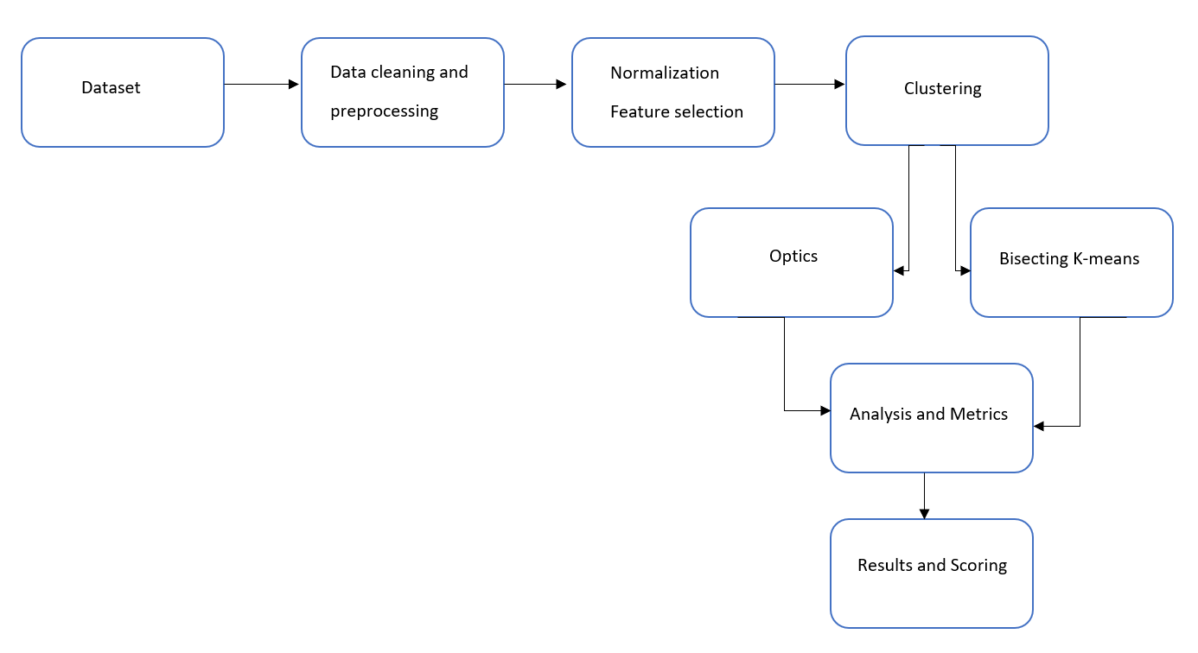
System Design & Implementation
System Design/Architecture Data Flow

Slide 5
Experiments
Dataset
Power Consumption from a house in Sceaux France between December 2006 and November 2010
2 Million measurements across 9 dimensions
Preprocessing
Converted time metrics from string format to a interval value
Removed uncaptured/missing data
Normalized data by max column value
Verified that trends on normalized data retained the same information
Feature Selection on the three meter measurands

Slide 6
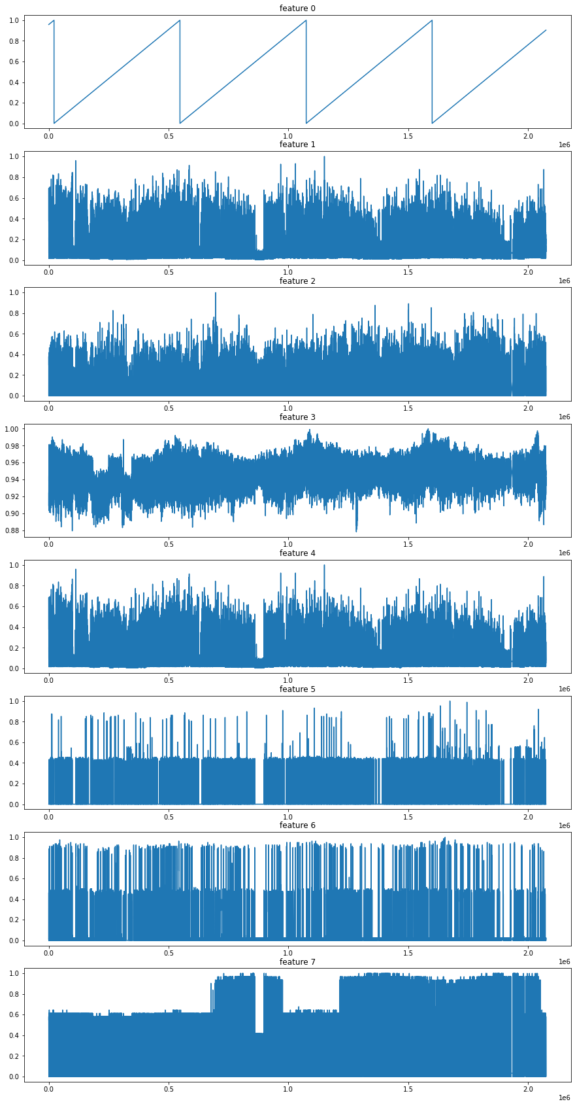
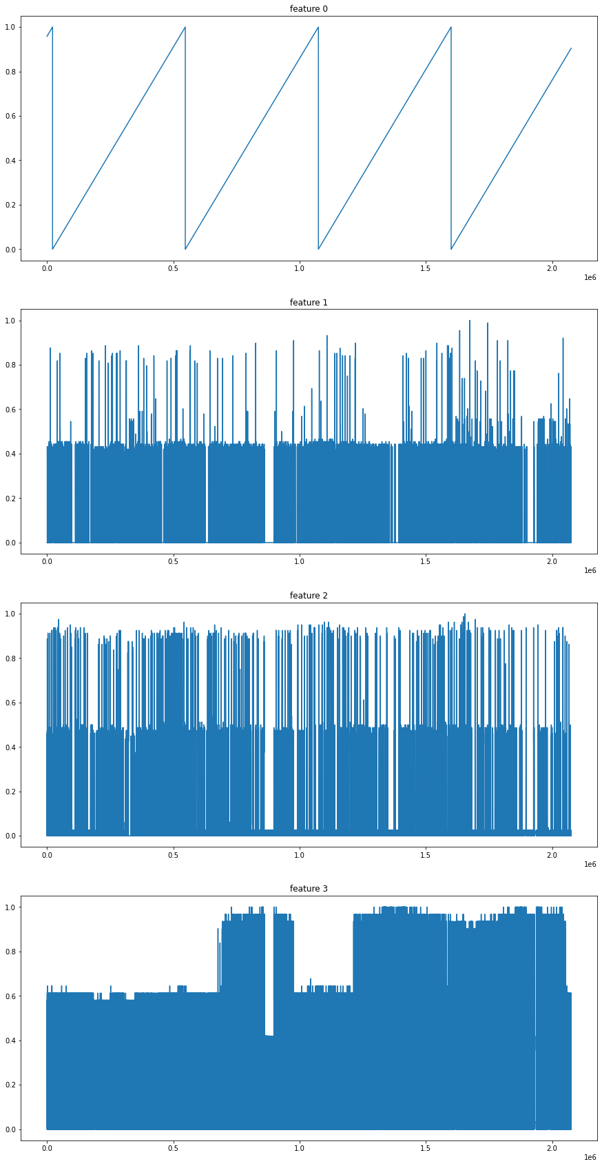
Experiments
Experimented dimensionality techniques of all the data
PCA
SVD
t-SNE
Took a look at only sub metering data
Submetering 1 (kitchen)
Submetering 2 (laundry room)
Submetering 3 (water heater/AC)

Slide 7
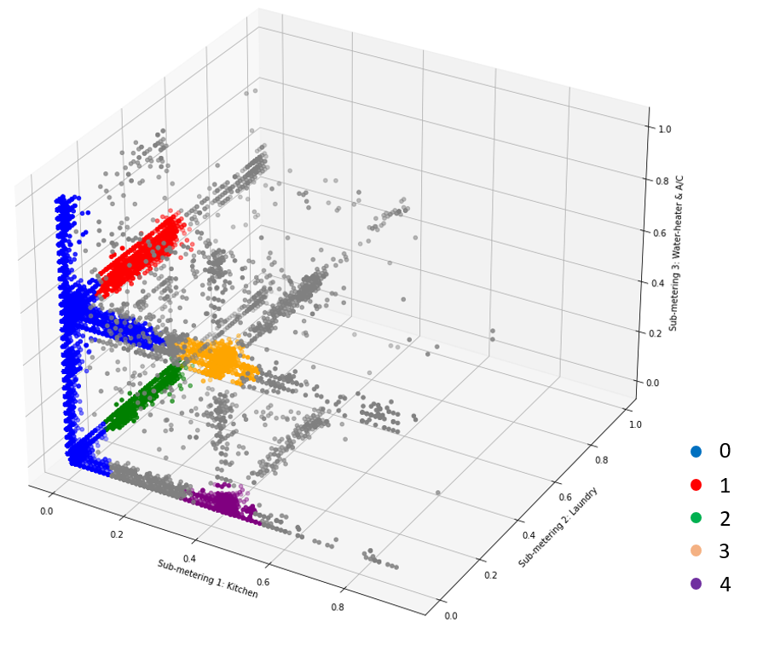
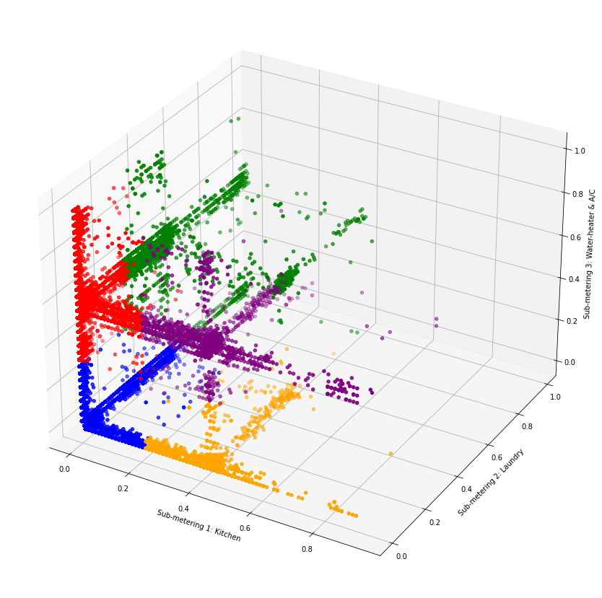
Clustering Metrics
Clustering Metrics using OPTICS
Silhouette Average
0.66
Davies-Bouldin
1.35
Calinski Harabasz
42314.28
Clustering Metrics using KMeans (5 Clusters)
Silhouette Average
0.85
Davies-Bouldin
0.38
Calinski Harabasz
674483.97

Slide 8
Time-Association Analysis
After clustering, we attempted to associate each cluster with a range of times
Does high laundry room usage correspond to a certain day of the week?
Extracted time stamps and turned them into Day, Week, and Year ratios
Every timestamp is a fraction of a day, week, and year
For each cluster and time ratio, binned the samples into a histogram

Slide 9
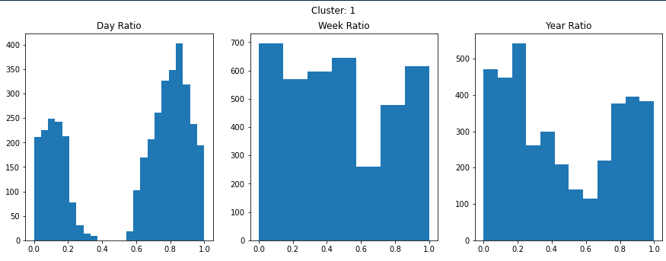
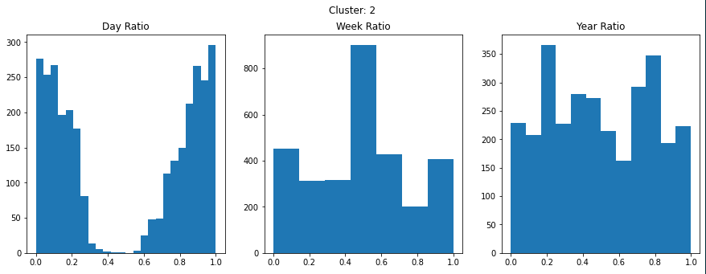
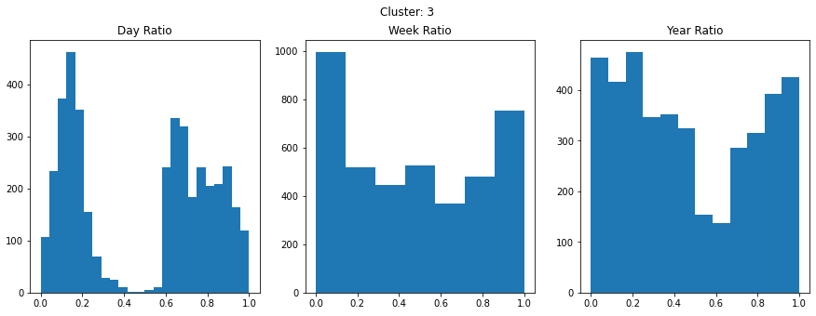
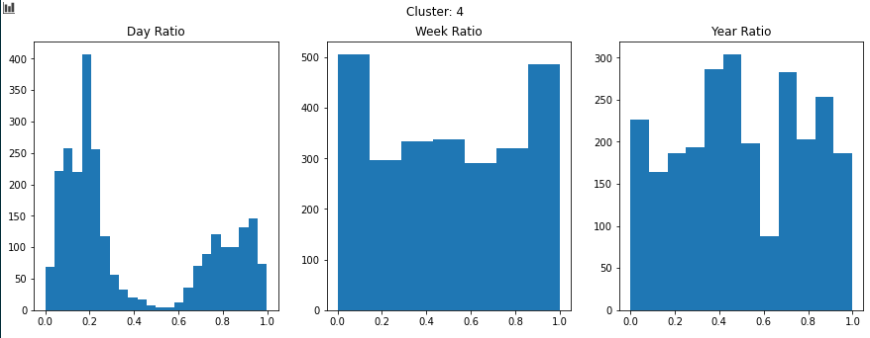
High Water-heater/AC with laundry room usage
High spread of laundry room usage
High Kitchen and Water-heater/AC usage
High Kitchen usage

Slide 10
Discussion & Conclusion
Decisions Made
Did not have time for regression tasks
Used Optics instead of K-means
Feature Selections/ Extraction
Did not normalize time ratio data
Difficulties Faced
Representing all the data in a visual format in 2D/3D
Noise and non-globular shape of the data
Dimensionality reduction techniques failed to show patterns
Overlapping/merged data
Processing time for graphing large cluster values
Processing time of Optics w/ DBScan

Slide 11
Discussion & Conclusion
Things that Worked well
Feature Selection / Feature Extraction
Time ration conversion
Optics with DBScan
3D Graph Modeling
Things that didn’t work well
Massive dataset
PCA / SVD Dimensionality Reduction
TSNE
K-Means / Bisecting K-Means

Slide 12
Discussion & Conclusion
Conclusion
Lifestyle trends can be derived from rudimentary clustering
Summer Vacations
Sleep Schedule
Work Schedule
Specific Utility Usage

Slide 13
Questions

