Slide 1

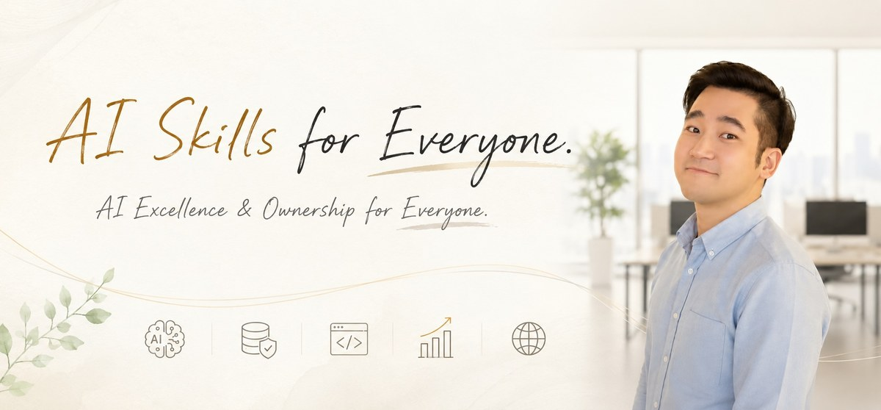
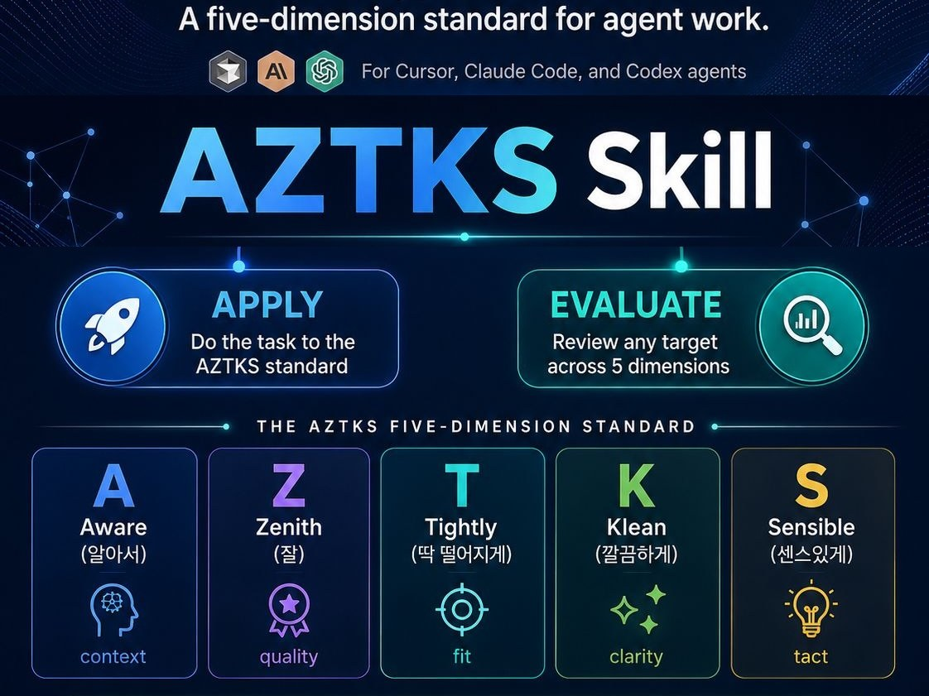
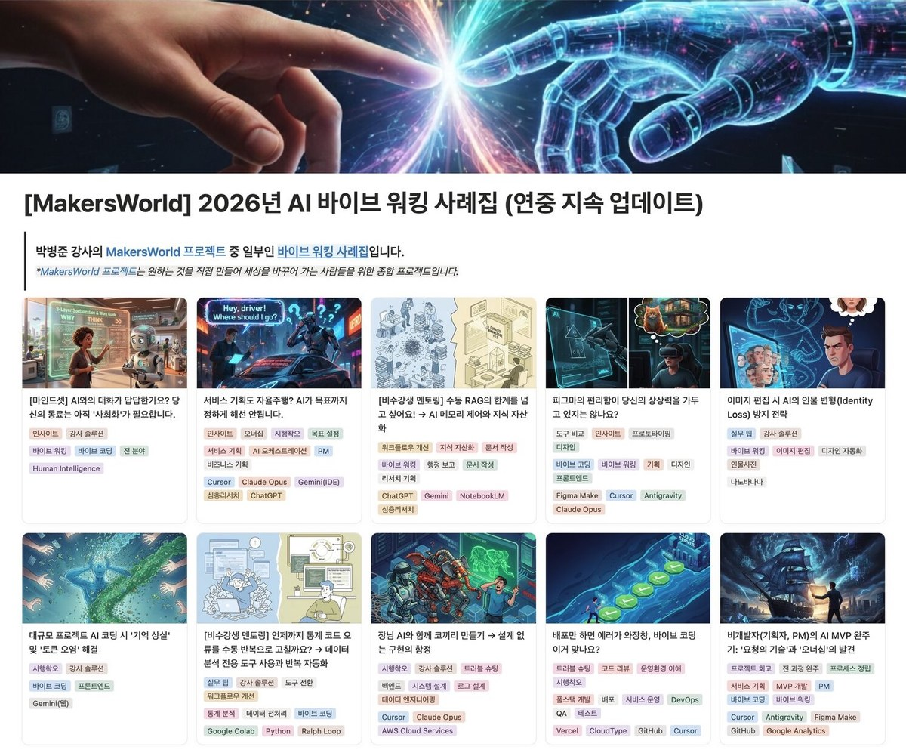
ByungJun Park
Principal AI & IT Education Consultant — Modulabs · UD IMPACT
Former Platform Backend Engineer — Kakao Kidsnote
Former FinTech & Blockchain Backend Engineer — Coinbit Exchange
A backend engineer turned AI and technology educator. Spent three years building high-throughput systems for Korean fintech and consumer platforms — sole engineer responsible for the advertising backend at Kakao Kidsnote, where the platform's ad revenue more than doubled over two years with zero production incidents after relaunch, and architect of a real-time alerting system at the Coinbit cryptocurrency exchange capable of dispatching three million notifications per minute, alongside backend work for ISMS-P information-security certification. AWS Certified Solutions Architect – Associate.
Delivers in-service technology programs for Hana Financial Group, KT, Kia Motors and LG HelloVision, and teaches on national workforce tracks at Sahmyook University, Modulabs and the Korea Information Education Institute — the Sahmyook KDT track graduated two consecutive cohorts at 100%. Has delivered programs in the United States and the Middle East, and led a KOICA-sponsored program in Korea for Sri Lankan platform operators. Contributor to policy research on AI education and curriculum innovation (KRIVET; Hanbat National University). Teaches in Korean and English.
Industry specific experience as a practitioner and/or educator across globe:
AX Productivity | AI Skills & Harness Engineering | Cloud Modernization in Finance
2026 AX Consulting Casebook
Spec-Driven Development for Both Engineers and Non-engineers | Hands-off AI Workflow Automation with Maximum Job Ownership | Prompt and Context Engineering | Microservices and Kubernetes Operations | Kafka Event Streaming | Ad-Tech Targeting and ML Monetization
Industry | Companies
Banking & Finance | Hana Financial Group
Digital Assets & Exchanges | Axiasoft (Coinbit)
Internet & Consumer Platform | Kakao Kidsnote
Telecommunications & Media | KT, LG HelloVision
Automotive & Manufacturing | Kia Motors
Government & Public Sector | KOICA, Korea Productivity Center, Korea Software Industry Association
Higher Education | Sahmyook University, Kwangwoon University
Corporate & Executive Training | Samsung Multicampus, Modulabs, Goorm EDU, Sparta Coding Club
MS in AI & Big Data · MBA — aSSIST University & SDG MS (Geneva, Switzerland)
BA in Computer Science — Korea National Open University
BA in Political Science & Communication — Sogang University
Portfolio
LinkedIn
Seoul, South Korea

