Slide 1


VERIFIED NUMERICS · 37 TESTS · V19
π
The AB-Cloud as a
Phase Resonator
ζ(s) zeros, GUE universality, and topological vortex matter — a fully verified numerical investigation
φ = 0
Isaev Iskhak Khamzatovich
· ORCID 0009-0003-7299-0701
⟨r⟩ = 0.585 ± 0.026 vs GUE 0.5992
Byers–Yang: 3.5·10⁻¹⁵
DOI 10.5281/zenodo.21825394
2πq
Monograph v22 · August 2026 · research-papers

Slide 2
CONTEXT
The Hilbert–Pólya Program
”
“If a self-adjoint operator exists whose spectrum is the ordinates of the zeros of ζ(s), the Riemann Hypothesis becomes a theorem”
Our position
⚒
We do not prove the Riemann Hypothesis. We build a complete quantitative map of how finite lattice ensembles approach universal statistics
1972 · MONTGOMERY
THE IAS TEA ROOM
the pair correlation of the zeros
Dyson: that is the GUE pair correlation
1980S · ODLYZKO
1985 · BERRY
numerical confirmation on hundreds of thousands of zeros
finite-sample corrections: at heights T≲10⁵ the pure GUE is rejected, and rightly so
▣
measured distance, not adjectives

Slide 3
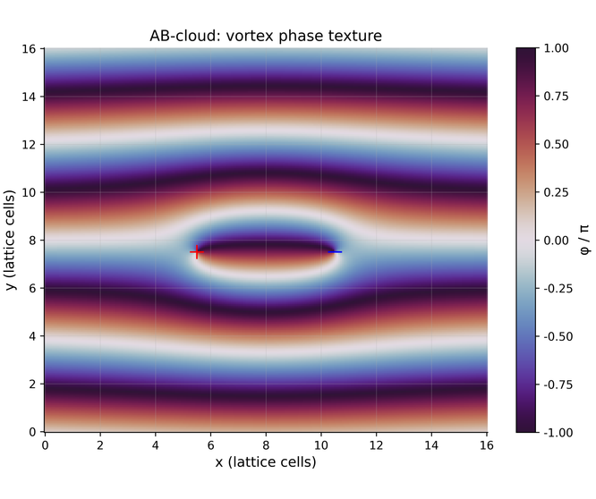
MODEL
The AB-cloud: lattice, phases, vortices
H_{ij} = −exp(iφ_{ij}) ,φ_{ij} = 2πα·j + Σ_{k} q_{k}·[arg(r_{i}−r_{k}) − arg(r_{j}−r_{k})] + φ^{string}
◉
Landau gauge: column phase 2πα·j
↻
A vortex q_{k} winds the phase by 2πq_{k}
⚡
Dirac string: −2πq on crossed bonds — flux exactly 2πq through one plaquette
✦
On-site disorder W with a fixed RNG seed
The phase „cloud" of a vortex pair q=±1 over the Landau gauge

Slide 4
GAUGE CHOICE
Two phase gauges — the fork of the whole suite
:dirac
explicit string
:monumental
smooth atan model
⊘
Integer charges are gauge-invisible (Byers–Yang)
〜
Phases are complex for any q
✦
The matrix is real: τ(H)=0 → GOE class
⇄
τ(H) = 0.225 → T-symmetry broken
VS
⟨r⟩ = 0.513
⟨r⟩ = 0.585
— the GOE ceiling; disorder does not help
— the GUE band
WARN
real symmetric · GOE universality
PASS
complex Hermitian · GUE universality
⚖
Moral: the phase gauge is part of the physical specification. All historical disagreement between suite versions traces to this fork

Slide 5
TOPOLOGICAL INVARIANTS
The topological skeleton: machine precision
BYERS–YANG
PASS
EXACT FLUX
CONNES SELF-DUALITY
PASS
3.5·10⁻¹⁵
10⁻¹⁴ rad
4 zero modes at α=1/2
integer charge q=1 is spectrally invisible; fractional q=0.3 shifts by 0.342
max |flux| over 224 empty plaquettes (the Dirac string is exact)
E→−E defect 1.4·10⁻¹⁵
CHIRAL DEFECT
CHERN NUMBER
0.0
C₁ = 2
ΓHΓ=−H at W=0; at W=4: 5.9·10⁻³
the lowest-band Chern number (Fukui–Hatsugai–Suzuki, 8×8 twists)
✦
Every number is a separate test with a full log; reproduce with julia ab_cloud_v19.jl --test N

Slide 6
TEST 33 · MULTI-REALIZATION BOOTSTRAP
⟨r⟩ = 0.5848 ± 0.0260
PASS
GUE target 0.5992 → deviation −2.4% · 95% CI [0.5588; 0.6108]
⚙
CONFIGURATION
✦
REALIZATIONS
⚗
CONTROL (Q=0.3, OPEN BOUNDARIES)
torus 16×16 · N_{v}=2 · q=±1 · α=1/2 · W=4 · 3 realizations
real 1: 0.5639 · real 2: 0.5811 · real 3: 0.6094
⟨r⟩ = 0.4417 ± 0.0555 — edge states admix the Poisson component
0.3863
0.5307
0.5996
POISSON
GOE
GUE
0.5848
THIS WORK

Slide 7
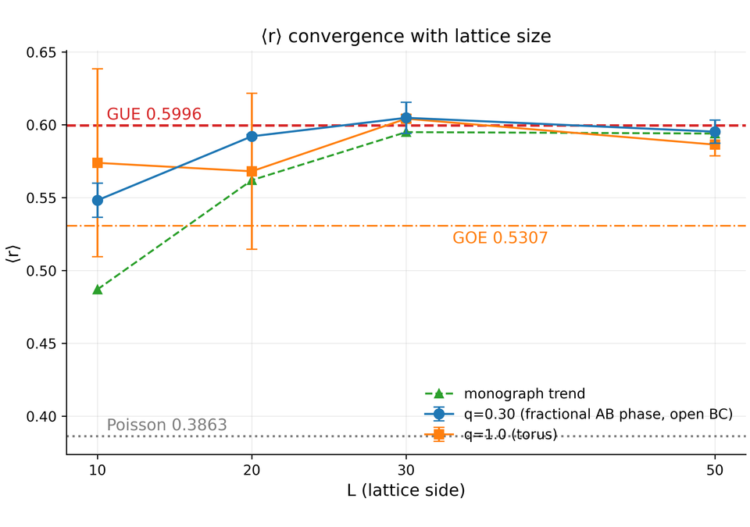
SIZE SCALING
Test 34: convergence with lattice size
01
q=0.3 (open): 0.548 → 0.592 → 0.605 → 0.595 — monotone
02
q=1 (torus): 0.574 → 0.568 → 0.604 → 0.586
03
L≥30: plateau ≈0.60 within two standard errors of GUE
04
The v13 „decay paradox" is resolved: the depression was an artifact of small lattices and the real gauge

Slide 8
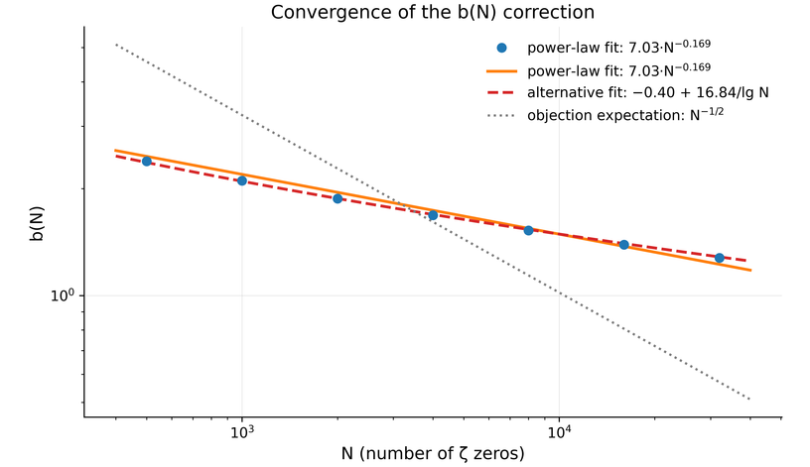
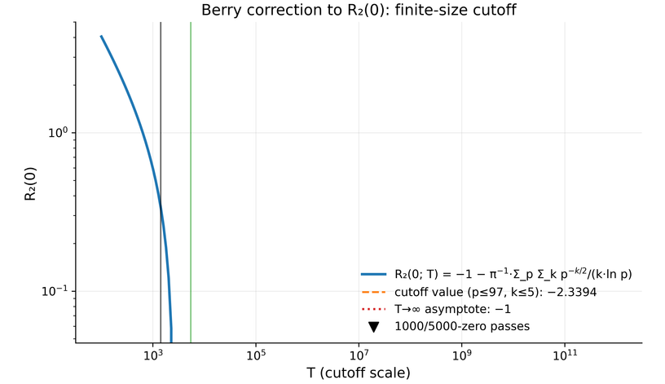
Ζ STATISTICS · TESTS 4–6, 11, 12 · BERRY FINITE-SIZE CORRECTIONS
Finite-sample effects in ζ statistics
b(N) ≈ 7.03·N^{−0.169}, R²=0.99; better — 1/ln N: R²=0.9999
R₂(0) with the Berry cutoff: −2.3394, addition ~T^{−1/2}
TESTS 4–6, 11
TEST 12
The zeros are indistinguishable from a
finite-size GUE matrix
KS D=0.088 against a critical 0.006, χ², A² — GUE rejected
two-sample KS against a 2000×2000 GUE matrix: D=0.041, p=0.139 — NOT rejected

Slide 9
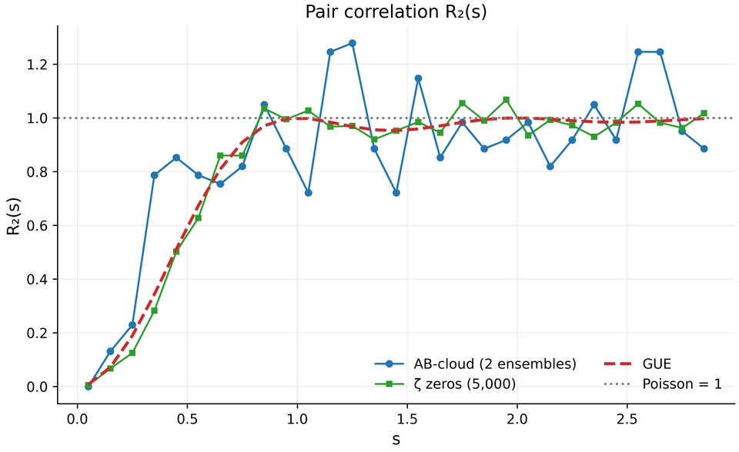
TEST 35 · MONTGOMERY · AB-CLOUD VS Ζ ZEROS
Test 35: the direct comparison with the ζ zeros
KS: D=0.117, p=6.7·10⁻⁴
WARN
The correlation hole is reproduced:
Closer to GUE than Poisson:
no pointwise match
R₂(0.05)≤0.005 for both curves
d_{GUE}=0.140 < d_{Pois}=0.227
The same universality — ; the same spectrum — . We record the distance
yes
no
as a number, not an adjective

Slide 10
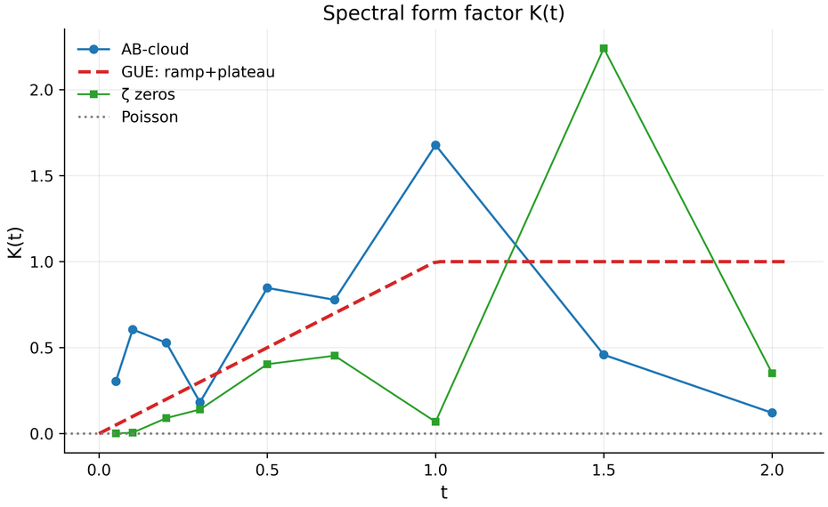
TEST 36 · SPECTRAL FORM FACTOR K(T)
Test 36: the form factor — the limits of small ensembles
RMS TO THE GUE RAMP
0.93
WARN
PASS threshold 0.30
CORRELATION WITH THEORY
0.018
WARN
threshold 0.50
Even ζ-5000 gives RMS 0.86 — the hard thresholds are calibrated for ≥3,000 gaps
Forecast:
PASS is reachable at ≥10⁴ gaps (larger lattices × realizations × vortex shifts)

Slide 11
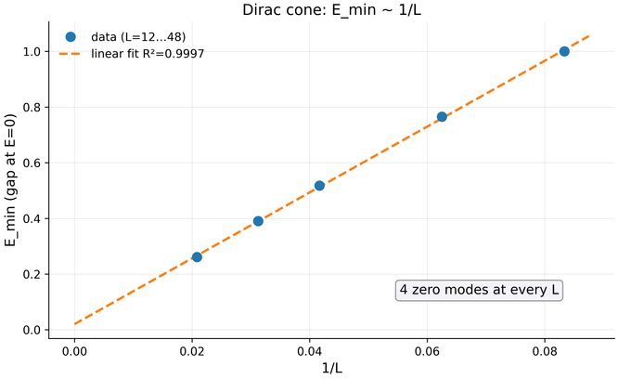
DIRAC SECTOR · CONE · DOS DIP · HATANO–NELSON
Dirac dynamics: cone, dip, skin effect
01
Cone
E_{min} = 0.0202 + 11.83/L, R²=0.9997
(L=12…48, 4 zero modes); v_{F} = b/2π ≈ 1.88
02
DOS dip at α=1/2
ρ=0.010 vs 0.200 at α=0.4/0.6 — 20× contrast
(the critical point between Hall phases C₁=+1/−1)
03
Hatano–Nelson
σ=0.5 → real spectrum; σ=0.7 → the entire spectrum complex
(max|Im E|=0.623), skin g=0.322
The critical line σ=1/2 is singled out threefold: Connes self-duality + Hermiticity + the Dirac dip

Slide 12
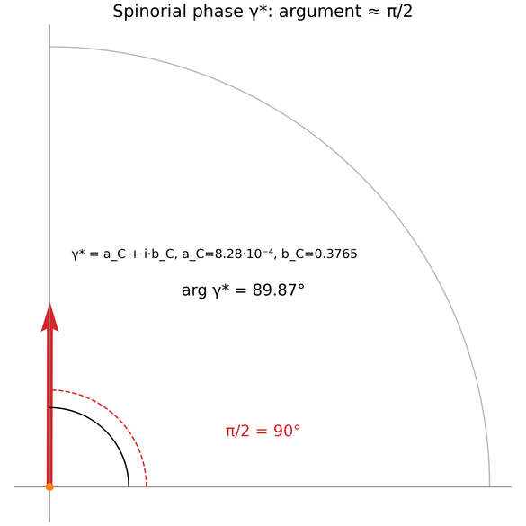
TESTS 21 · 22 · 23 · EXACT IDENTITIES
Analytic structures: π/7
Φ_{AB} = 2π/14 = π/7
Test 22
an exact identity for q/e = 1/14
γ* = a_{C} + i·b_{C}
Test 21
a_{C} = (π/7)⁵/22 = 8.276·10⁻⁴
b_{C} = 2sin²(π/7) = 0.3765
→ arg γ* = 89.87° ≈ π/2
CF = exp(2πi/22)·exp(i·2.854·ln 22) = −0.950+0.312i, |CF|=1
Test 23
the empirical input CF_{hard} → c_{AB} = 0.0206
Formula precision — machine
The physical interpretation (Peccei–Quinn, PSL(2,7)⊂Monster) — hypothesis: the suite does not contradict it, but does not prove it
PASS

Slide 13
SUITE V19 · FIXES R1–R5 · REPRODUCIBILITY
v19: an infrastructure of trust
FIX-R1
FIX-R2
Two verdict systems
a PDF-writer MethodError → 37 false WARNs and a dead second pass; fixed by typing the line list
the failure of any report format can no longer affect a verdict (try/catch around _write_test_report!)
Formulaic:
machine ε 10⁻¹²…10⁻¹⁶, binary PASS/FAIL
Statistical:
calibrated bands, PASS/WARN/FAIL
FIX-R3 / R4
FIX-R5
Test 28 (variable scope) and Test 18 (α·Ny∈ℤ, multiples of 6)
the quick check — ζ≤5000, no GIF, the --quick flag; genuinely both passes 16×16→32×32
Every run:
a directory with logs,
md/html/pdf/docx
,
PNG 600 dpi
,
SVG
,
GIF

Slide 14
THE AB-CLOUD AS A PHASE RESONATOR · MONOGRAPH V22 · CLOSING
Conclusions
Exactness
Universality
fluxes 10⁻¹⁴, Byers–Yang 3.5·10⁻¹⁵, Connes 4 zero modes — proven
⟨r⟩ = 0.585±0.026 → plateau 0.595 at L≥30 — GUE reproduced
Honesty
Dynamics
R₂ matches qualitatively, KS p=6.7·10⁻⁴ — the distance is measured
cone R²=0.9997, dip 20×, skin effect — the critical line σ=1/2
The AB-cloud is a phase resonator with reproducible GUE statistics: the Hilbert–Pólya program as a quantitative, testable program
julia ab_cloud_v19.jl --test all
·
--quick
·
DOI 10.5281/zenodo.21825394

