Slide 1
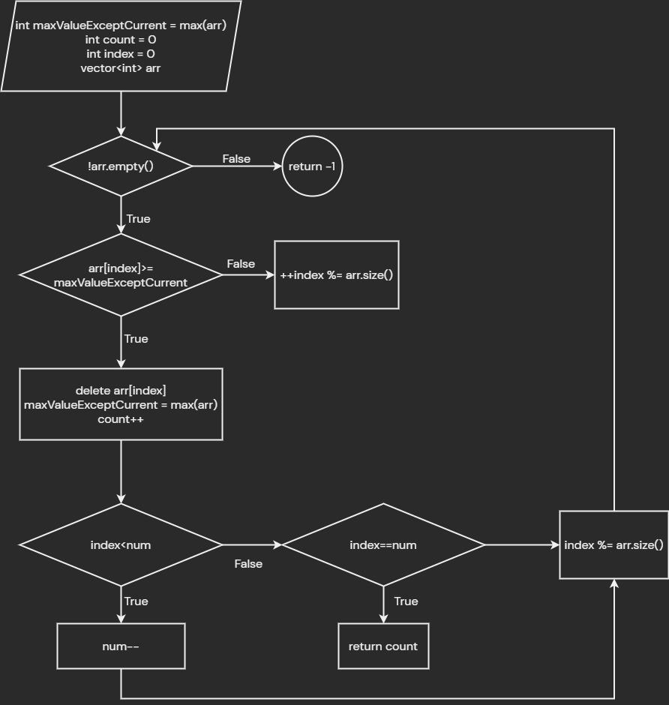

Slide 2
1
1
9
1
1
1

Slide 3
- erase
- calculate maxValue
- count++
count = 4
maxValue = 9
count = 0
maxValue = 9
count = 1
maxValue = 9
count = 2
maxValue = 9
count = 3
maxValue = 9
1 | 1 | 9 | 1 | 1 | 1
1 | 1 | 1 | 1 | 1
1 | 1 | 1 | 1
1 | 1
1 | 1 | 1
index
index %= arr.size()

Slide 4
Case: M = 4
1 | 1 | 9 | 1 | 3 | 1
index
index<M => M--

Slide 5
M = 3
1 | 1 | 1 | 3 | 1
index

