Slide 1
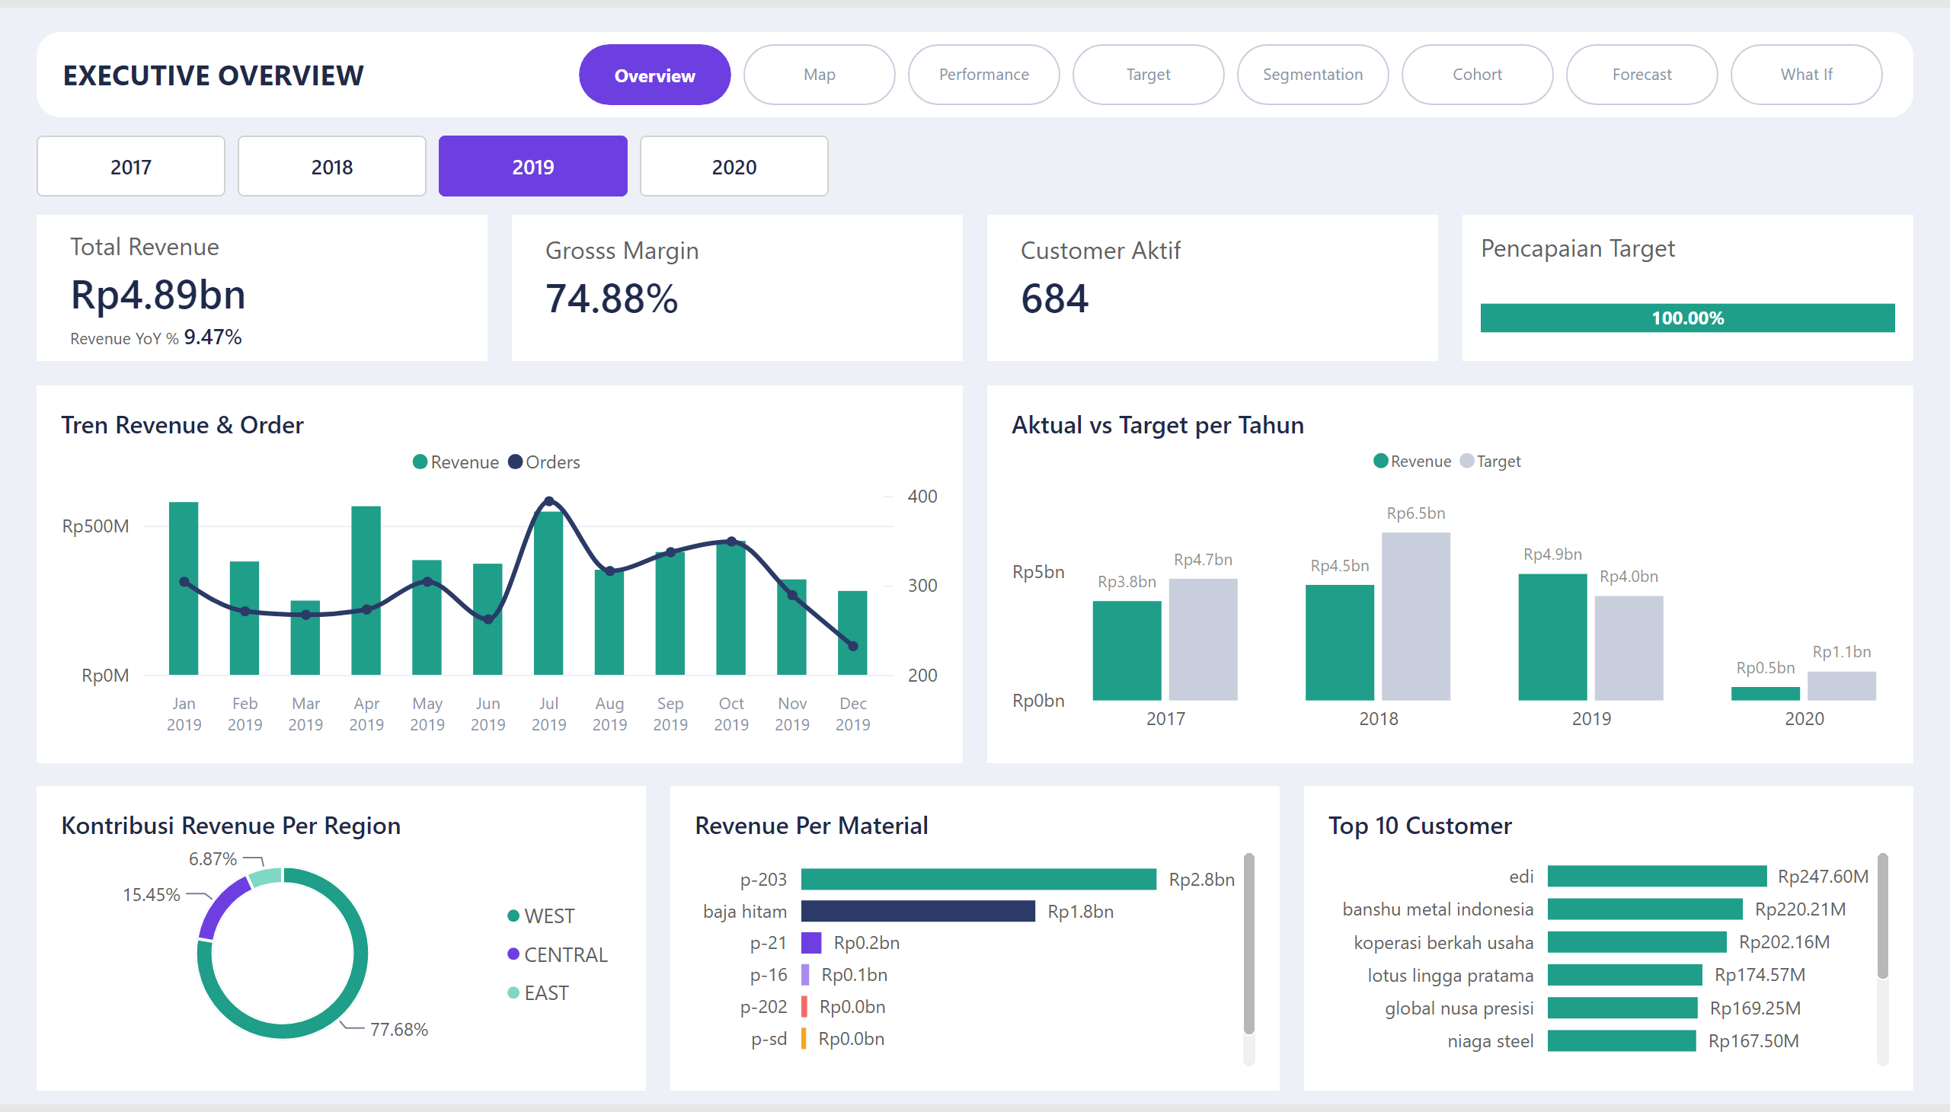
Overview
Notes:
Customer Aktif
No alt text provided
Total Revenue
No alt text provided
Gross Margin
No alt text provided
textbox
No alt text provided
Pencapaian Target
No alt text provided
advancedSlicerVisual
No alt text provided
pageNavigator
No alt text provided
Top 10 Customer
No alt text provided
Aktual vs Target per Tahun
No alt text provided
Tren Revenue & Order
No alt text provided
Kontribusi Revenue Per Region
No alt text provided
Revenue Per Material
No alt text provided

Slide 2
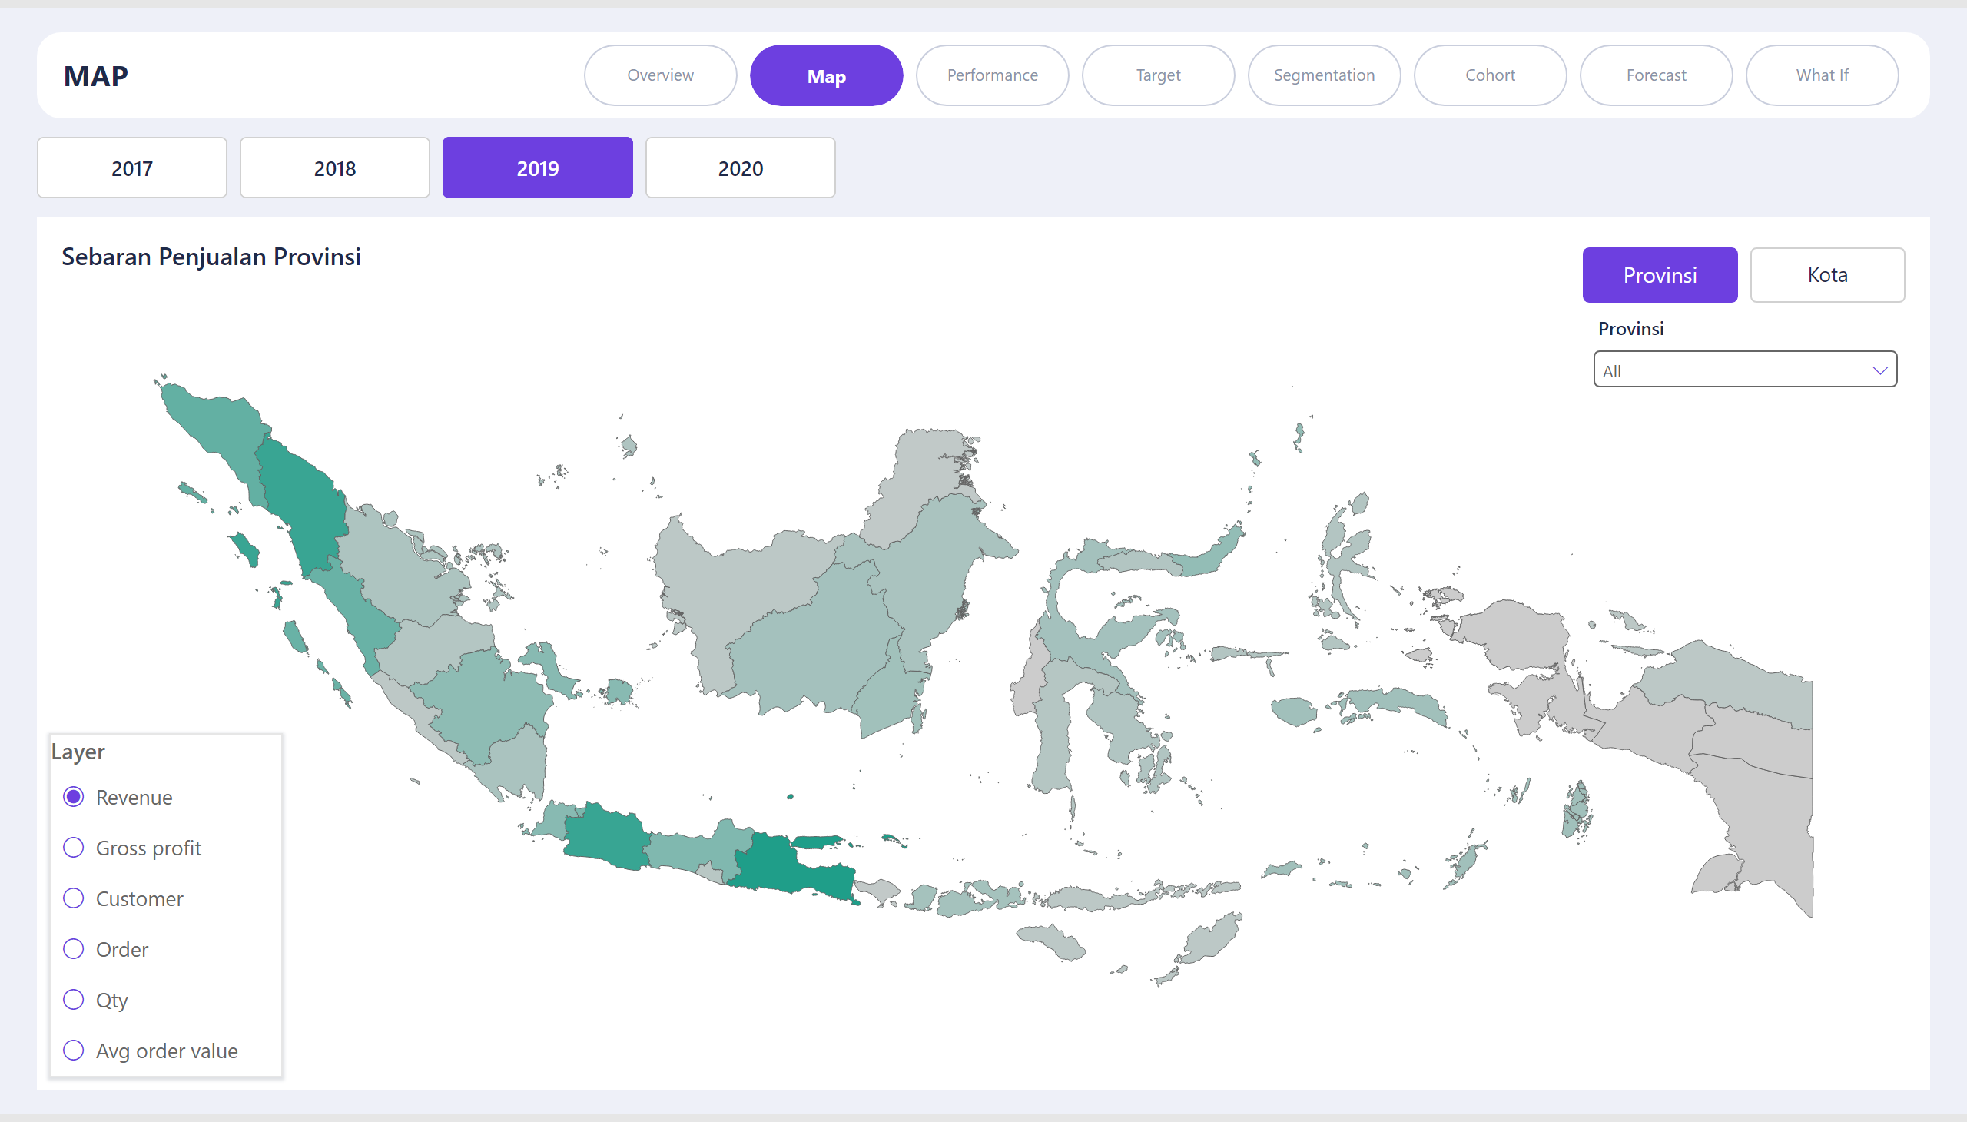
Map
Notes:
textbox
No alt text provided
Province Slicer
No alt text provided
shapeMap
No alt text provided
pageNavigator
No alt text provided
level_nav
No alt text provided
slicer
No alt text provided
year_slicer
No alt text provided
Sebaran Penjualan Provinsi
No alt text provided
Layer
No alt text provided

Slide 3
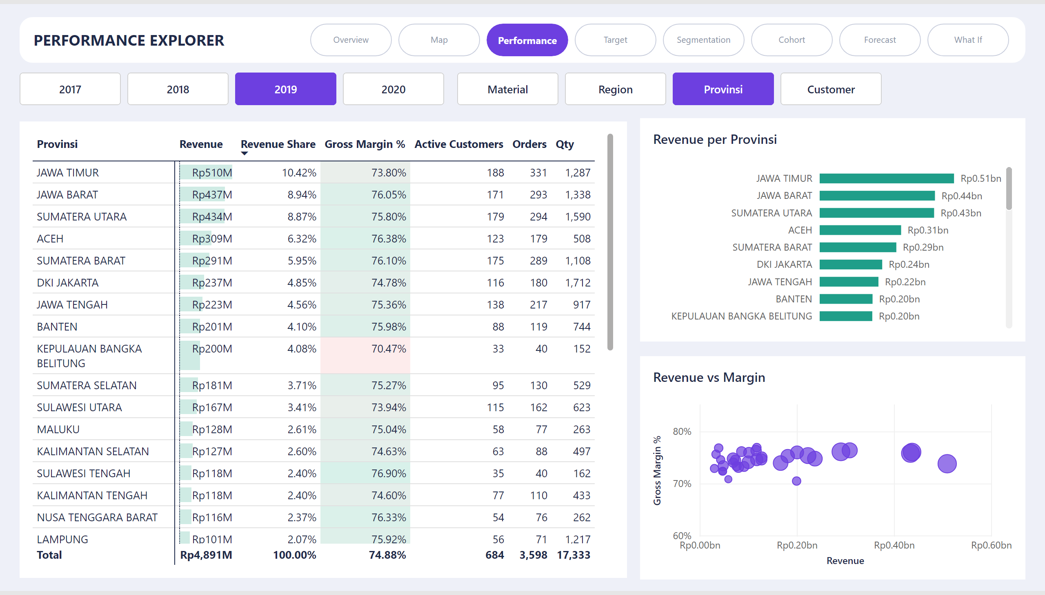
Performance
Notes:
Revenue per Provinsi
No alt text provided
Dimensions slicer
No alt text provided
year_slicer
No alt text provided
pageNavigator
No alt text provided
Revenue vs Margin
No alt text provided
textbox
No alt text provided
pivotTable
No alt text provided

Slide 4
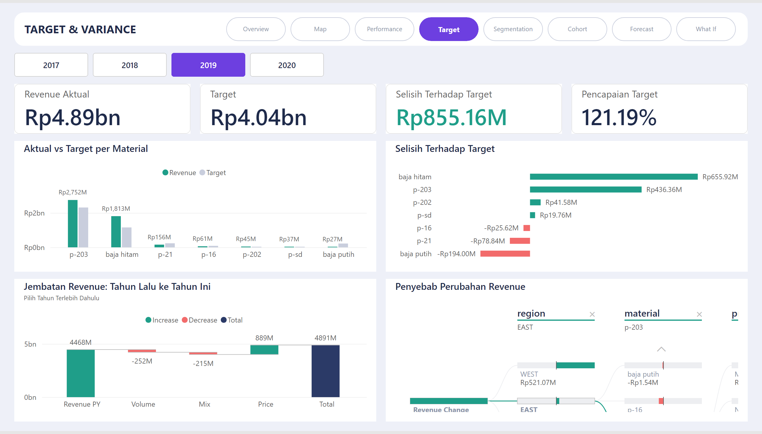
Target
Notes:
cardVisual
No alt text provided
year_slicer
No alt text provided
textbox
No alt text provided
Selisih Terhadap Target
No alt text provided
cardVisual
No alt text provided
Jembatan Revenue: Tahun Lalu ke Tahun Ini
No alt text provided
cardVisual
No alt text provided
cardVisual
No alt text provided
Aktual vs Target per Material
No alt text provided
pageNavigator
No alt text provided
Penyebab Perubahan Revenue
No alt text provided

Slide 5
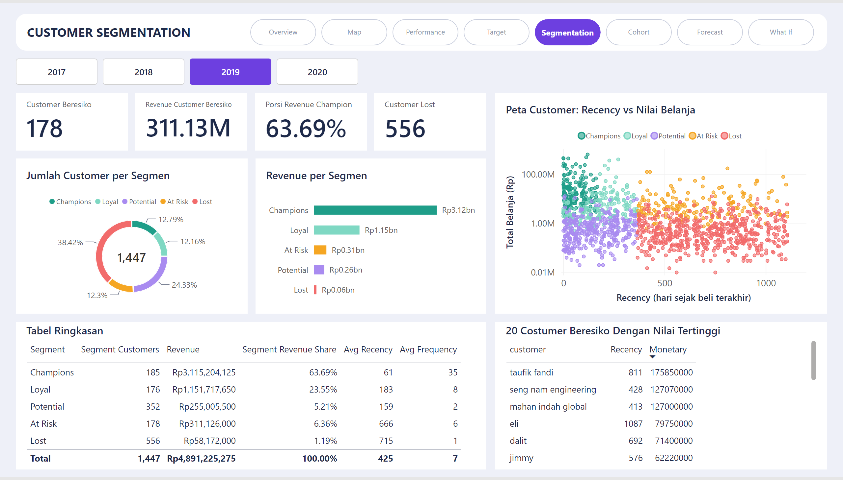
Segmentation
Notes:
cardVisual
No alt text provided
pageNavigator
No alt text provided
cardVisual
No alt text provided
Peta Customer: Recency vs Nilai Belanja
No alt text provided
Tabel Ringkasan
No alt text provided
year_slicer
No alt text provided
Jumlah Customer per Segmen
No alt text provided
textbox
No alt text provided
cardVisual
No alt text provided
advancedSlicerVisual
No alt text provided
20 Costumer Beresiko Dengan Nilai Tertinggi
No alt text provided
Revenue per Segmen
No alt text provided
cardVisual
No alt text provided

Slide 6
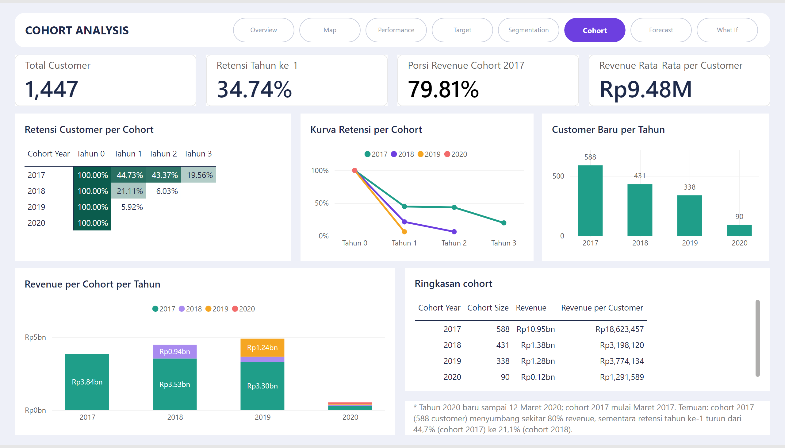
Cohort
Notes:
pageNavigator
No alt text provided
Retensi Customer per Cohort
No alt text provided
cardVisual
No alt text provided
textbox
No alt text provided
Ringkasan cohort
No alt text provided
Customer Baru per Tahun
No alt text provided
cardVisual
No alt text provided
Kurva Retensi per Cohort
No alt text provided
textbox
No alt text provided
cardVisual
No alt text provided
cardVisual
No alt text provided
Revenue per Cohort per Tahun
No alt text provided

Slide 7
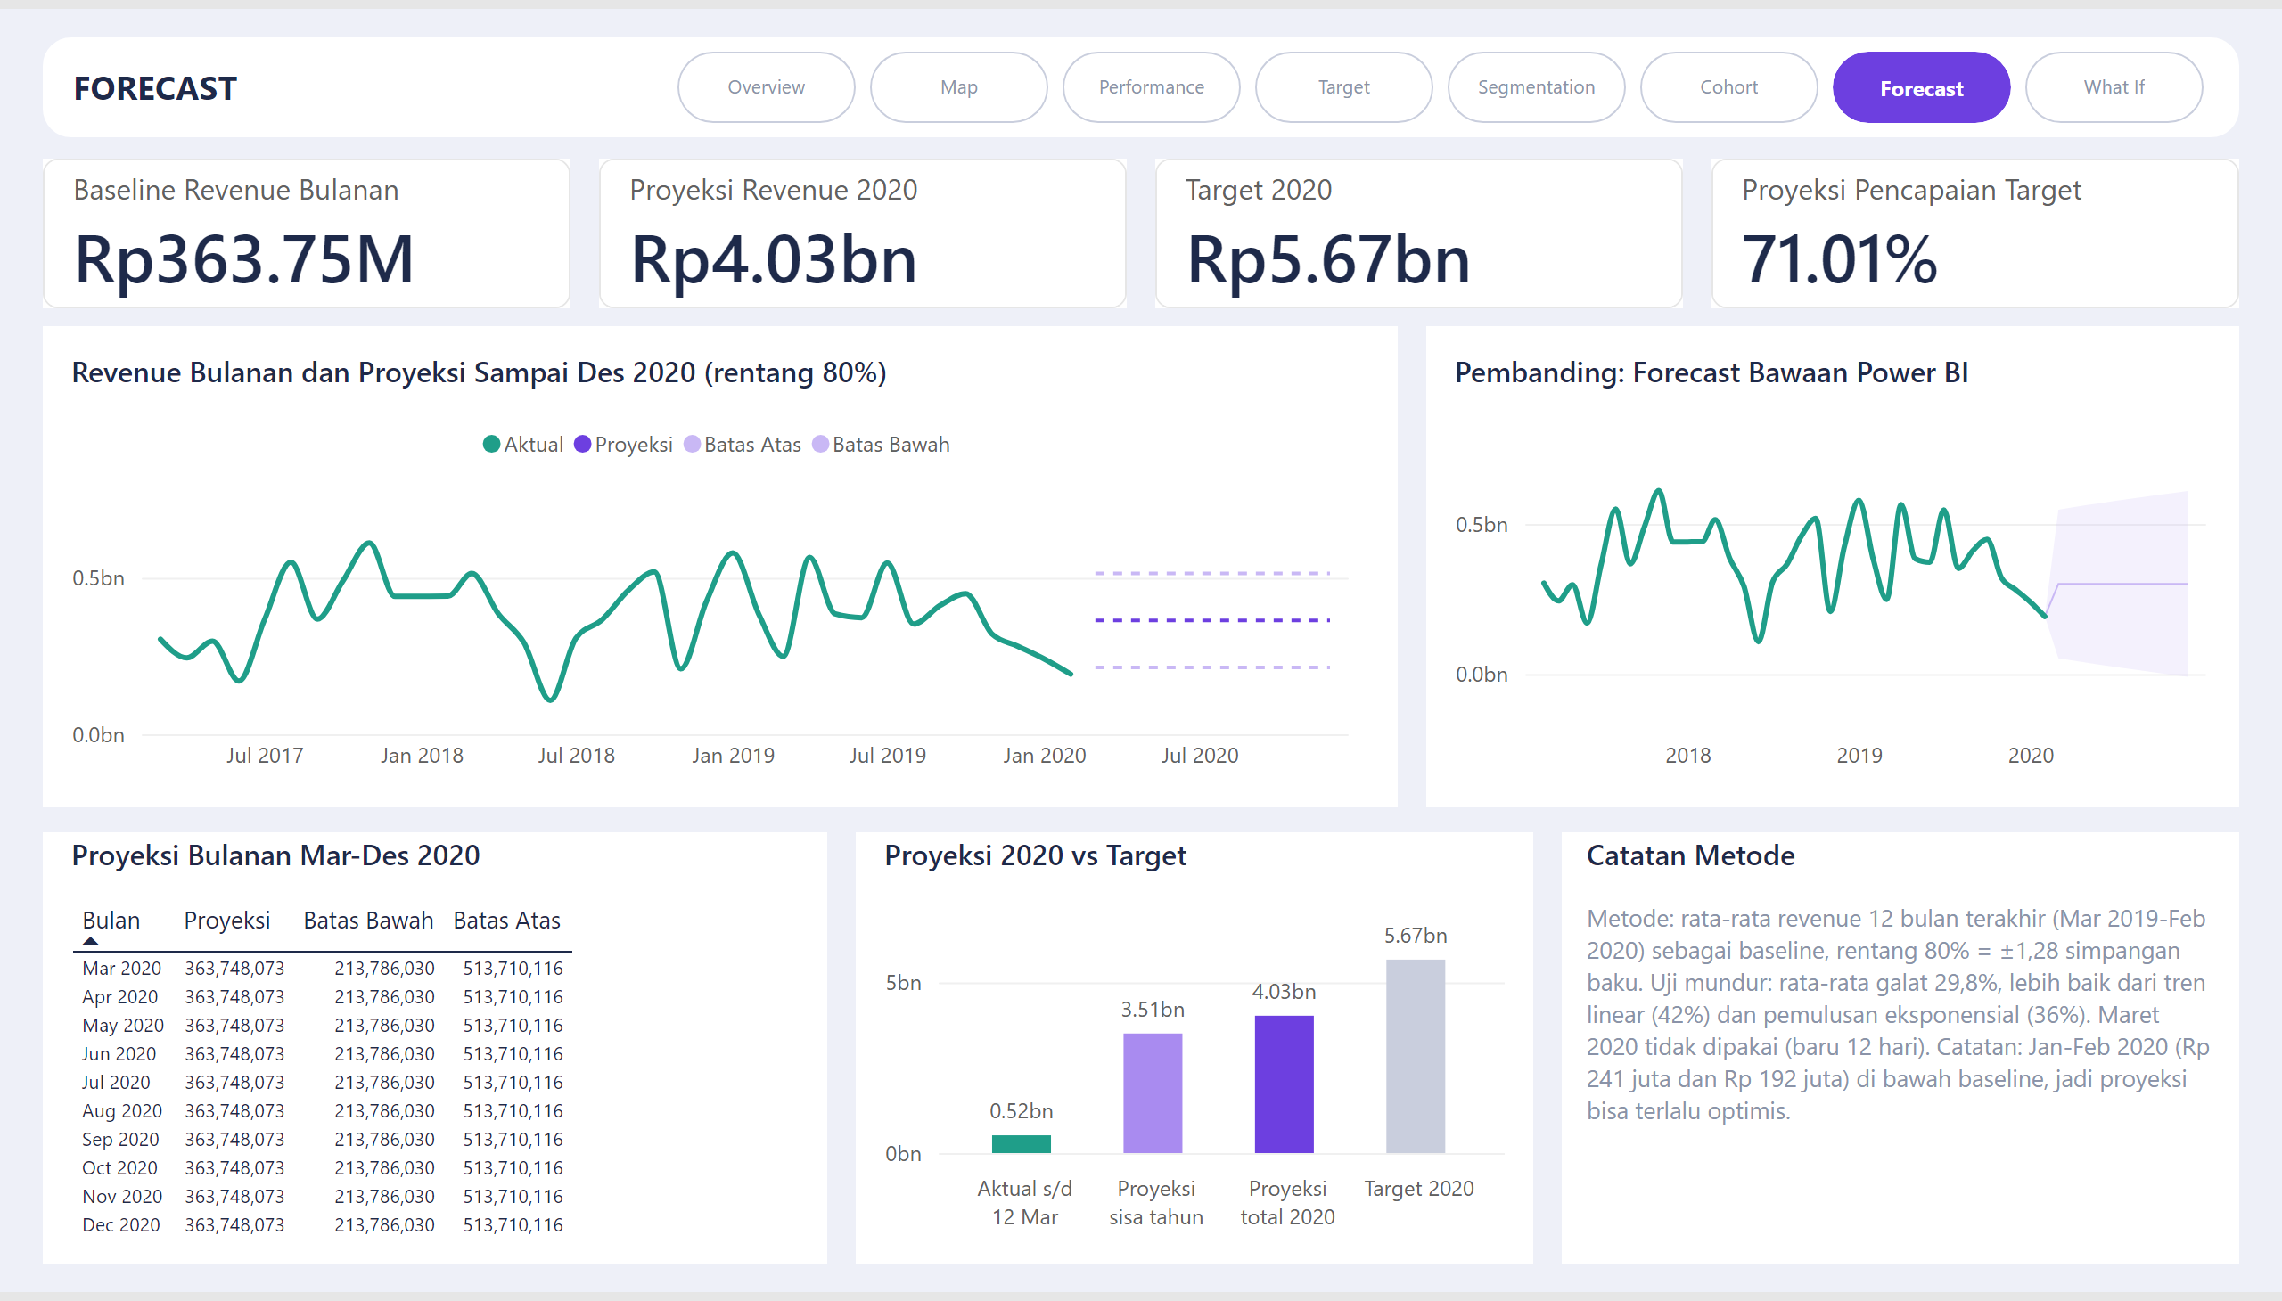
Forecast
Notes:
Proyeksi 2020 vs Target
No alt text provided
textbox
No alt text provided
cardVisual
No alt text provided
cardVisual
No alt text provided
Pembanding: Forecast Bawaan Power BI
No alt text provided
Revenue Bulanan dan Proyeksi Sampai Des 2020 (rentang 80%)
No alt text provided
Catatan Metode
No alt text provided
cardVisual
No alt text provided
cardVisual
No alt text provided
Proyeksi Bulanan Mar-Des 2020
No alt text provided
pageNavigator
No alt text provided

Slide 8
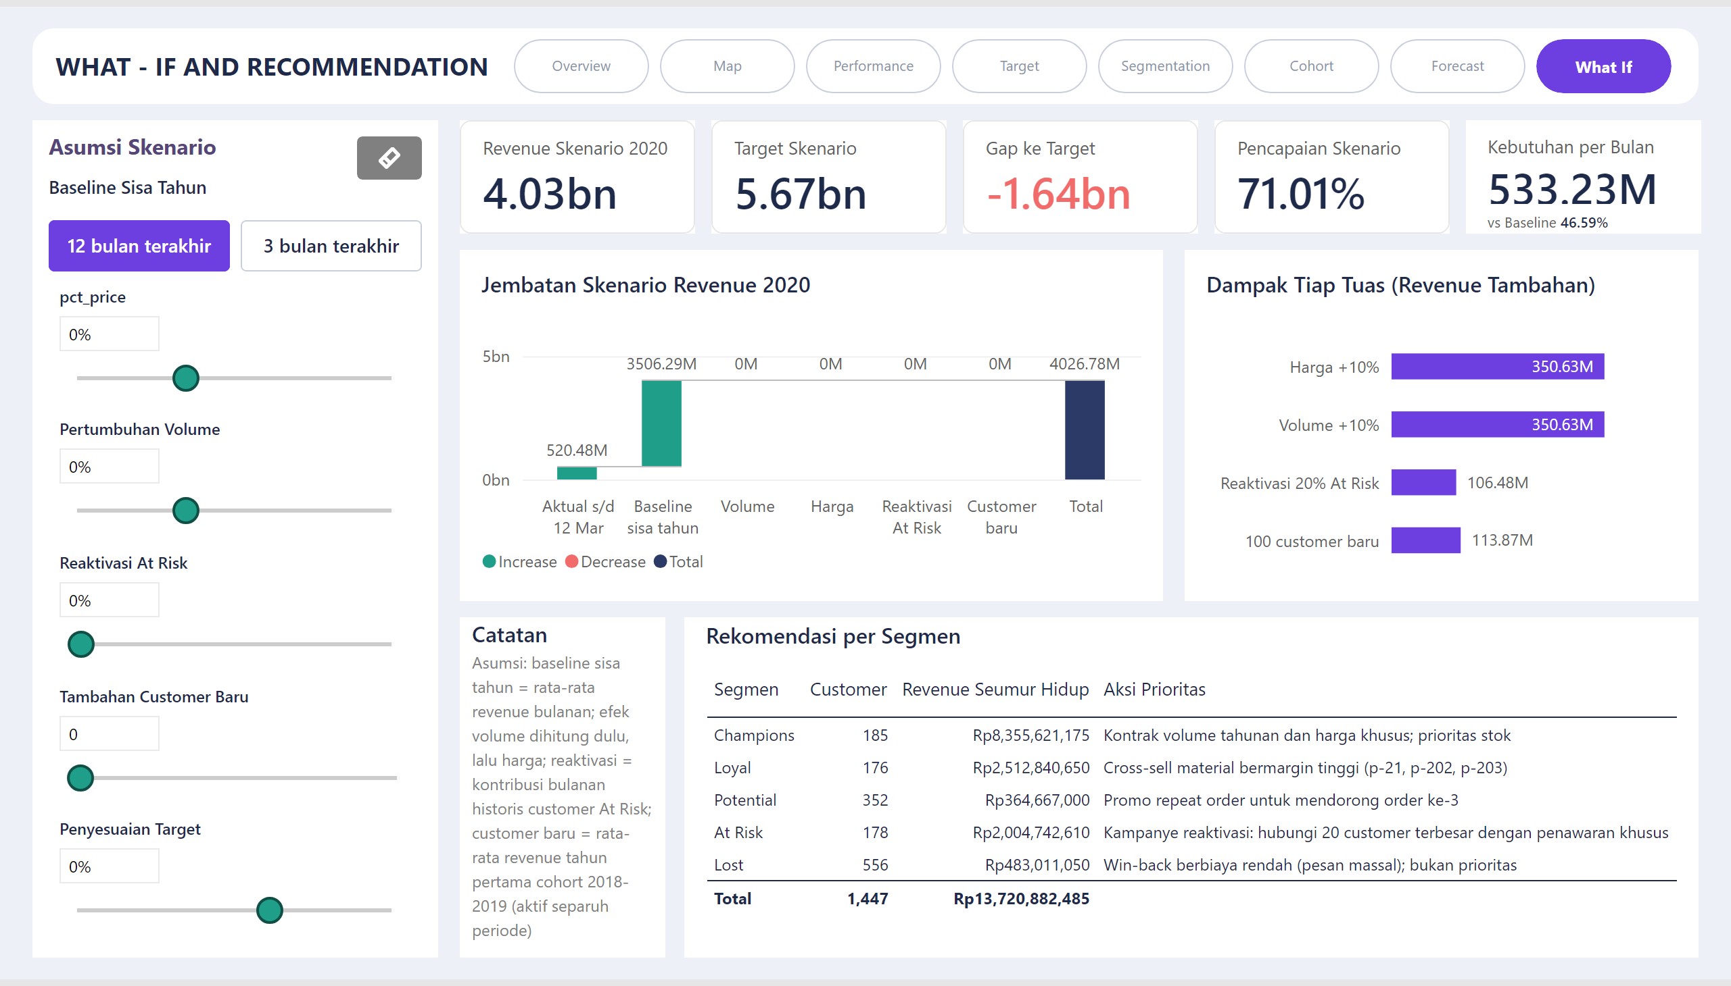
What If
Notes:
cardVisual
No alt text provided
Baseline Sisa Tahun
No alt text provided
slicer
No alt text provided
Dampak Tiap Tuas (Revenue Tambahan)
No alt text provided
cardVisual
No alt text provided
Jembatan Skenario Revenue 2020
No alt text provided
slicer
No alt text provided
Rekomendasi per Segmen
No alt text provided
cardVisual
No alt text provided
slicer
No alt text provided
textbox
No alt text provided
textbox
No alt text provided
pageNavigator
No alt text provided
Reset
No alt text provided
Catatan
No alt text provided
cardVisual
No alt text provided
slicer
No alt text provided
shape
No alt text provided
slicer
No alt text provided
cardVisual
No alt text provided

