Slide 1

Notifications

Slide 3
Why do we need it
TO NOTIFY THE USER WHEN AN MAJOR EVENT IS TRIGERED IN JBILLING

Slide 4
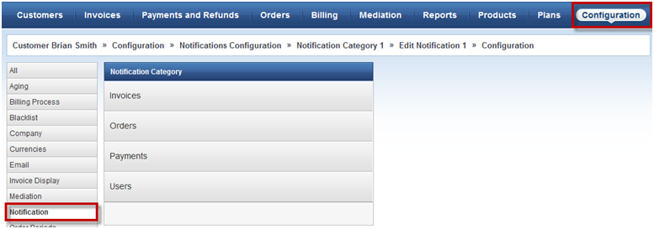

Slide 5
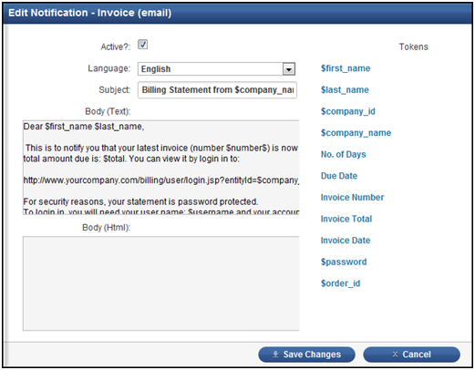

Slide 6


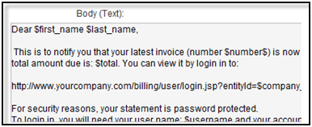
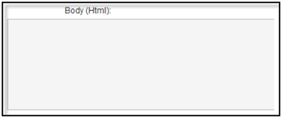

Slide 8
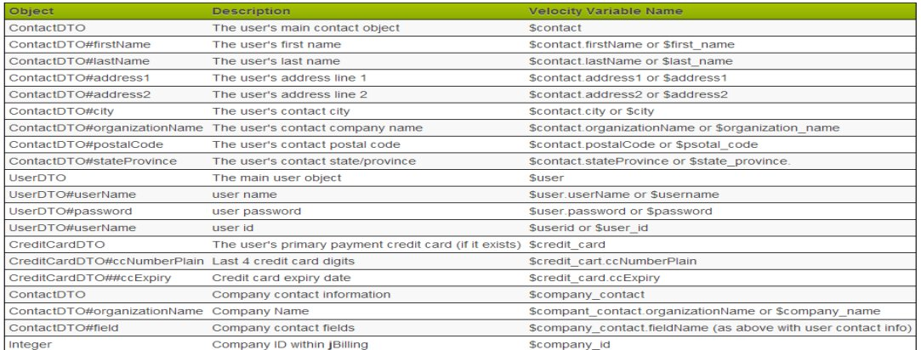

Slide 17
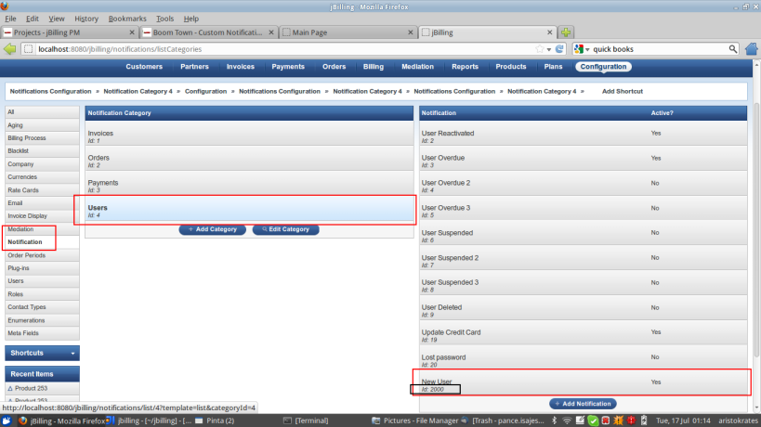

Slide 18
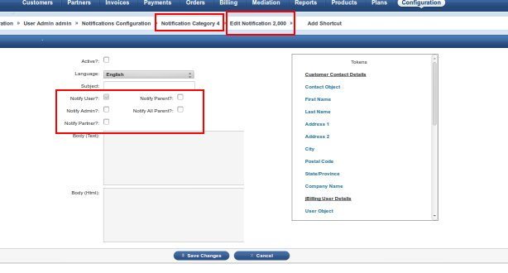

Slide 19
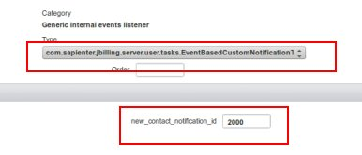

Slide 21

Notes:
<number>

Slide 22
!Thank you!
Notes:
<number>

