Slide 1

Realtime Mediation
Or pre-paid billing

Slide 2

REAL TIME Scenario
“The classic business case for this is pre-paid services where a customer has a balance and can only use a service as long as the balance remains positive. Every attempt to use the service has to check if there is enough balance.”
Customer subscribes to a pre-paid plan
Customer is required to maintain an advance reducing balance
Customer must have a min. balance to make a call/purchase
validate the purchase against pre-paid balance

Slide 3


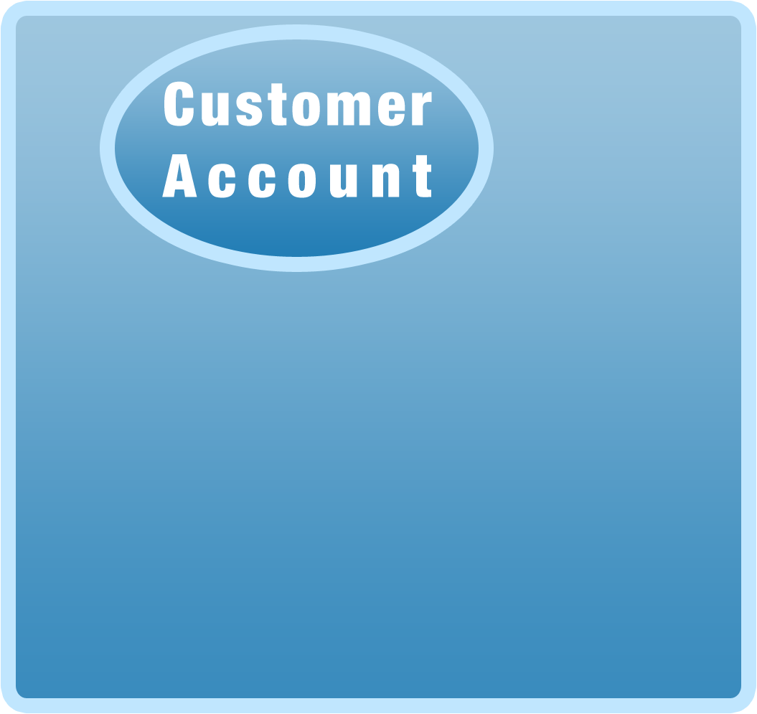







Process and rate calls:
1. Customer dialing
2. Checking jBilling to see if the customer is allowed to the make call…
1.
3. Has the customer reached his credit limit?
6.
4. Is the account overdue? Or Canceled?
5.
9.
4.
3.
5. Does the plan allow the call?
2.
8.
6. Call Validated
7. Call ends
8. How long did the call last?
7.
9. jBilling updates customer’s account

Slide 4
REAL TIME Scenario
The key objective is to prevent or limit lack of payment
Pre-paid: customers pay before they user the service
Credit limit: customer pay after, but can get too much into debt
User auto-recharge with credit cards to get small payments often: “pay as you go”.

Slide 5
Dynamic Balance
The dynamic balance comes in two types: Pre-paid or Credit limit:
Pre-Paid
e.g. $100 Payment increments the pre-paid balance by $100. Customer can be prevented from making a purchase above $100
Dynamic
Balance
Credit Limit
e.g. $100 of Credit Limit set on a Customer’s account means, a customer is not allowed to spend above and beyond $100 without making a payment first.

Slide 6
Dynamic Balance
Pre-Paid: Represents how much money someone has paid in advance to use a service
Increases with every payment
Decreases with every order
Should not be negative
A validation fails if the purchase is grater than the dynamic balance

Slide 7
Dynamic Balance
Credit Limit: Represents how much money someone can ‘borrow’ to use a service
Increases with every order
Decreases with every payment
Should not be greater than the value of the ‘Credit Limit’ attribute
A validation fails if the purchase plus the dynamic balance is greater than the credit limit

Slide 8
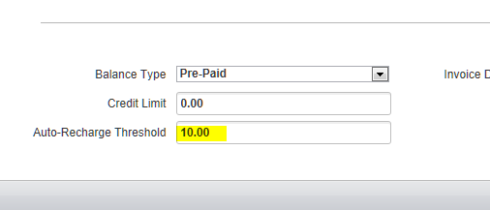
Maintaining Dynamic Balance
Manual Payment
Automatic recharge

Slide 9
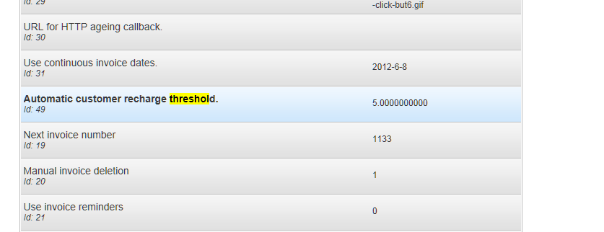
Maintaining Dynamic Balance (automatic recharge)
For Pre-paid: if balance goes below the threshold
For CREDIT LIMIT: IF balance + threshold is grater than the credit limit
Autorechargetask
Auto recharge threshold preference

Slide 10
VALIDATE PURCHASE
Runs the mediation process for a single event, but it does not update the customer account. Instead, it checks if the customer has enough balance to purchase the charges that the event represents.
Validate against dynamic balance vis-à-vis rules
IValidatePurchaseTask
User Balance
Validate Purchase Task
Rules Validate Purchase Task

Slide 11
OTHER REAL TIME CALLS..
rateOrder/rateOrders | Will evaluate an order with pricing and item plugins without creating the order. Your application can show the order to the customer to approved it, and the create it.
getCurrentOrder | Returns the order that the mediation process is using to collect usage for a billing period.
updateCurrentOrder | Runs the mediation process for a single event, passed as an argument
validateMultiPurchase | Same as validatePurchase except that it can validate purchase for more than one items together.

Slide 12
IMPORTANT CONCEPTS
balance type
credit limit
automatic recharge
automatic recharge threshold

