Slide 1

Reports

Slide 2
Agenda
What are reports?
Why would you create reports?
What you should know to create one?

Slide 3

What is a report?
iReports GUI
Database
REPORT
myReportDesign.jrxml
REPORT DATA
Jasper Reports
Report123.pdf
REPORT

Slide 4
Agenda
What are reports?
Why would you create reports?
What you should know to create one?

Slide 5
Why would you create reports?
Mainly done for companies
Reports with different layout, logic and data
Varies customer to customer

Slide 6
Agenda
What are reports?
Why would you create reports?
What you should know to create one?

Slide 7
What you should know to create one?
Reports Types
Reports Directory
Gsp Template
Gsp Template Directory
Summary
Sql Queries
i18n
Grails Commands
Using Reports

Slide 8
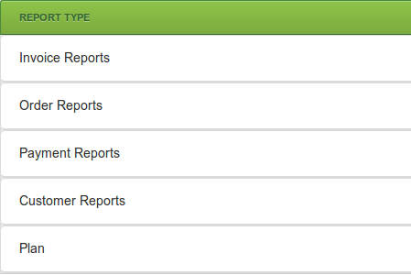
Report Types

Slide 9
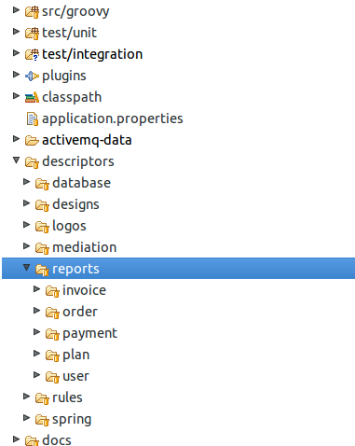
Report Directory

Slide 10
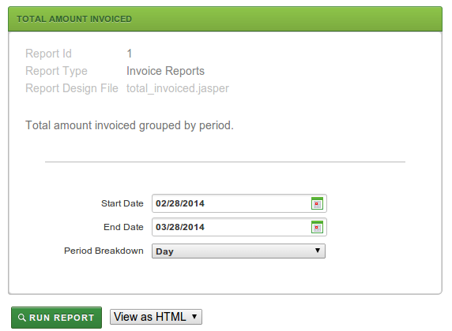
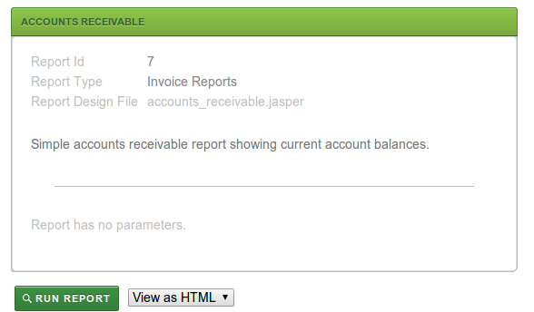
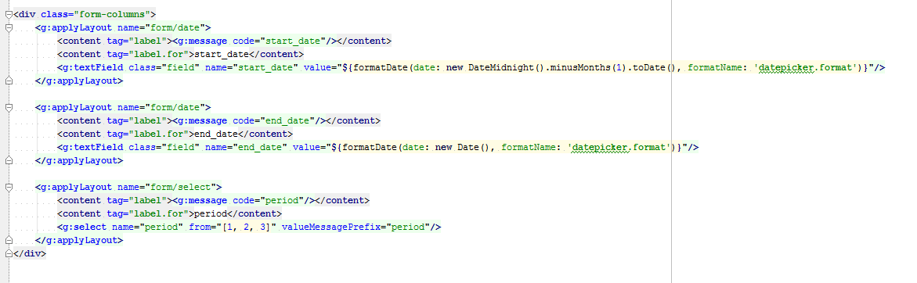
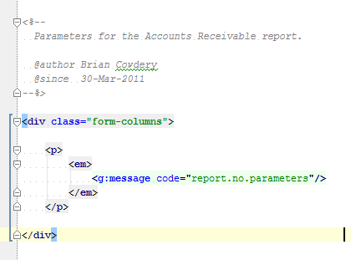
Gsp Template

Slide 11
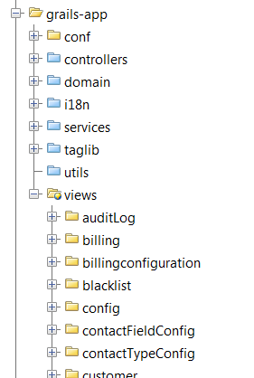
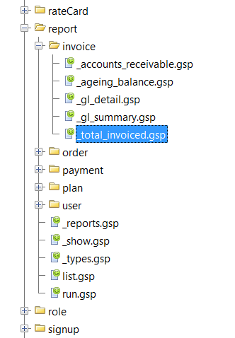
Gsp Template Directory

Slide 12
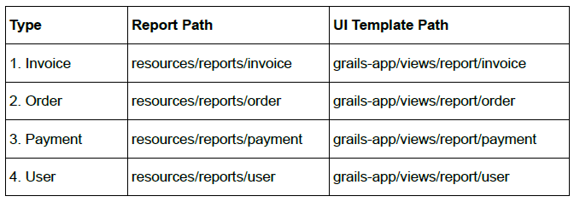
Summary

Slide 13
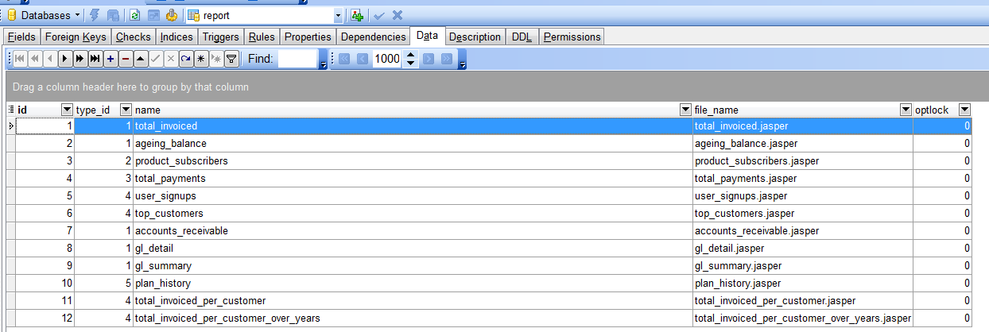
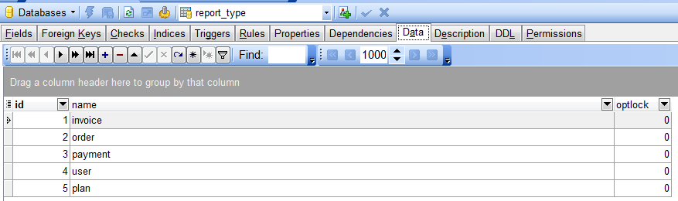
Reports Table

Slide 14
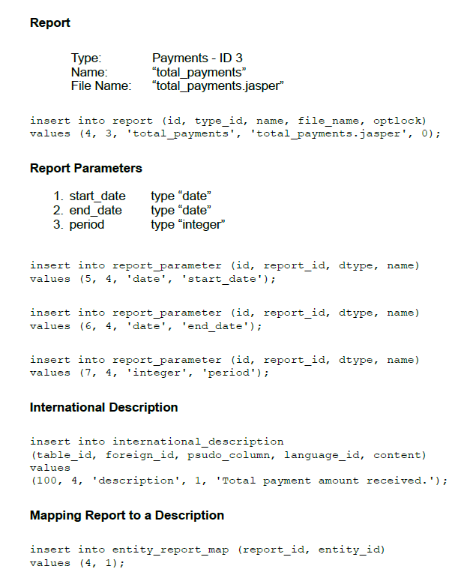
SQL Queries

Slide 15
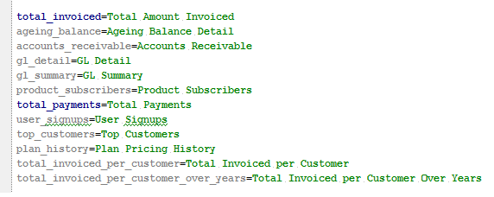
i18n

Slide 16
Grails Commands
grails compile-reports

Slide 17
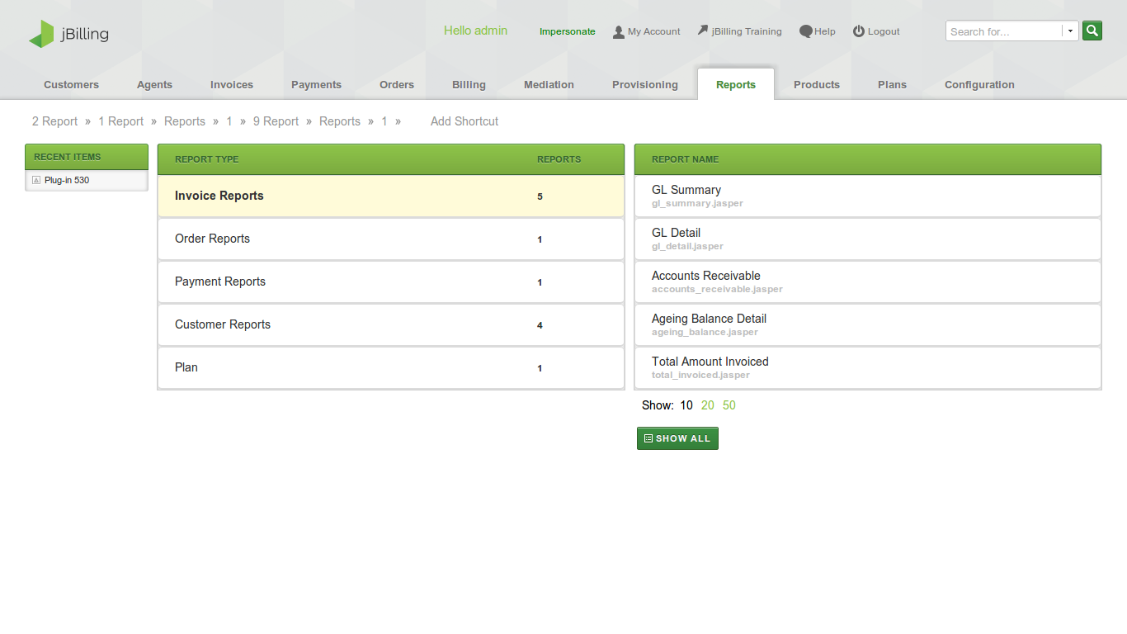
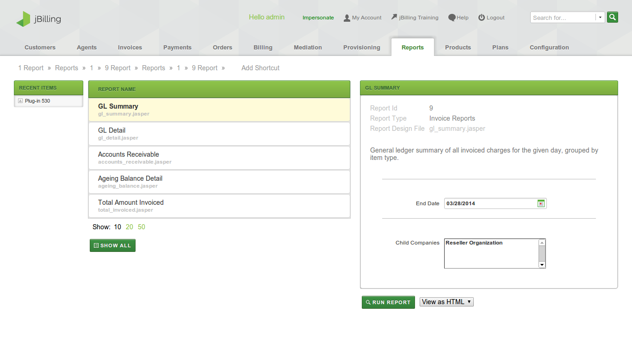
Using Reports

Slide 18


Slide 19
!Thank you!

