Slide 1

Junit-4 Training
jUnit Basics Introduction & annotations.

Slide 2

What is Unit Testing
What is Unit Testing
Test a 'small' piece of code or functionality e.g. Method
The test should verify the correctness of only that piece of code
A Unit Test should take less than a second to complete
Why should you write Unit Tests
Much faster to test than testing your entire application
Help in faster delivery of code where short release is a norm
Help regression testing

Slide 3
jUnit – Framework
JUnit
Very popular Test Framework for Java applications
JUnit assumes that all test methods can be executed in an arbitrary order
Testing with JUnit 4
JUnit 4.x introduces annotations to mark test methods
Backwards compatible i.e. Earlier versions of Test Cases should work as well
@Test – indicates that the method is a Test Case

Slide 4
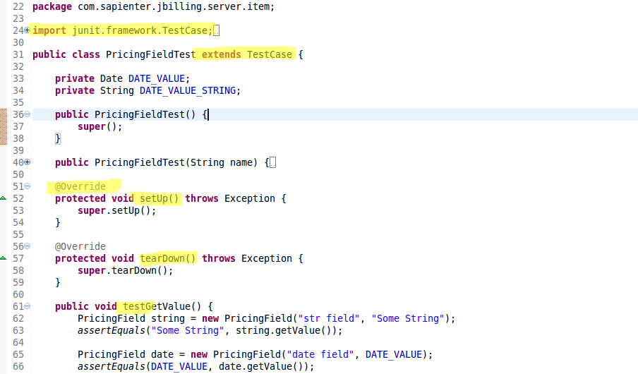
...earlier

Slide 5
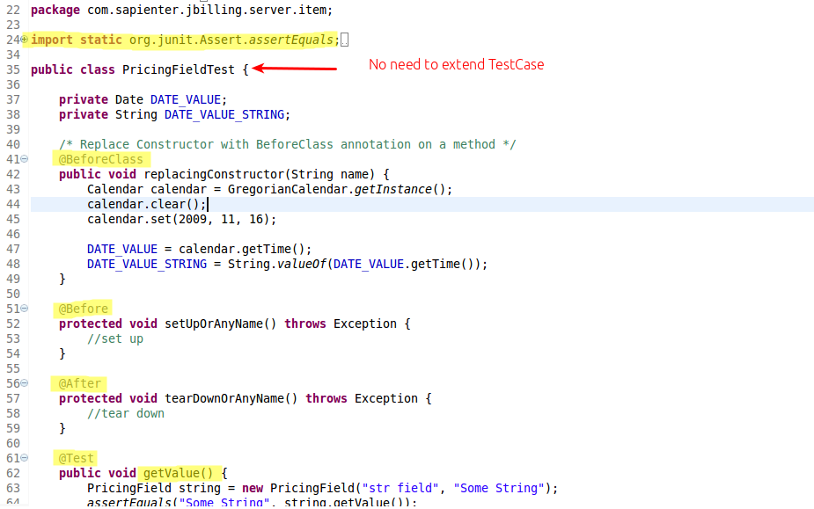
…jUnit 4

Slide 6
@Test
public class WSTest {
//
//
@Test
public void isEmptyCollection() {
// this is the actual test case which will be tested
assertTrue(collection.isEmpty());
System.out.println("@Test - testEmptyCollection");
}
}

Slide 7
Important Annotations
@BeforeClass
@Before
@After
@AfterClass
@Expected (condition)
@Ignore
@Time Test (condition)
@Suite Test
@Parameters
Notes:
Here go over https://pm.jbilling.com/projects/jbilling/wiki/Guide_to_Work_on_a_jBilling_Project and also show the ‘Welcome to jBilling document’.

Slide 8
@BeforeClass
@BeforeClass
public static void oneTimeSetUp() {
// one-time initialization code e.g.
api= JBillingAPIFactory.getAPI();
}
Notes:
Here go over https://pm.jbilling.com/projects/jbilling/wiki/Guide_to_Work_on_a_jBilling_Project and also show the ‘Welcome to jBilling document’.

Slide 9
@ Before
@Before
public void runBeforeEveryTestCase() {
// called before each test case in the test file is executed
collection = new ArrayList();
System.out.println("@Before - setUp");
}
Notes:
Here go over https://pm.jbilling.com/projects/jbilling/wiki/Guide_to_Work_on_a_jBilling_Project and also show the ‘Welcome to jBilling document’.

Slide 10
@After
@After
public void tearDown() {
// called after each test case in the test file is executed
collection.clear();
System.out.println("@After – tearDown");
}
Notes:
Here go over https://pm.jbilling.com/projects/jbilling/wiki/Guide_to_Work_on_a_jBilling_Project and also show the ‘Welcome to jBilling document’.

Slide 11
@AfterClass
@AfterClass
public static void oneTimeTearDown() {
// one-time cleanup code
System.out.println("@AfterClass - oneTimeTearDown");
}
Notes:
Only master

Slide 12
Attribute ‘expected’
@Test(expected = ArithmeticException.class)
public void divisionWithException() {
// It’s used to test the exception throw by the method.
int i = 1/0;
}
Notes:
Release/s branch for sure, also master is good

Slide 13
@Ignore
@Ignore("Not Ready to Run")
@Test
public void divisionWithException() {
// This “Ignored” means the method is not ready to test, the JUnit engine will just bypass this method.
System.out.println("Method is not ready yet");
}
Notes:
This goes in the Blue repository (customer), master branch.

Slide 14
Attribute ‘timeout’
@Test(timeout = 1000)
public void infinity() {
// The “Time Test” means if an unit test takes longer than the specified number of milliseconds to run, the test will terminated and mark as failed.
while (true);
}
In above example, the infinity() method will not return, so the JUnit engine will mark it as failed and throw an exception
java.lang.Exception: test timed out after 1000 milliseconds
Notes:
This goes in the Blue repository (customer), master branch. Also in master of jBilling.

Slide 15
@Suite
@RunWith(Suite.class)
@Suite.SuiteClasses({
JunitTest1.class,
JunitTest2.class
})
public class JunitTest5 {
/* The “Suite Test” means bundle a few unit test cases and run it together. In Junit, both @RunWith and @Suite annotation are used to run the suite test. The above example means both unit test JunitTest1 and JunitTest2 will run together after JunitTest5 is executed. */
}
Notes:
You need to merge: the release branch of the jBilling repository with the master branch of the customer repository.

Slide 16
@Parameters
@RunWith(value = Parameterized.class)
public class JunitTest6 {
private int number;
public JunitTest6(int number) {
this.number = number;
}
@Parameters
public static Collection<Object[]> data() {
Object[ ] [ ] data = new Object[][] { { 1 }, { 2 }, { 3 }, { 4 } };
return Arrays.asList(data);
}
@Test
public void pushTest() {
System.out.println("Parameterized Number is : " + number);
}
Notes:
Here go over https://pm.jbilling.com/projects/jbilling/wiki/Guide_to_Work_on_a_jBilling_Project and also show the ‘Welcome to jBilling document’.

Slide 17
@Parameters ..cont.
Result :
Parameterized Number is : 1
Parameterized Number is : 2
Parameterized Number is : 3
Parameterized Number is : 4
It has many limitations here; you have to follow the “JUnit” way to declare the parameter, and the parameter has to pass into constructor in order to initialize the class member as parameter value for testing. The return type of parameter class is “List []”, data type has been limited to String or primitive value
Notes:
Here go over https://pm.jbilling.com/projects/jbilling/wiki/Guide_to_Work_on_a_jBilling_Project and also show the ‘Welcome to jBilling document’.

Slide 18

..resources online.
http://www.vogella.com/articles/JUnit/article.html
http://www.junit.org
http://www.mkyong.com/unittest
Notes:
Here go over https://pm.jbilling.com/projects/jbilling/wiki/Guide_to_Work_on_a_jBilling_Project and also show the ‘Welcome to jBilling document’.

