Slide 1
Predictive Analytics
Instagram
Design

Slide 2
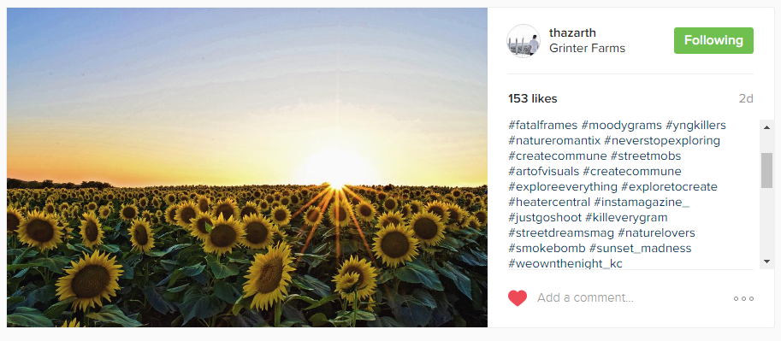
Overview
Tags : Frequency
streetDreamsMag 1
Artofvisuals 1
NatureLovers 1

Slide 3



-User Authentication -Parse Data
Retrieve User Data
Store User
Data
Perform MapReduce
-Sanitize Data -Store data
-Determine Tag Priority(Frequency) -Push to HDFS

Slide 4


-Transform Data -Determine Trends
Connect
Data points
Output Trends
-Web View
-Present analytics

Slide 5
Bibliography
http://wwhttp://www.semantikoz.com/blog/free-hive-book/images/hive-logo.pngw.semantikoz.com/blog/free-hive-book/images/hive-logo.png
http://www.jwt.com/blog/wp-content/uploads/2016/08/instagram-1581266_960_720.jpg
https://pbs.twimg.com/profile_images/1252505253/elephant_rgb_sq.png
http://blog.addthiscdn.com/wp-content/uploads/2014/11/addthis-react-flux-javascript-scaling.png
http://www.nextstepmarket.com/images//google-correlate.png

