Slide 1

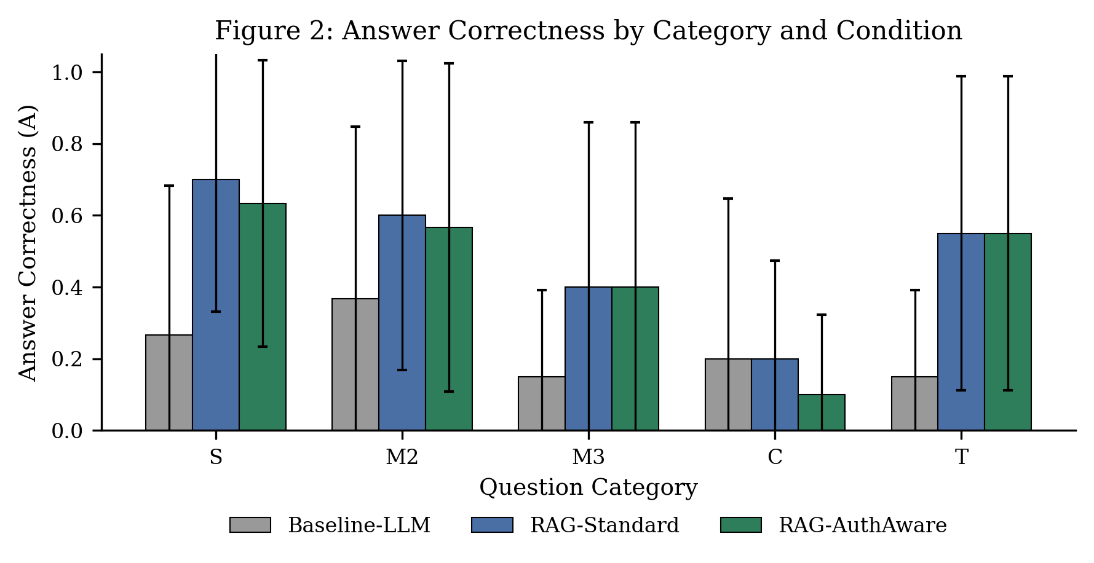
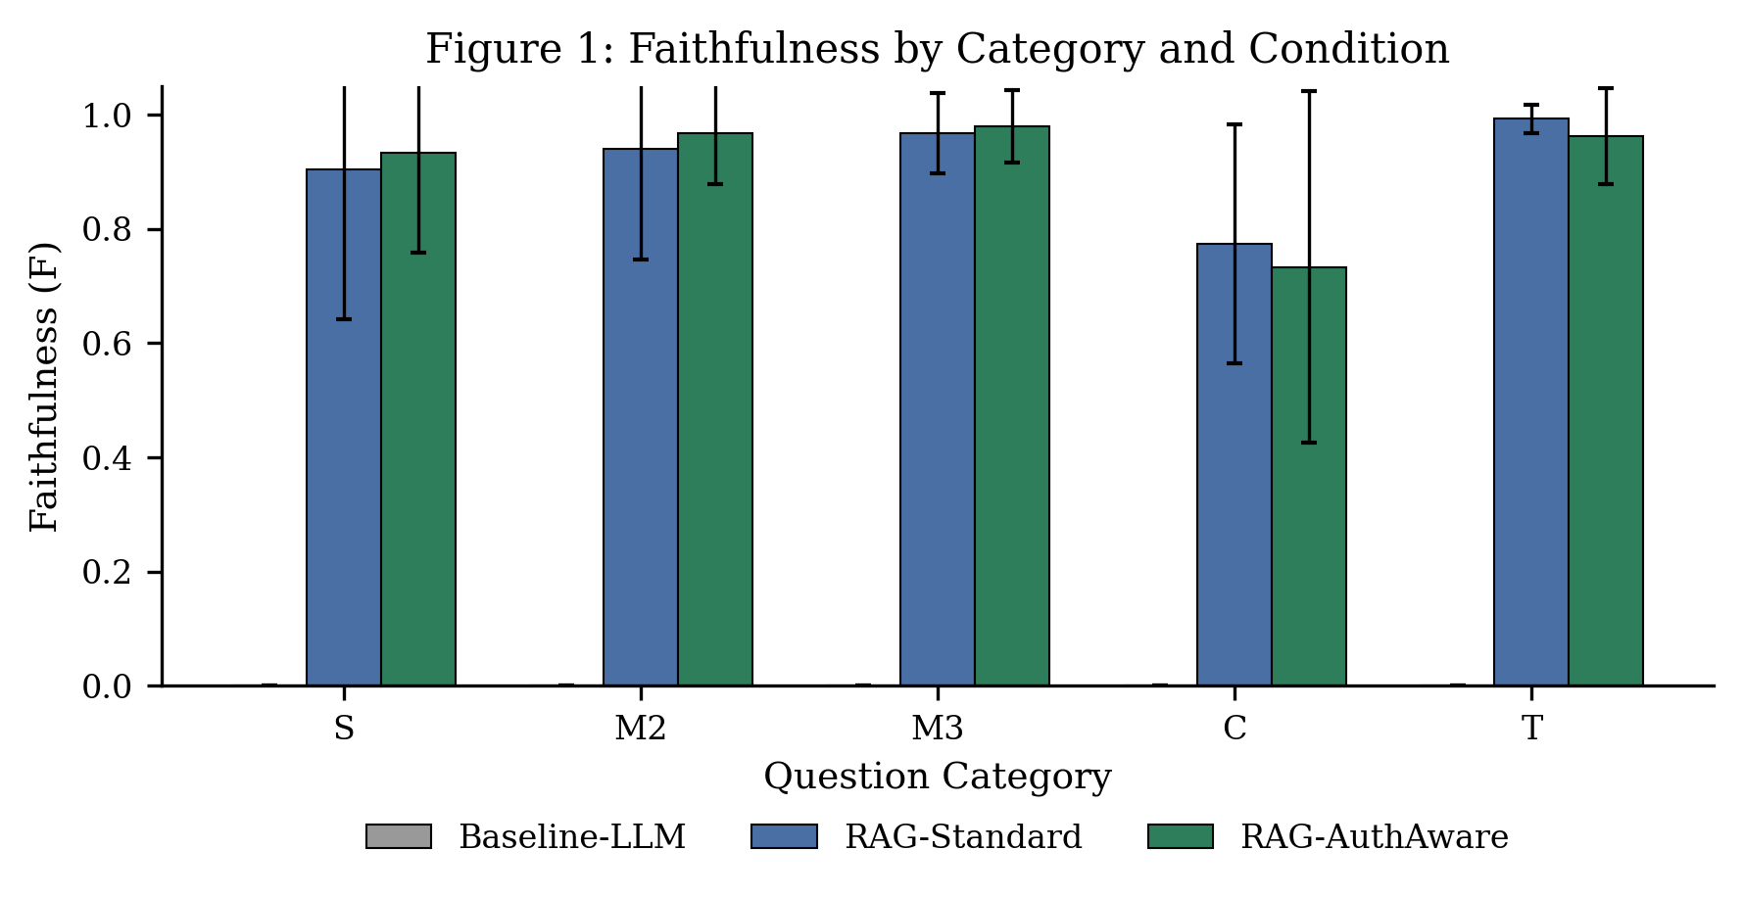
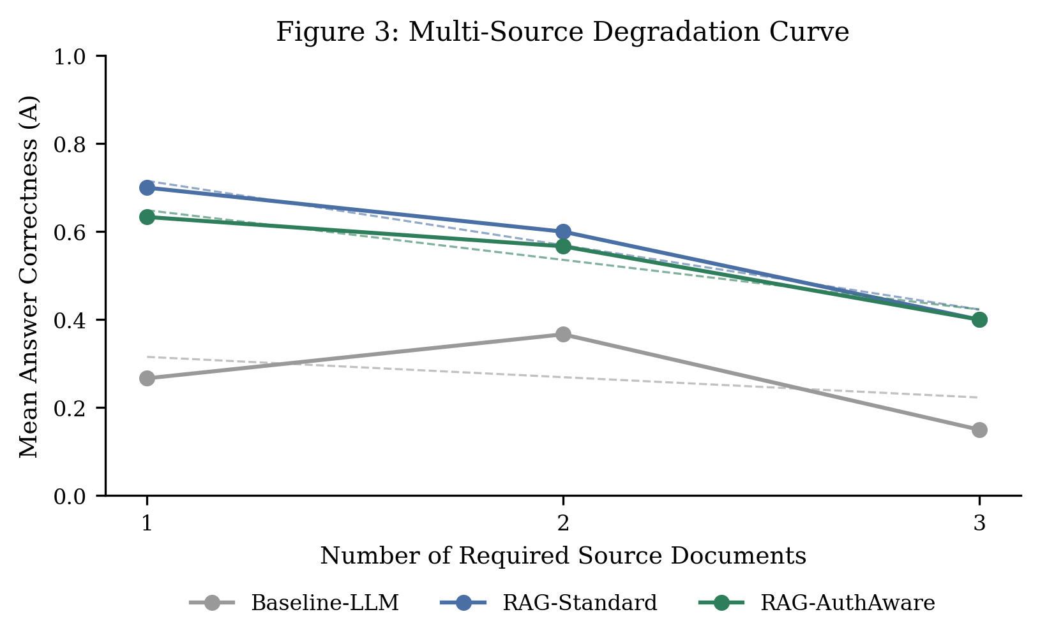
Evaluating Multi-Document RAG for Student Financial Aid Guidance:
Authority Confusion, Temporal Confusion, and the Limits of Faithfulness
Caleb Wilderotter, Malihe Aliasgari (Advisor)
Department of Mathematics, Kean University
Introduction
Results
Conclusions
LLMs deployed for financial aid guidance can give fluent but wrong or outdated answers, with real consequences for first-generation and low-income students.
The FAFSA Simplification Act replaced the EFC with the Student Aid Index for 2024–25, and universities layer stricter rules (e.g., 80% credit completion vs. a 67% federal floor) on top of federal policy.
A Day-1 audit showed a bare LLM answered 6 of 10 questions correctly but could not distinguish current policy from memorized, superseded rules.
RQ1: Does RAG improve correctness and grounding over baseline?
RQ2: Does correctness degrade as more sources are required?
RQ3: Do conflicting and outdated sources cause errors, and does authority-aware re-ranking help?
RAG beats baseline: mean Answer Correctness 0.545 (Standard) and 0.509 (AuthAware) vs. 0.255; F(2,150) = 8.87, p < 0.001. The gain is largest on S and M2 and vanishes on C questions (Fig. 2).
Faithful ≠ correct: Faithfulness (≈0.93) exceeds correctness by ≈0.40 in both RAG conditions. One fully grounded answer (F = 1.00) was wrong (A = 0) after re-ranking promoted a methodology chunk over the fact-bearing chunk.
Integration cost: correctness falls roughly 13–15 points per additional required source (Fig. 3).
Re-ranking is double-edged: it resolves temporal conflicts but pushed the correct institutional source down in rank on 2 of 5 contradictory questions.
RQ1: RAG improves correctness over a no-retrieval baseline, but the gain is category-dependent and disappears entirely on contradictory-source questions, where authority-aware re-ranking underperforms both alternatives.
RQ2: correctness declines as required sources rise from one to three in all conditions, steepest for RAG-Standard.
RQ3: re-ranking helps temporal conflicts but suppressed the correct institutional source on contradictory questions — a regression invisible to a presence-only metric.
Design recommendations:
• Condition re-ranking on question type
• Verify retrieved chunks contain an answerable fact before generation
• Check multi-source completeness; prefer “insufficient information” over partial answers
• Report rank-sensitive authority metrics (e.g., reciprocal rank)
Takeaway: faithful retrieval does not guarantee correct answers in high-stakes informational domains.
Methods and Materials
Corpus: 1,641 chunks (400 tokens each) from 71 files across five authority tiers: the 2025–26 and 2024–25 Federal Student Aid Handbooks, studentaid.gov guidance, NASFAA material, and SAP policies from three universities; embedded with all-MiniLM-L6-v2 in ChromaDB.
Benchmark: 55 questions in five categories — single-source (S), two-source (M2), three-or-more-source (M3), contradictory-source (C), and temporal (T) — each annotated with verbatim ground truth.
Conditions (165 runs): Baseline-LLM (no retrieval), RAG-Standard (top-5 cosine similarity), and RAG-AuthAware (fixed authority + award-year re-ranking); gpt-4o-mini at temperature 0.
Metrics: automated Faithfulness, human-scored Answer Correctness (0 / 0.5 / 1; Cohen’s κ = 0.887), and Source Authority Accuracy; two-way ANOVA, Bonferroni-corrected paired t-tests, and regression on source count.
References
[1] Z. Yang et al., “HotpotQA,” EMNLP, 2018.
[2] H. Trivedi et al., “MuSiQue,” TACL, 2022.
[3] P. Lewis et al., “Retrieval-augmented generation for knowledge-intensive NLP tasks,” NeurIPS, 2020.
[4] S. Es et al., “RAGAS: Automated evaluation of retrieval augmented generation,” 2023.
[5] U.S. Dept. of Education, Federal Student Aid Handbook, 2024–2026.

