Slide 1
Firewall Fundamentals

Slide 2

Overzicht
Introduction to Firewall
Firewall Taxonomy
Firewall Architectures
Firewall Planning & Implementation
Firewall Limitations

Slide 3
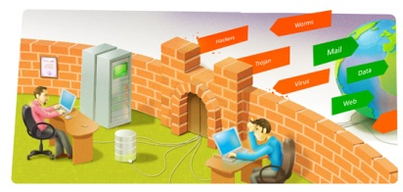
Introduction
Firewalls are devices or programs that control the flow of network traffic between networks or hosts that employ differing security postures.

Slide 4
Introduction
What can firewalls do?
Manage and control network traffic
Authenticate access
Act as an intermediary
Protect resources
Record and report on events (IDS, NIDS, IPS)
Firewalls operate at Layers 2, 3, 4, and 7 of the OSI model

Slide 5
Firewall - A device or application that analyzes packet headers and enforces policy based on protocol type, source address, destination address, source port, and/or destination port. Packets that do not match policy are rejected.
Intrusion Detection System - A device or application that analyzes whole packets, both header and payload, looking for known events. When a known event is detected a log message is generated detailing the event.
Intrusion Prevention System - A device or application that analyzes whole packets, both header and payload, looking for known events. When a known event is detected the packet is rejected.

Slide 6
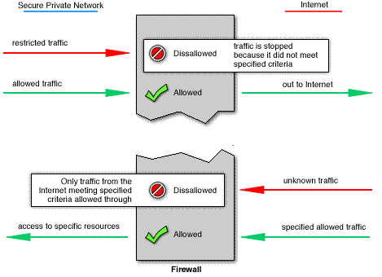
Introduction
How does a firewall work?
deny/grant access based on the rules pre-defined by admin

Slide 7
Taxonomy
FW Products
Software
ISA Server, Iptables, Comodo, ZoneAlarm,…
Appliance
Cisco PIX, Checkpoint, SonicWall, WatchGuard,…
Integrated
Multiple security functions in one single appliance: FW, IPS, VPN, Gateway Anti-virus/spam, data leak prevention…
Open vs. Closed Source FWs
ipfw, ModSecurity, pfSense,…

Slide 8
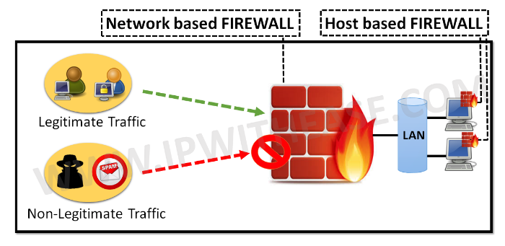
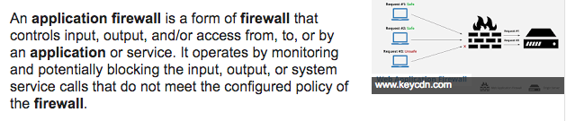
Taxonomy (classificatie)
FW Technologies
Host-based (or Personal) FW
Windows FW, Firestarter,…
Network FW
(Simple) Packet Filtering monitor in/out packets ip addresses (headers)
Stateful Inspection app layer. dynamic
Application FWs
Application-Proxy Gateways
Dedicated Proxy Servers NAT, cache, block sites, ..
Transparent (Layer-2) FWs https://www.cisco.com/c/en/us/td/docs/ios-xml/ios/sec_data_zbf/configuration/xe-3s/sec-data-zbf-xe-book/zbfw-l2-transp-fw.pdf

Slide 9
Taxonomy
FW Technologies
Others (Network FW)
NAT (it is actually a routing technology)
VPN
Network Access Control/Protection (NAC/NAP)
Web Application FW
Firewalls for Virtual Infrastructures
Unified Threat Management (UTM)

Slide 10
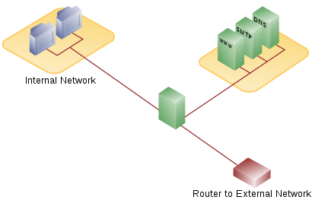
Architectures
DMZ
Single (Three legged) firewall
Firewall

Slide 11
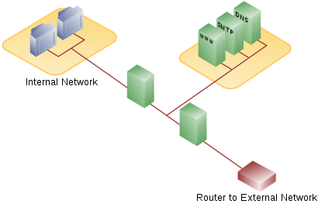
Architectures
DMZ
Dual firewall
Internal FW
External FW

Slide 12
Planning & Implementation
Plan
Configure
Test
Deploy
Manage

Slide 13
Limitations
What a firewall CAN’T protect against:
viruses/malwares
internal threats (disgruntled workers, poor security policy…)
attacks that do not traverse the firewall (social engineering, personal modems or unauthorized wireless connections…)
attacks on services that are allowed through the firewall (HTTP, SMTP, FTP…)

Slide 14
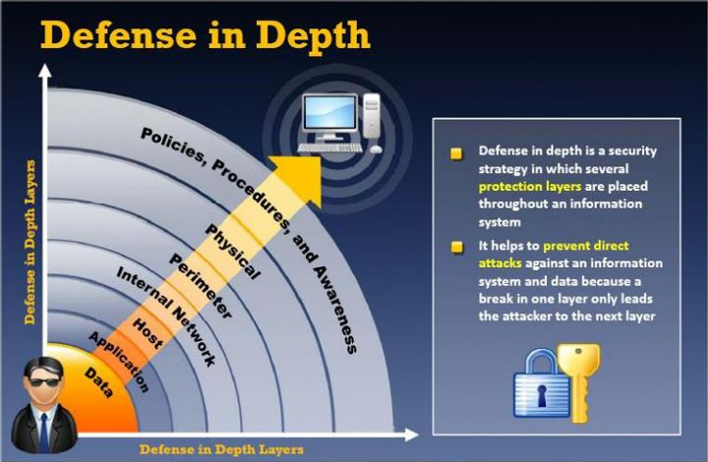
Conclusion
Firewalls are an integral part of any Defense in Depth strategy

Slide 15
References
[1] Firewall Fundamentals, Cisco Press (2006)
[2] Tactical Perimeter Defense, Element K (2007)
[3] Module 16 of CEH v7, EC-Council (2010)
[4] Building Internet Firewalls 2nd Edition, O'Reilly (2000)
[5] Guidelines on Firewalls and Firewall Policy, NIST (2009)

