Slide 1
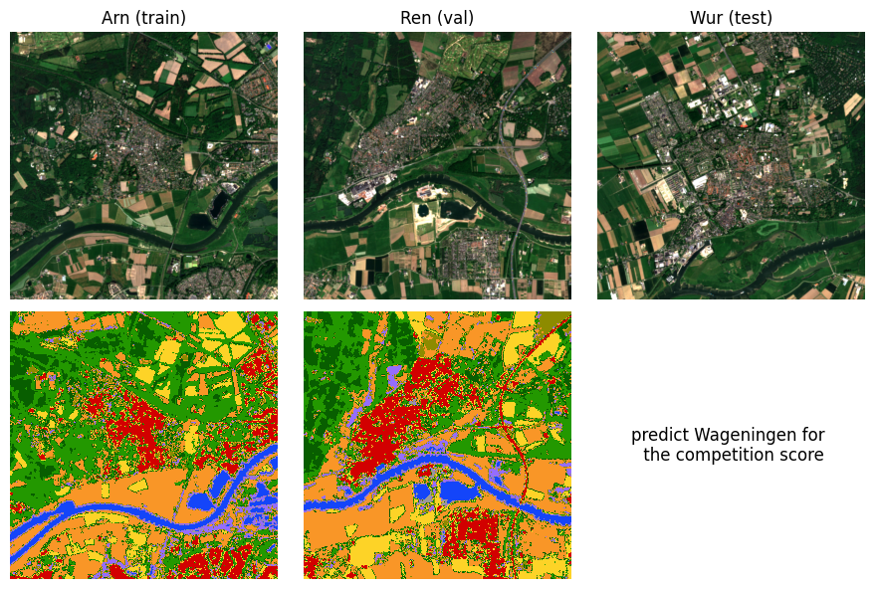
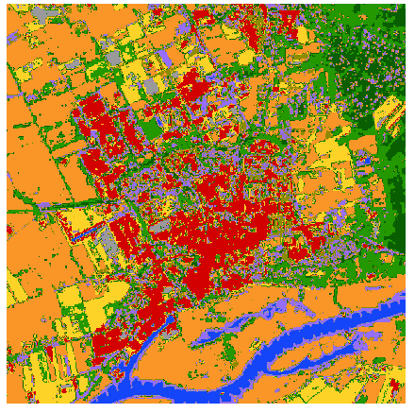
Land Classification by Machine learning
Arnhem (train)
Renkum (Validation)
Wageningen (Test)

