Slide 1
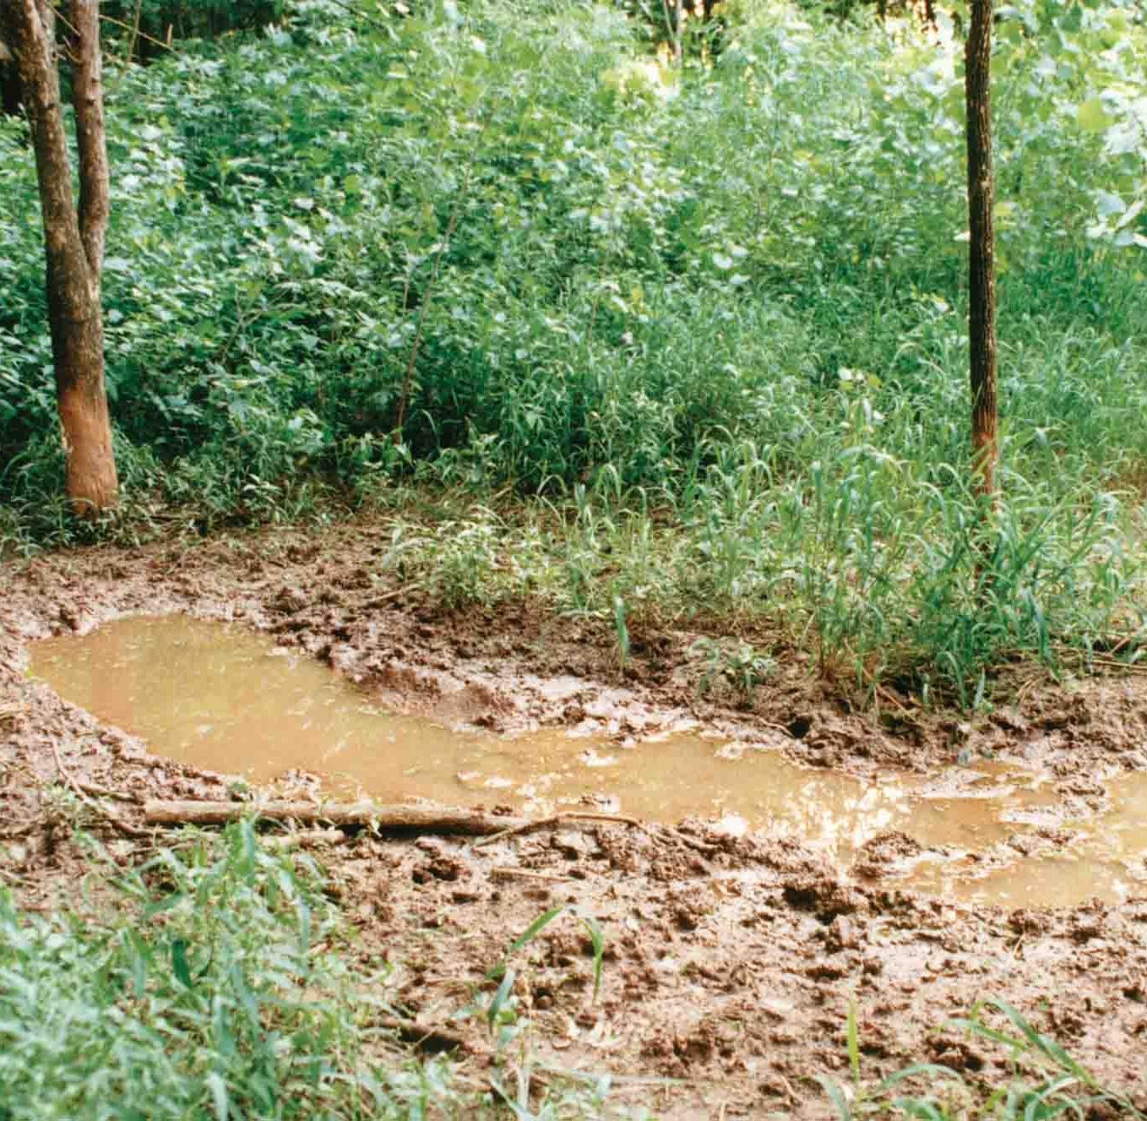
Identifying nests and wallows based on spatiotemporal wild boar data
Patterns & Trends in Environmental Data
MSc ENR ZHAW FS21
Yves Gubelmann & Tobias Wildhaber
Source: https://www.noble.org/globalassets/images/news/ag-publications/nf-wf-10-01/hog-wallow.jpg

Slide 2
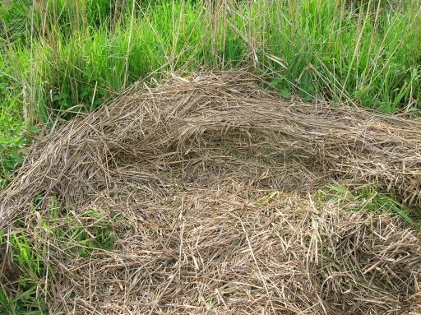
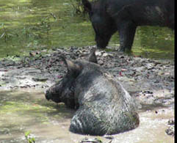
Context
Understanding the selection of resting places like nests and wallows build the basis for effective management measures to prevent wildboar damages in agriculutre.
Used data
Wild boar movement data and metadata¹
Field and vegetation type of surroundings¹
Area statistics and vegetation height²
¹Retrieved from ZHAW research project "Prevention of Wild Boar Damage in Agriculture“
²Retrieved from swisstopo
Sources: http://www.suwanneeriverranch.com/photos/HogsWaterTwo.jpg, http://aws.fuzzytravel.com/nimfi/pictures/66555.jpg

Slide 3
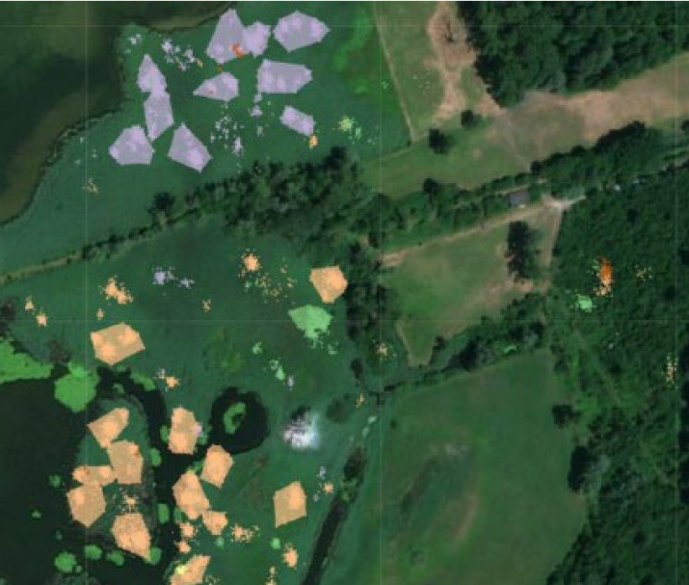
Research questions
How can resting sites be modelled based on spatiotemporal movement data?
Can locations frequently visited by wild boar be determined efficiently and effectively in the provided research data?
Can these regular resting places be clearly defined as kettles or wallows?
→ Best possible outcome: distinction between nests and wallows

Slide 4
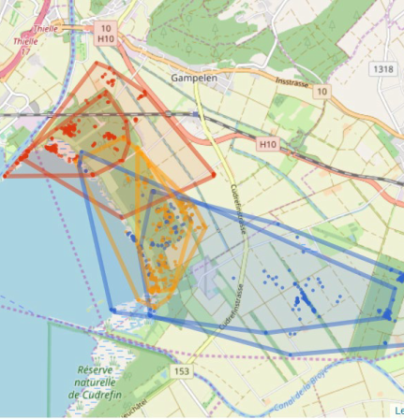
Research plan
Segmentation of movement data (criteria like speed, step length)
Annotation of status:
Resting
Moving
Feeding
Unclear
Spatial join (land use and vegetation type) for context
Identifying frequently visited areas
Allocation of wallows and nests
Visualisation of results as convex hull

Slide 5

Risk analysis and ideas for plan B
Finding clear criterias for the distinction between nests and wallows
Plan B: Best educated assumption based on literature or no differentiation between the two

