Slide 1
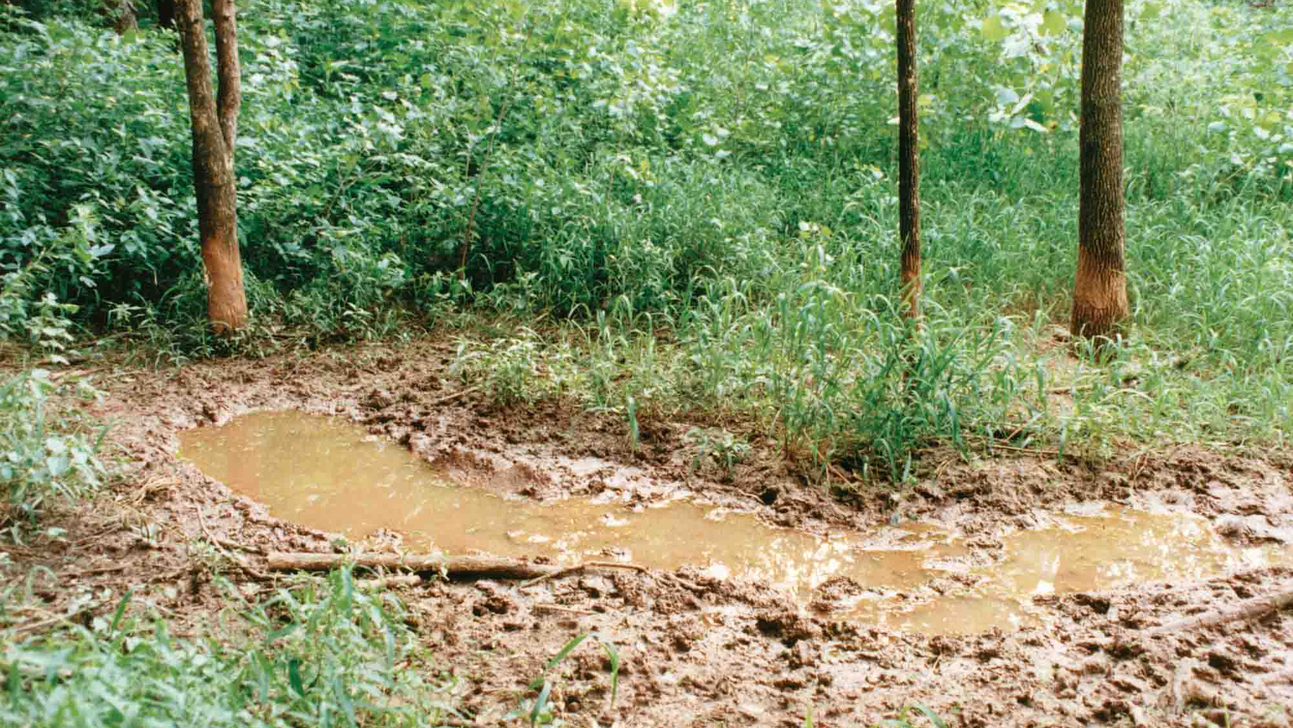
Identifying nests and swallows based on spatiotemporal wild boar data
Patterns & Trends in Environmental Data
MSc IUNR ZHAW
FS21
Source: https://www.noble.org/globalassets/images/news/ag-publications/nf-wf-10-01/hog-wallow.jpg

Slide 2
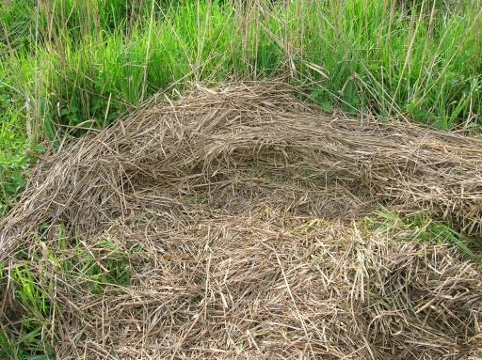
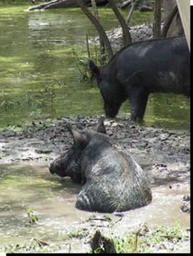
Context
Context of your project
(application area, conceptual models,
data structures, available data)
Used data
Wild boar movement data and metadata¹
Field and vegetation type of surroundings¹
Area statistics and vegetation height²
¹Retrieved from ZHAW research project "Prevention of Wild Boar Damage in Agriculture“
²Retrieved from swisstopo
Sources: http://www.suwanneeriverranch.com/photos/HogsWaterTwo.jpg, http://aws.fuzzytravel.com/nimfi/pictures/66555.jpg
nest
wallow

Slide 3
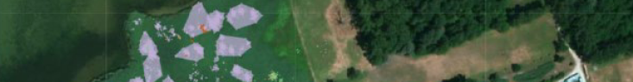
Research questions
How can resting sites be modelled based on spatiotemporal movement data?
Can locations frequently visited by wild boar be determined efficiently and effectively in the provided research data?
Can these regular resting places be clearly defined as kettles or wallows?
-> Best possible outcome: destinction between kettles and wallows

Slide 4
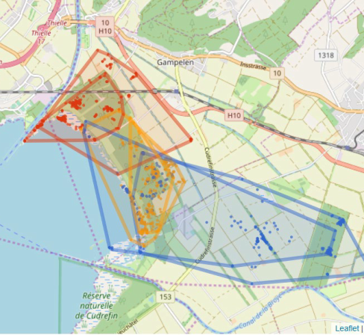
Research plan & Preliminary results
Segmentation of movement data (criterias like speed, step length)
Annotation of status:
Resting
Moving
Feeding
Unclear
Spatial join (land use and vegetation type)
Allocation of wallows and kettles
Visualisation of results as convex hull

Slide 5
Encountered problems and ideas for plan B
Finding clear criterias for the distinction between nests and wallows
Plan B: No differentiation

