Slide 1
Alex Mandel
Jan 20, 2012
Creative Commons Attribution-NonCommercial-ShareAlike 3.0 Unported License.

Slide 2
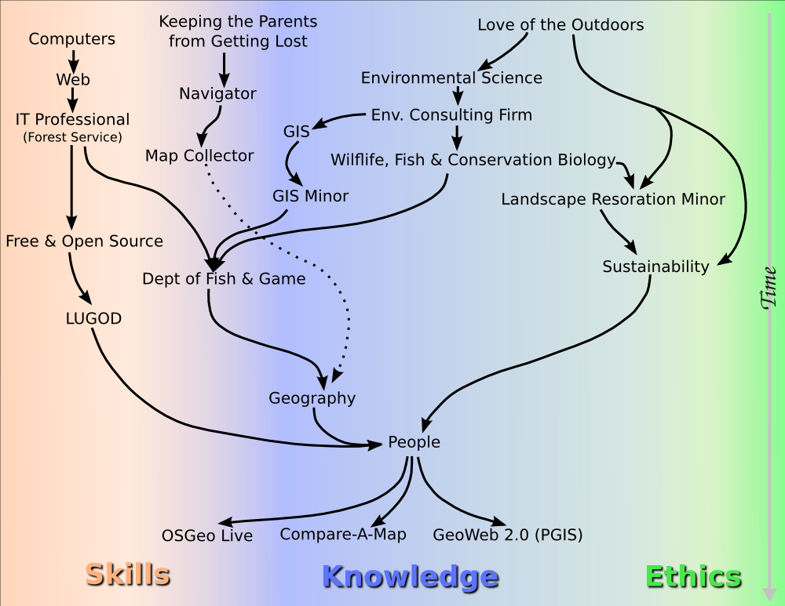
I was there now I'm here.

Slide 3
Preliminary Results
OSGeo Live DVD/USB/VM
Compare-A-Map
Placer Ag Guide

Slide 4
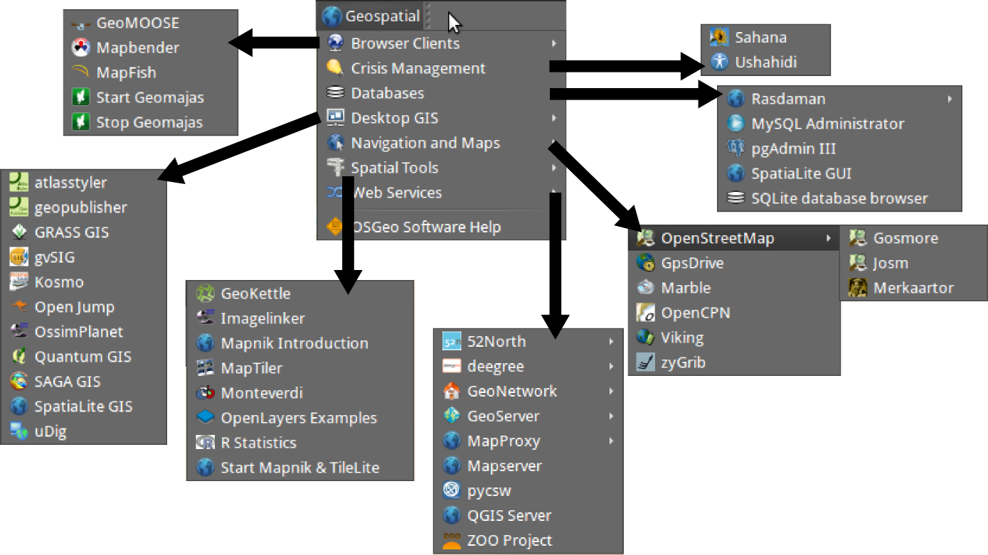
OSGeo Live Contents

Slide 5
OSGeo Live Contributors
Map
List

Slide 6
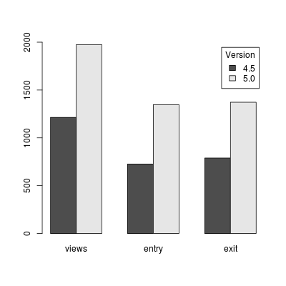
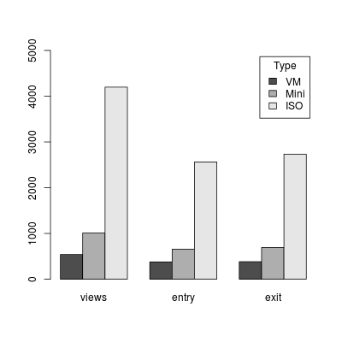
OSGeo Live Downloads
Estimates for 2011 from 2/5 servers

Slide 7
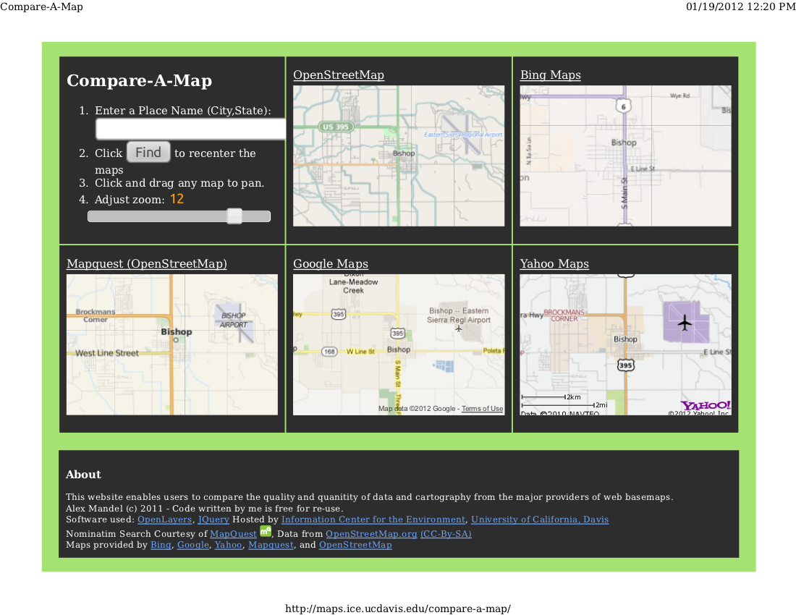
Compare-A-Map

Slide 8

Placer Ag Guide

