Slide 1
Placer County
Ag Guide Web Specificaions
The following document outlines the user types, workflows and features for the Ag Guide website. The information here was developed jointly with a group of farmers, the county ag commissioner, UC cooperative extension, and Phd researcher Alex Mandel.
The website is a re-envisioning of a printed product that lists all of the agricultural producers in the county and how to contact/locate them and their products. It's main focus is to encourage sustainable agriculture through the local food movement “Buy Local” concept.
Additional themes include agritourism, value added agriculture (organic, free range, grass fed, etc.)
If there are any question contact Alex Mandel aimandel@ucdavis.edu

Slide 2
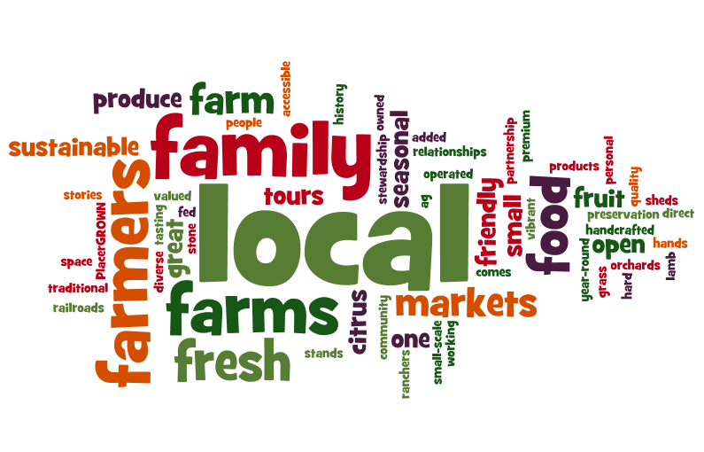
Wordle based on Survey of Participating Producers

Slide 3
Roles of User Groups
Public
Administrators
Add All
Edit All
Bookmark Favorites
Invite Retail editors
Add users to Retail and Producer groups
Feedback
Comments on Pages?
Producers
Add Producer
Edit Other Producers
Bookmark Favorites
Feedback
Comments on Pages?
Retail
Edit Retail (By Invite)
Bookmark Favorites
Feedback
Comments on Pages?
Suggest a new Page
Regulars
Bookmark Favorites
Feedback
Comment on Pages?
Suggest a new Page
Visitors
Bookmark Favorites
Feedback
Comment on Pages?
Suggest a new Page
Models
Products
Producer
Features
Practices
Member
Bookmarks
Address
Retail

Slide 4
Workflow
Anyone can be a member of the site
  All members can keep bookmarks of their favorite stuff
  Administrators can promote members who are also producers or approved retail businesses (Markets, Restaurants, etc)
Retail users can edit their business profile
Producers can edit any Producer or Business profile
Multiple members can be owners of a Producer or Business profile

Slide 5
Requirements - Feature List
Interactive Map
  Filters based on Crop, Features, Production Practices
  Search based on location
  Search based on proximity to selected Profiles
  Ability to submit correction to OSM basemap (Alt. Mapquest OSM)
  Custom icons by general product categories
  Preferably implemented in JS and/or AJAX
Producer Profile
  Map showing location, toggle nearby Profiles
  Link to driving directions which map to real location not necessarily address. Correct location and possibly last “mile” of directions provided by the Producers.

Slide 6
Requirements - Feature List
Session Tracker
  A tool that tracks a session from login to logout keeping track of each page and how long the user spends on a page
  Optional feature – implement with javascript to capture all clicks in the interactive map.
Public Registration
  Allow anyone to register for an account
  Use Captcha and/or email confirmation

Slide 7
Requirements - Feature List
User Management
  Allow admins to upgrade/downgrade user accounts to Public ↔ Retail ↔ Producer ↔ Admin
User Facing Forms
  Custom implementation of forms for the models that doesn't use the built in admin interface.
  Critical to this is the use of checkboxes, drop lists, and multi-selects for Crops, Features, Practices

Slide 8
Requirements - Feature List
Invitation
  Admins can invite Businesses that carry items from Producers in the county.
  After registration/confirmation the Business has access to edit their Profile.
  Optional - Producers can trigger an invite.
Public Views
  Publicly accessible views that render the models in a useful manner.
  Includes map of the data record
  Includes photos, social media links
  Includes internal links to related objects (All stores that sell a Producer's products.

Slide 9
Optional – Feature List
Favorites
  Let users bookmark and share their favorite pages with other users and via social media outlets.
Trip Planner
  Keep a list of bookmarked Producer and Business Profiles and produce driving directions based on their order. Allow re-ordering of Profiles and directions.
Feedback Survey
  Implement a survey designed by Alex (UCD) to assess the usability of the website
  Allow each user to only take it once, possibly allow for a future repeat.
  Protect the answers from security breaches.

Slide 10
Additional Notes
The code for the website will be release under some liberal Open Source license, TBD (BSD or LGPL)
Source code will be hosted in some publicly accessible repository (probably github)
Beta testing of website will occur on servers provided by Alex Mandel at the University of California, Davis – Information Center for the Environment. Eventually the site will be moved to a server hosted or paid for by Placer County.

