Slide 1


/ io.js
Introduction to NodeJS

Slide 2
What is NodeJS?
uses an event-driven, non-blocking model = lightweight, scalable, and efficient
built on Chrome's V8 JavaScript runtime

Slide 3
What is NodeJS?
Launched in 2009, slow development (currently 0.12.0, first major release since 2013)
Originally managed by Joyent (and now by a Node.js Foundation consisting of IBM, Paypal, Microsoft, and Linux)
Used by tens of thousands of organizations, 200 countries, 2 million + downloads monthly

Slide 4
What is io.js?
Essencially “hipster” Node.js
built on the newest Chrome's V8 JavaScript runtime (with ES6 features + more)

Slide 5
What is io.js?
A community-driven, “open-governance” fork of Node.js, managed by original contributors to Node.js
Active release cycles (currently v 1.3 as of this morning)
Already has a huge following, many are switching from Node.js

Slide 6
Future of Node.js/io.js
Possible outcomes:
Joyent will give in, offering node.js to the “open-governance” community
io.js will come to some sort of resolution, merge back in with Node.js
We will have two server-side JS platforms to choose from

Slide 7
Fork drama aside…
What is event driven, non-blocking IO?

Slide 8
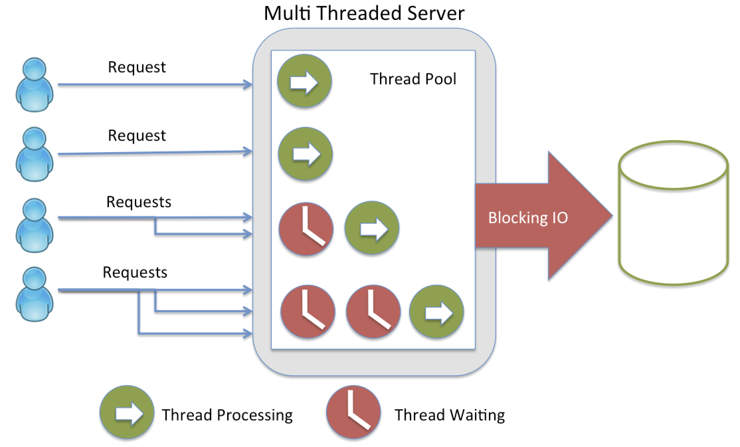
Blocking

Slide 9
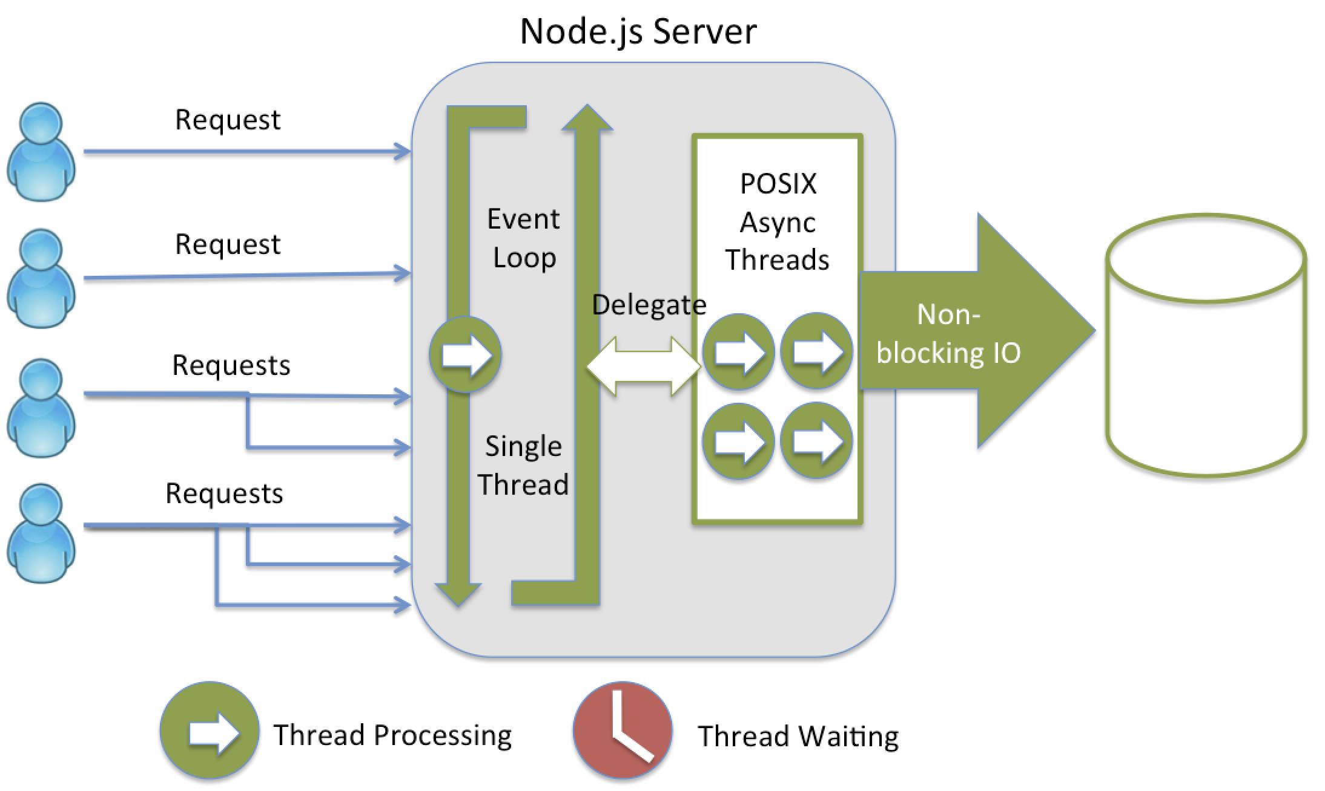
Non-Blocking

Slide 10
How does it compare?
Paypal’s Node.js vs Java application:
App built 2x as fast with fewer people
33% fewer lines of code
40% fewer files
2x requests/second
35% decrease in average response time

Slide 11
But that was 2013…
Two years later, the Java world has some more available and stable frameworks for asynchronous, truly scalable non-blocking applications
Vert.x
Akka

Slide 12
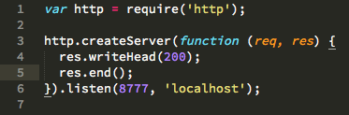
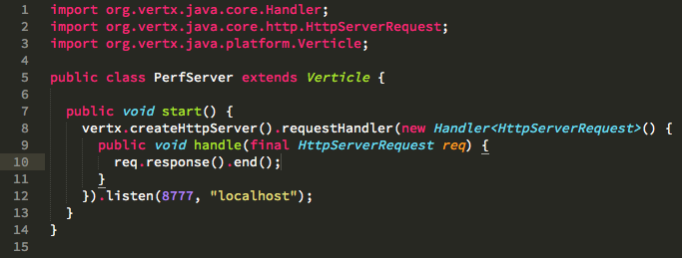
Test1: io.js vs Vert.x
Test 1: Single instances of io.js and vert.x servers, returning simple 200 response

Slide 13
Test1: io.js vs Vert.x
Test 1: Single instances of io.js and vert.x servers, returning simple 200 response
description | threads | ports | % CPU | real mem (MB) | virtual mem (GB) | responses/second
single iojs server | 10 | 28 | 98.66 | 60.3 | 2.96 | 29,555
single vertx server | 26 | 88 | 101.2 | 200.5 | 7.91 | 599,810

Slide 14
Test2: io.js vs Vert.x
Test 2: Cluster of 8 io.js servers and 8 instances of vert.x server, returning simple 200 response

Slide 15
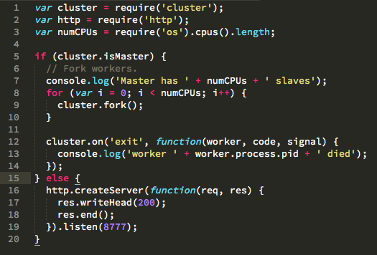
Test 2: io.js vs Vert.x

Slide 16
Test 2: io.js vs Vert.x
Test 2: Cluster of 8 io.js servers and 8 instances of vert.x server, returning simple 200 response
description | threads | ports | % CPU | real mem (MB) | virtual mem (GB) | responses/second
iojs cluster (8) | 48 | 184 | 434.4 | 424 | 23.52 | 100,391
vertx cluster (8) | 36 | 104 | 256.21 | 1320 | 8.07 | 851,390

Slide 17
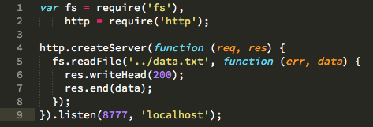
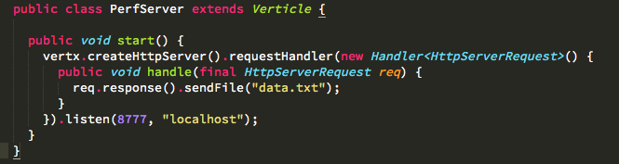
Test 3: io.js vs vert.x
Single instances of io.js and vert.x static file servers

Slide 18
Test 3: io.js vs vert.x
Single instances of io.js and vert.x static file servers
description | threads | ports | % CPU | real mem (MB) | virtual mem (GB) | responses/second
single iojs file server | 10 | 28 | 107.39 | 132.7 | 3.02 | 14,200
single vertx file server | 26 | 88 | 100.54 | 149.6 | 7.91 | 18,567

Slide 19
Test 4: io.js vs vert.x
Custer of 8 of io.js static file servers and 8 instances of vert.x static file servers
description | threads | ports | % CPU | real mem (MB) | virtual mem (GB) | responses/second
iojs file cluster (8) | 80 | 216 | 508.16 | 467.2 | 23.6 | 42,956
vertx file cluster (8) | 33 | 102 | 326.13 | 438.6 | 8.06 | 34,024

Slide 20
Test 5: io.js vs vert.x
Custer of 8 of io.js static file servers and 8 instances of vert.x static file servers, with cpu intensive calculations
description | threads | ports | % CPU | real mem (MB) | virtual mem (GB) | responses/second
iojs spin file cluster | 80 | 216 | 622.64 | 488 | 23.6 | 19,808
vertx spin file cluster | 33 | 102 | 322.28 | 468.8 | 8.06 | 31,874

Slide 21
Total Test Results
 | description | threads | ports | % CPU | real mem (MB) | virtual mem (GB) | responses/second
Test 1 | single iojs server | 10 | 28 | 98.66 | 60.3 | 2.96 | 29,555
 | single vertx server | 26 | 88 | 101.2 | 200.5 | 7.91 | 599,810
Test 2 | iojs cluster (8) | 48 | 184 | 434.4 | 424 | 23.52 | 100,391
 | vertx cluster (8) | 36 | 104 | 256.21 | 1320 | 8.07 | 851,390
Test 3 | single iojs file server | 10 | 28 | 107.39 | 132.7 | 3.02 | 14,200
 | single vertx file server | 26 | 88 | 100.54 | 149.6 | 7.91 | 18,567
Test 4 | iojs file cluster (8) | 80 | 216 | 508.16 | 467.2 | 23.6 | 42,956
 | vertx file cluster (8) | 33 | 102 | 326.13 | 438.6 | 8.06 | 34,024
Test 5 | iojs spin file cluster | 80 | 216 | 622.64 | 488 | 23.6 | 19,808
 | vertx spin file cluster | 33 | 102 | 322.28 | 468.8 | 8.06 | 31,874

Slide 22
Consensus
The JVM is still a beast, and we have come a long way in the last few years to better adapt to increasing network demands
Node.js/io.js is still a great solution – for some projects

Slide 23
So why use Node.js/io.js?
In a weird “forked” state…
Not the only big player in event-driven, non-blocking platforms today…

Slide 24
npm
npm is the package manager for Node and io.js
There is a module for EVERYTHING!
Huge community around npm
Writing JavaScript server code is FUN!
Very fast development, easy to scale up
Awesome ORMs for Mongo, MySql, Postgres, ect

Slide 25
Demo
How do I install Node.js?
Mac: ‘brew install node’
Windows: download online
Ubuntu: ‘sudo apt-get install nodejs’
RedHat: ‘sudo yum install nodejs’

Slide 26
Demo
Build a simple node REST server that handles:
GET: /team/member/:person_id
POST: /team/member/
GET: /team/:person_id

