Slide 1

Self-Organized Criticality and Phase Transitions in a Forest Fire Model
Presented by-
Michael Wild and Nishant Dogra
Supervisors-
Donnay Karsten and
Balietti Stefano

Slide 3
Structure
Introduction and Motivation
Description of the Model
Implementation
Simulation Results
Conclusion and Outlook

Slide 4
Structure
Introduction and Motivation
Description of the Model
Implementation
Simulation Results
Conclusion and Outlook

Slide 5
Self Organized Criticality
Self Organization:
Describing the dynamics of a system by a few collective degrees of freedom
Emergence of global patterns from completely local interactions
Example of Crystallization and Bird flocking
Critical Systems:
Interdependence of various individual degrees of freedom
Susceptibility to noise (Critical !!!)
Specific Spatial and Temporal signatures
Self Organized Criticality:
Combining the above 2 concepts
A simple example- Sandpile model

Slide 6
Forest Fire Model
Model of ignition, propagation and extinction of fires in a forest.
Simplified model for the spread of epidemics
Overcriticality of fires in real forests

Slide 7
Structure
Introduction and Motivation
Description of the Model
Implementation
Simulation Results
Conclusion and Outlook

Slide 8
Forest-Fire Model- Cellular Automata
Every cell has one of the following states:
0: A green tree
1: An empty site
2: Fire
The dynamics of a cell is decided by the following local rules:
Burning tree -> empty site
Empty site -> tree with probability p.
Green tree-> burning tree if any of the neighbors are burning or with a lightening probability, f.

Slide 9
Key Parameters in SOC of Forest-Fire Model
Burning time of a Cluster
Number Distribution of the size of clusters
Radius of a cluster
Correlation Length

Slide 10
Structure
Introduction and Motivation
Description of the Model
Implementation
Simulation Results
Conclusion and Outlook

Slide 11
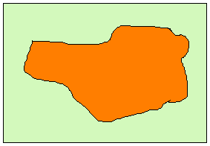
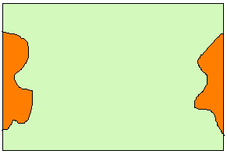
The Traditional Implementation
Random Initialization of grid and periodic boundary condition in 2 dimensions
Unique Indexing of clusters and counting the clusters
Calculation of radius of clusters and averaging involved.
Cluster without crossing the boundary
Cluster going over the boundary

Slide 12
A Faster Implementation

Slide 13
Structure
Introduction and Motivation
Description of the Model
Implementation
Simulation Results
Conclusion and Outlook

Slide 14
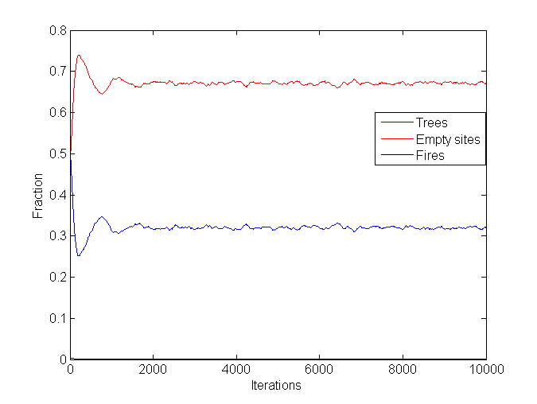
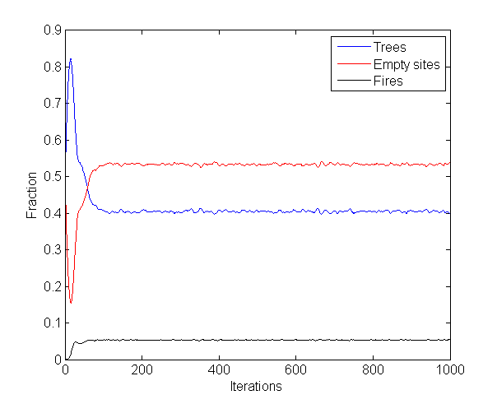
Insights from the Traditional Implementation
4 cases:
small p (< 0.001) and small p/f (~1)
large p (~ 0.1) and large p/f (~10000)
large p (~ 0.1) and small p/f (~1)
small p (< 0.001) and large p/f (~10000)
Case 1
Case 2

Slide 15
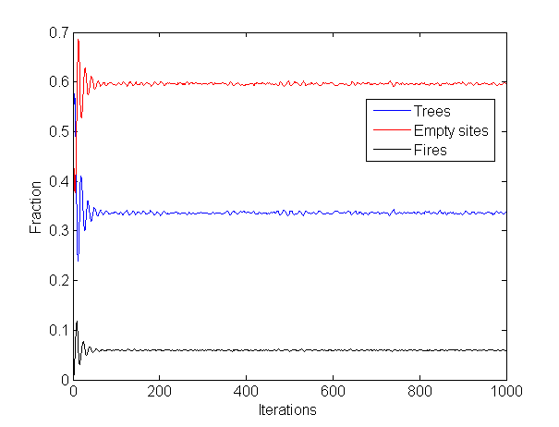
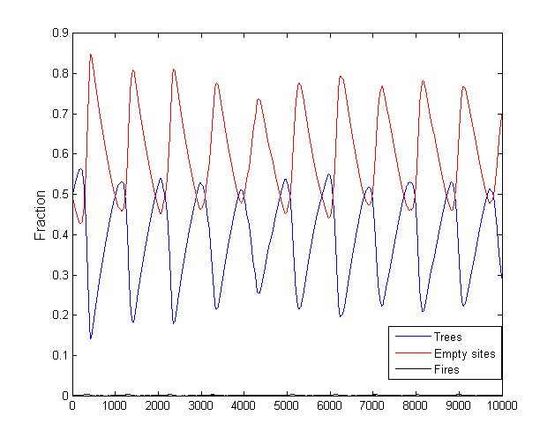
Insights from the Traditional Implementation
Case 3
Case 4

Slide 16
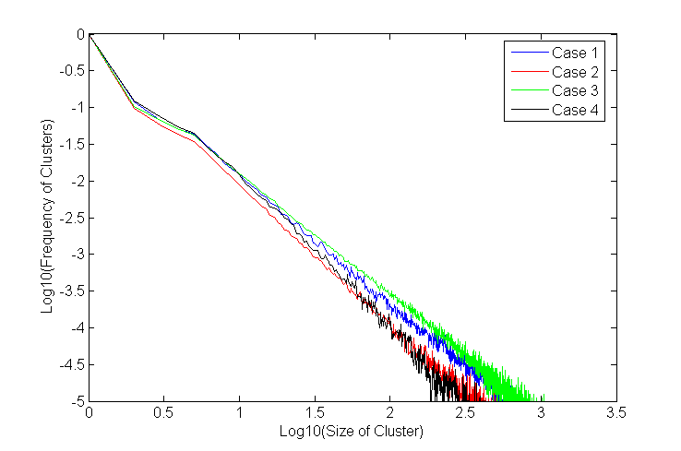
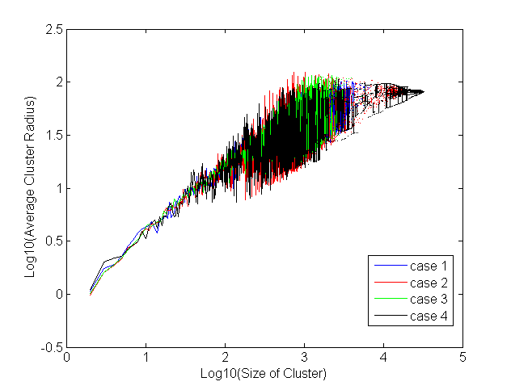
Limitation of the Traditional Implementation

Slide 20
References
Per Bak, Chao Tang, and Kurt Wiesenfeld. Self-organized criticality. Phys. Rev. A, 38:364-374, Jul 1988.
Per Bak, Kan Chen, and Chao Tang. A forest-re model and some thoughts on turbulence. Physics Letters A, 147(56):297 -300, 1990.
Peter Grassberger and Holger Kantz. On a forest re model with supposed self-organized criticality. Journal of Statistical Physics, 63:685-700, 1991.
W.K. Moner, B. Drossel, and F. Schwabl. Computer simulations of the forest-remodel. Physica A: Statistical Mechanics and its Applications, 190(34):205 - 217,1992.
B. Drossel and F. Schwabl. Self-organized critical forest-re model. Phys. Rev. Lett., 69:1629-1632, Sep 1992.
S. Clar, B. Drossel, and F. Schwabl. Scaling laws and simulation results for the self-organized critical forest-re model. Phys. Rev. E, 50:1009-1018, Aug 1994.
Siegfried Clar, Barbara Drossel, and Franz Schwabl. Forest res and other examples of self-organized criticality. Journal of Physics: Condensed Matter, 8(37):6803, 1996.

