Slide 1
⚡ Smart Home Energy Advisor
AI-Powered Conversational Energy Intelligence for Amazon Smart Thermostat (Snyder)
BLR Smart Home Hackathon 2k26
~ Developed by Abhishek Garg
° Powered by Kiro-Cli & Claude-Sonnet
Notes:
Slide 1

Slide 2
Background
🌡️ What is Snyder?
Amazon's Smart Thermostat — a $60 device that controls
your home's heating and cooling via Alexa.
Generates 1000s of events daily: temperature readings,
HVAC component operations, mode changes, DR events.
Supports 1M+ devices across the US.
☁️ How Events Flow
Snyder → Alexa Cloud → ASE Event Processor
Events decorated with device metadata (CHRS)
and customer address (AlexaAddressService).
Routed via SNS to downstream services:
DR Processor, Energy Estimator, Time Series.
⚡ What are Demand Response Events?
Utilities ask customers to reduce electricity
during peak grid demand (hot afternoons).
Thermostat auto-adjusts setpoint by 1-4°F.
Customers earn incentives for participating.
3-4 events/week during summer peak hours (2-6 PM).
🔧 HVAC Filter & Smart Reorder
Air filters clog over time → AC works harder →
backup heater kicks in (costs 2-3x more).
91% of customers find filter reminders useful.
Smart reorder via Dash: auto-order when health
detection triggers, with full context on why.
🔍 The Gap: Data-Rich, Insight-Poor
Today, all this data powers backend services. None of it reaches the customer in a way they understand.
Customers see "Cooling 74°F" on the Alexa app. They don't know why their bill spiked, whether their HVAC is healthy,
what demand response means, or when to replace their filter. The Energy Advisor bridges this gap with AI.

Slide 3
The Problem
💰
Energy Bill Confusion
Customers can't understand why their bill spiked — need simple explanations with dollar estimates
🔧
Invisible HVAC Degradation
Filter clogs and backup heater overuse go unnoticed until expensive breakdowns
⚡
Demand Response Complexity
Customers don't understand DR events or how to prepare for them
🤖
No Smart Automation
Thermostats don't auto-adjust based on weather, patterns, and energy prices
Notes:
Slide 2

Slide 4
Solution: Core Capabilities
• Correlates runtime + weather + components
• Real-time & Root cause analysis
💰 Energy Bill Explainability
🔧 HVAC Health Intelligence
⚡ DR & Clean Energy Advisor
🤖 AI Auto- Optimization
• "Your filter needs changing — costing you $10-15 extra" • Detects problems early • Prevents $200-2000 repairs
• "I'm pre-cooling your home before the peak event" • 3-4 events/week automated • Explains impact simply
• Bedrock adjusts thermostat • "Raised temp 3°F to save during peak pricing" • Runs every 60 seconds
Features
🧠 Pattern Learning
Tracks overrides, Bedrock learns preferences, adapts optimization
🤖 AI Optimize
Bedrock adjusts thermostat every 60s using weather forecast + user patterns
🔔 Notifications
Collapsible: filter reminder, DR events, AI adjustments
🎛️ Manual Override
+/− temp, Cool/Heat/Off mode, Apply Override, Resume AI
💰 Cost Estimation
Real-time: AC $1.73, Heater $0.80, Aux $0.40 — Monthly: $88
⏰ Routines
Mock Alexa routines: Morning Cool, Peak Savings, Night Mode
Notes:
Slide 3

Slide 5
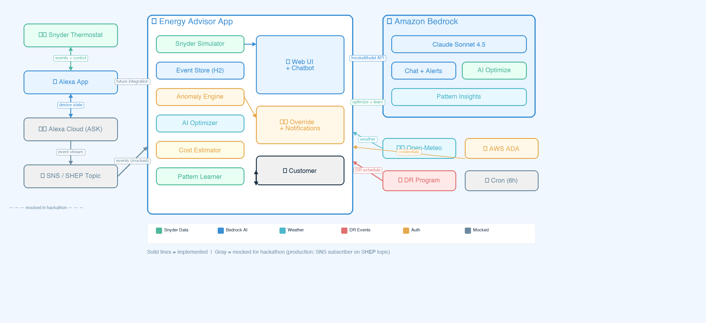
Architecture
Notes:
Slide 4

Slide 6
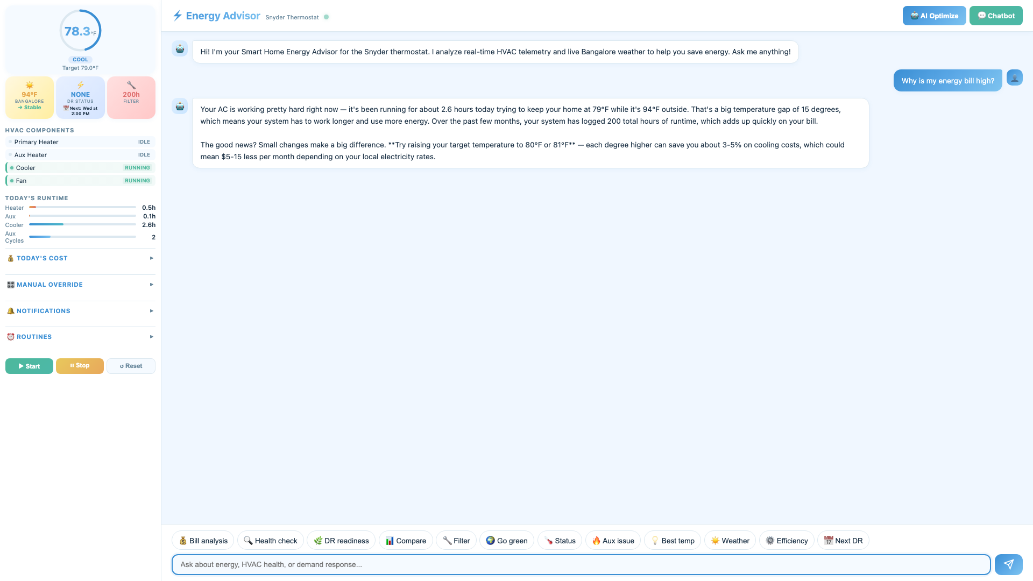
Pillar 1: Energy Bill Explainability
Notes:
Slide 6

Slide 7
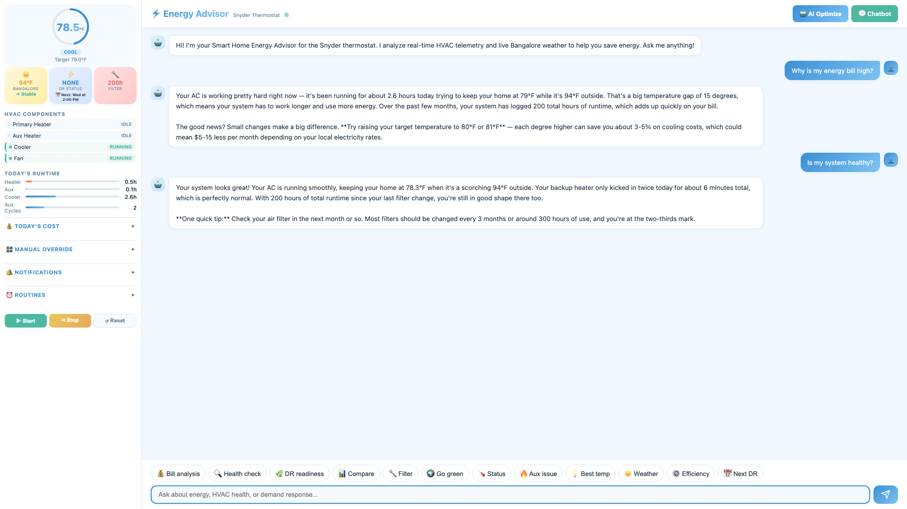
Pillar 2: HVAC Health Intelligence
Notes:
Slide 7

Slide 8
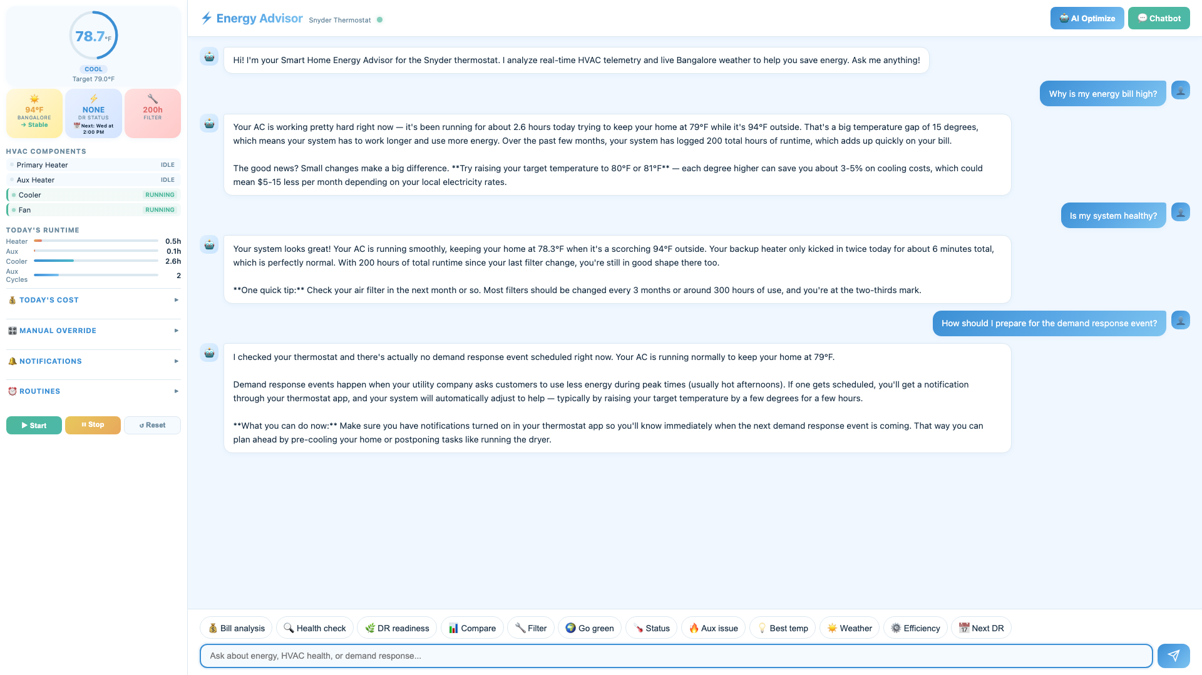
Pillar 3: Demand Response Advisor
Notes:
Slide 8

Slide 9
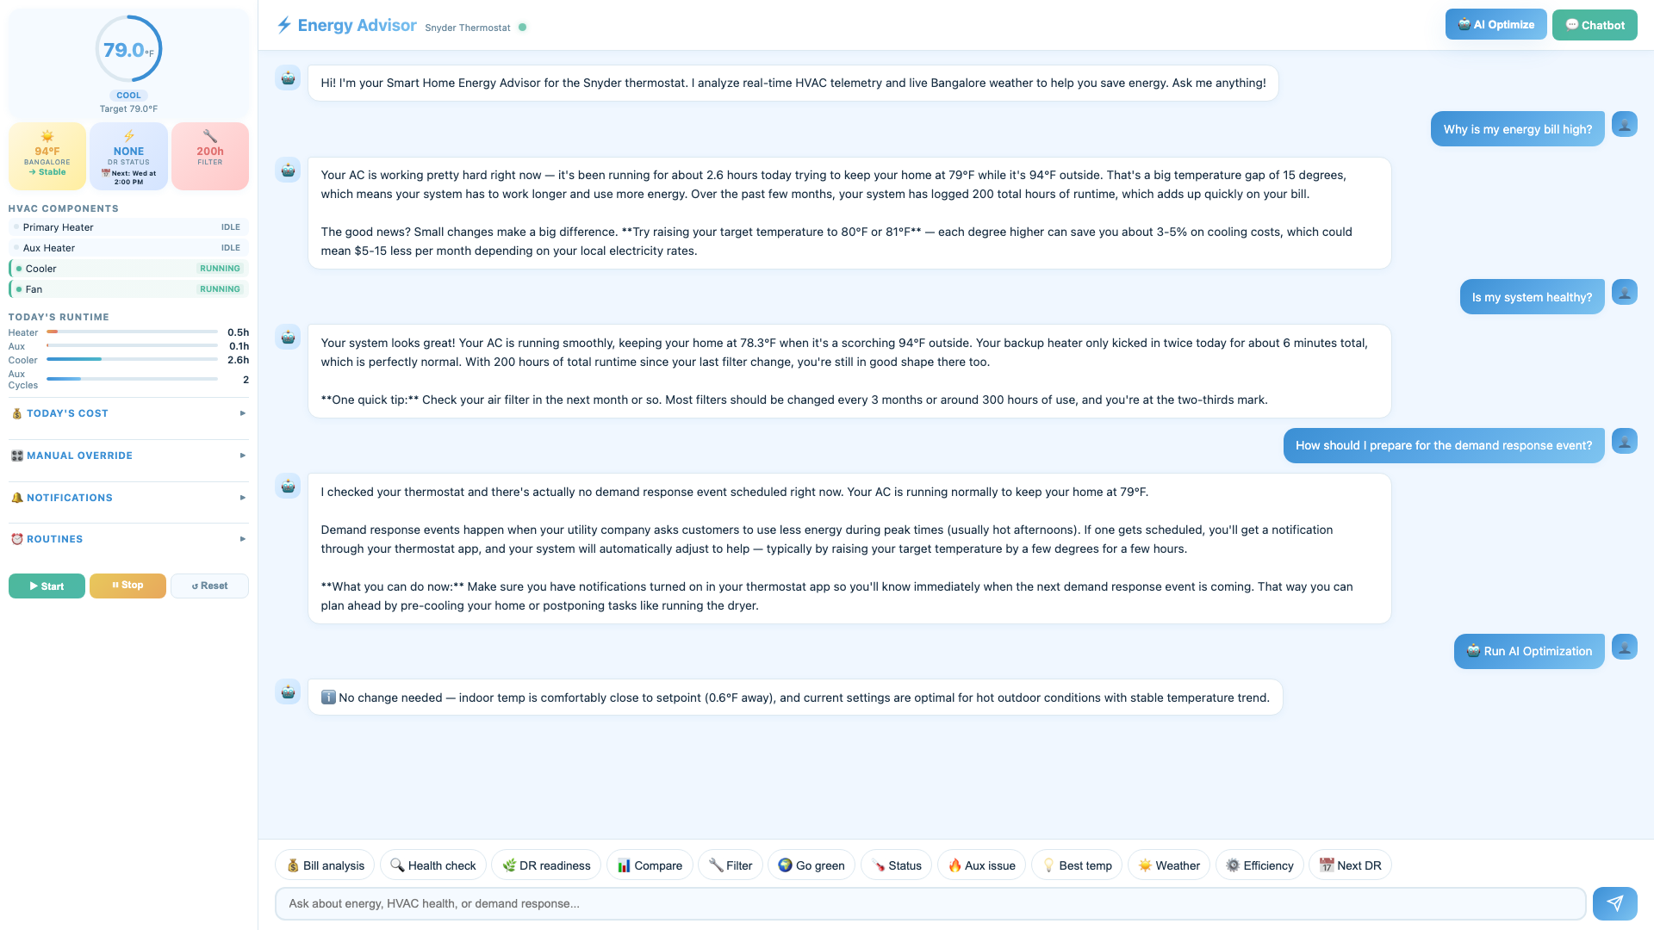
Pillar 4: AI Auto-Optimization
Notes:
Slide 9

Slide 10
How AI Was Used in Your Idea
💬 Chat
State + 50 events + anomalies → grounded response with $ estimates
🚨 Alerts
Anomaly detected → Bedrock generates friendly alert with $ impact
🤖 Control
Every 60s: JSON {mode, setpoint, reason} → auto-applied
🧠 Patterns
Overrides recorded → injected into optimize prompt → AI adapts
🧠 How AI Learns Your Preferences
👤 User Override
📝 Pattern Stored
🤖 Bedrock Prompt
✅ Smarter Decisions
72°F at 94°F outdoor
→
temp, mode, weather, time
→
preferences injected
→
"You prefer 72°F when hot"
Last 20 overrides tracked. Each records temp, mode, outdoor conditions, time. AI adapts automatically — no training needed.
🌤️ Live Weather Integration
🌡️ Simulation
🤖 AI Prompts
📈 Trend Detection
Real outdoor temp drives HVAC physics — indoor drifts toward actual conditions
Bedrock sees temp, humidity, wind, feels-like, and 6-hour forecast in every response
Rising/falling/stable trend triggers proactive tips and pre-emptive optimization
Open Meteo API: Updates every 10 min with 6-hour forecast. Feeds into simulation, Bedrock prompts, and AI decisions.

Slide 11
Sample Questions & Savings Model
💰 Billing
"Why is my energy bill high?"
"How much is my HVAC costing me today?"
"What temperature for best savings?"
"Compare my usage today vs yesterday"
🔧 Health
"Is my HVAC system healthy?"
"Why does my aux heater keep running?"
"Do I need to change my air filter?"
"Is my system running efficiently?"
⚡ Demand Response
"Am I ready for the DR event?"
"When is the next DR event?"
"Should I pre-cool before DR?"
"How much did I save during DR?"
Savings Model
🤖 AI Optimization: 15%
Smart setpoint adjustments based on
weather, time of day, and user preferences
reduce unnecessary runtime by ~15%.
🔧 Filter Maintenance: 10%
Clean filter improves airflow efficiency,
reducing compressor load and eliminating
unnecessary aux heater activation.
⚡ DR Participation: ~$12/mo
3.5 events/week × 2 hours ×
$0.40/hour savings = ~$12/month
in avoided peak pricing.

Slide 12
🚀 Future Improvements
📱 Priority: Alexa Skill Integration
Deploy the Energy Advisor as a native Alexa Skill — same AI, real device data, voice-first experience
What stays the same:
What changes:
• Bedrock prompts & AI logic
• Anomaly detection & cost estimation
• Pattern learning & weather integration
• REST API → Lambda handling Alexa directives
• Simulator → real SNS/SHEP events (1 new subscriber)
• Web UI → Echo voice + Echo Show APL dashboard
• "Alexa, show my energy dashboard" (APL cards)
Other Improvements
🔮 Predictive Forecasting
Tomorrow's cost from weather forecast
🛒 Smart Filter Reorder
Auto-order via Dash with context
🏠 Multi-Device & 3P
Nest, Ecobee, whole-home analysis
🧠 Predictive Maintenance
ML predicts failures 2-4 weeks early
⚡ Utility Rate Optimization
Auto-shift load to cheapest TOU hours
📺 Echo Show Dashboard
APL cards: temp ring, cost, DR status
Notes:
Slide 13

Slide 13
Thank you
Open to questions & Feedback 😇😊
Notes:
Slide 15

