Slide 1


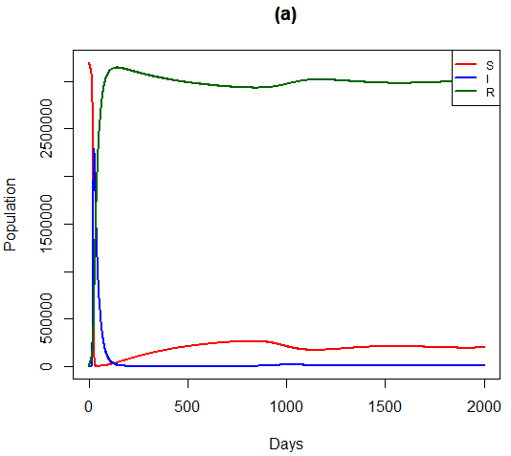
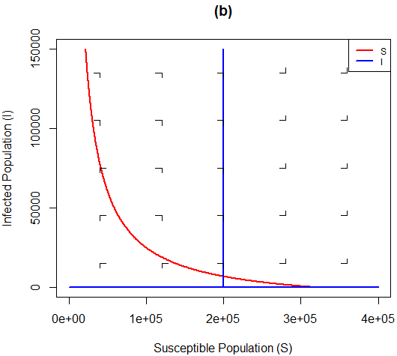
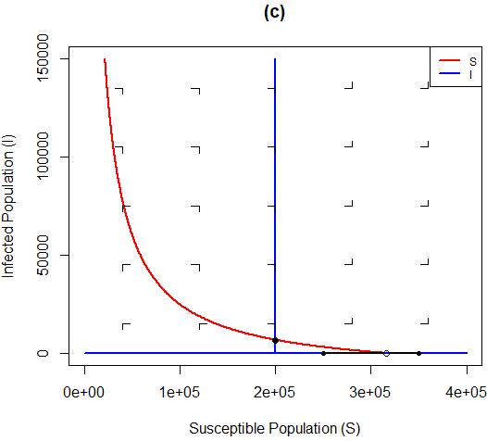
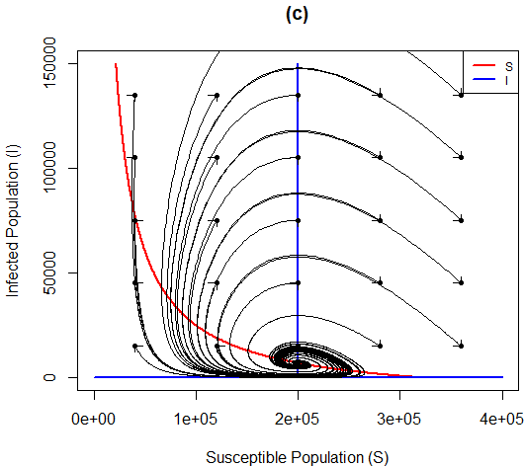
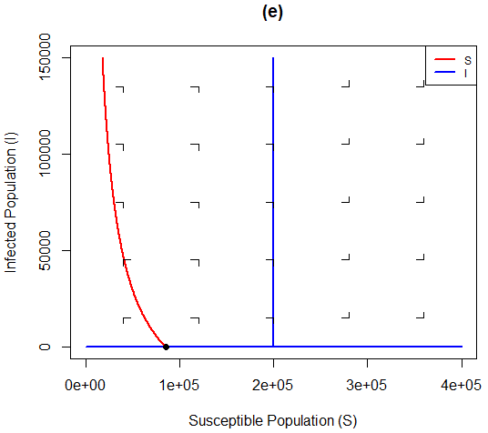
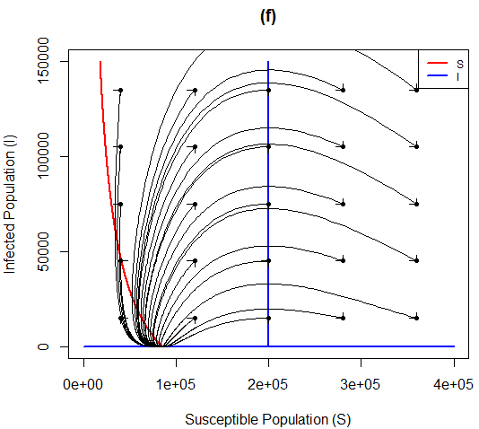
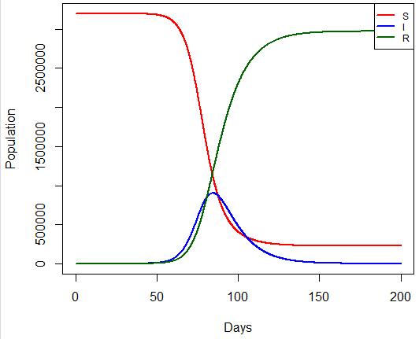
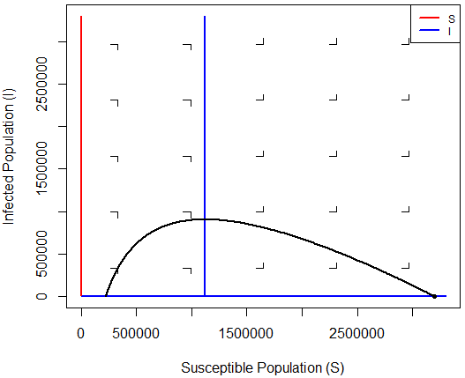
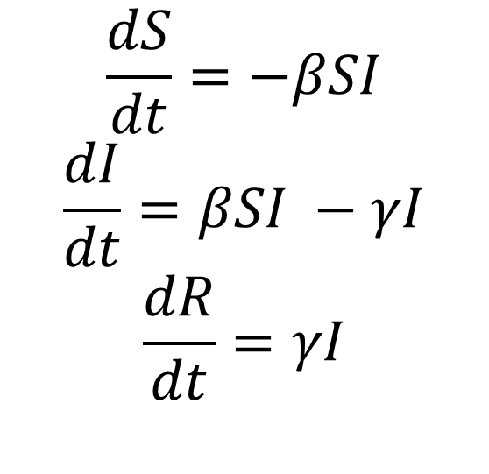
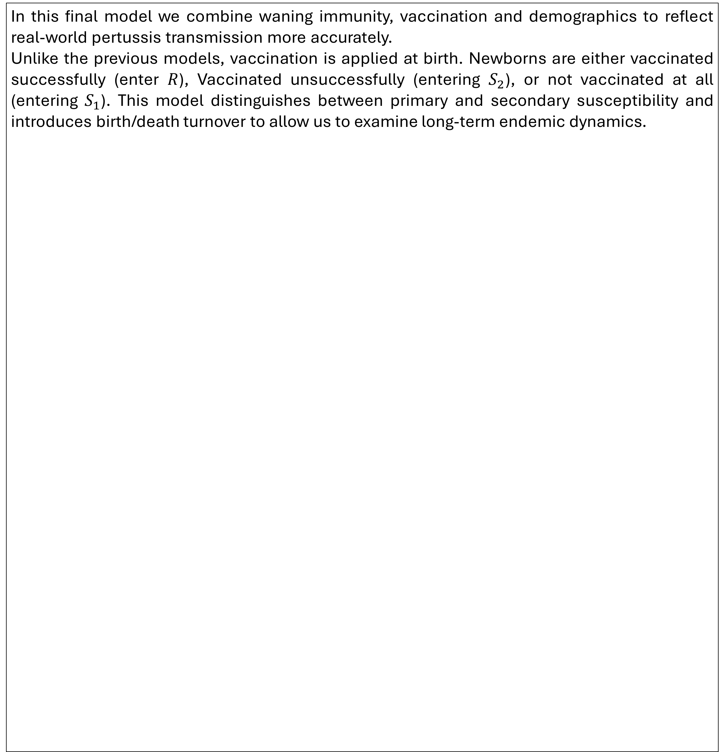
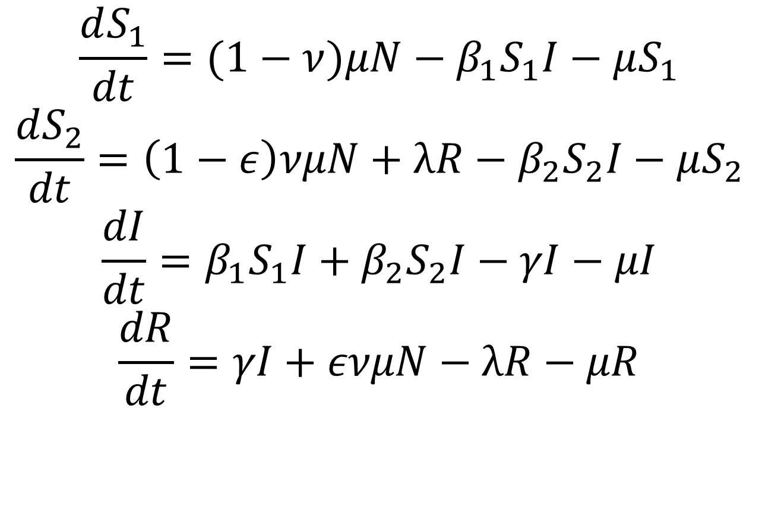
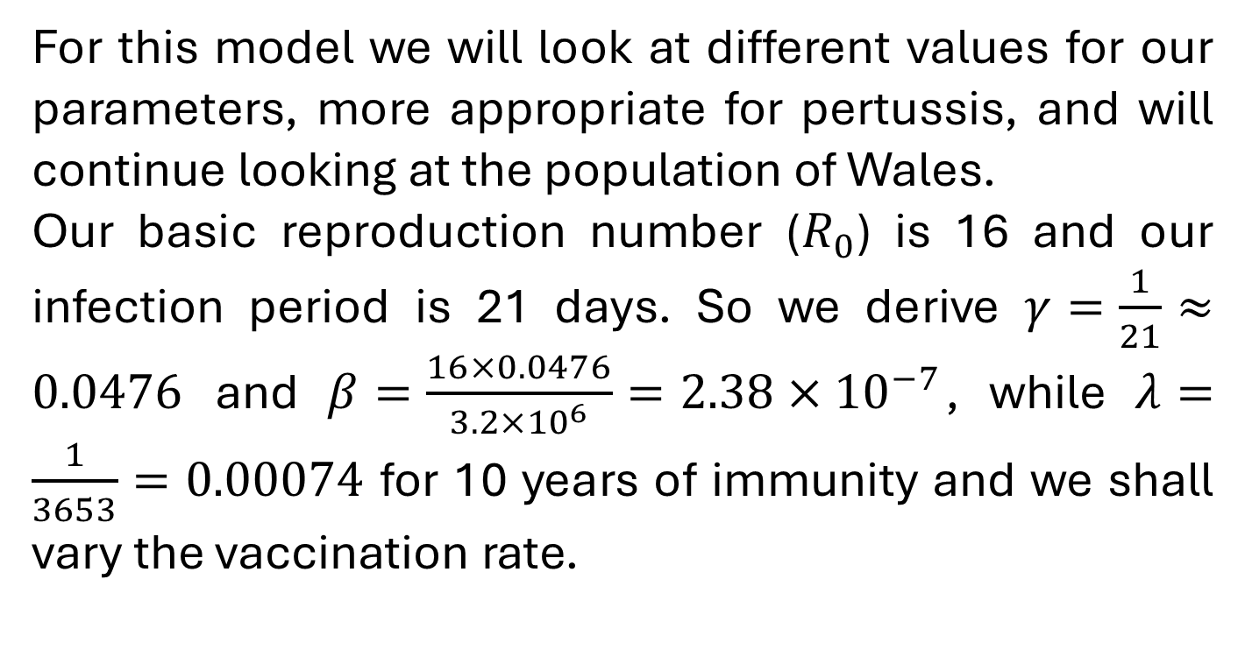
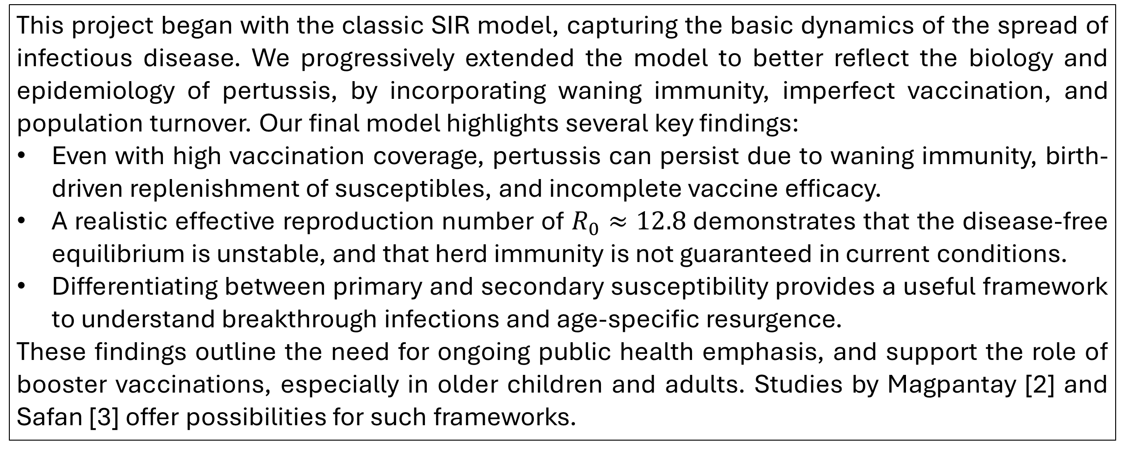
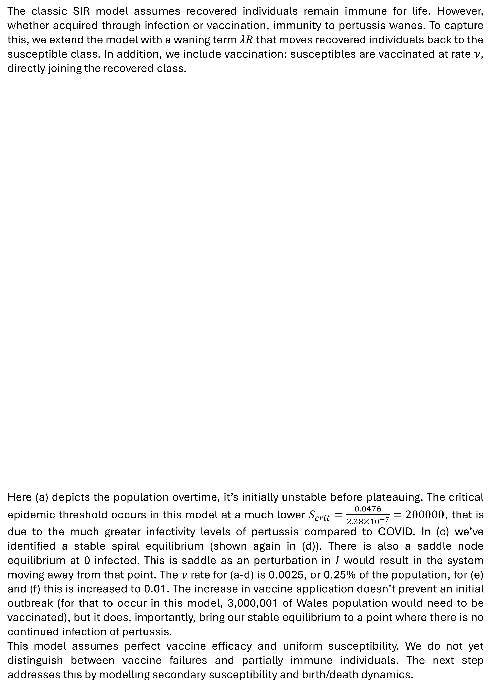
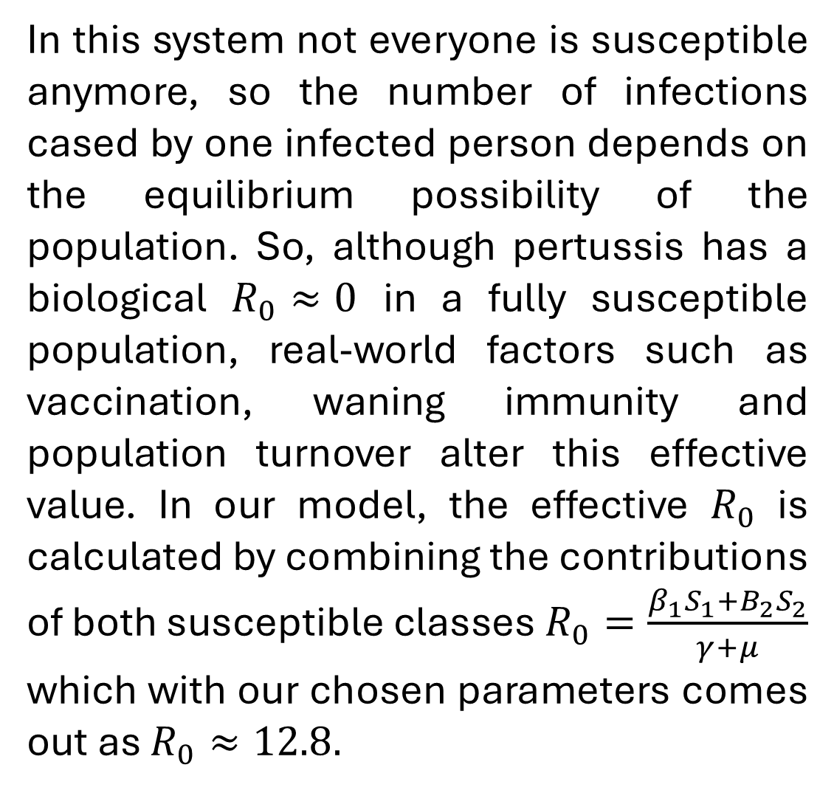
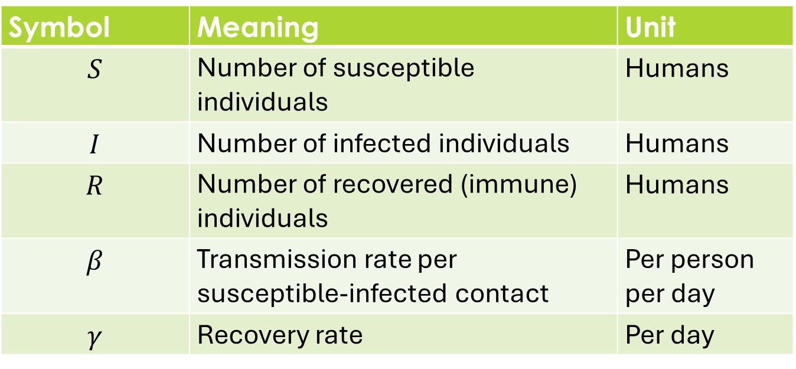
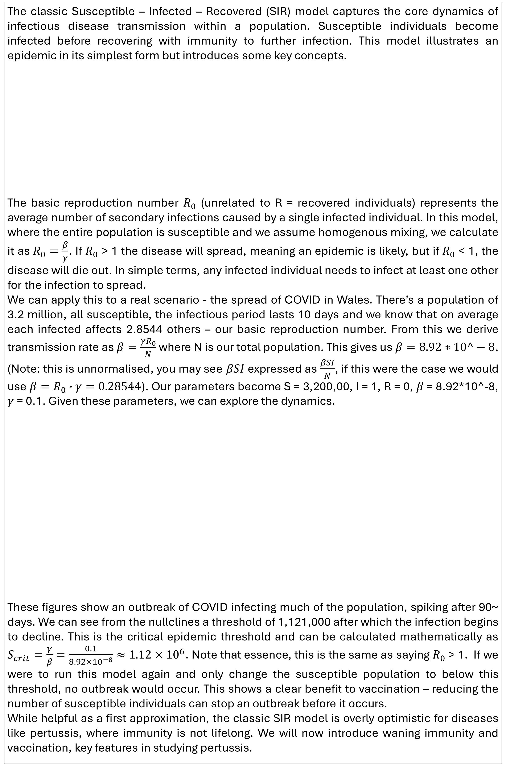
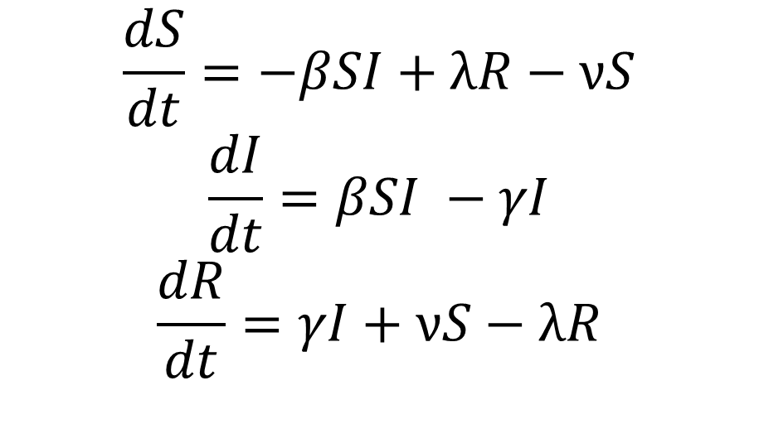
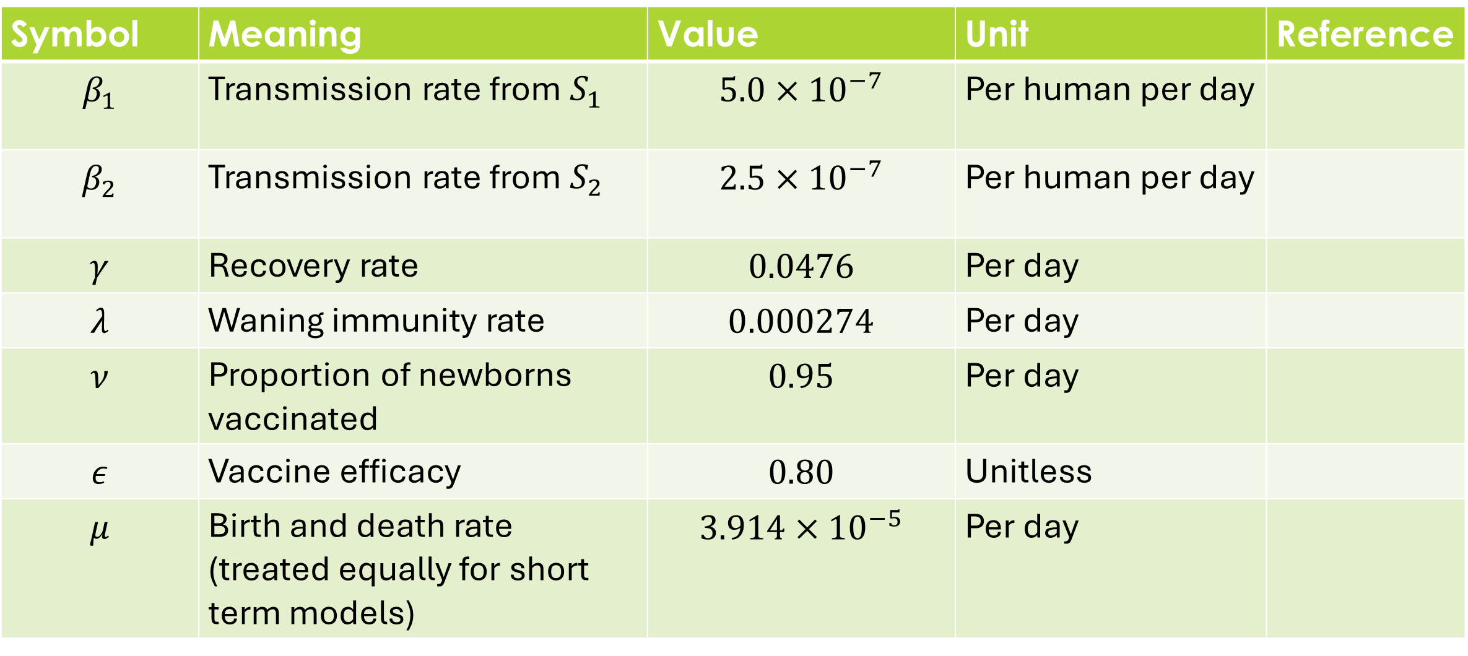
Modelling Pertussis Dynamics: Vaccination and Waning Immunity
Robert Wildy
1. Introduction
3. Vaccination and Waning Immunity
Our aim is to utilise the classic SIR model to analyse the dynamics of the spread of Whooping Cough, or Bordetella pertussis, an infectious disease that remains a global public health concern despite widespread vaccination.
Immunity from acellular vaccines wanes within a few years, and natural infection does not result in lifelong protection. The risk of infection has increased despite widespread vaccination [1].
This study progressively extends the SIR model to include waning immunity, vaccination with imperfect efficacy, birth and dearth rates, and two susceptible classes.
Our final model explores why pertussis can persist through vigorous vaccine programs.
The classic SIR model assumes recovered individuals remain immune for life. However, whether acquired through infection or vaccination, immunity to pertussis wanes. To capture this, we extend the model with a waning term $λR$ that moves recovered individuals back to the susceptible class. In addition, we include vaccination: susceptibles are vaccinated at rate $ν$, directly joining the recovered class.
Here (a) depicts the population overtime, it’s initially unstable before plateauing. The critical epidemic threshold occurs in this model at a much lower $S_{crit}=\frac{0.0476}{2.38×{10}^{−7}}=200000$, that is due to the much greater infectivity levels of pertussis compared to COVID. In (c) we’ve identified a stable spiral equilibrium (shown again in (d)). There is also a saddle node equilibrium at 0 infected. This is saddle as an perturbation in $I$ would result in the system moving away from that point. The $ν$ rate for (a-d) is 0.0025, or 0.25% of the population, for (e) and (f) this is increased to 0.01. The increase in vaccine application doesn’t prevent an initial outbreak (for that to occur in this model, 3,000,001 of Wales population would need to be vaccinated), but it does, importantly, bring our stable equilibrium to a point where there is no continued infection of pertussis.
This model assumes perfect vaccine efficacy and uniform susceptibility. We do not yet distinguish between vaccine failures and partially immune individuals. The next step addresses this by modelling secondary susceptibility and birth/death dynamics.
For this model we will look at different values for our parameters, more appropriate for pertussis, and will continue looking at the population of Wales.
Our basic reproduction number ($R_{0}$) is 16 and our infection period is 21 days. So we derive $γ=\frac{1}{21}≈0.0476$ and $β=\frac{16×0.0476}{3.2×{10}^{6}}=2.38×{10}^{−7}$, while $λ=\frac{1}{3653}=0.00074$ for 10 years of immunity and we shall vary the vaccination rate.
$$\frac{dS}{dt}=−βSI+λR−νS$$
$$\frac{dI}{dt}=βSI −γI$$
$$\frac{dR}{dt}=γI+νS−λR$$
2. SIR Model Overview
The classic Susceptible – Infected – Recovered (SIR) model captures the core dynamics of infectious disease transmission within a population. Susceptible individuals become infected before recovering with immunity to further infection. This model illustrates an epidemic in its simplest form but introduces some key concepts.
The basic reproduction number $R_{0}$ (unrelated to R = recovered individuals) represents the average number of secondary infections caused by a single infected individual. In this model, where the entire population is susceptible and we assume homogenous mixing, we calculate it as $R_{0}=\frac{β}{γ}$. If $R_{0}$ > 1 the disease will spread, meaning an epidemic is likely, but if $R_{0}$ < 1, the disease will die out. In simple terms, any infected individual needs to infect at least one other for the infection to spread.
We can apply this to a real scenario - the spread of COVID in Wales. There’s a population of 3.2 million, all susceptible, the infectious period lasts 10 days and we know that on average each infected affects 2.8544 others – our basic reproduction number. From this we derive transmission rate as $β=\frac{γR_{0}}{N}$ where N is our total population. This gives us $β=8.92∗10^−8$. (Note: this is unnormalised, you may see $βSI$ expressed as $\frac{βSI}{N}$, if this were the case we would use $β=R_{0}∙γ=0.28544$). Our parameters become S = 3,200,00, I = 1, R = 0, 𝛽 = 8.92*10^-8, $γ$ = 0.1. Given these parameters, we can explore the dynamics.
These figures show an outbreak of COVID infecting much of the population, spiking after 90~ days. We can see from the nullclines a threshold of 1,121,000 after which the infection begins to decline. This is the critical epidemic threshold and can be calculated mathematically as $S_{crit}=\frac{γ}{β}=\frac{0.1}{8.92×{10}^{−8}}≈1.12×{10}^{6}$. Note that essence, this is the same as saying $R_{0}$ > 1. If we were to run this model again and only change the susceptible population to below this threshold, no outbreak would occur. This shows a clear benefit to vaccination – reducing the number of susceptible individuals can stop an outbreak before it occurs.
While helpful as a first approximation, the classic SIR model is overly optimistic for diseases like pertussis, where immunity is not lifelong. We will now introduce waning immunity and vaccination, key features in studying pertussis.
$$\frac{dS}{dt}=−βSI$$
$$\frac{dI}{dt}=βSI −γI$$
$$\frac{dR}{dt}=γI$$
Symbol | Meaning | Unit
$$S$$ | Number of susceptible individuals | Humans
$$I$$ | Number of infected individuals | Humans
$$R$$ | Number of recovered (immune) individuals | Humans
$$β$$ | Transmission rate per susceptible-infected contact | Per person per day
$$γ$$ | Recovery rate | Per day
4. Expanding the model
In this final model we combine waning immunity, vaccination and demographics to reflect real-world pertussis transmission more accurately.
Unlike the previous models, vaccination is applied at birth. Newborns are either vaccinated successfully (enter $R$), Vaccinated unsuccessfully (entering $S_{2}$), or not vaccinated at all (entering $S_{1}$). This model distinguishes between primary and secondary susceptibility and introduces birth/death turnover to allow us to examine long-term endemic dynamics.
In this system not everyone is susceptible anymore, so the number of infections cased by one infected person depends on the equilibrium possibility of the population. So, although pertussis has a biological $R_{0}≈0$ in a fully susceptible population, real-world factors such as vaccination, waning immunity and population turnover alter this effective value. In our model, the effective $R_{0}$ is calculated by combining the contributions of both susceptible classes $R_{0}=\frac{β_{1}S_{1}+B_{2}S_{2}}{γ+μ}$ which with our chosen parameters comes out as $R_{0}≈12.8.$
$$\frac{dS_{1}}{dt}=(1−ν)μN−β_{1}S_{1}I−μS_{1}$$
$$\frac{dS_{2}}{dt}=\left(1−ε\right)νμN+λR−β_{2}S_{2}I−μS_{2}$$
$$\frac{dI}{dt}=β_{1}S_{1}I+β_{2}S_{2}I−γI−μI$$
$$\frac{dR}{dt}=γI+ενμN−λR−μR$$
5. Conclusion
This project began with the classic SIR model, capturing the basic dynamics of the spread of infectious disease. We progressively extended the model to better reflect the biology and epidemiology of pertussis, by incorporating waning immunity, imperfect vaccination, and population turnover. Our final model highlights several key findings:
Even with high vaccination coverage, pertussis can persist due to waning immunity, birth-driven replenishment of susceptibles, and incomplete vaccine efficacy.
A realistic effective reproduction number of $R_{0}≈12.8$demonstrates that the disease-free equilibrium is unstable, and that herd immunity is not guaranteed in current conditions.
Differentiating between primary and secondary susceptibility provides a useful framework to understand breakthrough infections and age-specific resurgence.
These findings outline the need for ongoing public health emphasis, and support the role of booster vaccinations, especially in older children and adults. Studies by Magpantay [2] and Safan [3] offer possibilities for such frameworks.
Symbol | Meaning | Value | Unit | Reference
$$β_{1}$$ | Transmission rate from $S_{1}$ | $$5.0×{10}^{−7}$$ | Per human per day
$$β_{2}$$ | Transmission rate from $S_{2}$ | $$2.5×{10}^{−7}$$ | Per human per day
$$γ$$ | Recovery rate | $$0.0476$$ | Per day
$$λ$$ | Waning immunity rate | $$0.000274$$ | Per day
$$ν$$ | Proportion of newborns vaccinated | $$0.95$$ | Per day
$$ε$$ | Vaccine efficacy | $$0.80$$ | Unitless
$$μ$$ | Birth and death rate (treated equally for short term models) | $$3.914×{10}^{−5}$$ | Per day
References
Lavine J, Broutin H, Harvill ET, Bjørnstad ON. Imperfect vaccine-induced immunity and whooping cough transmission to infants. Vaccine. 2010 Dec 10;29(1):11-6. doi: 10.1016/j.vaccine.2010.10.029.
Magpantay FMG, Domenech DE Cellès M, Rohani P, King AA. Pertussis immunity and epidemiology: mode and duration of vaccine-induced immunity. Parasitology. 2016 Jun;143(7):835-849. doi: 10.1017/S0031182015000979.
Safan, M.; Barley, K.; Elhaddad, M.M.; Darwish, M.A.; Saker, S.H. Mathematical Analysis of an SIVRWS Model for Pertussis with Waning and Naturally Boosted Immunity. Symmetry 2022, 14, 2288. https://doi.org/10.3390/sym14112288

