Slide 1
CS 4476 Project 3
Peter Gray
wileygray@gatech.edu
903393428

Slide 2
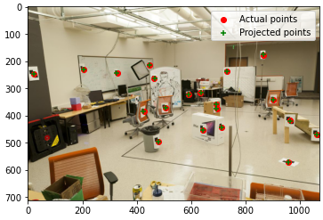
Part 1.5: Projection Matrix for provided image
<insert visualization of projected 3D points and actual 2D points for image provided by us here [1]>
<What is the minimum number of 3D-2D point correspondences needed to estimate the projection matrix? Why? [2]>
6, M is a 3x4 matrix, 3*4 = 12, 12 / 2 = 6

Slide 3
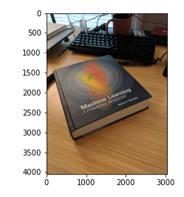
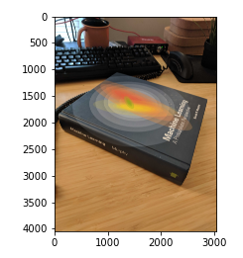
Part 2.1: Projection Matrix for custom images

Slide 4
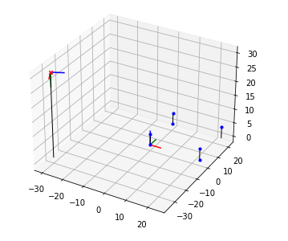
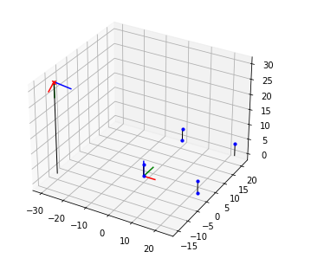
Part 2.2: Pose init for custom images
<Insert visualization for the initialized camera pose for 1st image> [1]
<Insert visualization for the initialized camera pose for 2nd image> [1]

Slide 5
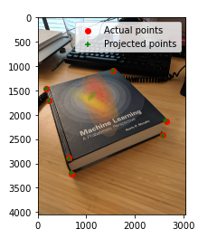
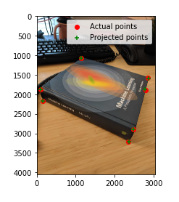
Part 2.2: Optimized results for custom images
<Insert visualization for projected 3D points and actual 2D points for 1st image> [1.5]
<Insert visualization for projected 3D points and actual 2D points for 2nd image> [1.5]

Slide 6
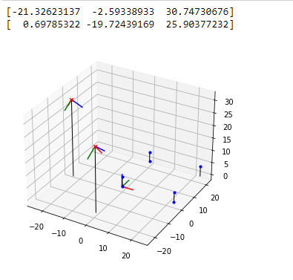
Part 2.3: Optimized Camera Poses
<Insert pose with world and optimized camera’s coordinate systems [1]>

Slide 7
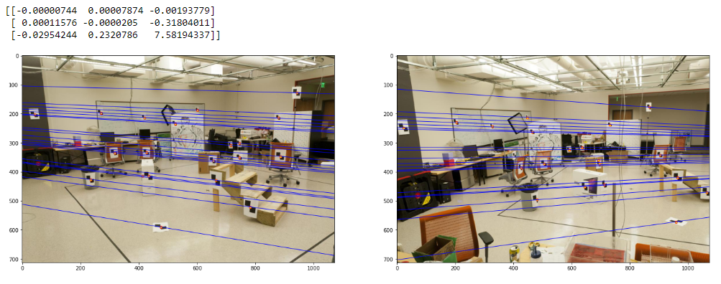
Part 3.2: Optimized Epipolar Lines (given images)
<Insert left image with epipolar lines> [1]
<Insert right image with epipolar lines> [1]

Slide 8
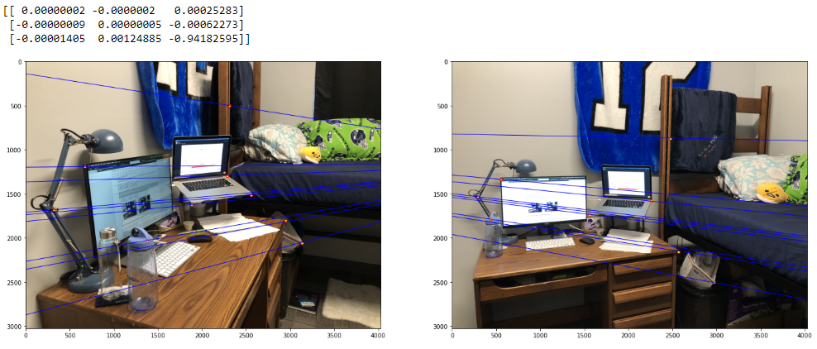
Part 3.3: Optimized Epipolar Lines (custom images)
<Insert left image with epipolar lines> [1.5]
<Insert right image with epipolar lines> [1.5]

Slide 9
Part 3.4: Reflection Questions [1x3]
1. If only a rotation is applied to the camera, the calculated distance between the cameras becomes very small and is not precise enough to accurately calculate the rotation relative to the initial camera.
2. The exact position can’t be found because there will be slight errors in precision throughout the cascading calculations which lead to the fundamental projection matrix. These errors will be small and will not skew the result to an absurd extent, but they will make the resultant point incorrect with regards to the ground truth.
3. The epipoles and resultant epiopolar lines become irradic with respect to the center of the image. This happens because once a camera point is within another space, the calculations become kinda wonky. I don’t know exactly how to explain this mathematically but given the epipoles and epipolar lines are supposed to help calculate change in distance and rotation, they don’t function as intended once within another photo.

Slide 10
Part 3.4: Reflection Questions [1x3]
4. It means that within the calculated space, the two cameras exist on the same horizontal axis.
5. I think what this is asking is why is it that the fundamental matrix is normalized. If so, then it is normalized because it is used to calculate the relative position of the cameras in the views and not the absolute position.
6. Because the two positions (x,y) must be a combination of two linearly independent vectors.

Slide 11
Part 4.2: RANSAC Iterations Questions [1x3]
Type your answers to the three RANSAC Iterations questions from the jupyter notebook below:
9
28
53

Slide 12
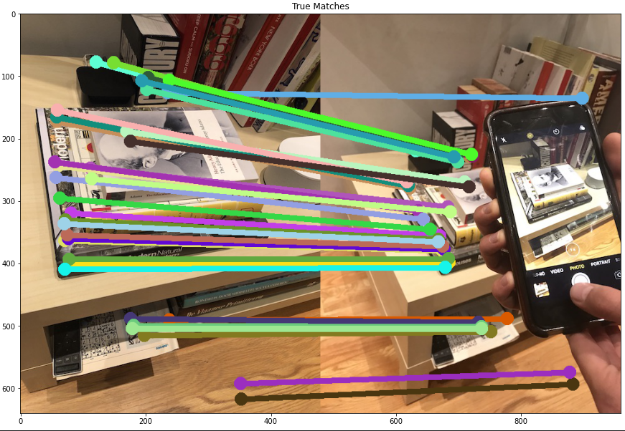
Part 4.4: RANSAC Inlier Matches
<Paste the inlier matches found by Ransac [2]>

Slide 13
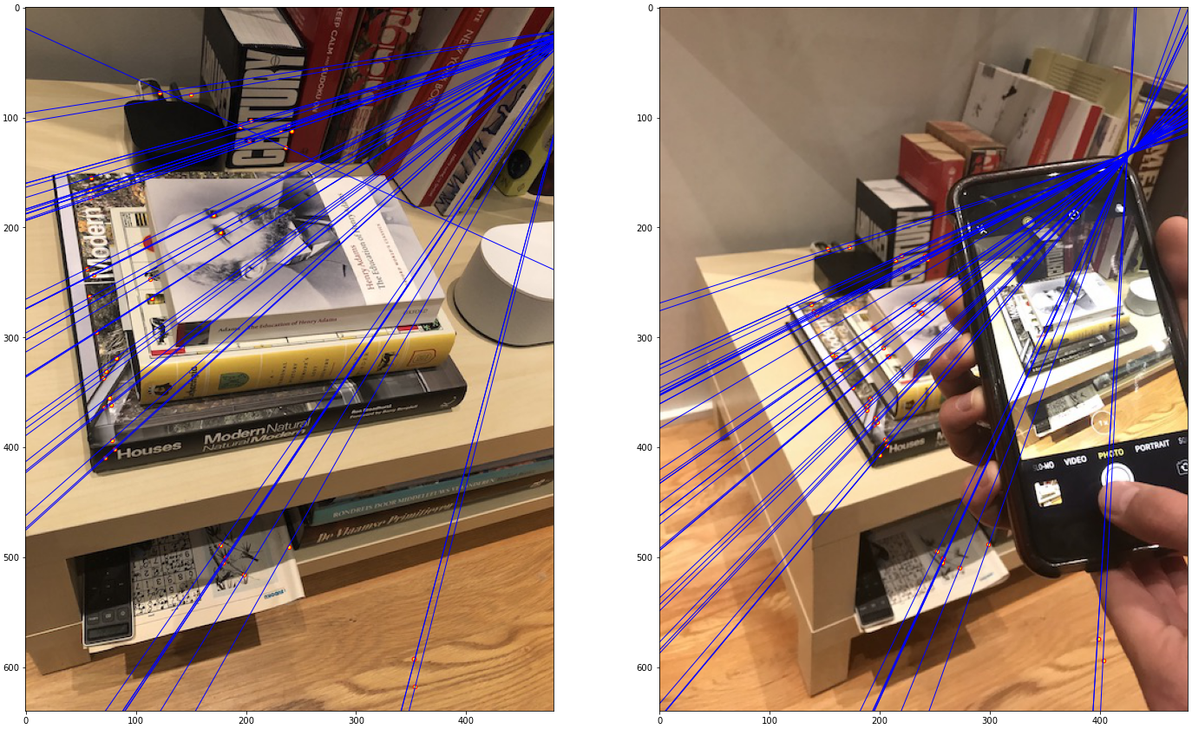
Part 4.4: RANSAC Epipolar Lines

Slide 14
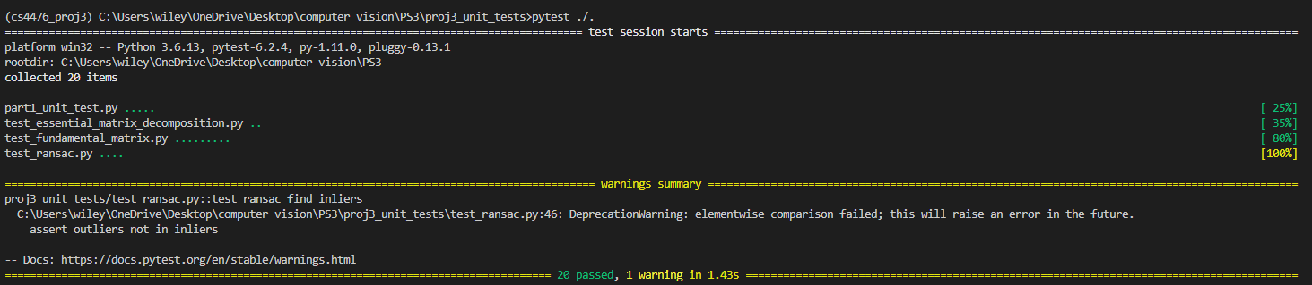
Local Unit tests results

Slide 15
Conclusions
I learned a lot from the displays provided about what I was doing actually looked like which really helped. The main struggle I had was translating the equations into code which was challenging but eventually I got through it. Shout out to math stack exchange and the slides.

