Slide 1
KenyaBidder
AI Auction Matchmaking Ecosystem
Full Specification, Architecture & Wireframes — Matchmaking-First Prototype (v2.1)
Seller Agents • Bidder Agents • Multi-Algorithm Auctions • Omnichannel • No Payment Module

Slide 2
What This Deck Covers
01
Product & Personas
02
Monetization
The core loop, who it's for, what's in and out of scope
Seller subscriptions, free buyer access, and the success-fee path
03
Architecture
04
Auction Mechanics
LLM reasons, Harness executes, MCP connects — and why that split matters
How strategy and execution adapt across English, Dutch, Sealed-Bid & more
05
Matching & Trust
06
Wireframes
Reputation tiers, contact-reveal timing, deterministic + LLM spec matching
Seller dashboard, live bidding, match confirmation, omnichannel continuity
07
Rollout & KPIs
08
Scaling & Cost
Four prototyping milestones, sequenced by risk, and how we'll measure success
Sizing for 200K sellers/1M buyers, and the LLM charging model
09
Implementation Plan
Phase-by-phase roadmap with hard gates between phases
KenyaBidder — AI Auction Matchmaking Ecosystem
2

Slide 3
PRODUCT
One Agent Per Party, Persistent Across Channels
KenyaBidder gives both sellers and buyers a persistent, autonomous “avatar” that acts on their behalf according to strategy set once and executed continuously. The platform's job is price discovery and matchmaking, not transaction processing — it runs real auction mechanics to find the right counterparty and price, then hands off a confirmed match for the two parties to settle directly.
Seller — “Amina”
Bidder — “David”
Wholesale electronics trader. Wants inventory cleared at the highest margin, fastest speed, without babysitting the auction.
Procurement manager. Wants to source at spec, under a landed-cost ceiling, by a delivery deadline.
Recommends the optimal auction type per product
Sets and adjusts reserve prices from market intel
Auto-relists unsold lots with revised parameters
Sends an evening WhatsApp performance summary
Holds standing constraints as durable memory
Scans live and upcoming auctions for fit
Executes bidding strategy per auction type
Escalates only when a decision exceeds its authority
KenyaBidder — AI Auction Matchmaking Ecosystem
3

Slide 4
SCOPE
Core Loop & Feature Scope
1
2
3
4
5
Seller Agent lists a product with an auction type & terms
→
Bidder Agents matching the spec discover & participate
→
The auction runs to completion using real auction mechanics
→
A Match is produced — terms agreed, contact exchanged
→
Both parties confirm the outcome, feeding reputation
In Scope
Explicitly Out of Scope
Seller & Bidder Agents with durable constraints
English, Dutch, First & Second-Price Sealed-Bid (prototype)
Reverse, Multi-Unit, Combinatorial (architected, later)
Web + WhatsApp channels (prototype)
Reputation scoring from match outcomes
Market Intelligence (historical clearing prices, demand)
Any fund holds, in-platform checkout, or payment processing
Delivery / logistics coordination (handled off-platform)
Platform-mediated dispute resolution or refunds
Slack, Voice, and public API (deferred past prototype)
KenyaBidder — AI Auction Matchmaking Ecosystem
4

Slide 5
MONETIZATION
How KenyaBidder Makes Money Without a Payment Module
The platform never touches transaction funds, so the usual take-rate-on-GMV model isn't available. Monetization works through access, signal, and successful outcomes instead.
Seller Subscription
Free Buyer Access
Success / Match Fee
Market Intelligence
PRIMARY — FROM LAUNCH
FROM LAUNCH
LAYER IN LATER
LATER-STAGE PRODUCT
Continuous agent access, listing capacity, priority matching. Predictable revenue, fits sellers' recurring usage.
Buyers aren't taxed — they're what makes seller subscriptions worth paying for. Maximizes demand-side liquidity.
Charged on confirmed matches, once reputation data justifies it as "vetted introductions," not just an intro.
Sell historical pricing/demand data once auction history is genuinely differentiated — not before.
Structural risk: no-payment platforms leak revenue to disintermediation more easily. Contact-reveal logging (from the Matching & Trust design) measures this with real data rather than guessing.
KenyaBidder — AI Auction Matchmaking Ecosystem
5

Slide 6
ARCHITECTURE
The Governing Principle
The LLM reasons and recommends. The Agentic Harness decides deterministically, persists state, and executes. MCP Servers are the only way either layer touches the outside world. The LLM never calls an external system directly.
LLM
Harness
MCP
Strategy & Reasoning
Deterministic Execution
Connective Tissue
Game-theoretic calculation
Natural-language negotiation
Proposes structured actions only
Never touches money or state directly
Validates every proposal against guardrails
Sub-200ms bid execution (English/Dutch)
Owns persistent agent state & identity
Fires pre-approved conditional actions
Auction Engine, Match, Market Intel servers
Only path either layer has to the outside world
Standardized tools & resources
Same pattern regardless of channel
KenyaBidder — AI Auction Matchmaking Ecosystem
6

Slide 7
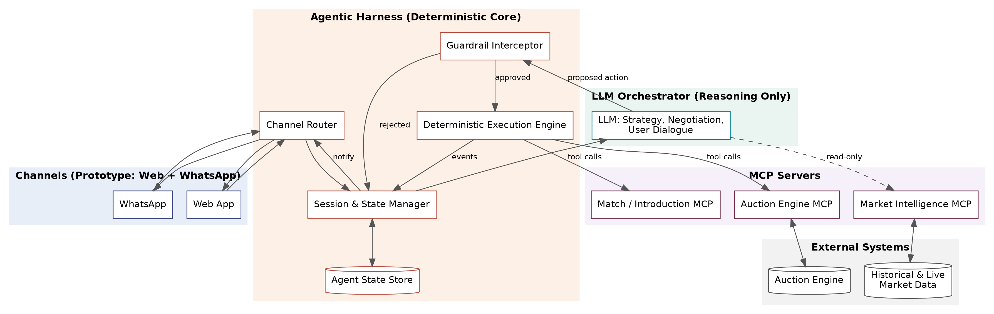
ARCHITECTURE
System Architecture
KenyaBidder — AI Auction Matchmaking Ecosystem
7

Slide 8
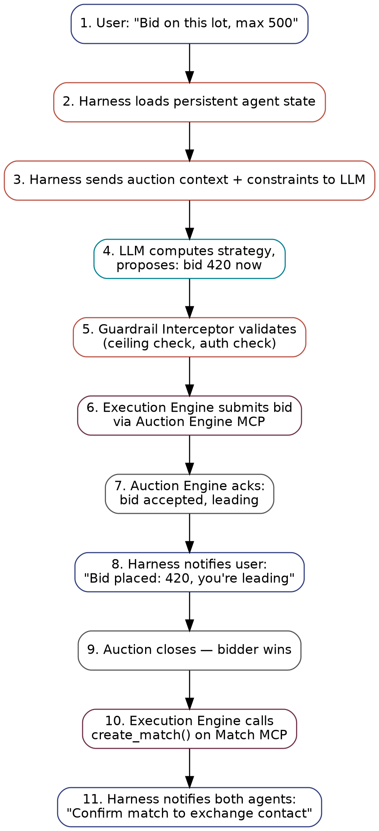
ARCHITECTURE
Bid Execution → Match Creation Sequence
KenyaBidder — AI Auction Matchmaking Ecosystem
8

Slide 9
ARCHITECTURE
Strategy vs. Execution — Why the Split Matters
 | LLM Strategy Layer | Harness Execution Layer
Responsibility | Decide what to do and why | Decide whether it's allowed and do it, precisely, on time
Output | A proposed action (structured JSON), never a direct execution | A confirmed, executed, logged action
Latency tolerance | Seconds — can reason, can call tools | Milliseconds — no LLM call in this path
Failure mode | Wrong strategy → suboptimal outcome | Failure here → missed auction, real cost to trust
KenyaBidder — AI Auction Matchmaking Ecosystem
9

Slide 10
ARCHITECTURE
MCP Server Specifications
Auction Engine MCP
Match / Introduction MCP
Market Intelligence MCP
list_active_auctions(filters)
get_auction_detail(auction_id)
submit_bid() — Execution Engine only
create_listing() / withdraw_listing()
submit_sealed_bid()
create_match() on auction close
confirm_match(match_id, agent_id)
reveal_contact() — on double-confirm
report_outcome() — feeds reputation
get_match_status()
get_historical_clearing_prices()
get_demand_signal(category)
get_comparable_active_auctions()
forecast_price_trajectory() — later phase
KenyaBidder — AI Auction Matchmaking Ecosystem
10

Slide 11
AUCTION MECHANICS
How Strategy & Execution Adapt Per Auction Type
Type | LLM Strategy Role | Harness Execution Role
English (ascending) | Max willingness-to-pay; increment pacing; snipe timing | Hot-path state machine fires the trigger bid instantly
Dutch (descending) | Stopping-time optimization for accept threshold | Watches price-decrement feed; fires at threshold — latency is existential
Vickrey (2nd-price sealed) | Estimate true value — truthful bidding is dominant | Submit once before deadline; retry-safe, not speed-critical
Multi-Unit (later) | Quantity-price demand schedule, not a single number | Submit schedule; adjust holds as partial fills occur
Combinatorial (later) | Valuations per meaningful bundle | Hand to winner-determination solver; execute winning bundle
KenyaBidder — AI Auction Matchmaking Ecosystem
11

Slide 12
MATCHING & TRUST
Spec-Matching: Deterministic Pre-Filter, Then LLM
Hard constraints (price, quantity, deadline, category) are filtered deterministically — no LLM call, sub-second. The LLM only reasons over the resulting shortlist: fuzzy spec fit, ranking, and borderline judgment calls. This keeps the expensive reasoning step scoped to what it's actually good at, and keeps the system responsive as listing volume grows.
KenyaBidder — AI Auction Matchmaking Ecosystem
12

Slide 13
MATCHING & TRUST
Reputation Tiers & Contact-Reveal Timing
Tier | Criteria | What It Unlocks
New | 0 completed matches | Low-stakes auctions only, labeled transparently
Established | ≥3 matches, <20% fall-through | Full access to all auction types & value ranges
Trusted | ≥15 matches, <10% fall-through | Priority visibility, invite-only high-value listings
Contact Reveal: Default = Immediate
No artificial delay on double-confirmation. The prototype's job is proving match quality, not building bypass-prevention friction before there's data to justify it.
Every reveal event is logged and tied to the later outcome report — real signal on repeat-pair platform bypass, to inform any future changes.
Value-based gating (not auction-type gating) targets the actual risk: a flaky new agent wasting a high-value counterparty's time — without blocking new agents from exercising every auction mechanic.
KenyaBidder — AI Auction Matchmaking Ecosystem
13

Slide 14
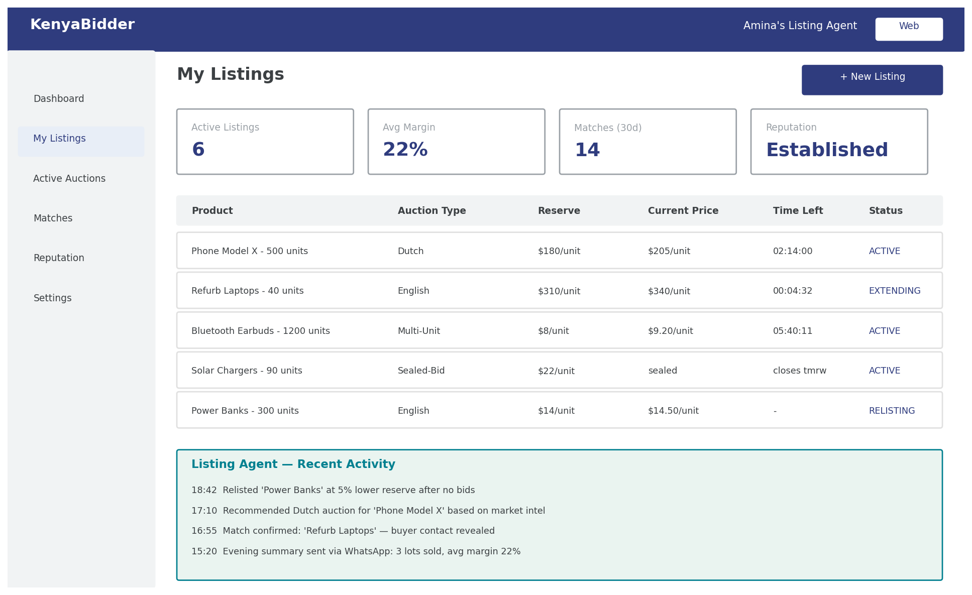
WIREFRAMES
Seller Dashboard (Web)
Amina's Listing Agent: active listings across auction types, summary stats, and a live agent-activity feed.
KenyaBidder — AI Auction Matchmaking Ecosystem
14

Slide 15
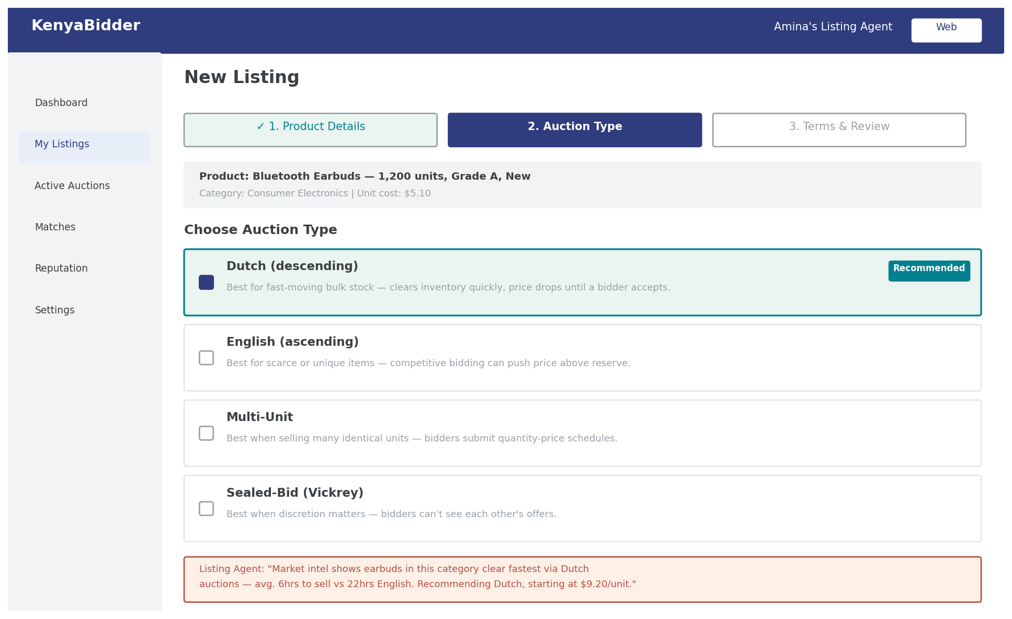
WIREFRAMES
New Listing Flow (Seller)
The Listing Agent pre-selects and explains its auction-type recommendation, based on Market Intelligence, rather than hiding it behind the pick.
KenyaBidder — AI Auction Matchmaking Ecosystem
15

Slide 16
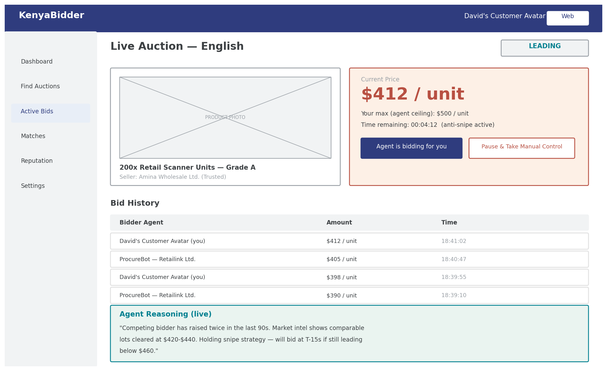
WIREFRAMES
Live Auction View — Bidder Side
David's Customer Avatar mid-auction, with a transparency panel showing the LLM's live strategic reasoning.
KenyaBidder — AI Auction Matchmaking Ecosystem
16

Slide 17
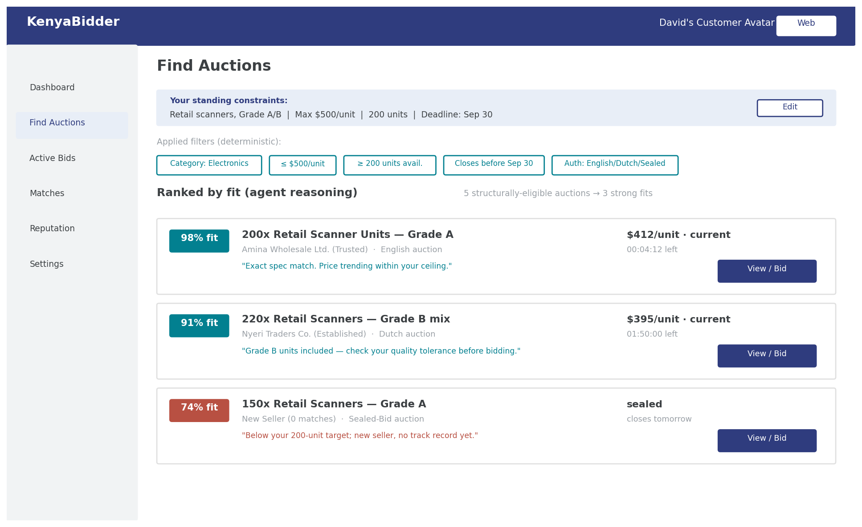
WIREFRAMES
Find Auctions — Discovery (Bidder)
Deterministic filters (from standing constraints) narrow the pool; the LLM then ranks the shortlist by genuine fit and explains each score.
KenyaBidder — AI Auction Matchmaking Ecosystem
17

Slide 18
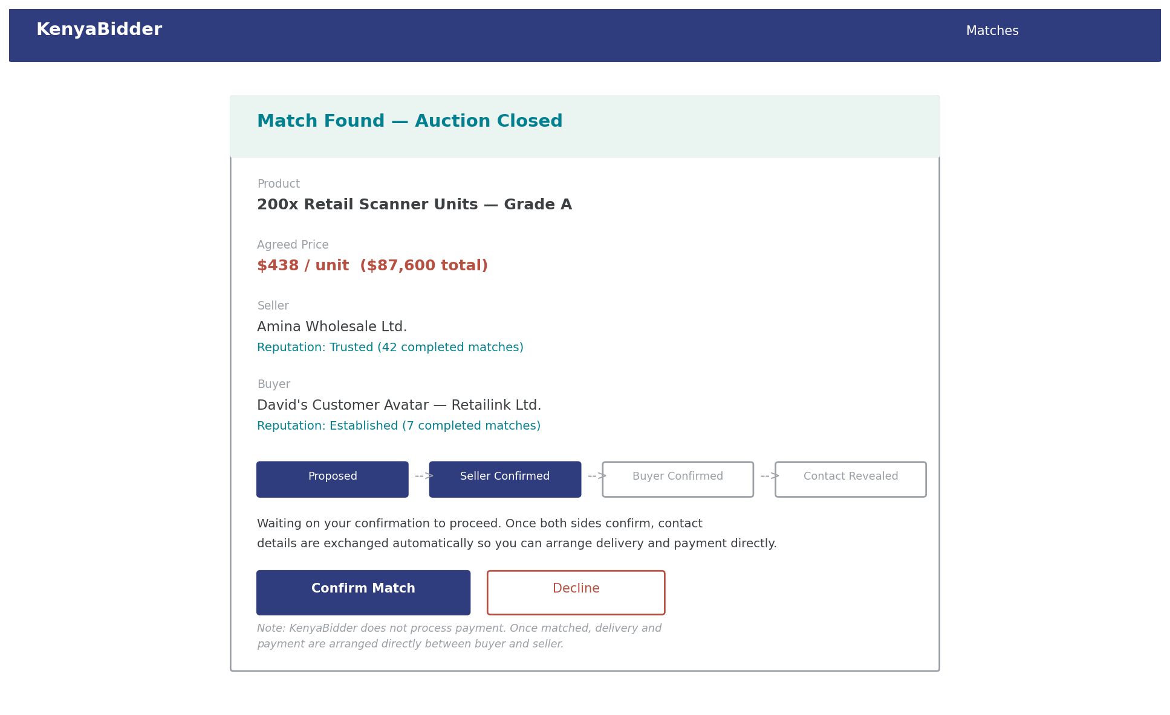
WIREFRAMES
Match Confirmation Screen
A visible status stepper makes the reveal-timing mechanism legible; delivery & payment happen directly between the parties.
KenyaBidder — AI Auction Matchmaking Ecosystem
18

Slide 19
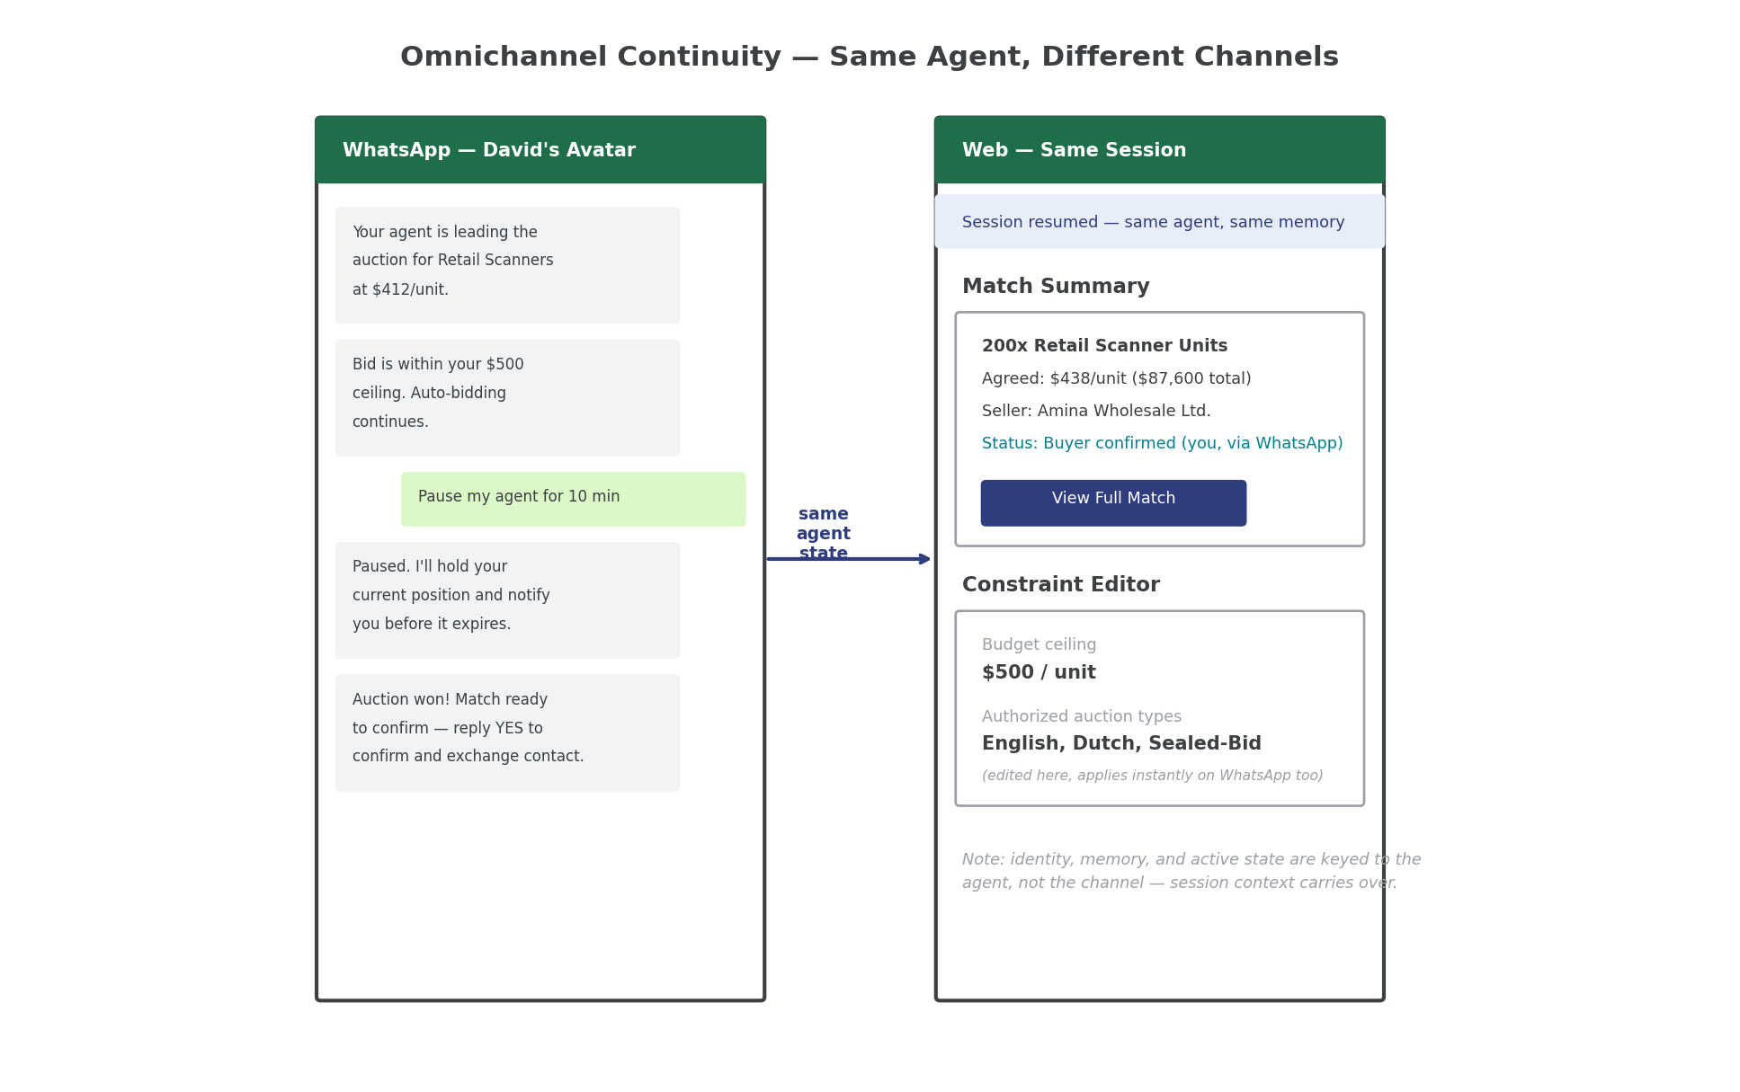
WIREFRAMES
Omnichannel Continuity — WhatsApp to Web
Same agent, same memory: a WhatsApp conversation and a Web session share one continuous state.
KenyaBidder — AI Auction Matchmaking Ecosystem
19

Slide 20
ROLLOUT
Four Prototyping Milestones, Sequenced by Risk
M1
M2
M3
M4
Prove Execution
Prove Strategy
Prove Portability & Trust
Expand Coverage
Web only, English auction only, hardcoded bidder strategy. Validates the highest-risk technical piece: deterministic, low-latency bid execution.
Add Dutch auction + real LLM reasoning + Match MCP. A/B the LLM bidder against the naive M1 bidder — the core value-prop test.
Add WhatsApp, test cross-channel continuity, add reputation scoring from outcome reports.
Sealed-bid & Reverse auctions. Multi-Unit and Combinatorial deferred — they need a bigger winner-determination build.
KenyaBidder — AI Auction Matchmaking Ecosystem
20

Slide 21
METRICS
How We'll Know It's Working
Win rate & realized margin
Bid latency
Are agents actually getting good outcomes for their principals?
Sub-200ms decision-to-submission for English/Dutch
Strategy accuracy (A/B)
Guardrail intercept rate
Does LLM-driven strategy beat a naive baseline bidder?
Proof the safety net is actually catching bad proposals
Match confirmation rate
Fall-through rate
% of proposed matches both sides confirm
% of confirmed matches later reported as not completed
Session continuity
Override rate
% of cross-channel handoffs with zero state loss
How often users manually override their agent — a trust signal
KenyaBidder — AI Auction Matchmaking Ecosystem
21

Slide 22
SCALING
Sizing for 200K Sellers, 1M Buyers
Provision against concurrent activity, not registered population
Component | What Drives Its Size | Why
Execution Engine | Concurrent active auctions | Only component with a real-time (sub-200ms) SLA — sized via pub/sub fan-out to an autoscaled worker pool
State Manager & Store | 1.2M rows for storage; active sessions for load | 1.2M agent records is trivial for Postgres; Redis handles the much smaller active-session working set
LLM Orchestrator | "Decision moments," not agent count | Event-triggered — scales with auction/listing activity, not population
MCP Servers & Gateways | Standard API request volume | Ordinary horizontally-scaled stateless services
Honest caveat: concurrency figures here are planning assumptions, not measured facts. Milestone 1 is the first real opportunity to measure concurrency-to-registered-user ratios before committing to a production capacity plan.
KenyaBidder — AI Auction Matchmaking Ecosystem
22

Slide 23
SCALING
LLM Cost Economics & Charging Model
Cost Levers (in order of impact)
Charging Model — "Agent Actions," Not Tokens
Event-driven triggering, not polling — the single biggest lever
Prompt caching on system prompt & constraints (~90% cheaper)
Model routing: Haiku for routine, Sonnet default, Opus rare
Batch API (50% off) for non-urgent reasoning
Rate-limit LLM calls per agent as a guardrail, not just cost control
Tier | Allowance | Overage
Seller — Starter | ~500/mo | Fallback to deterministic-only
Seller — Growth | ~3,000/mo | Same, higher threshold
Seller — Trusted | Soft-capped | Priority routing
Buyer (free) | Rate-limited | Guardrail ceiling, not billed
~$0.002–$0.005 per LLM decision
Internal metering (FinOps) tracks real spend per agent — invisible to the customer. User-facing pricing wraps reasoning into an abstracted unit bundled into subscription tiers, never raw $/token billing.
Blended Haiku/Sonnet/Opus estimate. At full scale: a wide low-to-mid-six-figure monthly range — refine with real decisions/agent/day data from Milestone 2.
KenyaBidder — AI Auction Matchmaking Ecosystem
23

Slide 24
ROADMAP
Implementation Plan
Validate the riskiest, hardest-to-reverse assumptions first
0
Foundations
Schemas, Canonical Agent ID, core infra — nothing auction-specific yet
1–2 wks
1
Prove Execution
English only, no LLM. Hard gate: sub-200ms bid latency, measured
~4 wks
2
Add the Brain
LLM strategy + Dutch auction. A/B vs. naive bidder — the value-prop test
~4 wks
3
Expand Reach
WhatsApp + reputation scoring. Verify zero state loss cross-channel
~4 wks
4
Fill Coverage
Sealed-Bid, Reverse. Multi-Unit/Combinatorial deferred to their own track
~4 wks
5
Business Layer
Subscription billing, Agent Actions metering, FinOps dashboard
~3–4 wks*
6
Scale & Harden
Load-test against real data, security/compliance review, observability
Ongoing
KenyaBidder — AI Auction Matchmaking Ecosystem
24
*Phase 5 overlaps Phase 4.

Slide 25
ROADMAP
Hard Gates Between Phases
Phase 1 → 2
Sub-200ms bid-execution latency, measured end-to-end — an infrastructure problem to solve now, not defer.
Phase 2 → 3
A/B test shows the LLM bidder beating the naive baseline — the platform's core value-proposition test.
Phase 3 → 4
Cross-channel session continuity holds with zero state loss; reputation tiers actually gate eligibility.
The one sequencing rule to protect:
Don't let Phase 2's LLM work start until Phase 1's latency numbers are in hand. If the Execution Engine can't hit its target, that's an architecture-level problem that changes what the LLM even needs to produce — building strategy against unvalidated execution risks redoing both.
KenyaBidder — AI Auction Matchmaking Ecosystem
25

Slide 26
No Payment Module — By Design, Not By Omission
This prototype validates the hardest, most novel part of the idea — whether agent-driven auction strategy produces better outcomes — without needing payment infrastructure before that question is answered. Buyers and sellers settle directly; the platform's job is to find them the right match, fast.
Next: Phase 0 foundations, then Phase 1's hard latency gate before any LLM work begins.

