Slide 1


The shortest guide about…
Configuring a local repository and push to a remote repository…
Wilson Govindji
wg@wilsongovindji.net
V 1.0 – 2014/01

Slide 2
Let’s Git started
What will you not learn from here?
What Git is;
How to install Git;
How to be Git Ninja;
So… what’s the point??
Sometimes learning Git can be overwhelming, there are so many details and too much to learn about… well it’s true…
So, i will show you the foundation steps to create a local repository and push it to a remote repository… nothing more… nothing less

Slide 3
What do we need to get start?
Download and install Git;
http://git-scm.com/
Create a GitHub account;
https://github.com/

Slide 4

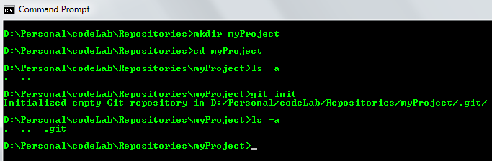
Step #1- Create local repository
Create a folder;
Execute “git init”;
Well done!! Now myproject folder is a git repository.
A hidden folder named ”.git” was created which contains this particular repository settings, no need to worry about that for now;

Slide 5

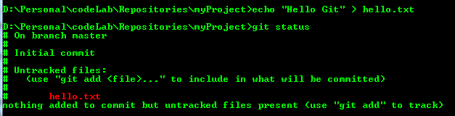
Step #2- Create a file
Create a new file i.e.: echo “Hello Git” > hello.txt;
Execute “git status”;
This command shows the working tree status;
And currently hello.txt is untracked;

Slide 6


Hold your horses!!
Previously you’ve seen that hello.txt is untracked, what does that mean?? It means it isn’t in none of the stages identified below;
In Git you haves three stages where your files can reside in:
Committed – means data is safely stored in your local git database;
Modified – means a file is modified and hasn’t been commited yet;
Staged – means a modified file is marked to go in the next commit;
With Git you can say exactly what you want to commit from your working directory to database;

Slide 7

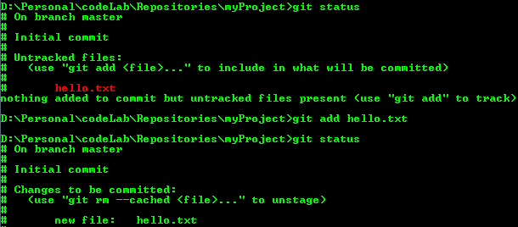
Step #3- Staging file
Let’s add hello.txt to staging area by running “git add * ”
Execute “git status”;
This command will show that hello.txt is ready to be commited;
From now on, git is tracking hello.txt file;
By now you’ve understood that with git you can choose WHAT you want to commit to git repository database by adding from working directory to staging area;

Slide 8

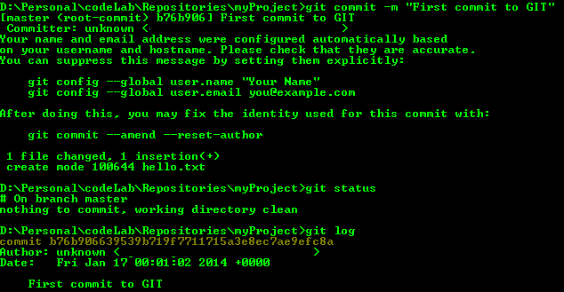
Step #4- Let’s COMMIT
Execute “git commit –m <Message>”;
This command will let you record changes to the repository
and associate a message to this commit;
Execute “git status”;
Now it shows that there is nothing to be commited;
Execute “git log”;
This command shows commits log;
Commits
log

Slide 9

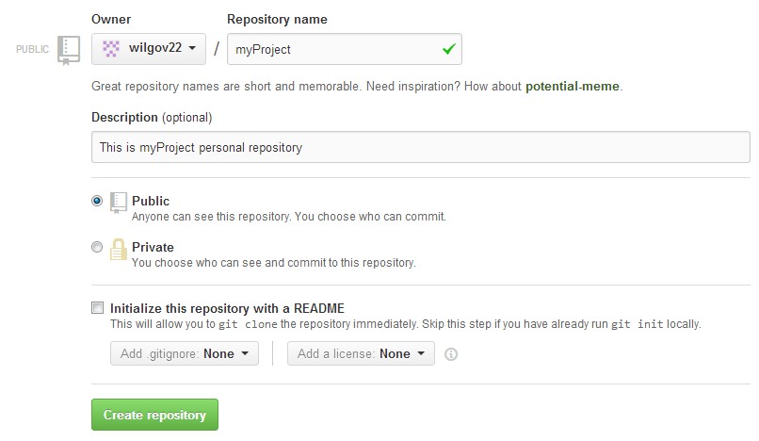


Step #5- Create remote repository
Go to your GitHub account;
Click over to create a new repository;
Give a name to the repository, fill the description field, select the visibility of your repository;
Click
Next, copy the given url of the new brand remote repository;
You will need it for the next step;

Slide 10

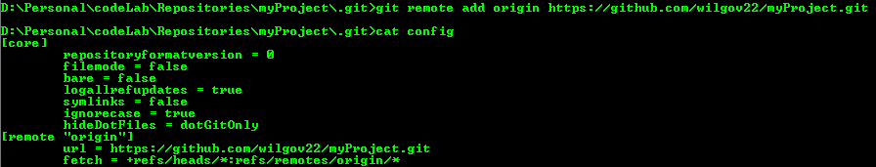
Step #6- Configure remote repository on git
Now is time to add the remote repository location on your local git repository;
Execute “git remote add <nameToRemoteRepository> <gitRepositoryURL>”;
See config file executing “cat config ”;
You will see a section named “remote” that points to the remote repository

Slide 11

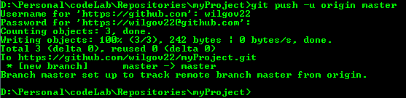
Step #7- Pushing to remote repository
We are almost there, time to push!! Push!! Push to GitHub!!
Execute “git push –u <nameToRemoteRepository> master”;
Next time only need to type “git push”;
Insert username and password as requested;
Objects will be uploaded to remote repository;

Slide 12

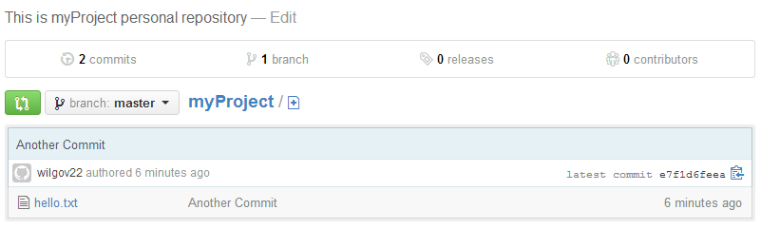
Step #8- Verify remote repository
Go to your github repository and check that the file commited on local repository is there;

Slide 13

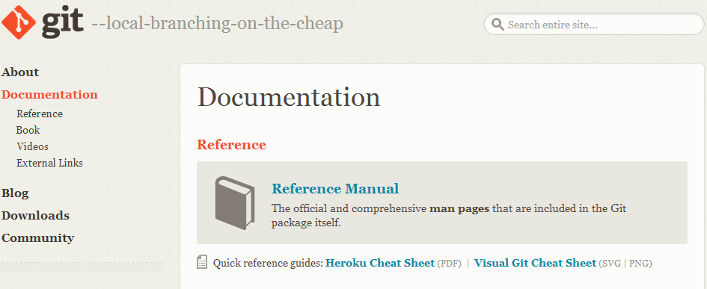
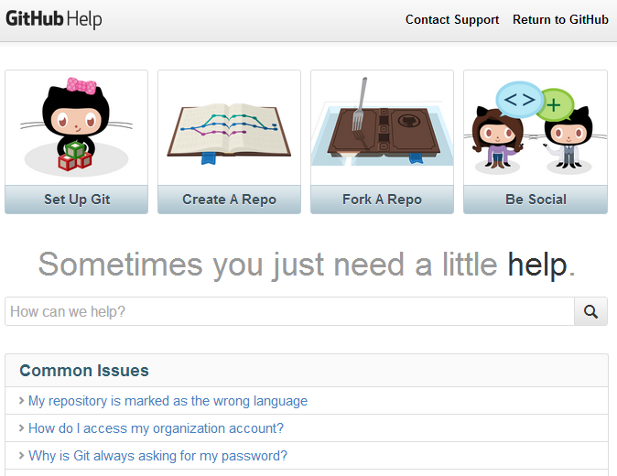
Step #9- Learn more
Now it’s time for you to learn more about git;
Online documentation;
http://git-scm.com/doc
https://help.github.com/

