Slide 1
Energy Management for Solar Power Plants
CW Gestão

Slide 2
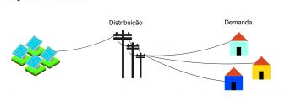


The solution
Solar power plant
Customers
Monthly consumption
reports
public power
distribution
system
Invoices
CW Gestão

