Slide 1




PB vs. Thrift vs. Avro
Author: Igor Anishchenko
Lohika - May, 2012

Slide 2
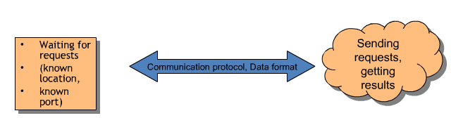
Problem Statement
Simple Distributed Architecture
serialize
deserialize
Basic questions are:
What kind of protocol to use, and what data to transmit?
Efficient mechanism for storing and exchanging data
What to do with requests on the server side?
deserialize
serialize

Slide 3
…and you want to scale your servers...
When you grow beyond a simple architecture, you want..
flexibility
ability to grow
latency
and of course - you want it to be simple

Slide 4
How components talk
Database protocols - fine.
HTTP + maybe JSON/XML on the front - cool.

Slide 5
How components talk
Database protocols - fine.
HTTP + maybe JSON/XML on the front - cool.
But most of the times you have internal APIs.

Slide 6
Hasn't this been done before? (yes)
SOAP
CORBA
DCOM, COM+
JSON, Plain Text, XML

Slide 7
Should we pick up one of those? (no)
SOAP
XML, XML and more XML. Do we really need to parse so much XML?
CORBA
Amazing idea, horrible execution
Overdesigned and heavyweight
DCOM, COM+
Embraced mainly in windows client software
HTTP/JSON/XML/Whatever
Okay, proven – hurray!
But lack protocol description.
You have to maintain both client and server code.
You still have to write your own wrapper to the protocol.
XML has high parsing overhead.
(relatively) expensive to process; large due to repeated tags

Slide 8

Decision Time?
As a developer - what are you looking for?
Be patient, I have something for you on the subsequent slides!!

Slide 9
High level goals!
Transparent interaction between multiple programming languages
A language and platform neutral way of serializing structured data for use in communications protocols, data storage etc.

Slide 10
High level goals!
Transparent interaction between multiple programming languages
A language and platform neutral way of serializing structured data for use in communications protocols, data storage etc.
Maintain Right balance between:
Efficiency (how much time/space?)
Ease and speed of development
Availability of existing libraries and etc..

Slide 11
Consideration: Protocol Space
{"deposit_money": "12345678"}
JSON | Binary
'0x6d', '0x6f', '0x6e', '0x65', '0x79', '0x31', '0x32', '0x33', '0x34', '0x35', '0x36', '0x37', '0x38' | '0x01', '0xBC614E'
Binary takes less space. No contest!

Slide 12
Consideration: Protocol Time
JSON | Binary
Push down automata (PDA) parser (LL(1), LR(1)) -- 1 character lookahead. Then, final translation from characters to native types (int, float, etc) | No parser needed. The binary representation IS [as close as to] the machine representation.
Binary is way faster. No contest

Slide 13
Consideration: Protocol Ease of Use
JSON | Binary
Brainless to learn Popular | Need to manually write code to define message packets (total pain and error prone!!!) or Use a code generator like Thrift (oh noes, I don't want to learn something new!)
Json is easier, binary is a pain.

Slide 14
Several smart people have attacked this problem over the years and as a result there several good open source alternatives to choose from
Here is where
Data Interchange Protocols comes in play…

Slide 15
Serialization Frameworks
XML, JSON,
Protocol Buffers, BERT,
BSON, Apache Thrift, Message Pack,
Etch, Hessian, ICE, Apache Avro,
Custom Protocol...

Slide 16
SF have some properties in common
Interface Description (IDL)
Performance
Versioning
Binary Format

Slide 17
Protocol Buffer
Designed ~2001 because everything else wasn’t that good those days
Production, proprietary in Google from 2001-2008, open-sourced since 2008
Battle tested, very stable, well trusted
Every time you hit a Google page, you're hitting several services and several PB code
PB is the glue to all Google services
Official support for four languages: C++, Java, Python, and JavaScript
Does have a lot of third-party support for other languages (of highly variable quality)
Current Version - protobuf-2.4.1
BSD License

Slide 18
Apache Thrift
Designed by an X-Googler in 2007
Developed internally at Facebook, used extensively there
An open Apache project, hosted in Apache's Inkubator.
Aims to be the next-generation PB (e.g. more comprehensive features, more languages)
IDL syntax is slightly cleaner than PB. If you know one, then you know the other
Supports: C++, Java, Python, PHP, Ruby, Erlang, Perl, Haskell, C#, Cocoa, JavaScript, Node.js, Smalltalk, OCaml and Delphi and other languages
Offers a stack for RPC calls
Current Version - thrift-0.8.0
Apache License 2.0

Slide 19
Avro
I have a lot to say about Avro towards the end

Slide 20
Typical Operation Model
The typical model of Thrift/Protobuf use is
Write down a bunch of struct-like message formats in an IDL-like language.
Run a tool to generate Java/C++/whatever boilerplate code.
Example: thrift --gen java MyProject.thrift
Outputs thousands of lines - but they remain fairly readable in most languages
Link against this boilerplate when you build your application.
DO NOT EDIT!

Slide 21
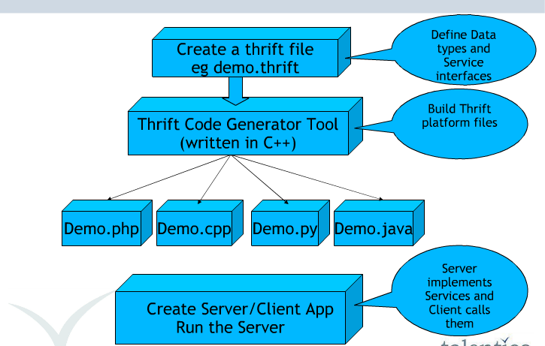
Thrift Principle of Operation

Slide 22
Interface Definition Language (IDL)
Web services interfaces are described using the Web Service Definition Language. Like SOAP, WSDL is a XML-based language.
The new frameworks use their own languages, that are not based on XML.
These new languages are very similar to the Interface Definition Language, known from CORBA.

Slide 23
Thrift | Protobuf
namespace java serializers.thrift.media typedef i32 int typedef i64 long enum Size { SMALL = 0, LARGE = 1, } enum Player { JAVA = 0, FLASH = 1, } struct Image { 1: string uri, //url to the images 2: optional string title, 3: required int width, 4: required int height, 5: required Size size, } struct Media { 1: string uri, //url to the thumbnail 2: optional string title, 3: required int width, 4: required int height, 5: required list<string> person, 6: required Player player, 7: optional string copyright, } struct MediaContent { 1: required list<Image> image, 2: required Media media, } | package serializers.protobuf.media; option java_package = "serializers.protobuf.media"; option java_outer_classname = "MediaContentHolder"; option optimize_for = SPEED; affects the C++ and Java code generators message Image { required string uri = 1; //url to the thumbnail optional string title = 2; //used in the html required int32 width = 3; // of the image required int32 height = 4; // of the image enum Size { SMALL = 0; LARGE = 1; } required Size size = 5; } message Media { required string uri = 1; optional string title = 2; required int32 width = 3; required int32 height = 4; repeated string person = 5; enum Player { JAVA = 0; FLASH = 1; } required Player player = 6; optional string copyright = 7; } message MediaContent { repeated Image image = 1; required Media media = 2; }

Slide 24
Defining IDL Rules
Every field must have a unique, positive integer identifier ("= 1", " = 2" or " 1:", " 2:" )
Fields may be marked as ’required’ or ’optional’
structs/messages may contain other structs/messages
You may specify an optional "default" value for a field
Multiple structs/messages can be defined and referred to within the same .thrift/.proto file

Slide 25
Tagging
The numbers are there for a reason!
The "= 1", " = 2" or " 1:", " 2:" markers on each element identify the unique "tag" that field uses in the binary encoding.
It is important that these tags do not change on either side
Tags with values in the range 1 through 15 take one byte to encode
Tags in the range 16 through 2047 take two bytes
Reserve the tags 1 through 15 for very frequently occurring message elements
Notes:
Assigning Tags
As you can see, each field in the message definition has a unique numbered tag. These tags are used to identify your fields in themessage binary format, and should not be changed once your message type is in use. Note that tags with values in the range 1 through 15 take one byte to encode, including the identifying number and the field's type (you can find out more about this in Protocol Buffer Encoding). Tags in the range 16 through 2047 take two bytes. So you should reserve the tags 1 through 15 for very frequently occurring message elements. Remember to leave some room for frequently occurring elements that might be added in the future.

Slide 26
Java Example (Thrift example)
// this file is BankDeposit.thrift
struct BankDepositMsg { 1: required i32 user_id; 2: required double amount = 0.00; 3: required i64 datestamp;}
...
import bank_example.BankDepositMsg;
...
BankDepositMsg my_transaction = new BankDepositMsg();
my_transaction.setUser_id(123);
my_transaction.setAmount(1000.00);
my_transaction.setDatestamp(new Timestamp(date.getTime()));
...
In Java (and other compiled languages) you have the getters and the setters, so that if the fields and types are erroneously changed the compiler will inform you of the mistake.

Slide 27
The Comparison…
 | Thrift | Protocol Buffers
Composite Type | Struct {} | Message {}
Base Types | bool byte 16/32/64-bit integers double string | bool 32/64-bit integers float double string byte sequence
Containers | list<t1>: An ordered list of elements of type t1. May contain duplicates. set<t1>: An unordered set of unique elements of type t1. map<t1,t2>: A map of strictly unique keys of type t1 to values of type t2. | No
Enumerations | Yes | Yes
Constants | Yes Example: const i32 INT_CONST = 1234; const map<string,string> MAP_CONST = {"hello": "world", "goodnight": "moon"} | No
Exception Type/Handling | Yes (exception keyword instead of the struct keyword.) | No

Slide 28
The Comparison
 | Thrift | Protocol Buffers
License | Apache | BSD-style
Compiler | C++ | C++
RPC Interfaces | Yes | Yes
RPC Implementation | Yes | No (they do have one internally)
Composite Type Extensions | No | Yes
Data Versioning | Yes | Yes

Slide 29
Performance
To keep things simple a lot is missing in the new frameworks.
For example the extensibility of XML or the splitting of metadata (header) and payload (body).
Of course the performance depends on the used operating system, programming language and the network.
Size Comparison
Runtime Performance

Slide 30
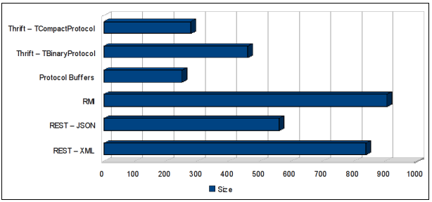
Size Comparison
Each write includes one Course object with 5 Person objects, and one Phone object.
TBinaryProtocol – not optimized for space efficiency. Faster to process than the text protocol but more difficult to debug.
TCompactProtocol – More compact binary format; typically more efficient to process as well
Method | Size (smaller is better)
Thrift — TCompactProtocol | 278 (not bad)
Thrift — TBinaryProtocol | 460
Protocol Buffers | 250 (winner!)
RMI | 905
REST — JSON | 559
REST — XML | 836

Slide 31
Runtime Performance
Test Scenario
Query the list of Course numbers.
Fetch the course for each course number.
This scenario is executed 10,000 times. The tests were run on the following systems:
Operating System | Ubuntu®
CPU | Intel® Core™ 2 T5500 @ 1.66 GHz
Memory | 2GiB
Cores | 2

Slide 32
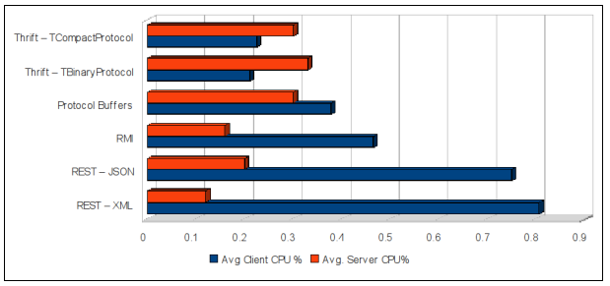
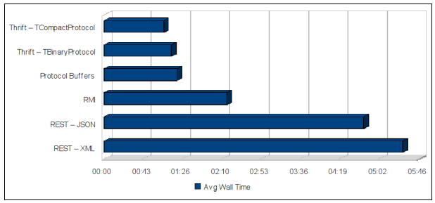
Runtime Performance

Slide 33
Runtime Performance
 | Server CPU % | Avg. Client CPU % | Avg. Time
REST — XML | 12.00% | 80.75% | 05:27.45
REST — JSON | 20.00% | 75.00% | 04:44.83
RMI | 16.00% | 46.50% | 02:14.54
Protocol Buffers | 30.00% | 37.75% | 01:19.48
Thrift — TBinaryProtocol | 33.00% | 21.00% | 01:13.65
Thrift — TCompactProtocol | 30.00% | 22.50% | 01:05.12

Slide 34
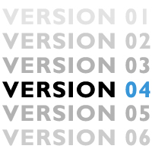
Versioning
The system must be able to support reading of old data, as well as requests from out-of-date clients to new servers, and vice versa.
Versioning in Thrift and Protobuf is implemented via field identiﬁers.
The combination of this field identiﬁers and its type speciﬁer is used to uniquely identify the field.
An a new compiling isn't necessary.
Statically typed systems like CORBA or RMI would require an update of all clients in this case.

Slide 35
Forward and Backward Compatibility Case Analysis
There are four cases in which version mismatches may occur:
Added ﬁeld, old client, new server.
Removed ﬁeld, old client, new server.
Added ﬁeld, new client, old server.
Removed ﬁeld, new client, old server.

Slide 36
Forward and Backward Compatibility: Example 1
BankDepositMsg
user_id: 123
amount: 1000.00
datestamp: 82912323
BankDepositMsg
user_id: 123
amount: 1000.00
datestamp: 82912323
Producer (client) sends a message to a consumer (server). All good.

Slide 37
Forward and Backward Compatibility: Example 2
BankDepositMsg
user_id: 123
amount: 1000.00
datestamp: 82912323
BankDepositMsg
user_id: 123
amount: 1000.00
datestamp: 82912323
branch_id: None
Producer (old client) sends an old message to a consumer (new server). The new server recognizes that the ﬁeld is not set, and implements default behavior for out-of-date requests… Still good

Slide 38
Forward and Backward Compatibility: Example 3
BankDepositMsg
user_id: 123
amount: 1000.00
datestamp: 82912323
branch_id: 1333
BankDepositMsg
user_id: 123
amount: 1000.00
datestamp: 82912323
Producer (new client) sends a new message to an consumer (old server). The old server simply ignores it and processes as normal... Still good

Slide 39
Serialization/deserialization performance are unlikely to be a decisive factor
 | Thrift | Protocol Buffers
Features | Richer feature set, but varies from language to language | Fewer features but robust implementations
Code Quality and Design | It was open sourced by Facebook in April 2007 probably to speed up development and leverage the community’s efforts. | Compare a protobuf Message definition to a thrift struct definition Compare the protobuf Java generator to the thrift Java generator
Open-ness | Apache project | Open mailing list Code base and issue tracker Google still drives development
Documentation | Severely lacking, but catching up Compare the protobuf documentation to the thrift wiki | Excellent documentation

Slide 40
Projects Using Thrift
Applications, projects, and organizations using Thrift include:
Facebook
Cassandra project
Hadoop supports access to its HDFS API through Thrift bindings
HBase leverages Thrift for a cross-language API
Hypertable leverages Thrift for a cross-language API since v0.9.1.0a
LastFM
DoAT
ThriftDB
Scribe
Evernote uses Thrift for its public API.
Junkdepot

Slide 41
Projects Using Protobuf
Google ☺
ActiveMQ uses the protobuf for Message store
Netty (protobuf-rpc)
I couldn’t find a complete list of protobuf users anywhere ☺

Slide 42
Pros & Cons
 | Thrift | Protocol Buffers
Pros | More languages supported out of the box Richer data structures than Protobuf (e.g.: Map and Set) Includes RPC implementation for services | Slightly faster than Thrift when using "optimize_for = SPEED" Serialized objects slightly smaller than Thrift due to more aggressive data compression Better documentation API a bit cleaner than Thrift
Cons | Good examples are hard to find Missing/incomplete documentation | .proto can define services, but no RPC implementation is defined (although stubs are generated for you).

Slide 43
I’d choose Protocol Buffers over Thrift, If:
You’re only using Java, C++ or Python.
Experimental support for other languages is being developed by third parties but are generally not considered ready for production use
You already have an RPC implementation
On-the-wire data size is crucial
The lack of any real documentation is scary to you

Slide 44
I’d choose Thrift over Protocol Buffers, If:
Your language requirements are anything but Java, C++ or Python.
You need additional data structures like Map and Set
You want a full client/server RPC implementation built-in
You’re a good programmer that doesn’t need documentation or examples ☺

Slide 45
Wait, what about Avro?
Avro is another very recent serialization system.
Avro relies on a schema-based system
When Avro data is read, the schema used when writing it is always present.
Avro data is always serialized with its schema. When Avro data is stored in a file, its schema is stored with it, so that files may be processed later by any program.
The schemas are equivalent to protocol buffers proto files, but they do not have to be generated.
The JSON format is used to declare the data structures.
Official support for four languages: Java, C, C++, C#, Python, Ruby
An RPC framework.
Apache License 2.0

Slide 46
Avro IDL syntax is butt ugly and error prone
// Avro IDL: { "type": "record", "name": "BankDepositMsg", "fields" : [ {"name": "user_id", "type": "int"}, {"name": "amount", "type": "double", "default": "0.00"}, {"name": "datestamp", "type": "long"} ] }
// Same Thrift IDL: struct BankDepositMsg { 1: required i32 user_id; 2: required double amount = 0.00; 3: required i64 datestamp; }

Slide 47
Comparison
 | Avro | Thrift and Protocol Buffer
Dynamic schema | Yes | No
Built into Hadoop | Yes | No
Schema in JSON | Yes | No
No need to compile | Yes | No
No need to declare IDs | Yes | No
Bleeding edge | Yes | No
Sexy name ☺ | Yes | No

Slide 48
Specification
Schema represented in one of:
JSON string, naming a defined type.
JSON object of the form:
{"type": "typeName" ...attributes...}
JSON array
Primitive types: null, boolean, int, long, float, double, bytes, string
{"type": "string"}
Complex types: records, enums, arrays, maps, unions, fixed

Slide 49
Comparison with other systems
Avro provides functionality similar to systems such as Thrift, Protocol Buffers, etc.
Dynamic typing: Avro does not require that code be generated. Data is always accompanied by a schema that permits full processing of that data without code generation, static datatypes, etc.
Untagged data: Since the schema is present when data is read, considerably less type information need be encoded with data, resulting in smaller serialization size.
No manually-assigned field IDs: When a schema changes, both the old and new schema are always present when processing data, so differences may be resolved symbolically, using field names.

Slide 50
Avro Hands On Review
Q3 2012, I tested the latest Avro (1.6.3)
It throws you a message incompatible message when you change the field name
Serious bug, crashes w/ different versions of message (no fw/back compatibility). Emailed avro-dev@...
Documentation is nearly non-existent and no real users. Bleeding edge, little support

Slide 51
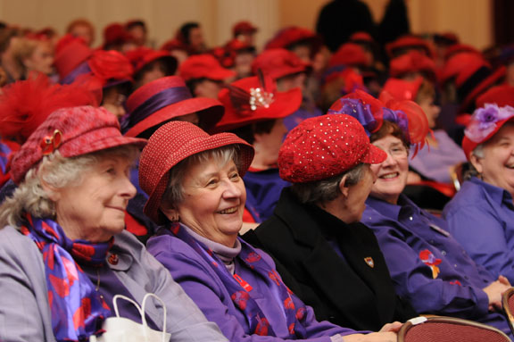
Q&A

