Slide 1

Data
3
CS/COE 0449 Introduction to Systems Software
Representation
II
wilkie
(with content borrowed from Vinicius Petrucci and Jarrett Billingsley)
Spring 2019/2020

Slide 2
Bit Manipulation
Flippin’ Switches

Slide 3

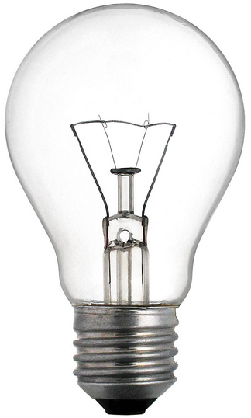
What are "bitwise" operations?
The "numbers" we use on computers aren't really numbers right?
It's often useful to treat them instead as a pattern of bits.
Bitwise operations treat a value as a pattern of bits.
0
1
0
0
0

Slide 4
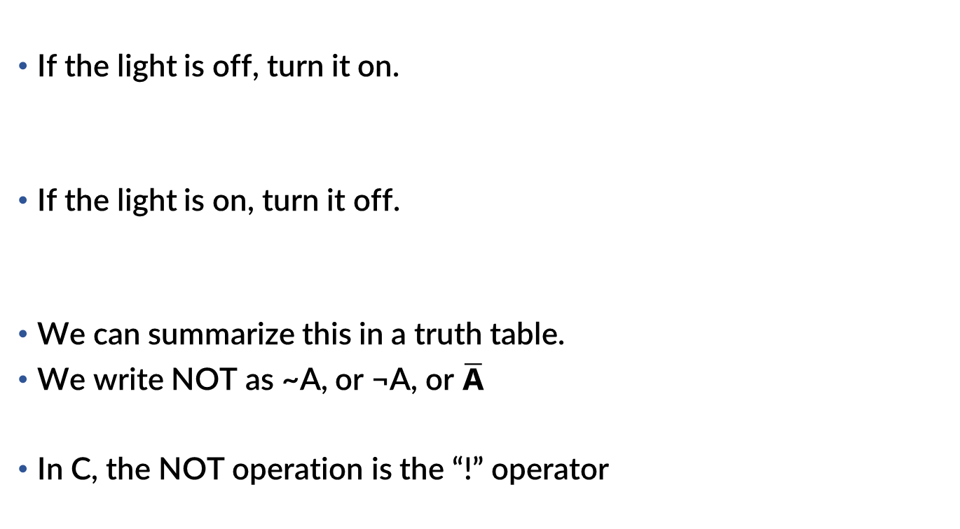
The simplest operation: NOT (logical negation)
If the light is off, turn it on.
If the light is on, turn it off.
We can summarize this in a truth table.
We write NOT as ~A, or ¬A, or $\overline{\text{A}}$
In C, the NOT operation is the “!” operator
A | Q
0 | 1
1 | 0

Slide 5
Applying NOT to a whole bunch of bits
If we use the not instruction (~ in C), this is what happens:
~ | 0 | 0 | 1 | 1 | 1 | 0 | 1 | 0
= | 1 | 1 | 0 | 0 | 0 | 1 | 0 | 1
we did 8 independent NOT operations
That's it.
only 8 bits shown cause 32 bits on a slide is too much

Slide 6
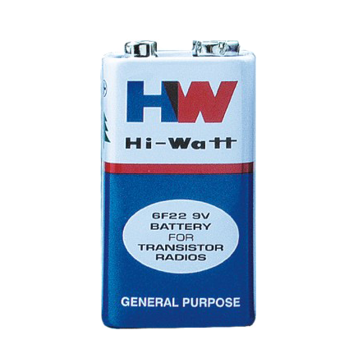

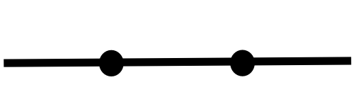
Let's add some switches
There are two switches in a row connecting the light to the battery.
How do we make it light up?

Slide 7
AND (Logical product)
AND is a binary (two-operand) operation.
It can be written a number of ways:
A&B A∧B A⋅B AB
If we use the and instruction (& in C):
A | B | Q
0 | 0 | 0
0 | 1 | 0
1 | 0 | 0
1 | 1 | 1
 | 1 | 1 | 1 | 1 | 0 | 0 | 0 | 0
& | 0 | 0 | 1 | 1 | 1 | 0 | 1 | 0
= | 0 | 0 | 1 | 1 | 0 | 0 | 0 | 0
we did 8 independent AND operations

Slide 8
"Switching" things up ;))))))))))))))))))))))
NOW how can we make it light up?

Slide 9
OR (“Logical” sum…?)
We might say "and/or" in English.
It can be written a number of ways:
A|B A∨B A+B
If we use the or instruction ( | in C):
A | B | Q
0 | 0 | 0
0 | 1 | 1
1 | 0 | 1
1 | 1 | 1
 | 1 | 1 | 1 | 1 | 0 | 0 | 0 | 0
| | 0 | 0 | 1 | 1 | 1 | 0 | 1 | 0
= | 1 | 1 | 1 | 1 | 1 | 0 | 1 | 0
We did 8 independent OR operations.

Slide 10
Bit shifting
Besides AND, OR, and NOT, we can move bits around, too.
1 1 0 0 1 1 1 1
if we shift these bits left by 1…
1 1 0 0 1 1 1 1 0
we stick a 0 at the bottom
1 1 0 0 1 1 1 1 0 0
again!
1 1 0 0 1 1 1 1 0 0 0
AGAIN!
1 1 0 0 1 1 1 1 0 0 0 0
AGAIN!!!!

Slide 11
Left-shifting in C/Java (animated)
C (and Java) use the << operator for left shift
B = A << 4; // B = A shifted left 4 bits
If the bottom 4 bits of the result are now 0s…
…what happened to the top 4 bits?
0000
0011
0000 0000 1111 1100 1101 1100 1111
the bit bucket is not a real place
Bit Bucket
it's a programmer joke ok
in the UK they might say the “Bit Bin”
bc that’s their word for trash

Slide 12
>_> >_> >_> ☺
We can shift right, too
0 0 1 1 0 0 0 0 0 0 0 0 1 1 1 1 1 1 0 0 1 1 0 1 1 1 0 0 1 1 1 1
0 0 0 1 1 0 0 0 0 0 0 0 0 1 1 1 1 1 1 0 0 1 1 0 1 1 1 0 0 1 1 1
0 0 0 0 1 1 0 0 0 0 0 0 0 0 1 1 1 1 1 1 0 0 1 1 0 1 1 1 0 0 1 1
0 0 0 0 0 1 1 0 0 0 0 0 0 0 0 1 1 1 1 1 1 0 0 1 1 0 1 1 1 0 0 1
0 0 0 0 0 0 1 1 0 0 0 0 0 0 0 0 1 1 1 1 1 1 0 0 1 1 0 1 1 1 0 0
C/Java use >>, this in MIPS is the srl (Shift Right Logical) instruction
see what I mean about 32 bits on a slide
Q: What happens when we shift a negative number to the right?

Slide 13
Shift Right (Logical)
We can shift right, too (srl in MIPS)
1 1 0 0 1 1 1 1
if we shift these bits right by 1…
0 1 1 0 0 1 1 1 1
we stick a 0 at the top
0 0 1 1 0 0 1 1 1
again!
0 0 0 1 1 0 0 1 1
AGAIN!
Wait… what if this was a negative number?
0 0 0 0 1 1 0 0 1

Slide 14
Shift Right (Arithmetic)
We can shift right with sign-extension, too (MIPS: sra)
1 1 0 0 1 1 1 1
if we shift these bits right by 1…
1 1 1 0 0 1 1 1 1
we copy the 1 at the top (or 0, if MSB was a 0)
1 1 1 1 0 0 1 1 1
again!
1 1 1 1 1 0 0 1 1
AGAIN!
AGAIN!!!!!! (It’s still negative!)
1 1 1 1 1 1 0 0 1
Is there a sla instruction?

Slide 15
Huh… that's weird
Let's start with a value like 5 and shift left and see what happens:
Binary | Decimal
101 | 5
Why is this happening
Well uh... what if I gave you 49018853
1010
10
10100
20
How do you multiply that by 10?
101000
40
by 100?
by 100000?
1010000
80
Something very similar is happening here

Slide 16
a << n == a * 2^{n}
Shifting left by n is the same as multiplying by 2^{n}
You probably learned this as "moving the decimal point"
And moving the decimal point right is like shifting the digits left
Shifting is fast and easy on most CPUs.
Way faster than multiplication in any case.
(It’s not a great reason to do it when you’re using C though)
Hey… if shifting left is the same as multiplying…

Slide 17
a >> n == a / 2^{n}, ish
You got it
Shifting right by n is like dividing by 2^{n}
sort of.
What's 101₂ shifted right by 1?
10₂, which is 2…
It's like doing integer (or flooring) division
Generally, compilers are smart enough that you just multiply/divide
It’s confusing to shift just to optimize performance.
It’s good to not be clever until it is proven that you need to be.

Slide 18
C Bitwise Operations: Summary
C code Description MIPS instruction
x | y or or x, x, y
x & y and and x, x, y
x ^ y xor xor x, x, y
!x not seq x, x, $0 (“seqz”)
~x complement (negate) nor x, x, $0 (“not”)
x << y left-shift logical sll x, x, y
x >> y right-shift logical srl x, x, y
When x is signed (most of the time…):
x >> y right-shift arithmetic sra x, x, y

Slide 19
Fractional Encoding
Every Time I Teach Floats I Want Some Root Beer

Slide 20
Fixing the point
If we want to represent decimal places, one way of doing so is by assuming that the lowest n digits are the decimal places.
$12.34
1234
+$10.81
+1081
this is called fixed-point representation
$23.15
2315

Slide 21
A rising tide
A 16.16 fixed-point number looks like this:
0011 0000 0101 1010.1000 0000 1111 1111
binary point
the largest (signed) value we can represent is +32767.999
the smallest fraction we can represent is 1/65536
But if we let the binary point float around…
0011.0000 0101 1010 1000 0000 1111 1111
…we can get much higher accuracy near 0…
0011 0000 0101 1010 1000 0000.1111 1111
…and trade off accuracy for range further away from 0.
Notes:
- the places after the binary point are 1/2s, 1/4ths, 1/8ths, etc.
- with fixed point, the "split" between whole number and fraction is stuck in place
- with floating point, that split is flexible
- usually we need either accurate numbers near 0 or a large, but inaccurate number

Slide 22
IEEE 754
Established in 1985, updated as recently as 2008.
Standard for floating-point representation and arithmetic that virtually every CPU now uses.
Floating-point representation is based around scientific notation:
1348 =
-0.0039 =
-1440000 =
+1.348 × 10⁺³
-3.9 × 10⁻³
-1.44 × 10⁺⁶
sign
significand
exponent

Slide 23
Binary Scientific Notation
scientific notation works equally well in any other base!
(below uses base-10 exponents for clarity)
+1001 0101 =
-0.001 010 =
-1001 0000 0000 0000 =
+1.001 0101 × 2⁺⁷
-1.010 × 2⁻³
-1.001 × 2⁺¹⁵
what do you notice about the digit before the binary point?
(+/-)1.f × 2^{exp}
f – fraction
1.f – significand
exp – exponent
Notes:
- the digit before the binary point is ALWAYS 1!
- …except for 0.

Slide 24
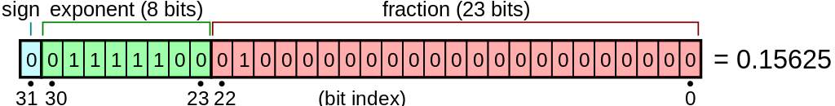
IEEE 754 Single-precision
Known as float in C/C++/Java etc., 32-bit float format
1 bit for sign, 8 bits for the exponent, 23 bits for the fraction
Tradeoff:
More accuracy ➔ More fraction bits
More range ➔ More exponent bits
Every design has tradeoffs ¯\_(ツ)_/¯
Welcome to Systems!
illustration from user Stannered on Wikimedia Commons
Notes:
- two zeroes, and harder math.

Slide 25
IEEE 754 Single-precision
Known as float in C/C++/Java etc., 32-bit float format
1 bit for sign, 8 bits for the exponent, 23 bits for the fraction
The fraction field only stores the digits after the binary point
The 1 before the binary point is implicit!
This is called normalized representation
In effect this gives us a 24-bit significand
The only number with a 0 before the binary point is 0!
The significand of floating-point numbers is in sign-magnitude!
Do you remember the downside(s)?
illustration from user Stannered on Wikimedia Commons
Notes:
- two zeroes, and harder math.

Slide 26
The exponent field
The exponent field is 8 bits, and can hold positive or negative exponents, but... it doesn't use S-M, 1's, or 2's complement.
It uses something called biased notation.
biased representation = signed number + bias constant
single-precision floats use a bias constant of 127
-127 =>
-10 =>
34 =>
0
117
161
Signed
Biased
The exponent can range from -126 to +127 (1 to 254 biased)
0 and 255 are reserved!
Why'd they do this?
so you can sort floats with integer comparisons??
Notes:
Why 127?

Slide 27
Binary Scientific Notation (revisited)
Our previous numbers are actually
+1.001 0101 × 2⁺⁷ =
-1.010 × 2⁻³ =
-1.001 × 2⁺¹⁵=
(-1)⁰ x 1.001 0101 × 2¹³⁴⁻¹²⁷
(-1)¹ x 1.010 × 2¹²⁴⁻¹²⁷
(-1)¹ x 1.001 × 2¹⁴²⁻¹²⁷
(-1)^{s} x1.f × 2^{exp-127}
s – sign
f – fraction
exp – biased exponent
Notes:
- the digit before the binary point is ALWAYS 1!
- …except for 0.

Slide 28
Encoding an integer as a float
You have an integer, like 2471 = 0000 1001 1010 0111₂
put it in scientific notation
1.001 1010 0111₂ × 2⁺¹¹
get the exponent field by adding the bias constant
11 + 127 = 138 = 10001010₂
copy the bits after the binary point into the fraction field
s | exponent | fraction
0 | 10001010 | 00110100111000000…000
positive
start at the left side!
Notes:
- decoding is the opposite: put 1. before the fraction, and subtract 127 from the exponent field to get the signed exponent

Slide 29
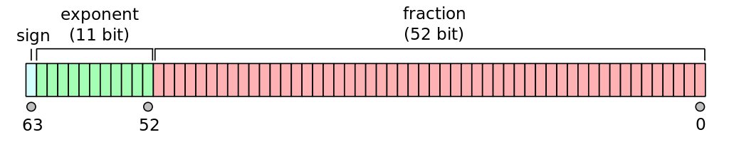
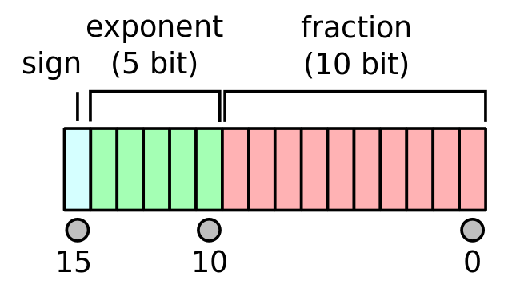
Other formats
The most common other format is double-precision (C/C++/Java double), which uses an 11-bit exponent and 52-bit fraction
GPUs have driven the creation of a half-precision 16-bit floating-point format. it's adorable
How much is the bias?
How much is the bias?
both illustrations from user Codekaizen on Wikimedia Commons
Notes:
Double bias is 1023
Half bias is 15

Slide 30
This could be a whole unit itself...
Floating-point arithmetic is COMPLEX STUFF.
But it's not super useful to know unless you're either:
Doing lots of high-precision numerical programming, or
Implementing floating-point arithmetic yourself.
However...
It's good to have an understanding of why limitations exist.
It's good to have an appreciation of how complex this is... and how much better things are now than they were in the 1970s and 1980s!
It’s good to know things do not behave as expected when using float and double!!

