Slide 1
Making Decisions
Lecture 4

Slide 2
Motivation
We know how to do some simple things with data, numbers, etc.
We can only do so much!
  We go from the top of our code to the bottom with no exceptions.
  This isn't good enough...
For one, we can't react to user input.
  We can't write dynamic websites, programs to do our homework for us, or video games!

Slide 3
Overview
See how to build a simple Java program
Take a look at an algorithm
  What types of behaviors are required?
  How can we translate a visual representation to code?
Learn about the “if” statement
  How it is used?
  How are more complicated decisions made?
Discuss logical operators

Slide 4
First Program
Let's review using some variables to write a simple program.
We have to start with some boilerplate code:
public class MyFirstProgram {
  public static void main(String[] args) {
    // This is a comment!
    // Our code goes here!
  }
}

Slide 5
A Finished Program
public class MyFirstProgram {
  public static void main(String[] args) {
    int number;
    number = 42;
    int remainder;
    remainder = number % 2;
    boolean truth = remainder == 0;
    // This will print out to the screen:
    System.out.println(truth);
  }
}

Slide 6
To Execute
Save program as: MyFirstProgram.java
First, we need to compile the program
  Translates our code into machine language
  Produces a MyFirstProgram.class file
  Type: javac MyFirstProgram.java
Now, we can run!
  Type: java MyFirstProgram

Slide 7
Algorithms
An algorithm is a procedure to solve a problem.
A program is an solution for a machine based upon an algorithm.
Example:
  Problem: Sorting midterms by name
  Algorithm: Finding the first... finding the second...
  Program: Write the code!

Slide 8
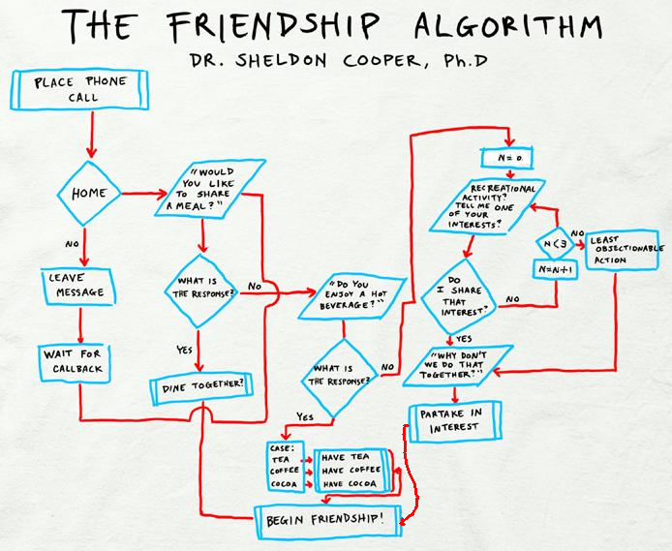

Slide 9
Breaking it Down
This algorithm, used by geeks to acquire friends, is comprehensive!
  It contains all elements of computability
  If we learn how to code each of these, we can code anything!
These elements include procedures, decisions, and repetition.

Slide 10
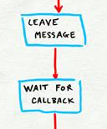
Procedures
We looked at this situation in the last lecture
  Step-by-step instructions
int remainder;
remainder = number % 2;
boolean truth = remainder == 0;
// This will print out to the screen:
System.out.println(truth);

Slide 11
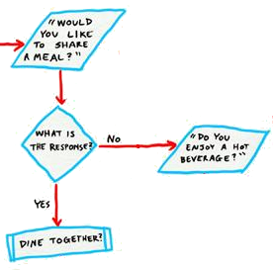
Decisions
Now, we want to ask questions and react to the answer
Notice that these are “Yes”
or “No” questions
  (A common trend, eh?)
We will focus on these today!

Slide 12
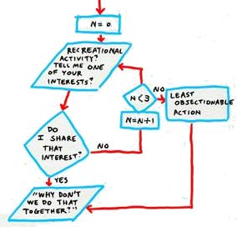
Repetition
Repeating sections of code is also important
We can repeat while a
question responds “Yes”
We will look at this in a
later class.

Slide 13
If Statement
int number = 3;
if (some boolean expression) {
// Code when 'true'
number = number + 5;
}
// The rest of the program...
number = number + 3;

Slide 14
If Statement
int number = 3;
int remainder = number % 2;
if (remainder == 0) {
// Code when number is even
number = number + 1;
}
// The rest of the program...
// What do we know about the value in “number” ?
Try to draw the diagram with this small program

