Slide 1
The Machine
Lecture 1

Slide 2
What are we learning?
Programming is the act of transforming a procedure to that which is understood by a computer.
We first need to understand what a computer is and what motivation led to its creation.
First, we will study the history and physical nature of the computer.

Slide 3
Wisdom to Lead Us
“ You have to know the past to understand the present. ”
      – Dr. Carl Sagan

Slide 4
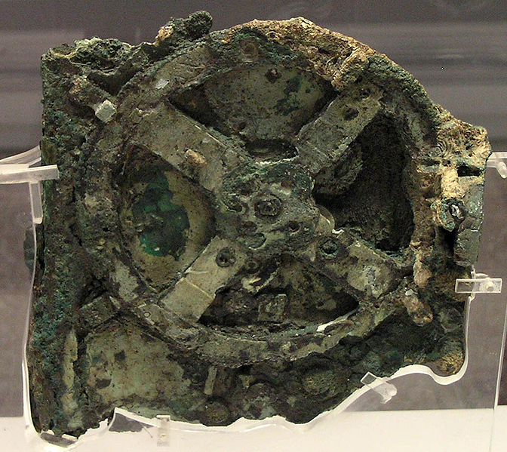
Ancient Computers

Slide 5
Antikythera Mechanism
The Antikythera mechanism
is historically one of the first
examples of computation.
  (100BC, Discovered 1902AD)
It would be thousands of years
before its sophistication would be matched.
It calculated positions of astronomical objects given a date.

Slide 6
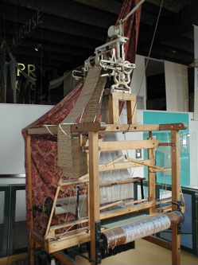
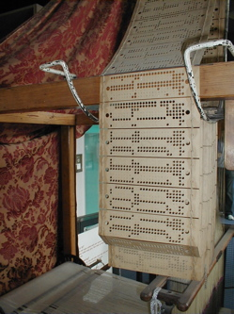
Jacquard Loom
It is a mechanical loom (1801)
invented by Joseph Jacquard.
Produced textiles with complex
patterns with ease.
“Programmed” with
the usage of small
punch cards.

Slide 7
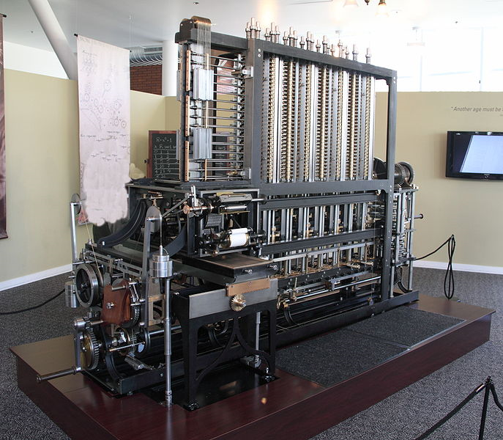
Difference Engine

Slide 8
The Difference Engine
Computation of large formulas was necessary for many fields of science and engineering.
Calculators existed, but were non-programmable. (They did one thing)
The Difference engine was designed to provide this functionality.
  Multi-purpose calculator!
Initially conceived by the Hessian army (1786) and then designed by Charles Babbage (1849) and built by the London Science Museum (1989-1991)

Slide 9
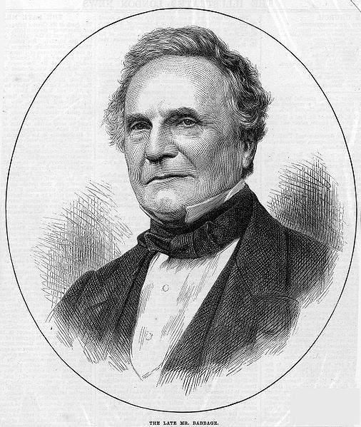
Charles Babbage,
Father of the Computer
Charles Babbage (1791-1871)
Mathematician and Mechanical Engineer
Tried very hard to implement
the difference engine, but never
procured the finances.
Surely, his next machine was
easier and cheaper to
implement???

Slide 10
The Analytical Engine
PHOTO DOES NOT EXIST
MACHINE NEVER BUILT
… oh

Slide 11
The Analytical Engine
Charles Babbage went on to design a more general purpose machine.
It did not simply calculate values, but performed computations (calculations based upon logic).
This machine, designed in 1837, as described, was the first mechanical computer.
  It is just as powerful as modern machines!
  It was so complicated, it has never been built.

Slide 12
Describing the Analytical Engine
The Analytical engine was meant to be more general purpose.
Proving that an arbitrary computation was possible on the machine was necessary to provide motivation.
Babbage left this to mathematicians.
  To date, these notes were the major contributions as the machine was never built!
  Their notes became the basis of programming.

Slide 13
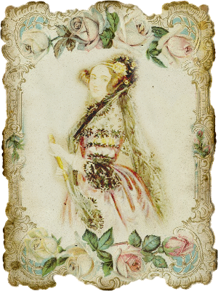
Describing the Analytical Engine
One such mathematician
was Ada Lovelace.

Slide 14
Ada Lovelace,
Enchantress of Numbers
Augusta Ada King
(née Byron), Countess of
Lovelace (1815-1852)
Considered the first
computer programmer.
Ada Lovelace Day is
celebrated March 24th of
every year.

Slide 15
The First Programmer
She was tasked with translating a French paper describing the machine to English. (1843)
She added an extensive collection of notes of her own.
She devised a mathematical language to show the flexibility of the difference engine.
With this language, she described how to compute various mathematical series.
She inadvertently created the first programming language!

Slide 16
Ada's Vision
Ada saw the usage of computers beyond that of engineers – even Babbage himself.
“ Supposing, for instance, that the fundamental relations of pitched sounds in the science of harmony and of musical composition were susceptible of such expression and adaptations, the engine might compose elaborate and scientific pieces of music of any degree of complexity or extent.
            ” – Ada Lovelace

Slide 17
Timeline
1837 – Analytical Machine
1991 – Difference Engine Built
What happened for those 100 years?
1937 – Alan Turing presents the Turing Machine
1843 – Ada Lovelace Describes the Machine
100 BC - Antikythera Mechanism

Slide 18
Founding Computer Science
It wasn't until the Church-Turing thesis (1937-1939) that computers were formally defined.
With this model, the merits and limits of computation could be explored. (what can be programmed and what can not)
This exploration and its eventual application is called computer science.

Slide 19
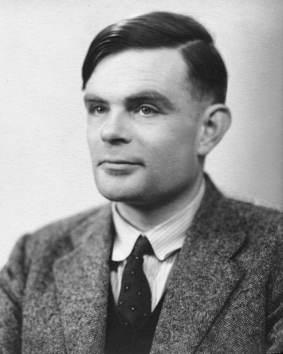
Alan Turing,
Father of Computer Science
Alan Turing (1912-1954)
Mathematician and
cryptanalyst.
Devised the scheme that
broke the Enigma code in
World War II. (Bombe)
Published a thesis that
provided a model of a
computational machine, the Turing Machine, asserting the previous work of Kurt Gödel.

Slide 20
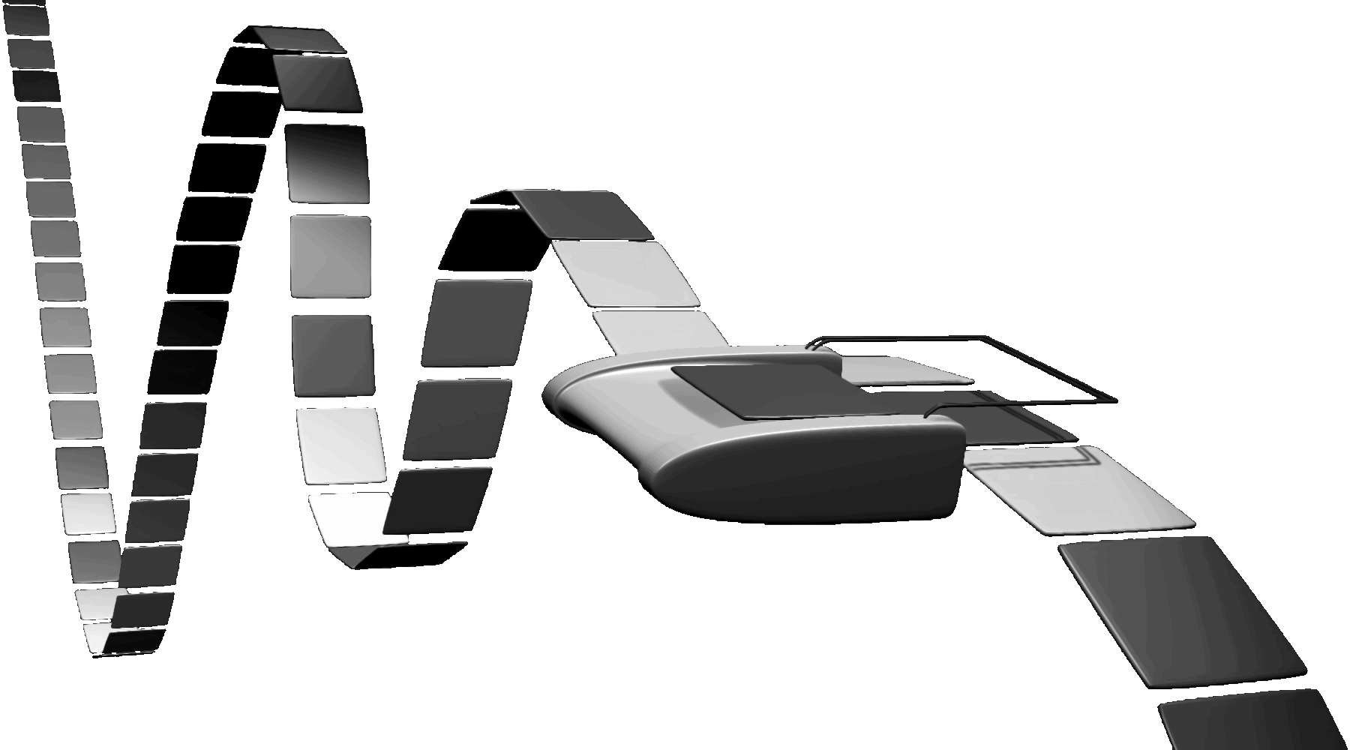
The Turing Machine
Has infinite memory represented by a single tape.
    A head moves along the tape and can read and write values.
          The movement (left or right) is based upon the value read.

Slide 21
The Turing Machine
A general, formal description of a computer.
Theoretical (and simple) but all physical machines live up to this formal description.
Programming languages model the theoretical machine not the physical machine.
  They assume infinite memory!
  They assume infinite time!
  The programmer, not the language, imposes and takes into account any extra limitations.

Slide 22
Turing's Vision
Machines can be used to model a system, and uncomputability can be used to ascertain scientific feasibility.
  If a problem cannot be computed via a Turing Machine, then no solution by any machine can solve it.
  If something cannot be done via a Turing Machine, no physical machine can do it either.
    This may apply to the human brain as well.
  An open question is whether or not a machine is as capable as a human being.
    Proof is a program that passes the Turing Test

Slide 23
Future Discussion
We will discuss Turing's vision in more detail later.
  What cannot be computed by a Turing machine? (which implies not computable by any supercomputer ever!)
  What open questions about computability exist?
  How do the answers affect us? Philosophically? Scientifically?

Slide 24
What is a computer?
In our context, a computer is a Turing Machine.
Input is the initial setting of the tape.
The output is the eventual setting of the tape.

Slide 25
What is a computer?
We can think of it as a black box.
Input
Some computation
Output

Slide 26
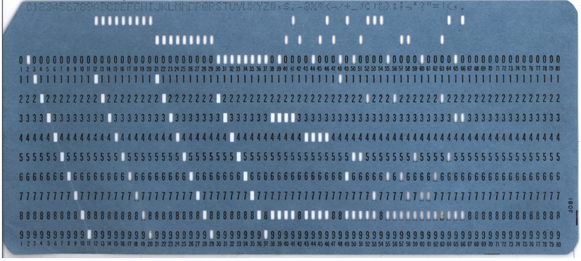
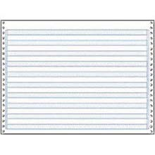
What is a computer?
“Modern” machines modeled this behavior.
Some computation
3.1415

Slide 27
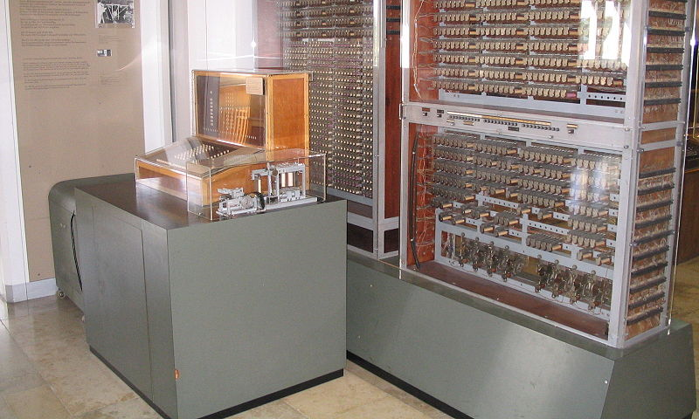
Z3 – First Turing Complete Computer (1941)

Slide 28

ENIAC – First General Purpose Computer (1946)

Slide 29
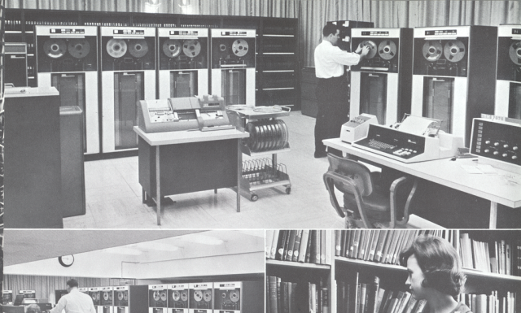
University of Pittsburgh's Computation and Data Processing Center (1965)

Slide 30
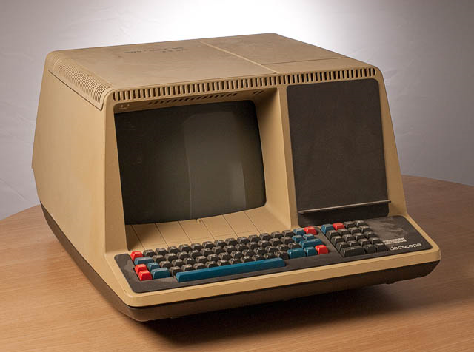
DEC VT52 – Terminal (1975)

Slide 31
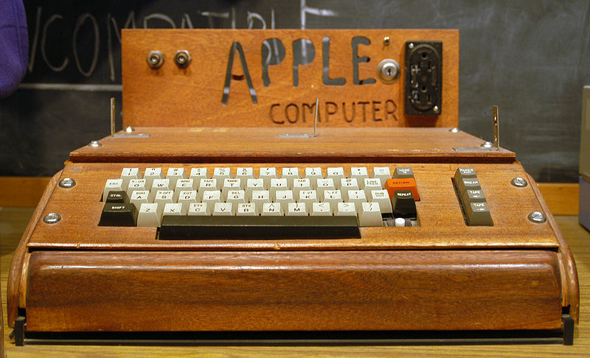
The Apple I – One of the first personal computers (1976)

Slide 32
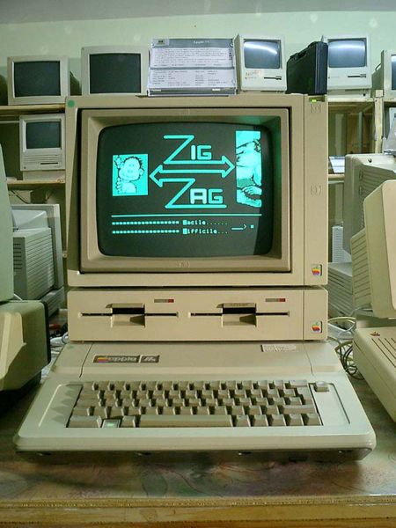
The Apple II – First widely used personal computer (1977)

Slide 33
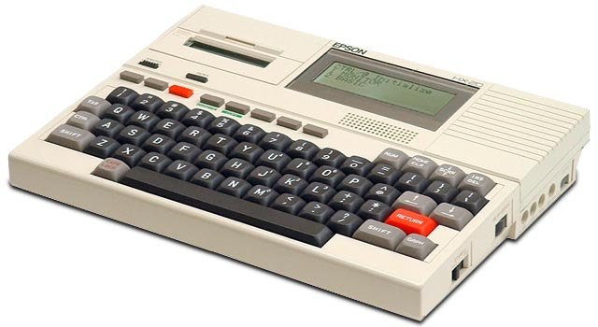
Epson HX-20 – First laptop (1981)

Slide 34
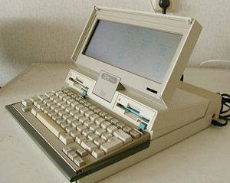
IBM Convertible – First “IBM Compatible” laptop (1986)

Slide 35
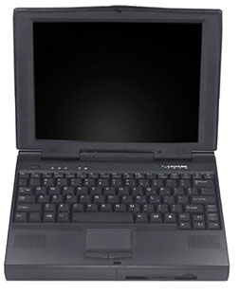
Gateway Solo – First laptop with a Pentium and CD Rom (1996)

Slide 36
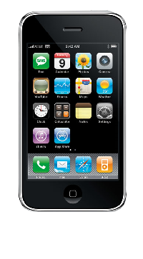
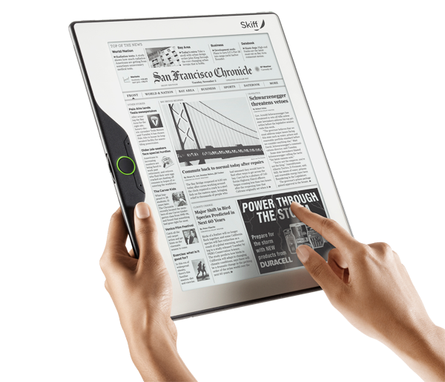
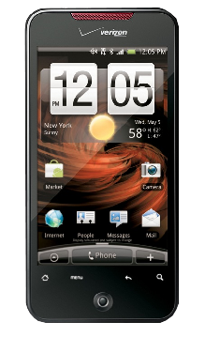
2010

