Slide 1
Types of Data
Lecture 3

Slide 2
Looking at Code
Finally!
  Hey, that background is really important!
  Lots of Computer Scientists don't know that stuff
  We will see how it all relates
    Starting today!

Slide 3
Outline
Data types
  How data is manipulated
  Variables and constants
  What ranges of values are possible?
  What expressions are possible?

Slide 4
Types
Data is represented by a value and a type.
The type is the category of value
  It represents what range of values are possible
There are primitive types and complex types
  Primitive types are simple values
  Complex types are made up of primitive types

Slide 5
The Primitive Types
These types accept basic values we are all used to using
  Integer numbers
  Real numbers
  Letters
  Words
  Truth

Slide 6

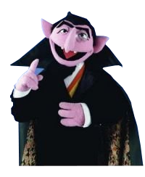
Integers
An integer is a whole number.
  Ex: 1, -5, 42, 3 * 5, 2 + 2, 2 / (4 * 2) + 5
Mathematically, these values represent the set of numbers called ℤ
ℤ is infinite, so we usually restrict the type to a range of numbers.
These are primarily used for counting
“ … 7 bits! 8 bits! 8 bits in a byte! Bwahahahahaha! ”
      – Count von Count

Slide 7
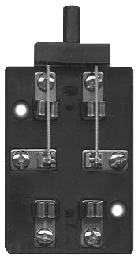
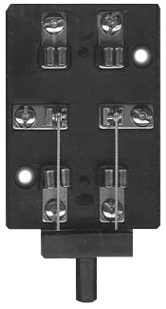
Java's Integers
In Java, there are several Integer types:
  byte, short, int, and long
Each have a different range of values
  Remember: we can only store finite values!

Slide 8
Java's Integer Numbers
byte – 8 bits
  -2⁷ to 2⁷-1 (-128 to 127)
short – 16 bits
  -2¹⁵ to 2¹⁵-1 (−32,768 to 32,767)
int – 32 bits
  -2³¹ to 2³¹-1 (−2,147,483,648 to 2,147,483,647)
long – 64 bits
  -2⁶³ to 2⁶³-1 (−9,223,372,036,854,775,808 to 9,223,372,036,854,775,807)

Slide 9

Real Numbers
Real numbers are those that may have a fractional component.
  Ex: 3.1415, -1.5, 3, 1.5 + 1.5, 1.3 * 2
Mathematically, these values represent the set of numbers called ℝ
These are used for a wide variety of things
  Currency, measurement, percentages, etc

Slide 10
Java's Real Numbers
Much like integers, Java has a couple of real types
  They also differ in the ranges of values
We have to encode these in binary
  There are several ways to do this
Java makes use of floating point representation
  IEEE 754 to be exact
  It is actually über complicated
    It makes my head hurt

Slide 11
Java's Real Numbers
float – 32 bits
  Stores 2³² values (1.401e-45 to 3.402e38)
double – 64 bits
  Stores 2⁶⁴ values (4.941e-324 to 1.798e308)
That range is far more than 2⁶⁴
  In fact, it is infinite
  What gives?

Slide 12
Floating Point Approximation
Floating point values are approximations
  Like all infinite things on a computer
That means, some values cannot be stored
  For instance, 3.42 might not fit!
  It may be stored as 3.420000000000001
You will see this behavior in your programs

Slide 13
Expressions
An expression is a group of symbols that makes a mathematical statement
Interestingly, these expressions have a value and they have a type
Examples:
  2 + 2
  1.5 * 2
  4.0 – 2
  7 / 2

Slide 14
Java's Expressions
In Java, expressions look very much like familiar mathematical symbols
      + Addition
      - Subtraction
      * Multiplication
      / Division
      % Modulo (remainder)

Slide 15
Java's Expressions
Java uses the tried and true My Dear Aunt Sally precedence
  Parentheses will be done first
  2 + 4 * 3 14
  (2 + 4) * 3 18
  3 * 2 + 4 10
  3 * (2 + 4) 18

Slide 16
Constants and Variables
Constants are values that cannot change during the execution of the program
Variables are values that may change during the execution of the program
  These are given a name
  When you refer to a variable, you use the value it represents
(2 + a) * 3 ((3 * b) + c) / d

Slide 17
Java's Variables
To use a variable, you have to declare it first
  You must describe the type and give it a name
  The type and name do not change
For instance, I need a variable to count the number of apples I have
  int apples;
I need to measure the area of my living room
  double area;

Slide 18
Assignment in Java
Once you have a variable declared, you can update its value at any time
You do so with the assignment operator =
  int apples;
  apples = 42;
  apples = 3 * apples;
  apples = apples;

Slide 19
Assignment in Java
Remember variables have a type
  A type tells us what values can be assigned
Some assignments are invalid:
  int apples;
  apples = 3.4;
  apples = 3.4 * apples;
  apples = 1.5 + 1.5;

Slide 20
Other Data Types: char
We can store letters (characters) in a variable
  char mander;
  mander = 'a';
  mander = 'a' + 1;
  mander = mander + 1;

Slide 21
Other Data Types: boolean
We can also represent truth values
  These are values that reflect a value of true or false (much like a bit)
  boolean truthiness;
  truthiness = 3 > 4;
  truthiness = 3 <= 4;
  truthiness = apples == 42;

Slide 22

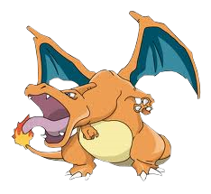
Asking Questions
Booleans are useful for making decisions
  We might react differently depending on whether or not a statement is true
  Like how to pronounce 'char' in conversation
<
  char bear;
  char izard;

Slide 23
Asking Questions
Some other questions people or code might ask:
  Is a number even?
  Am I done reading this file?
  Is this password I received the correct one?
  Has picobot cleared the maze?
  Do students really get Monty Python references?
  How devastating is the answer to the previous question?
  Note: These are all either yes or no

Slide 24
Logical Operators
Logical Operators are mathematical operators that compute truth values from a comparison
  They are given two inputs
  They result in a value of true or false
There are several comparison operators:
    > < >= <= == !=

Slide 25
Boolean Expressions
The result of a comparison has a boolean type
  Just like 2 + 2 yields an int and 3.2 * 2 a double
  boolean truthiness;
  int apples;
  apples = 42;
  truthiness = apples == 42;
  apples = 41;
  truthiness = apples == 42;

Slide 26
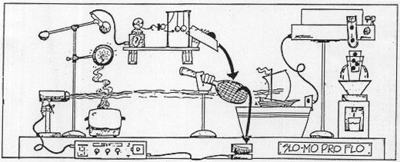
Complex Types
Complex types are those that are composed of primitive types
We noted that we can represent complicated things with a simple mechanism
  This is how we express this with programming

Slide 27
Other Data Types: String
A String is a complex data type that represents a string of letters
  It can represent words, street addresses, etc
It is composed of many char variables, but you don't have to worry about how they are used
  This is abstracted away!
  String words;
  words = “Hello”;
  words = words + “, Rosa!”;

Slide 28
String is Different
Because it is a complex data type, String operates differently
  Because the actual values (chars) are hidden deep inside an abstraction
  We will learn much more about this later
As such, comparing Strings is awkward
  String words = “Hello”;
  boolean truth = words.equals(“Hello”);

Slide 29
First Program
Let's use some variables to write a simple program.
We have to start with some boilerplate code:
public class MyFirstProgram {
  public static void main(String[] args) {
    // This is a comment!
    // Our code goes here!
  }
}

Slide 30
A Finished Program
public class MyFirstProgram {
  public static void main(String[] args) {
    int number;
    number = 42;
    int remainder;
    remainder = number % 2;
    boolean truth = remainder == 0;
    // This will print out to the screen:
    System.out.println(truth);
  }
}

Slide 31
To Execute
Save program as: MyFirstProgram.java
First, we need to compile the program
  Translates our code into machine language
  Produces a MyFirstProgram.class file
  Type: javac MyFirstProgram.java
Now, we can run!
  Type: java MyFirstProgram

