Slide 1
What's Inside
Lecture 2

Slide 2
Motivation
Programming languages, such as Java are designed for theoretical Turing Machines
However, they also may have the physical nature of the machine in mind.
We need to know how these things work under the hood!

Slide 3
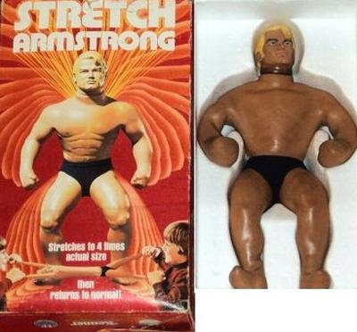
Motivation II
WHAT MAKES IT SO STRETCHY?!

Slide 4
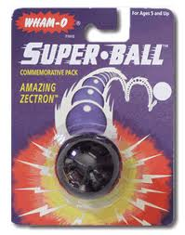
Motivation III
WHAT MAKES IT SO BOUNCY?!

Slide 5
Outline
Computer Architecture
  How these machines are built
  What the components do
Dataflow
  How are numbers represented?
  How are letters represented?
  Colors? Images? Videos?
Control
  Mathematical Operations

Slide 6
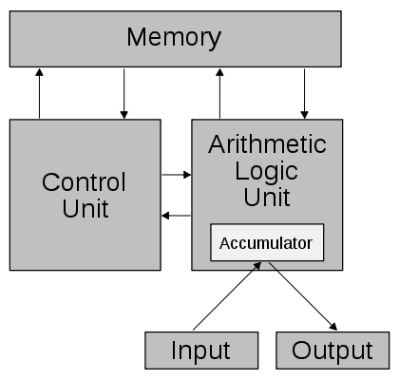
Computer Architecture

Slide 7
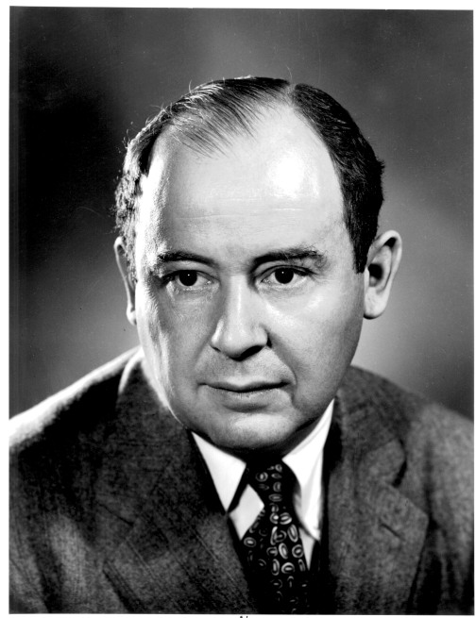
John Von Neumann
John Von Neumann
(1903-1957)
Mathematician and nuclear
physicist.
Worked on the hydrogen bomb
Collaborated with Eckert and
Mauchly (ENIAC)
The Von Neumann architecture came from a 1945 paper about the upcoming EDVAC
  Eckert and Mauchly's names were left out :(

Slide 8
Stored-Program Computer
Instructions
(code)
What do I do?
Data
What do I use?
This will run any Turing Machine!

Slide 9
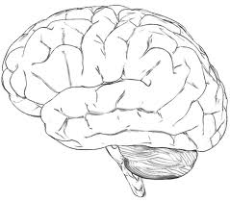
Memory
The memory is a storage device.
  Much like a set of bins
This memory can read or store information.
Memory can be considered sequential access and random access.

Slide 10
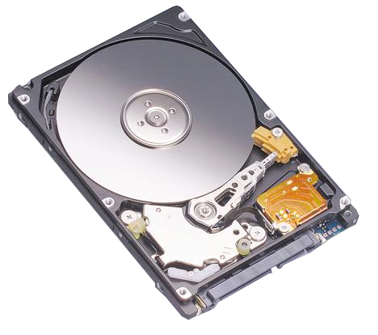
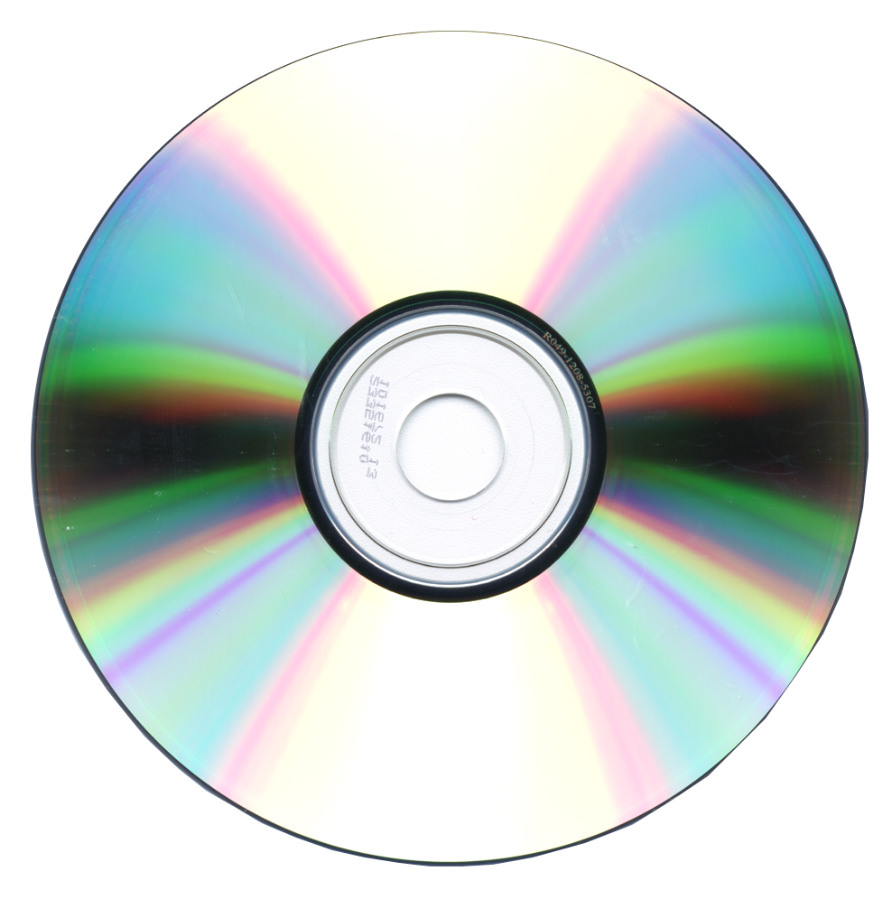
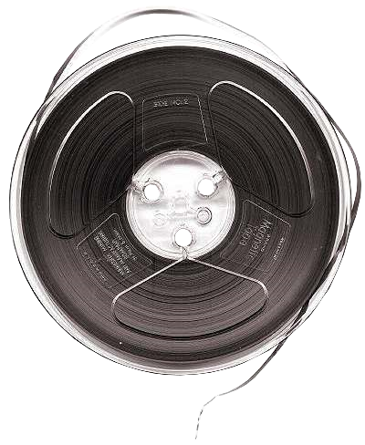
Sequential Memory
There is sequential memory.
  Like going through a filing cabinet a file at a time

Slide 11
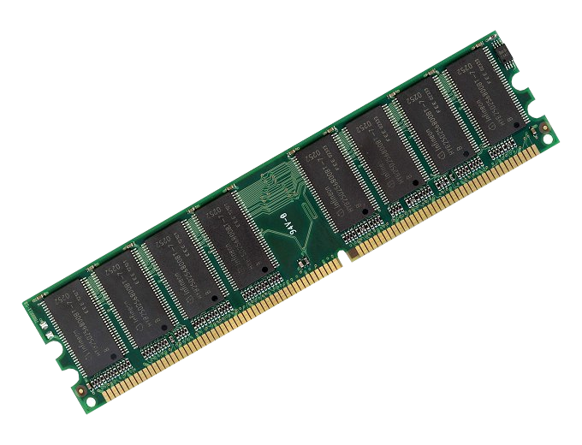
Random Access Memory
What we need here is random access memory.
  Retrieving/Storing anything at any time regardless of its location.
  Sequential memory can be random access...
    As long as you are willing to wait!

Slide 12
Control Unit
Memory stores two things
  Code (Instructions)
  Data (Information)
The control unit reads instructions, and executes them.
It also chooses the next instruction to be executed.
  It may choose between two instructions
  An earlier instruction might mean a loop!

Slide 13
Arithmetic Logic Unit
The last component is the unit that carries out the instruction. (ALU)
  It implements basic logic and mathematics
  Examples: Add, Subtract, Multiply, Compare
x ≥ y
Σ
ϕ
П
x + y

Slide 14
Running a Program

Slide 15
Representing Data
You may wonder... how can this memory hold everything we know a computer can manipulate?
  Books?
  Images?
  Videos?
  Sounds?
The answer is a very common mechanical device.

Slide 16
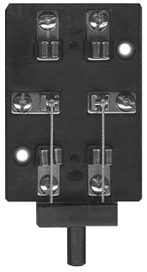
Switches
This is how we will represent any piece of information!
  The typical state-of-the-art
  “switch” is made up of
  transistors.
  Hard drives use the polarity
  of a small magnet.
  CDs use the difference
  between a flat region
  and a small hole
  measured by a laser.

Slide 17
The Bit
This single unit of information is called a bit.
How many different values can this represent?

Slide 18
Switches
How many different values can this represent?

Slide 19
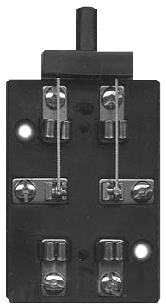
The Byte
With 8 switches we can represent how many
values?
The usage of 8 switches is actually the smallest unit of information.
  It is called a byte.

Slide 20
Representing Numbers
0
1
2
...

Slide 21
Binary
Because of these switches, computers use what is called binary encoding.
Normally we use decimal encoding... (base 10)
145 = (1)100 + (4)10 + (5)1 = (1)10² + (4)10¹ + (5)10⁰
In binary (base 2), 145 is:
10010001 = (1)2⁰ + (0)2¹ + (0)2² + (0)2³ + (1)2⁴ + (0)2⁵ + (0)2⁶ + (1)2⁷
There are other bases... hexadecimal (base 16), octal (base 8), and roman numerals or tally marks are an example of unary (base 1)

Slide 22
Binary
What is this number?
2⁰ = 1 2¹ = 2 2² = 4 2³ = 8 2⁴ = 16 2⁵ = 32 2⁶ = 64 2⁷ = 128
0 1 0 1 1 0 0 0

Slide 23
What About Negatives?
How can we represent a negative number?
-

Slide 24
One's Complement

Slide 25
Weird!
Wait. What's this?
Something called two's complement fixes this issue... but we won't get into that.

Slide 26
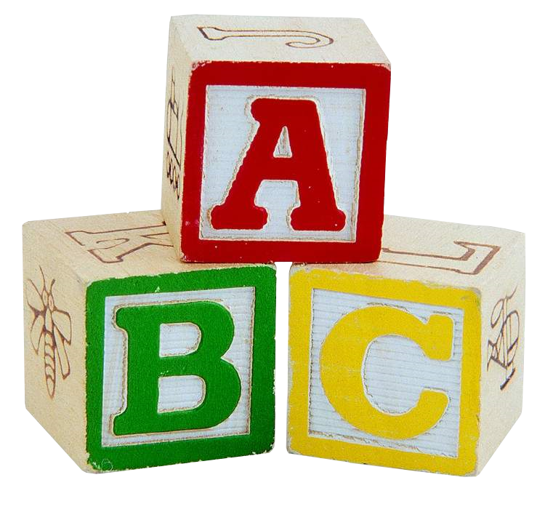
Representing Letters
How can we representing letters using these switches?
Surely there are examples of something like this?
10011010010001110

Slide 27
Morse Code?
We can represent letters using a binary signal.
  Pulse on versus a pulse off
For instance: Morse code
  Translating the pulses and their lengths into binary is easy
  Dot: 1
  Dash: 111
  Gap between codes: 0
  Gap between letters: 000
  Gap between words: 0000000

Slide 28
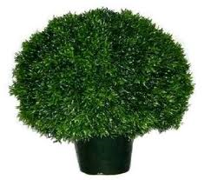
Morse Code to Binary
N
I
11101000101

Slide 29
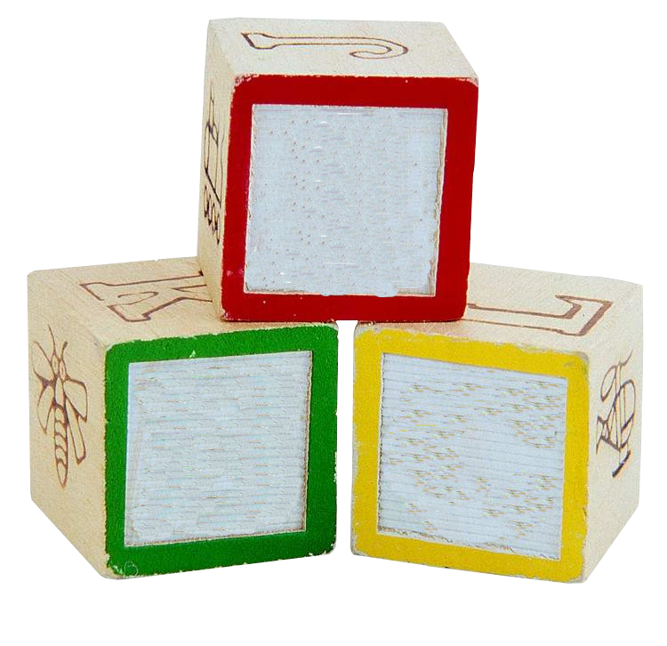
Character Mapping
Although, more trivially, we just represent characters as numbers.
A = 0 = 00000
B = 1 = 00001
...
Y = 24 = 11000
Z = 25 = 11001
0
1
2

Slide 30
Strings
String a bunch of these sequences together...
110010111001110
ZOO
Such a scheme is typically used today:
  The scheme is called ASCII (American Standard Code for Information Interchange)

Slide 31
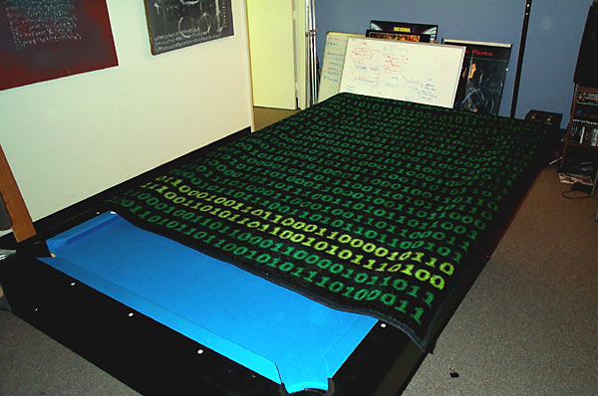
ASCII... art?

Slide 32
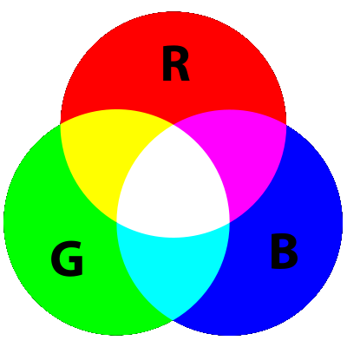
Representing Colors
Representing color is a tricky concept.
  It is not necessarily finite (so we approximate)
  How do we mix colors?

Slide 33
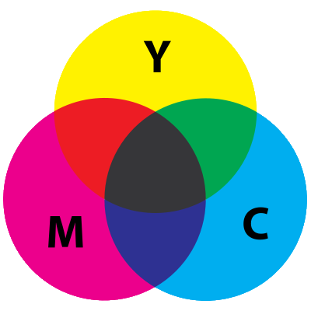
Subtractive Color
This is what we commonly learn first. It represents the mixing of colors in dyes.
  Used by printers
  Normally, you'd have
  red, yellow, and blue
  as primary colors

Slide 34
Additive Color
This represents how light combines to form different colors.
  Typically how CRT
  monitors work is
  that they shoot
  red, green, and
  blue beams.
  These combine to
  form the pixels
  you see.

Slide 35
Approximation
We know that 8 switches (a byte) can hold 256 values.
Studies have shown that humans cannot differentiate between around 200 shades.
Therefore, each “dye” is represented by a byte.
No red
Lots of red

Slide 36
Representing Color
We just need the primary colors.
So three values (three bytes) will suffice for any color!
What would
00000000 red
11111111 green
11111111 blue
yield?

Slide 37
Pixels
An image is just a collection of small dots.
A pixel (picture element) is the smallest such dot.
A pixel is just a color.
pixel a == r:11111111 g:00000000 b:11111111
pixel b == r:11111111 g:11111111 b:00000000
pixel c == r:11111111 g:00000000 b:00000000

Slide 38

Representing Images
An image is just a collection of pixels!
Red: 175 == 10101111
Green: 150 == 10010110
Blue: 109 == 01101101

Slide 39
It is a good shrubbery!
We can now encode the shrubbery for the Knights that say 11101000101
  Or any image our heart so desired...
10011010010001110
01001001110110110
10001011100010011
011011001110110100110100100101001001101000100010100

Slide 40
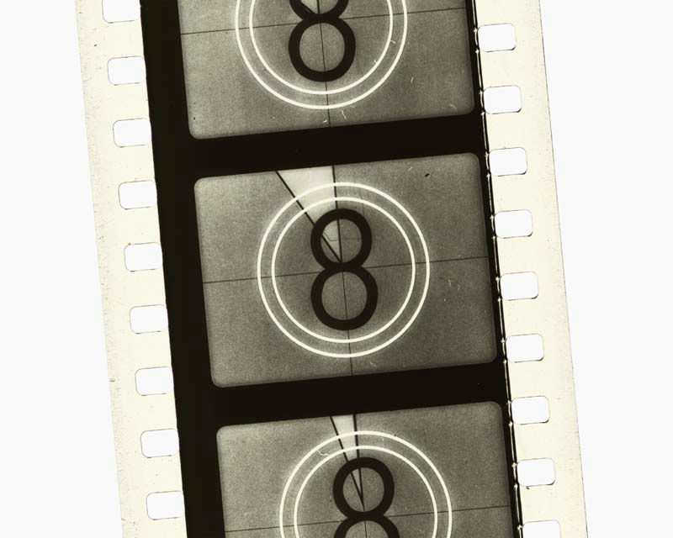
Representing Videos
And videos are simply collections of images!

Slide 41
Mathematical Operations
Alright... convinced you can do everything with switches?
  Good.
  Alright, fine. Maybe we will get to sound later in the course. (It's a lot trickier)
Let us now abstract all information as a set of switches.
  What can we do with these switches?
  Add? Subtract? Multiply?
  How is the possible?

Slide 42
Decimal Addition
The answer: The same way we always do it.
  Simply add the digits
  If greater than or equal to the base (10) then carry a 1!
      2363
      + 1289
      3652

Slide 43
Binary Addition
The answer: The same way we always do it.
  Simply add the digits
  If greater than or equal to the base (10) then carry a 1!
      0011
      + 0101
      1000

Slide 44
Binary Multiplication
Multiplication can be expressed as addition:
    2 * 5 == 2 + 2 + 2 + 2 + 2 == 5 + 5
Of course, more complicated expressions benefit from a more sophisticated approach:
  What happens if I shift bits over one?

Slide 45
Binary Multiplication
If we factor a larger multiplication into a series of multiplications of 2...
  we can use simple shifts and additions to multiply!
  A technique in common use is Booth's Algorithm

Slide 46
Binary Division
Division is roughly the inverse of multiplication.
Knowing what we know about multiplication,
how can we divide?

Slide 47

Binary Division
Of course, there are also techniques and algorithms related to efficient division.
Take note that not all things are divisible on a machine:
  Most computers do not respect division by zero!
  x / 0

Slide 48
What have we shown?
Computers use a simple architecture to perform tasks.
Computers represent numbers using switches called bits.
This is a binary representation, and it is sufficient for any finite data.
  Or anything that can be approximated as finite
  Colors, images, sound, video...
This representation can be manipulated mathematically just like decimal numbers!

Slide 49
Keep in Mind
We will now learn a programming language.
  Languages are often inspired by either the theoretical or physical nature of the machine.
  Variables might be constrained to a certain number of switches.
  Ask yourself why certain design decisions of the language were made.

