Slide 1
Picobot
Based on lecture slides from Harvey Mudd College

Slide 2
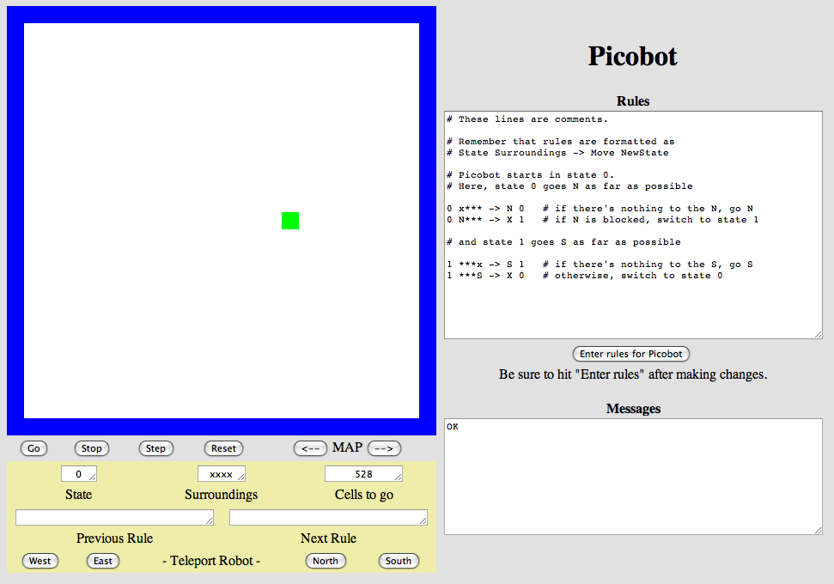
An Introduction to Picobot

Slide 3
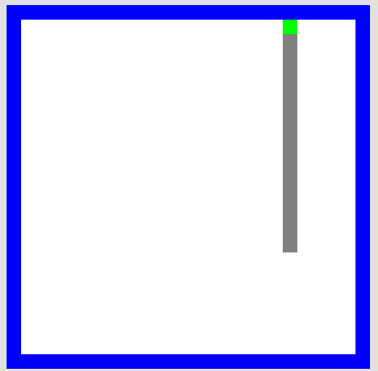
Overview
Goal: To cover the entire environment
  The picobot moves in each direction
  It leaves a gray trail
  It is guided by your
  instruction
Does this remind you of
anything?
The Picobot!

Slide 4
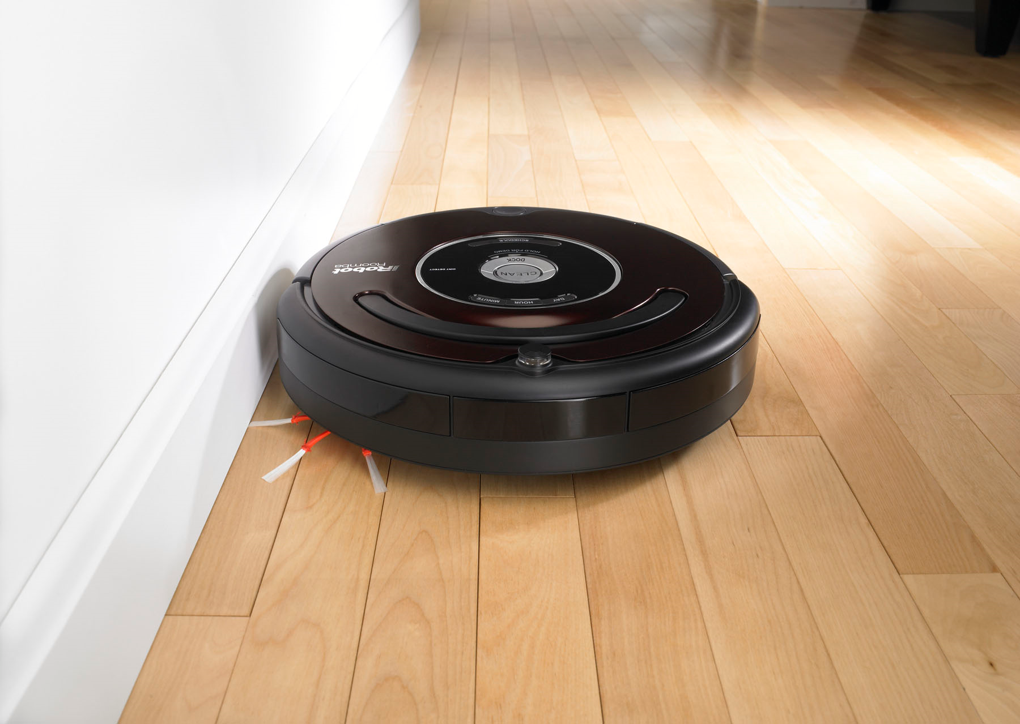
Roomba!
This represents something like a vacuum robot!
Cannot tell a “vacuumed” area from “unvacuumed”
May vacuum an area more than once

Slide 5
Environment
The Picobot!
Area Not Covered
Covered Area
Walls

Slide 6
What can Picobot sense?
Picobot can sense things in each cardinal direction:
  North, East, West, South
In this case, he senses his surroundings as:
NxWx
They are always represented in NEWS order!
NEWS
N
W
E
S

Slide 7
What can Picobot sense?
NxWx
(NEWS)
N – wall to the north
x – empty to the east
W – wall to the west
x – empty to the south

Slide 8
What are these surroundings?
N E W S
NxWx

Slide 9
Question!
How many unique surroundings exist?
N
W
E
S

Slide 10
Hint!
How many unique surroundings exist?
  Remember that for each direction, there are
  only two possible states (Wall or Empty)
N
W
E
S

Slide 11
16 Unique Surroundings
Each direction has 2 different possibilities...
2 * 2 * 2 * 2 == 2⁴ == 16 possible …
xxxx
Nxxx
xExx
xxWx
xxxS
NExx
NxWx
NxxS
xEWx
xExS
xxWS
NEWx
NExS
NxWS
xEWS
NEWS
(won’t happen)

Slide 12
Picobot's State of Mind
Picobot's memory consists of a single number
  This is called a state.
  Picobot always starts at state 0.
State and surroundings
represent everything
Picobot knows about
the world!
I am in state 0.
My surroundings
are xxWS.

Slide 13
Picobot's Instructions
state surroundings direction new state
0 xxWS -> N 0
If I am in state 0, and I'm sensing xxWS...
Then, move north and “change” my state to state 0
I am in state 0.
My surroundings
are xxWS.
Ah! I should
move North and
go to state 0!
Specifying an X
for a direction would cause Picobot to not move!

Slide 14
Wildcard!
state surroundings direction new state
0 x*** -> N 0
If I am in state 0, and I'm sensing an empty space to the North
Then, move north and “change” my state to state 0
I am in state 0.
My surroundings
are xxWS.
Ah! This matches
x***!
Asterisks (*) represent both a wall and an empty space!

Slide 15
How Picobot chooses what to do
Picobot reads through the list of instructions from top to bottom.
Whenever it finds a matching rule, it executes it.
What would these rules do?
  What would it mean for poor Picobot?
state surroundings direction new state
0 x*** -> N 0
0 N*** -> X 0

Slide 16
What would Picobot do?
Picobot reads through the list of instructions from top to bottom.
Whenever it finds a matching rule, it executes it.
state surroundings direction new state
0 x*** -> N 0
0 N*** -> X 1
1 ***x -> S 1
1 ***S -> X 0

Slide 17

Goal: Cover everything!
Do so regardless of starting position!

Slide 18
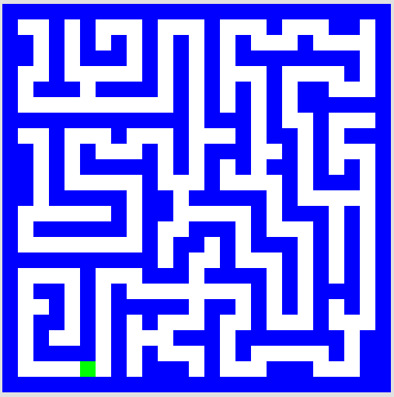
Homework: Cover everything!
Do so regardless of starting position!

Slide 19

Homework: Cover everything!
Do so regardless of starting position!

Slide 20
How does Picobot measure up?
You can look at a problem and come up with many different solutions in Picobot.
  This is true of programming in general.
We can measure the efficiency of our solutions!
  The number of states and rules you have given.
  The amount of steps your bot takes.
Measuring, competing, and proving that no better can be done are all aspects of computer science and programming.

