Slide 1


Correlation Detection using ReRAM Array
Sarah Rafiq

Slide 2
Goals
Detected temporal correlations using PCM devices (Sebastian et al. (2017). Temporal correlation detection using computational phase-change memory. Nature Communications, 8(1115))
Goal: Simulate algorithm in python using 5x5 ReRAM array

Slide 3
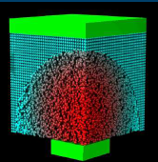
Memristors
Low-R state
High-R state
Electrode
SET
Metal oxide
Filament
Forming
RESET
Electrode
Figure 1. Cady, N. (2016) Towards Memristive Dynamic Adaptive Neural Network Arrays: Memristance
Figure 2. Eleftheriou, E.(2017). Neuromorphic Computing based on Phase-Change-Memory Devices [PowerPoint slides].

Slide 4
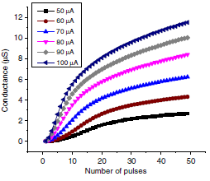
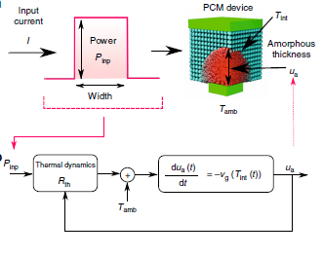
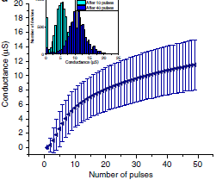
Memristors
Figure 3. Sebastian, et al. (2017). Temporal correlation detection using computational phase-change memory. Nature Communications, 8(1115), 3.

Slide 5
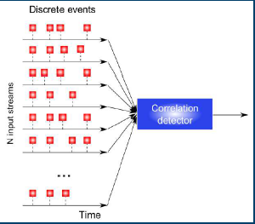
Temporal Correlation Detection Algorithm
Figure 4. Eleftheriou, E.(2017). Neuromorphic Computing based on Phase-Change-Memory Devices [PowerPoint slides].

Slide 6
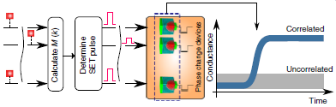
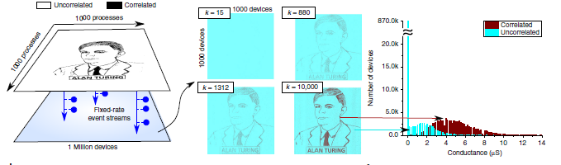
Temporal Correlation Detection Algorithm
Figure 5. Sebastian, et al. (2017). Temporal correlation detection using computational phase-change memory. Nature Communications, 8(1115), 4.

Slide 7
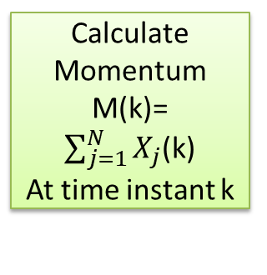
Temporal Correlation Detection Algorithm
After all time instants:
Read final resistance in array
Write Circuitry:
Apply SET pulse to all memristors where Xi(k)=1
Parameter: pulse amplitude/width
Adjust SET pulse parameter
Generate Correlated Processes Xi
Assign to each ReRAM
Calculate Momentum M(k)=
$\sum_{j=1}^{N}{X_{j}}$(k)
At time instant k

Slide 8
Algorithm Block Diagram
Class Analysing Software
Attributes:
Max. row
Max. Column
Momentum constant C
Functions:
generate_x (database)
array_at_time_k
Momentum
check_row_col(decides where to send SET pulse)
read_resistance
conductancePlot
plotImage
Interface functions
For virtual array parameters :
Vpulse
pulse width
Row
Column
CurrentCompliance
SR (switch polarity of voltage)
Class RRAM simulation Array
Attributes:
Max. Row
Max. Column
Array RRAM model
Functions/Methods:
Read_or_Write
Class RRAM Model
(Polynomial model with window=0)
Initialized R
LRS and HRS
Vtp and Vtn
Class Generate Correlated Process
Notes:
This is the block diagram for python code.
Each memristor is represented by the RRAM model. The array can be written to or read from.
RRAM model is mathematical model. It calculates the resistance change during write operation.
Analysing software runs algorithm in prev slide; database is an array where the inputs are stored (rows are processes, columns are time instants called k). Analysing software loads value at each time instant, calculates momentum, decides which RRAM to set and sends to interface. Read final R and plot conductance to see result.

Slide 9
Classes RRAM Simulation Array and RRAM Model
Row
Column
Vpulse
Pulse width
SR
Read_or_write method
New resistance for Write
OR
Read resistance/current
Vpulse
Rate of change of R for write operation
Class RRAM model’s instance
Notes:
Array takes parameters from interface, row and col shows which memristor to set/reset/read, vpulse and pw to know if it’s a read or write pulse using the threshold voltages of the model. The model is used to calculate the resistance change for write operation. The memristor’s R is changed if it’s a write operation and the resistance is read out of the RRAM array if it’s a read operation.

Slide 10
Read_or_write method
Check valid row and column
Check Vpulse is positive
Adjust voltage polarity using SR
Class RRAM model
Write depends on:
SET if V>Vtp
RESET if V<Vtn
RRAM_model is used to calculate resistance change
Continue with Write:
Clip to either HRS or LRS if new resistance exceeds HRS and LRS respectively
Current compliance
Read depends on:
pulse width
voltage (Vtn<V<Vtp)
Notes:
How it knows whether it is a read/write pulse?
Uses SR to know whether its +ve or –ve voltage
If new R crosses LRS or HRS, it is changed to the LRS or HRS

Slide 11
Class Analysing Software
Momentum (C*M(k)),
Row, Column
Analysing Software
Interface
Resistance Read from RRAM Array

Slide 12
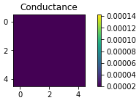
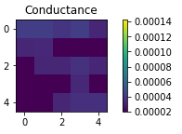
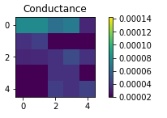
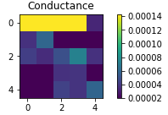
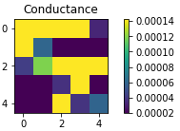
Results: 4 Correlated Processes
Correlation coefficient=0.8, P(X=1)=0.5
K=5
K=20
K=50
K=70
K=80
Notes:
Darker color shows location of correlated processes. Rest are conductance plots from memristor array. At initial stage for corr coef of 0.8, low conductance.
After 80 time instants, other RRAMs saturate as well.

Slide 13
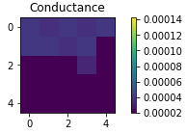
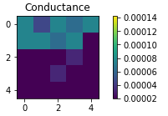
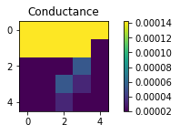
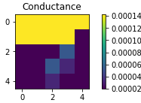
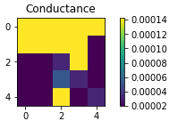
Results: 9 Correlated Processes
Correlation coefficient=0.8, P(X=1)=0.5
K=5
K=10
K=13
K=15
K=20
Notes:
Darker color shows location of correlated processes. Higher no of corr process, goes to high conductance sooner, at low k. The other RRAMs saturated sooner too becoz of higher momentum.

Slide 14
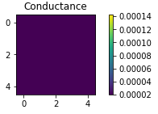
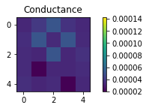
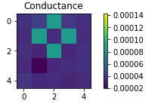
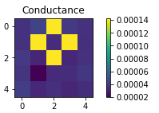
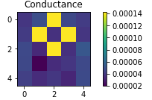
Results: 4 Correlated Processes
Correlation coefficient=1 , P(X=1)=0.5
K=10
K=1000
K=1500
K=2000
K=3000
Notes:
Corr coeff ranges from -1 to 1, with 1 being the highest, where the processes are identical. With high k’s, correlated processes showed up with higher conductance compared to other uncorrelated processes. They took longer to show up because fewer correlated processes have lower momentum, so the voltage was too low to change the resistance at many of the time instants. Therefore, it took a large number of time instants to get to the highest conductance.

Slide 15
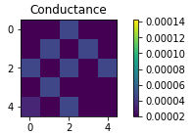
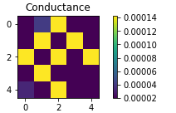
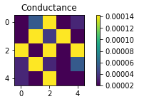
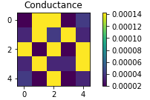
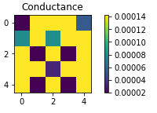
Results: 8 Correlated Processes
Correlation coefficient=1 , P(X=1)=0.5
K=10
K=20
K=50
K=70
K=200

Slide 16

Neurons Spiking Data
5 neurons
Correlation between neurons based on their spiking time
Neuron 0 cause neuron 1 to fire more
0 | 0,1 | 0,2 | 0,3 | 0,4
 | 1 | 1,2 | 1,3 | 1,4
 |  | 2 | 2,3 | 2,4
 |  |  | 3 | 3,4
 |  |  |  | 4
K=2000

Slide 17
Conclusion
Algorithm simulated using 5x5 ReRAM array in python
Algorithm shows memristors that were assigned correlated data go to high conductance states.

Slide 18
Acknowledgement
PI: Professor Nathaniel Cady
SUNY Poly CNSE:
Karsten Beckmann
Wilkie Olin-Ammentorp
University of Tennessee, Knoxville:
Sherif Amer

Slide 19
Thank You!

