Slide 1
Microsoft Visual C#: An Introduction to Object-Oriented Programming
7th Edition
Chapter 1
A First Program Using C#
© 2018 Cengage. All Rights Reserved. May not be copied, scanned, or duplicated, in whole or in part, except for use as permitted in a license distributed with a certain product or service or otherwise on a password-protected website for classroom use.

Slide 2
Objectives (1 of 2)
1.1 Describe the programming process
1.2 Differentiate between procedural and object-oriented programming
1.3 Describe the features of object-oriented programming languages
1.4 Describe the C# programming language
1.5 Write a C# program that produces output
1.6 Select identifiers to use within your programs
© 2018 Cengage. May not be copied, scanned, or duplicated, in whole or in part, except for use as permitted in a license distributed with a certain product or service or otherwise on a password-protected website for classroom use.

Slide 3
Objectives (2 of 2)
1.7 Improve programs by adding comments and using the System namespace
1.8 Compile and execute a C# program using the command prompt and using Visual Studio
© 2018 Cengage. May not be copied, scanned, or duplicated, in whole or in part, except for use as permitted in a license distributed with a certain product or service or otherwise on a password-protected website for classroom use.

Slide 4
The Programming Process (1 of 3)
Computer program (also called software)
A set of instructions that tells a computer what to do
Software comes in two broad categories
System software – programs that operate the computer
Application software – allows users to complete tasks
Hardware – The physical devices that make up a computer system
Machine language
Expressed as a series of 1s and 0s
1s represent switches that are on, and 0s represent switches that are off
© 2018 Cengage. May not be copied, scanned, or duplicated, in whole or in part, except for use as permitted in a license distributed with a certain product or service or otherwise on a password-protected website for classroom use.

Slide 5
The Programming Process (2 of 3)
High-level programming language
Uses reasonable keywords such as “read,” “write,” or “add” instead of the sequence of on/off switches that perform these tasks
Allows you to assign reasonable names to areas of computer memory
Has its own syntax (rules of the language)
Compiler
Translates high-level language statements into machine language
The compiler issues an error message each time a programmer commits a syntax error
Syntax error is when the programmer uses the language incorrectly
© 2018 Cengage. May not be copied, scanned, or duplicated, in whole or in part, except for use as permitted in a license distributed with a certain product or service or otherwise on a password-protected website for classroom use.

Slide 6
The Programming Process (3 of 3)
Programming logic
Involves executing the various statements and procedures in the correct order to produce the desired results
Debugging
The process of removing all syntax and logical errors from the program
Syntax errors are discovered through compilation
Logical errors are discovered through testing
© 2018 Cengage. May not be copied, scanned, or duplicated, in whole or in part, except for use as permitted in a license distributed with a certain product or service or otherwise on a password-protected website for classroom use.

Slide 7
Procedural and Object-Oriented Programming (1 of 4)
Procedural program
Creates and names computer memory locations that can hold values (variables) that are referenced by using a one-word name (identifier)
Writes a series of steps or operations to manipulate those values
Procedures or methods
Logical units that group individual operations used in a computer program
Called or invoked by other procedures or methods
A single procedural program often contains hundreds of variables and thousands of method calls
© 2018 Cengage. May not be copied, scanned, or duplicated, in whole or in part, except for use as permitted in a license distributed with a certain product or service or otherwise on a password-protected website for classroom use.

Slide 8
Procedural and Object-Oriented Programming (2 of 4)
Object-oriented programming (OOP)
An extension of procedural programming
Objects
Similar to concrete objects in the real world
Contain their own attributes and behaviors
The attributes of an object represent its characteristics
The state of an object is the collective value of all its attributes
The behaviors of an object, or methods, are the things it “does”
© 2018 Cengage. May not be copied, scanned, or duplicated, in whole or in part, except for use as permitted in a license distributed with a certain product or service or otherwise on a password-protected website for classroom use.

Slide 9
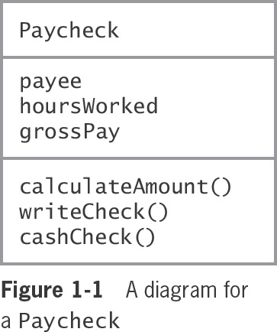
Procedural and Object-Oriented Programming (3 of 4)
© 2018 Cengage. May not be copied, scanned, or duplicated, in whole or in part, except for use as permitted in a license distributed with a certain product or service or otherwise on a password-protected website for classroom use.

Slide 10
Procedural and Object-Oriented Programming (4 of 4)
An object-oriented approach to programming means defining the objects needed to accomplish a task and developing classes that describe those objects
Object-oriented programming was originally used for two types of applications
Computer simulations
Graphical user interfaces (GUIs)
© 2018 Cengage. May not be copied, scanned, or duplicated, in whole or in part, except for use as permitted in a license distributed with a certain product or service or otherwise on a password-protected website for classroom use.

Slide 11
Features of Object-Oriented Programming Languages (1 of 3)
For a language to be considered object-oriented, it must support:
Classes
Objects
Encapsulation and interfaces
Inheritance
Polymorphism
Class
A category of objects or a type of object
Describes the attributes and behaviors of every object that is an instance, or object, of that class
© 2018 Cengage. May not be copied, scanned, or duplicated, in whole or in part, except for use as permitted in a license distributed with a certain product or service or otherwise on a password-protected website for classroom use.

Slide 12
Features of Object-Oriented Programming Languages (2 of 3)
Object
An instance of a class
Contains its own set of attribute values (also called the properties of the object)
Encapsulation
A technique of packaging an object’s attributes and behaviors into a cohesive unit; an undivided entity
Using a black box to control what behaviors are exposed to calling methods
Interface
The interaction between a method and an object’s exposed behaviors
Uses message-passing to request and receive information
© 2018 Cengage. May not be copied, scanned, or duplicated, in whole or in part, except for use as permitted in a license distributed with a certain product or service or otherwise on a password-protected website for classroom use.

Slide 13
Features of Object-Oriented Programming Languages (3 of 3)
Inheritance
Provides the ability to extend a class to create a more specific class
The more specific class contains all the attributes and methods of the more general class and usually contains new attributes or methods as well
Polymorphism
Describes the ability to create methods that act appropriately depending on the context
Programs written in object-oriented languages can distinguish between methods with the same name based on the type of object that uses them
© 2018 Cengage. May not be copied, scanned, or duplicated, in whole or in part, except for use as permitted in a license distributed with a certain product or service or otherwise on a password-protected website for classroom use.

Slide 14
The C# Programming Language
Developed as an object-oriented and component-oriented language
Part of Microsoft Visual Studio
A package designed for developing applications that run on Windows computers
Allows every piece of data to be treated as an object and to consistently employ the principles of object-oriented programming
C# features:
Contains a GUI interface that makes it similar to Visual Basic but is considered more concise than Visual Basic
Modeled after the C++ programming language
Similar to Java
C# is more truly object oriented
© 2018 Cengage. May not be copied, scanned, or duplicated, in whole or in part, except for use as permitted in a license distributed with a certain product or service or otherwise on a password-protected website for classroom use.

Slide 15
Writing a C# Program that Produces Output (1 of 4)
Literal string of characters
A series of characters that will be used exactly as entered
In C#, appears between double quotation marks
Arguments
Represent information that a method needs to perform its task
Arguments to methods always appear within parentheses
The WriteLine() method
A built-in method that is part of the C# language that displays output on the screen and positions the cursor on the next line
© 2018 Cengage. May not be copied, scanned, or duplicated, in whole or in part, except for use as permitted in a license distributed with a certain product or service or otherwise on a password-protected website for classroom use.

Slide 16
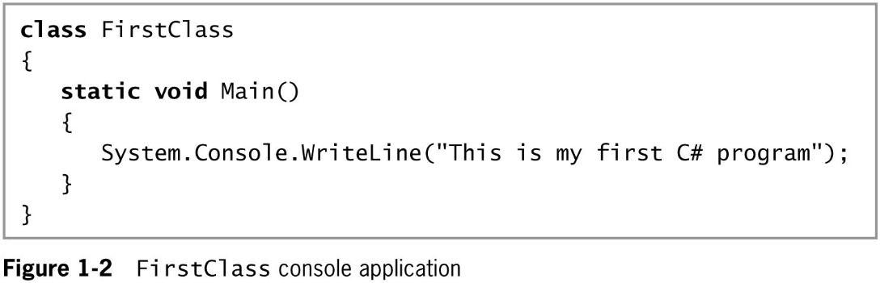
Writing a C# Program that Produces Output (2 of 4)
© 2018 Cengage. May not be copied, scanned, or duplicated, in whole or in part, except for use as permitted in a license distributed with a certain product or service or otherwise on a password-protected website for classroom use.

Slide 17
Writing a C# Program that Produces Output (3 of 4)
Namespace
Provides a way to group similar classes
Can be used to avoid naming conflicts in large projects
C# method parts
Method header
Includes the method name and information about what will pass into and be returned from a method
Method body
Contained within a pair of curly braces and includes all the instructions executed by the method
© 2018 Cengage. May not be copied, scanned, or duplicated, in whole or in part, except for use as permitted in a license distributed with a certain product or service or otherwise on a password-protected website for classroom use.

Slide 18
Writing a C# Program that Produces Output (4 of 4)
Whitespace
Any combination of spaces, tabs, and carriage returns (blank lines)
Organizes your code and makes it easier to read
Keywords
Predefined and reserved identifiers that have special meaning to the compiler
The name of the method is Main()
Every application must have a Main() method
Classes with a Main() method are called application classes; others are non-application classes
The method returns nothing as indicated by the keyword void
© 2018 Cengage. May not be copied, scanned, or duplicated, in whole or in part, except for use as permitted in a license distributed with a certain product or service or otherwise on a password-protected website for classroom use.

Slide 19
Selecting Identifiers (1 of 2)
Requirements
Must begin with an underscore, the at sign (@), or a letter
Letters include foreign-alphabet letters
Can contain only letters, digits, underscores, and the at (@) sign
Not special characters such as #, $, or &
Cannot be a C# reserved keyword, such as class or void
An identifier with an @ prefix is a verbatim identifier
This feature allows you to use code written in other languages that do not have the same set of reserved keywords
© 2018 Cengage. May not be copied, scanned, or duplicated, in whole or in part, except for use as permitted in a license distributed with a certain product or service or otherwise on a password-protected website for classroom use.

Slide 20
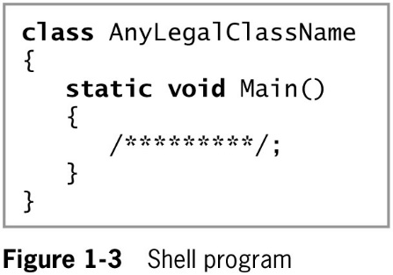
Selecting Identifiers (2 of 2)
The following identifiers have special meaning in C# but are not keywords:
add, alias, get, global, partial, remove, set, value, where, and yield
You should avoid using these words as your own identifiers
Figure 1-3 shows a program that can be used as a shell
Where you replace the identifier AnyLegalClassName with any legal class name and the line /********/ with any statements that you want to execute
© 2018 Cengage. May not be copied, scanned, or duplicated, in whole or in part, except for use as permitted in a license distributed with a certain product or service or otherwise on a password-protected website for classroom use.

Slide 21
Improving Programs by Adding Comments and Using the System Namespace
Even simple C# programs takes several lines of code
Large programs that perform many tasks include much more code
Two things you can do immediately are:
Add program comments
Use the System namespace
© 2018 Cengage. May not be copied, scanned, or duplicated, in whole or in part, except for use as permitted in a license distributed with a certain product or service or otherwise on a password-protected website for classroom use.

Slide 22
Adding Program Comments (1 of 2)
Program comments
Nonexecuting statements that document a program
Programmers use these to leave notes for themselves and for others who might read their programs
Comment out
Turn a statement into a comment so the compiler will ignore it
Types of comments in C#
Line comments – start with //
Block comments – start with /* and end with */
XML-documentation format comments – use a special set of tags within angle brackets <>
© 2018 Cengage. May not be copied, scanned, or duplicated, in whole or in part, except for use as permitted in a license distributed with a certain product or service or otherwise on a password-protected website for classroom use.

Slide 23
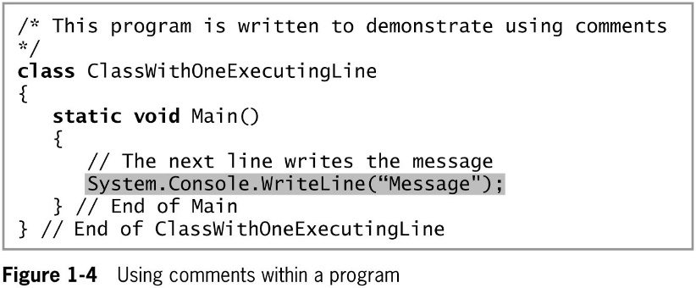
Adding Program Comments (2 of 2)
© 2018 Cengage. May not be copied, scanned, or duplicated, in whole or in part, except for use as permitted in a license distributed with a certain product or service or otherwise on a password-protected website for classroom use.

Slide 24
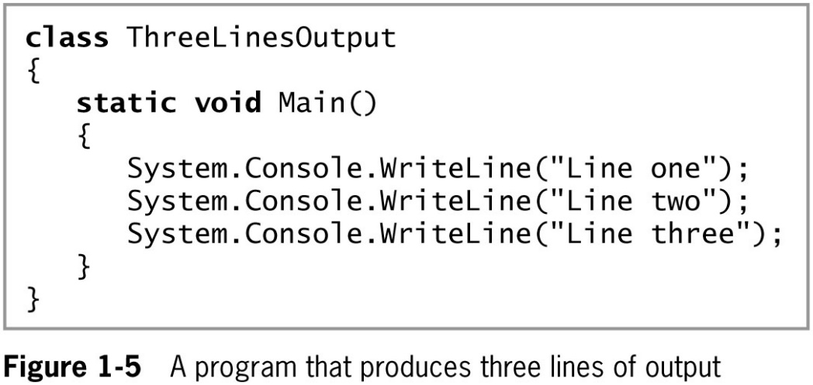
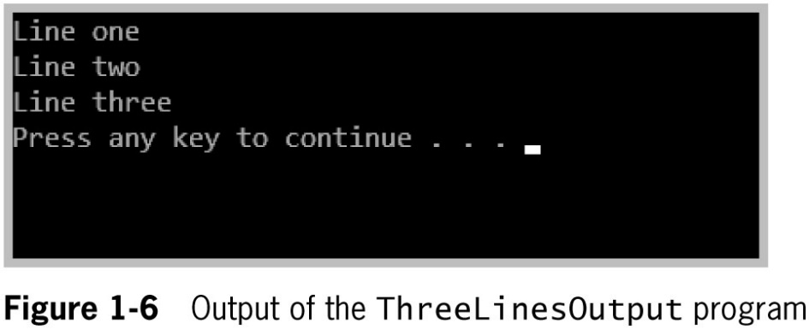
Using the System Namespace (1 of 3)
The program in Figure 1-5 produces the three lines of output shown in Figure 1-6
© 2018 Cengage. May not be copied, scanned, or duplicated, in whole or in part, except for use as permitted in a license distributed with a certain product or service or otherwise on a password-protected website for classroom use.

Slide 25
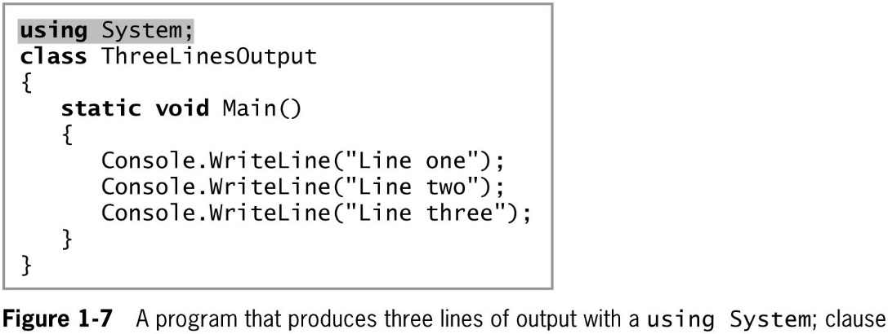
Using the System Namespace (2 of 3)
When you need to repeatedly use a class from the same namespace
You can shorten statements by adding a clause that indicates a namespace containing the class
Indicate a namespace with a using clause or using directive
© 2018 Cengage. May not be copied, scanned, or duplicated, in whole or in part, except for use as permitted in a license distributed with a certain product or service or otherwise on a password-protected website for classroom use.

Slide 26
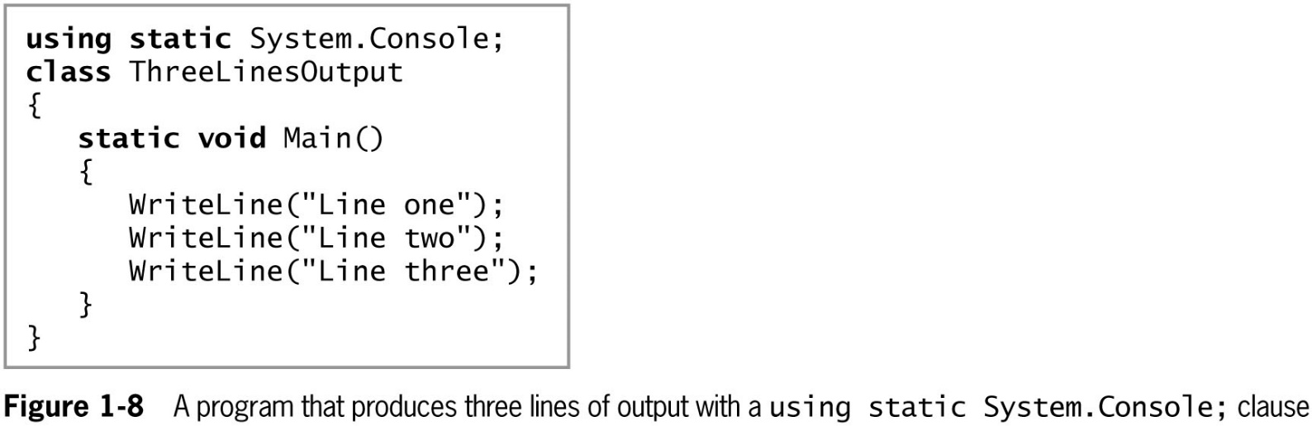
Using the System Namespace (3 of 3)
© 2018 Cengage. May not be copied, scanned, or duplicated, in whole or in part, except for use as permitted in a license distributed with a certain product or service or otherwise on a password-protected website for classroom use.

Slide 27
Compiling and Executing a C# Program
Steps for viewing a program’s output
Compile source code into intermediate language (IL)
The C# just in time (JIT) compiler translates the intermediate code into executable statements
You can use either of two ways to compile
The command line – the line on which you type a command in a system that uses a text interface
The Integrated Development Environment (IDE) – a programming environment that allows you to issue commands by selecting choices from menus and clicking buttons
© 2018 Cengage. May not be copied, scanned, or duplicated, in whole or in part, except for use as permitted in a license distributed with a certain product or service or otherwise on a password-protected website for classroom use.

Slide 28
Compiling Code from the Command Prompt (1 of 6)
At the command prompt:
Change the path to the location of your file
Type csc, followed by the name of the file that contains the source code
The command csc stands for C Sharp compiler
Example: to compile a file named ThreeLinesOutput.cs type:
csc ThreeLinesOutput.cs and press enter
One of three outcomes is possible:
Receive an OS error message such as Bad command or file name
Receive one or more program language error messages
You receive no error messages, indicating the program compiled successfully
© 2018 Cengage. May not be copied, scanned, or duplicated, in whole or in part, except for use as permitted in a license distributed with a certain product or service or otherwise on a password-protected website for classroom use.

Slide 29
Compiling Code from the Command Prompt (2 of 6)
If you receive an OS error message such as csc is not recognized…, or Source file… could not be found, it may mean:
You misspelled the command csc
You misspelled the filename
You forgot to include the extension .cs with the filename
You are not within the correct subdirectory or folder on your command line
The C# compiler was not installed properly
© 2018 Cengage. May not be copied, scanned, or duplicated, in whole or in part, except for use as permitted in a license distributed with a certain product or service or otherwise on a password-protected website for classroom use.

Slide 30
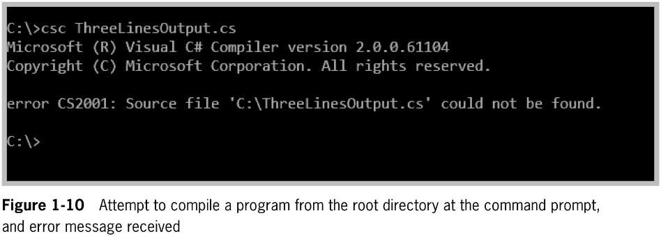
Compiling Code from the Command Prompt (3 of 6)
© 2018 Cengage. May not be copied, scanned, or duplicated, in whole or in part, except for use as permitted in a license distributed with a certain product or service or otherwise on a password-protected website for classroom use.

Slide 31
Compiling Code from the Command Prompt (4 of 6)
If you receive a programming language error message
It means the compiler was installed correctly, but that the source code contains one or more syntax errors
A syntax error occurs when you introduce typing errors into your program
Program error messages start with the program name, followed by parentheses that hold the line number and the position in the line where the compiler noticed the error
© 2018 Cengage. May not be copied, scanned, or duplicated, in whole or in part, except for use as permitted in a license distributed with a certain product or service or otherwise on a password-protected website for classroom use.

Slide 32
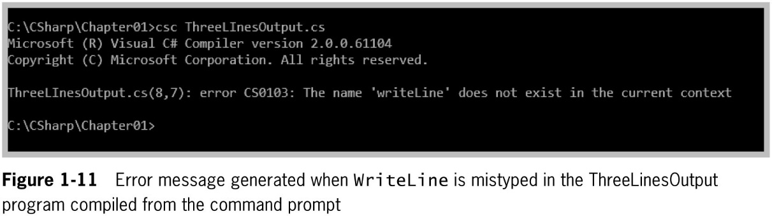
Compiling Code from the Command Prompt (5 of 6)
© 2018 Cengage. May not be copied, scanned, or duplicated, in whole or in part, except for use as permitted in a license distributed with a certain product or service or otherwise on a password-protected website for classroom use.

Slide 33
Compiling Code from the Command Prompt (6 of 6)
If you receive no error messages after compiling the code
Then the program compiled successfully and a file with the same name as the source code is created and saved in the same folder as the program text file
The new file name will have an .exe extension
To run the program from the command line
Simply type the program name
Example: ThreeLinesOutput or ThreeLinesOutput.exe
© 2018 Cengage. May not be copied, scanned, or duplicated, in whole or in part, except for use as permitted in a license distributed with a certain product or service or otherwise on a password-protected website for classroom use.

Slide 34
Compiling Code Using the Visual Studio IDE (1 of 5)
Advantages of using the Visual Studio IDE
Some of the code you need is already created for you
The code is displayed in color
Some syntax errors are caught as you type
You can double-click an error message and the cursor will move to the line of code that contains the error
Other debugging tools are available
Open Visual Studio by typing Visual Studio in the “Ask me anything” search box
© 2018 Cengage. May not be copied, scanned, or duplicated, in whole or in part, except for use as permitted in a license distributed with a certain product or service or otherwise on a password-protected website for classroom use.

Slide 35
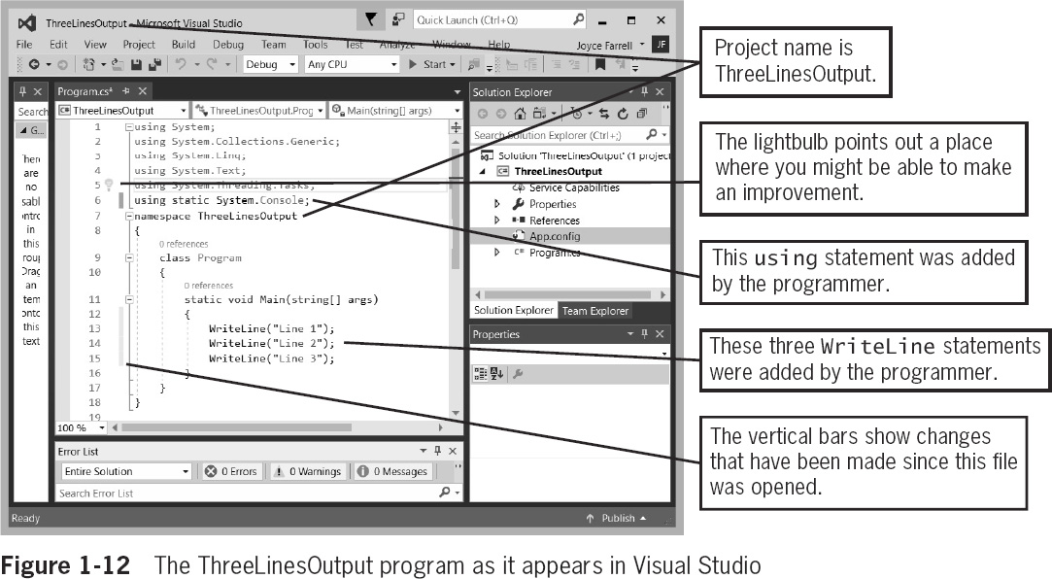
Compiling Code Using the Visual Studio IDE (2 of 5)
© 2018 Cengage. May not be copied, scanned, or duplicated, in whole or in part, except for use as permitted in a license distributed with a certain product or service or otherwise on a password-protected website for classroom use.

Slide 36
Compiling Code Using the Visual Studio IDE (3 of 5)
One way to compile a program from Visual Studio is to select Build from the menu bar
Then select Build Solution from the drop-down menu
An alternative is to press Ctrl + Shift + B
You can also select Debug from the menu bar
Then click Start Without Debugging
© 2018 Cengage. May not be copied, scanned, or duplicated, in whole or in part, except for use as permitted in a license distributed with a certain product or service or otherwise on a password-protected website for classroom use.

Slide 37
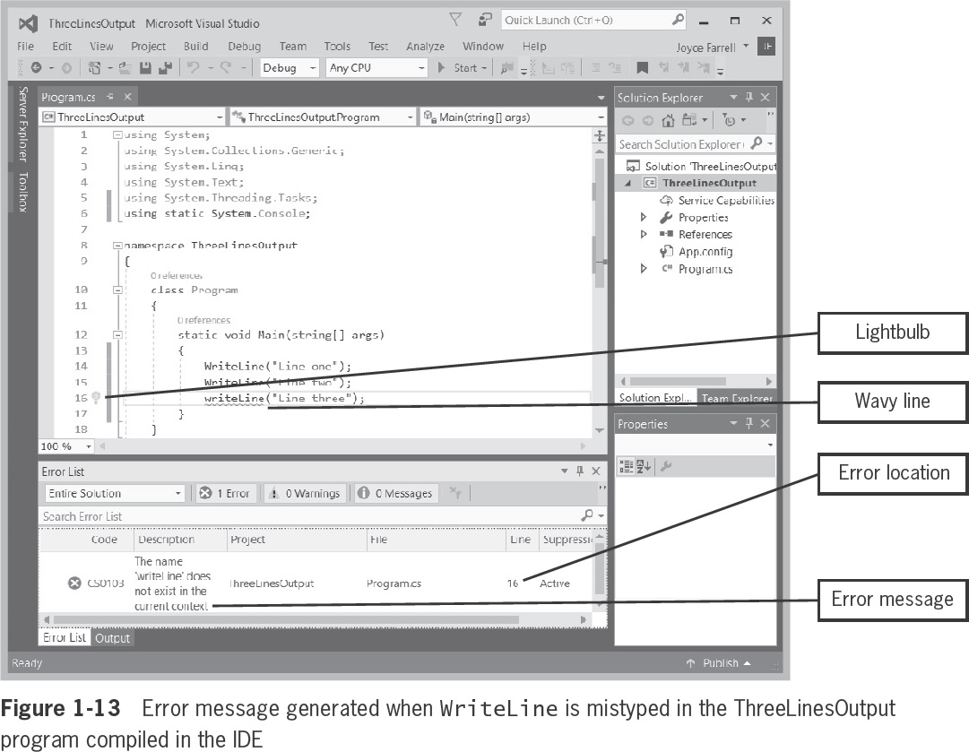
Compiling Code Using the Visual Studio IDE (4 of 5)
If you introduce a syntax error into a program in the IDE
You receive a programming language error message
© 2018 Cengage. May not be copied, scanned, or duplicated, in whole or in part, except for use as permitted in a license distributed with a certain product or service or otherwise on a password-protected website for classroom use.

Slide 38
Compiling Code Using the Visual Studio IDE (5 of 5)
If you receive no error messages after compiling the code
The program compiled successfully and you can run the program
Select Debug from the menu bar
Then select Start Without Debugging
© 2018 Cengage. May not be copied, scanned, or duplicated, in whole or in part, except for use as permitted in a license distributed with a certain product or service or otherwise on a password-protected website for classroom use.

Slide 39
Noticing the Differences Between the Programs in the Text Editor and the IDE (1 of 2)
There are a few differences between the ThreeLinesOutput programs in Figures 1-8 and 1-12
The Visual Studio version in Figure 1-12 contains extra components highlighted in Figure 1-14
Five using statements at the top of the file
A namespace declaration and its opening and closing curly braces
A class named Program
The words string[] args between the parentheses of the Main() method header
© 2018 Cengage. May not be copied, scanned, or duplicated, in whole or in part, except for use as permitted in a license distributed with a certain product or service or otherwise on a password-protected website for classroom use.

Slide 40
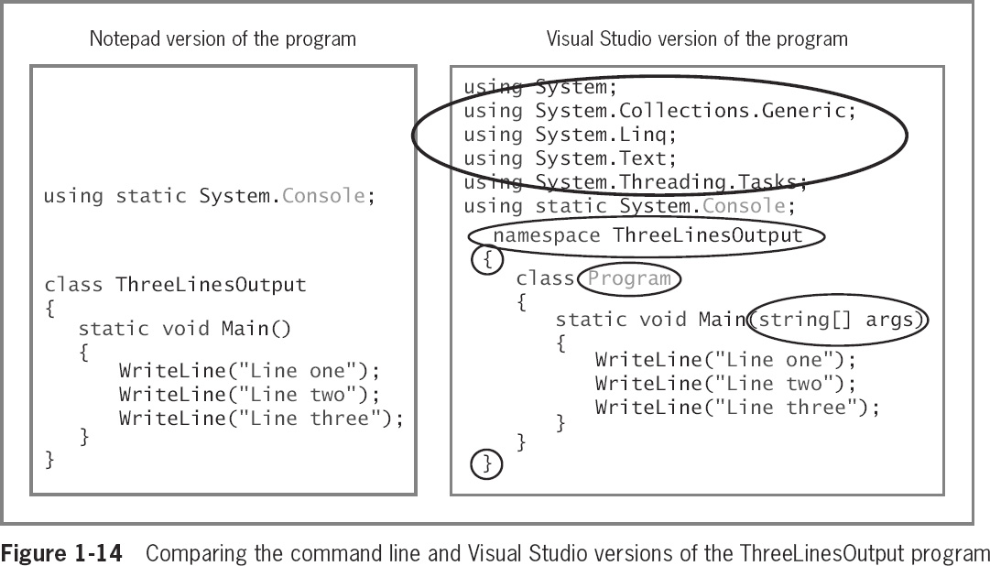
Noticing the Differences Between the Programs in the Text Editor and the IDE (2 of 2)
© 2018 Cengage. May not be copied, scanned, or duplicated, in whole or in part, except for use as permitted in a license distributed with a certain product or service or otherwise on a password-protected website for classroom use.

Slide 41
Deciding Which Environment to Use
Advantage of using the command line
Saves disk space
Advantages of using the Visual Studio IDE
Automatic sentence completion
Words are displayed using different colors based on their category
Easier to correct many errors
The code automatically generated by the IDE is very helpful when writing a GUI
© 2018 Cengage. May not be copied, scanned, or duplicated, in whole or in part, except for use as permitted in a license distributed with a certain product or service or otherwise on a password-protected website for classroom use.

Slide 42
Chapter Summary (1 of 2)
A computer program is a set of instructions that tell a computer what to do
Procedural programming involves creating variables and methods
In object-oriented programming, the focus is on objects that encapsulate variables and methods
Objects are instances of classes and are made up of attributes and methods
The C# programming language is an object-oriented and component-oriented language
To produce a line of console output, you must pass a literal string as an argument to the System.Console.WriteLine() method
© 2018 Cengage. May not be copied, scanned, or duplicated, in whole or in part, except for use as permitted in a license distributed with a certain product or service or otherwise on a password-protected website for classroom use.

Slide 43
Chapter Summary (2 of 2)
You can define a C# class or variable by using any name or identifier
Comments are nonexecuting statements that you add to document a program
Or to disable statements when you test a program
Use namespaces to improve programs
To create a C# program, you can use the Microsoft Visual Studio IDE or any text editor
© 2018 Cengage. May not be copied, scanned, or duplicated, in whole or in part, except for use as permitted in a license distributed with a certain product or service or otherwise on a password-protected website for classroom use.

